Slide 1
Open Science Platforms This module is part of the training session “Train for trainers” within project TrainRDM
University POLITEHNICA of Bucharest
National Institute of Research and Development in Informatics (ICI Bucharest)
This work is licensed under the Creative Commons Attribution 4.0 International License.
All images are public domain unless otherwise noted.

Slide 2
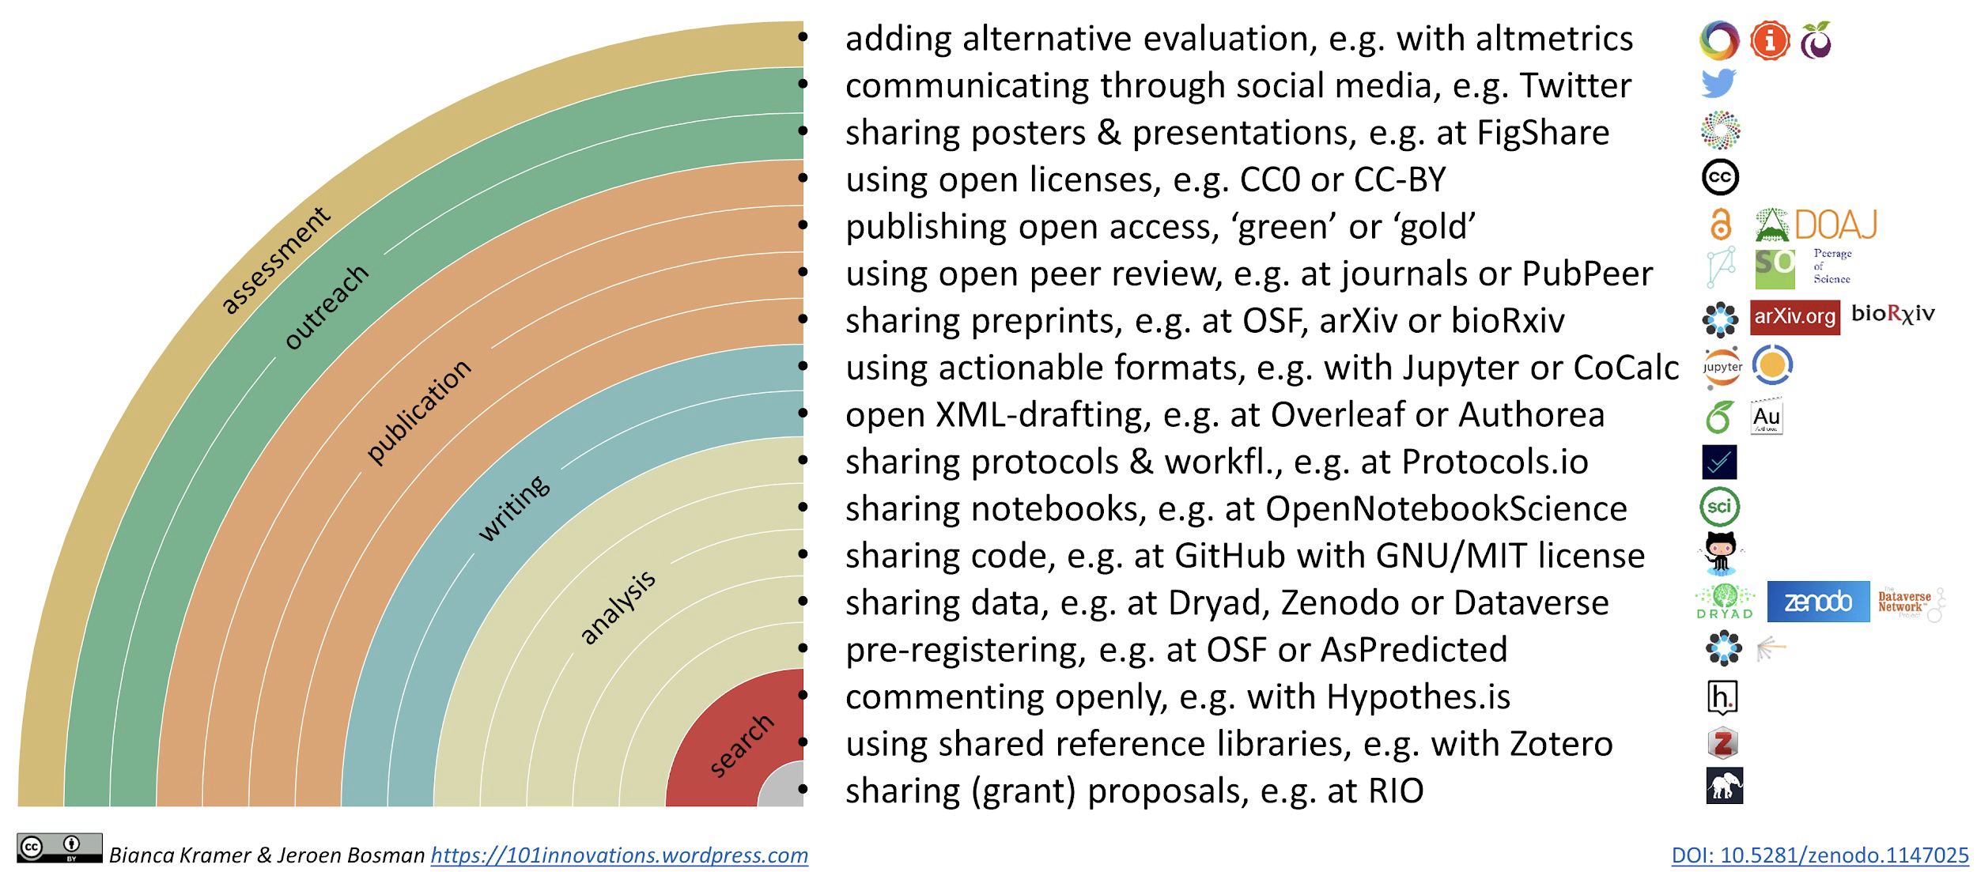
From Open Science practices to platforms
Rainbow of open science practices (available on Zenodo in different formats, including as editable slide:10.5281/zenodo.1147025)

Slide 3
Tools and platforms
There are many tools and platforms that support Open Science practices
Which tools and platforms to use (or advise) depends on factors such as: whether the tool is available (either free of at low cost or licensed to your institution), whether it works in your browser or for your operating system, whether it is available in your language, and whether it meets your security and privacy requirements.
In addition to these more technical criteria, consider whether a tool fits with the way you work.
What is the open science practice you’d like to implement?
Then explore which tools/platforms are available, which ones the people in your community use, and why (ask around!). Then make your own decision. Don’t be afraid to experiment and try out something new!
Does it work well with other tools and platforms that you use?
Do the people you collaborate with use the same tool for the same practice, or at least one that is compatible with the one you use?
Do you need to invest a lot of time into learning the new tool, and if so, is that worth it for you?
Do you have support (either in real life or online) that can help you learn to use the tool?

Slide 4
1. Research data storage

Slide 5
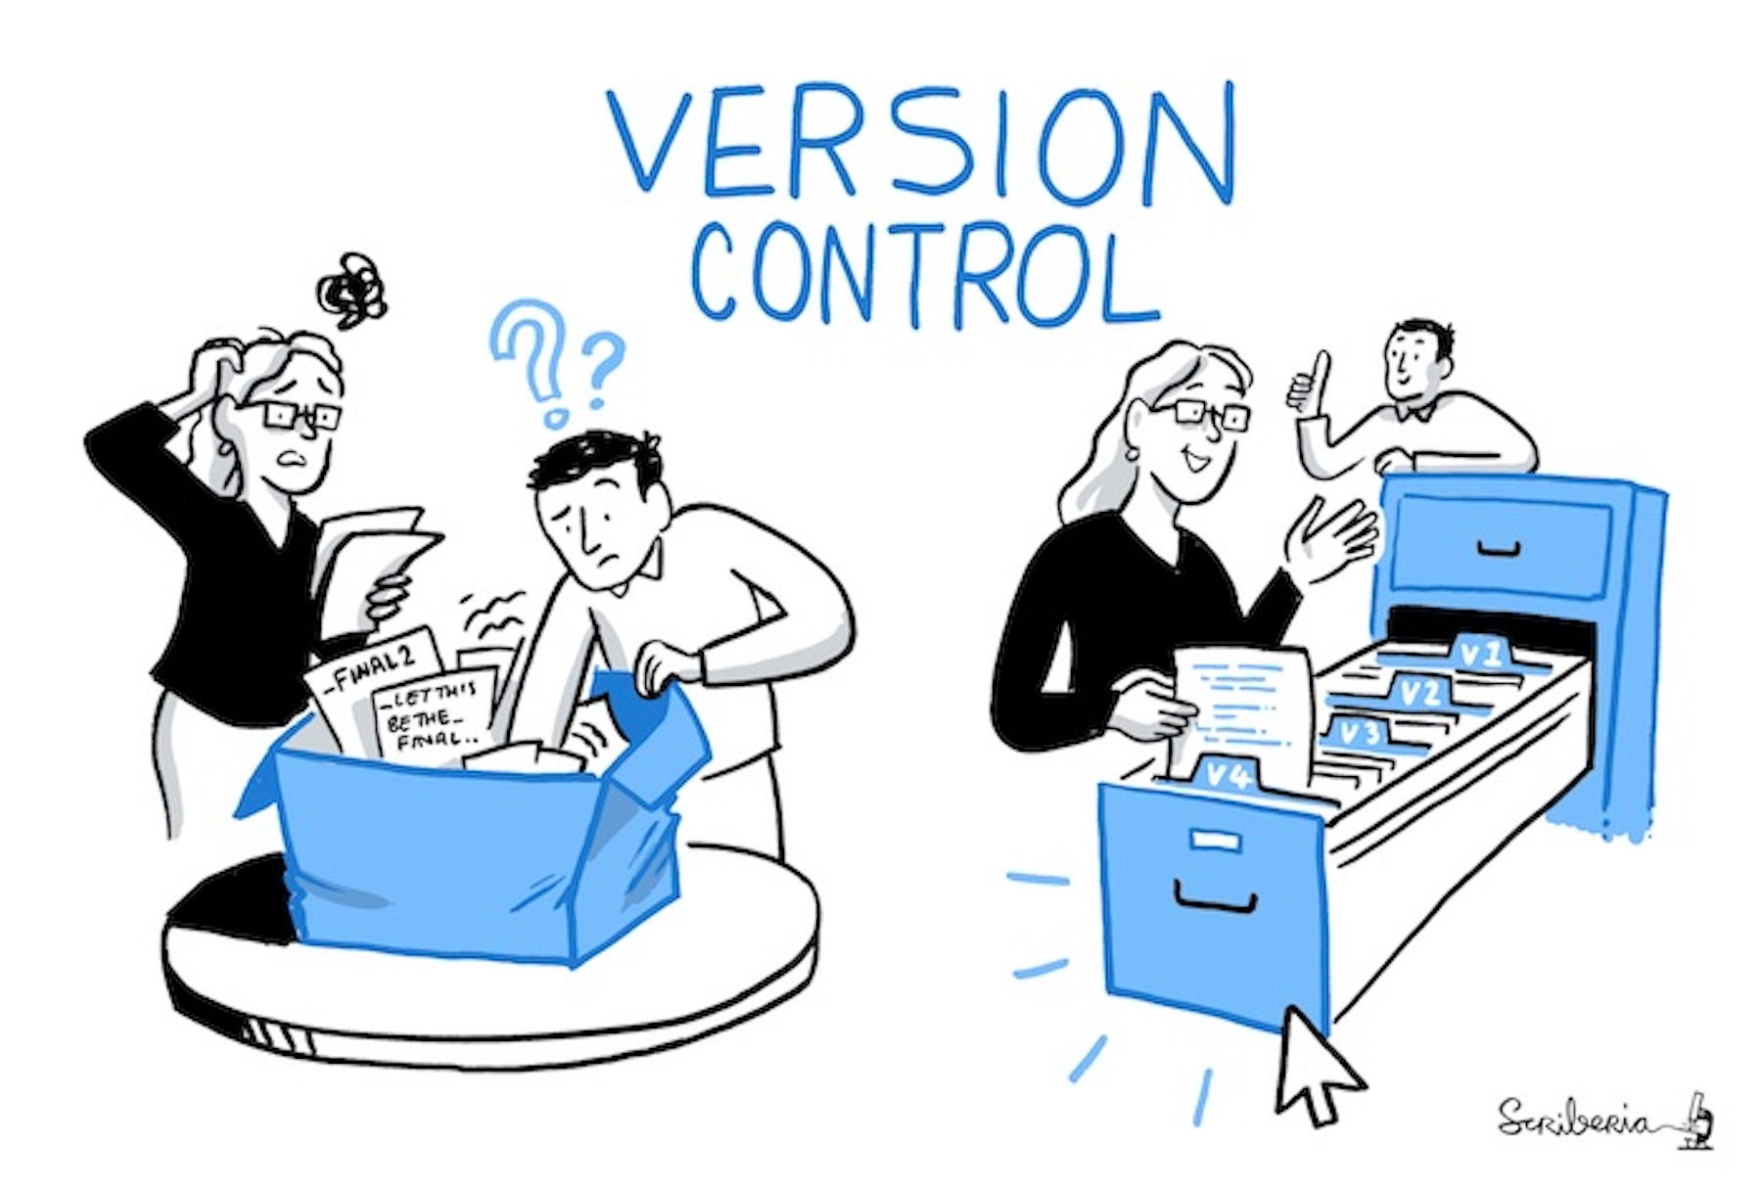
Data Storage and Organisation
Data loss can be catastrophic for your research project and can happen often.
You can prevent data loss by picking suitable storage solutions and backing your data up frequently.
Where to Store Data
Most institutions will provide a network drive that you can use to store data.
Portable storage media such as memory sticks (USB sticks) are more risky and vulnerable to loss and damage.
Cloud storage provides a convenient way to store, backup and retrieve data. You should check terms of use before using them for your research data.

Slide 6
Documentation and Metadata
Having data available is of no use if it cannot be understood. Without metadata to provide provenance and context, the data can’t be used effectively.
For example, a table of numbers is useless if no headings describe what the columns/rows contain.
You should ensure that open datasets include consistent metadata, that is information about the data so that the data is fully described.
This requires that information accompanying data is captured in documentation and metadata.
Documentation
Documentation provides context for your work. It allows your collaborators, colleagues and future you to understand what has been done and why.
Metadata
Metadata is information about the data, descriptors that facilitate cataloguing data and data discovery. Often, metadata are intended for machine reading.

Slide 7
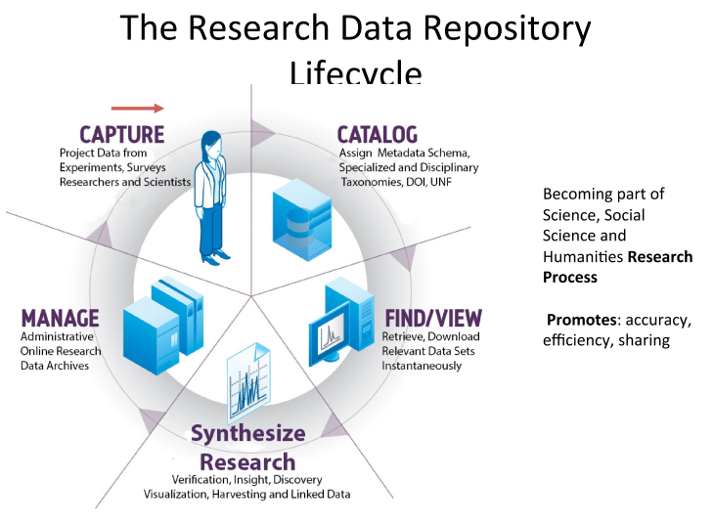
Data repository : the what
IT infrastructure (cloud based/online) set up to manage, share, access, maintain, and archive datasets.
An application database specialized in storing metadata of data files/datasets/databases.
Differs from publication repository mainly in its ability to:
Store metadata at different level/hierarchy.
Store and ingest data files in various formats for long-term preservation
http://www.infotoday.com/cilmag/apr16/Uzwyshyn--Research-Data-Repositories.shtml

Slide 8
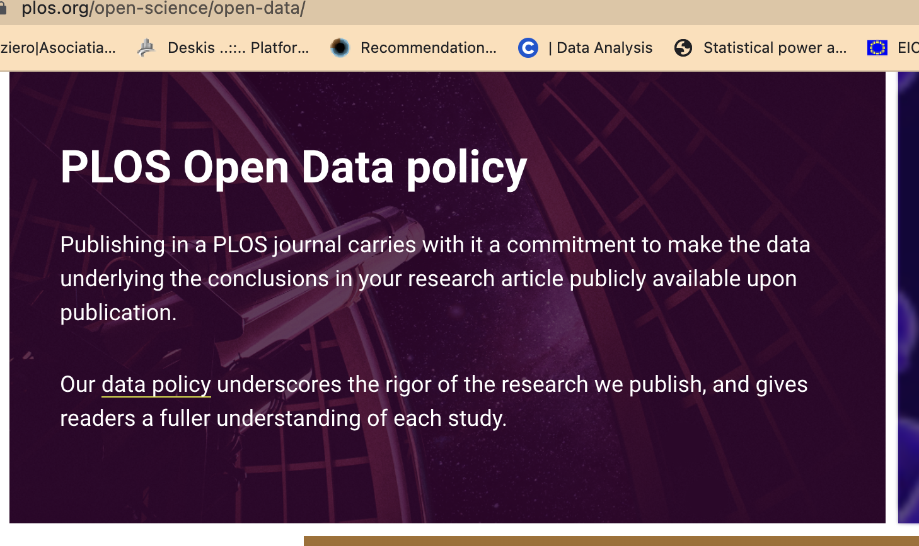
Data publishing
More and more funders expect the data produced in research projects they finance to be findable, accessible and as open as possible.
How to make research data accessible? Publishing data as supplemental material associated with a research article, typically with the data files hosted by the publisher of the article.

Slide 9
What are Data Repositories?
Databases in which objects can be
archived,
documented,
published.
Search tools allow the objects to be retrieved.
Types of repositories:
discipline-specific
generic
institutional
media-specific (texts, research data, movies, etc.)

Slide 10
Repositories: How do I choose?
Criteria:
visibility in your community
long-term availability
accessibility
persistent identifiers (e.g. DOI, URN, ARK)
licenses offered (e.g. open access)
review process
Discipline-specific or
institutional repository?

Slide 11
What Criteria Do I Use to Select a Repository?
Is the repository certified? (e.g. Core Trust Seal)?
Are persistent identifiers assigned? (e.g. DOI)?
How is access to the data regulated (open, restricted)?
What are the terms of use/license for the data (e.g. Creative Commons licenses)?
Does the repository have its own policy?

Slide 12
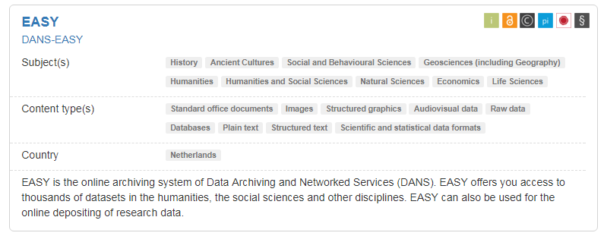
How to select a data repository?
We recommend to use a data subject / domain-oriented data repository, if available
Check if the repository meets specific data needs, e.g. supported formats, open and restricted access mix.
Is a persistent and unique global identifier assigned for sustainable citations and links to specific researchers and grants?
Look for the "Trusted Digital Repository" certification with an explicit ambition to keep data available for the long term.
Icons to specify open access licenses, PIDs, certificates...

Slide 13
Using Repositories
A repository makes it possible to ...
… archive data safely over the long term.
... hold data and metadata together.
... share data (restricted user group).
... search for data yourself.
… keep track of the state of research.
... include data from other authors in your own work.
… publish data
Research data is often exchanged in informal ways with colleagues.
However, officially published data brings many benefits to both data sharer and data re-user.

Slide 14
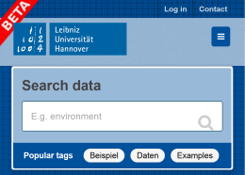
Examples of Repositories
discipline-specific
institutional
generic (interdisciplinary)
data journals
media-specific

Slide 15
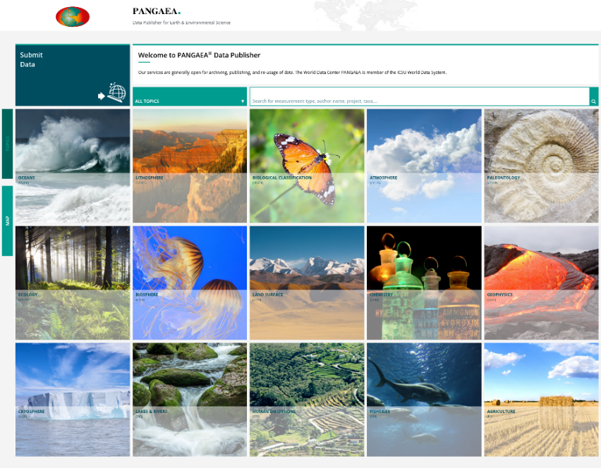
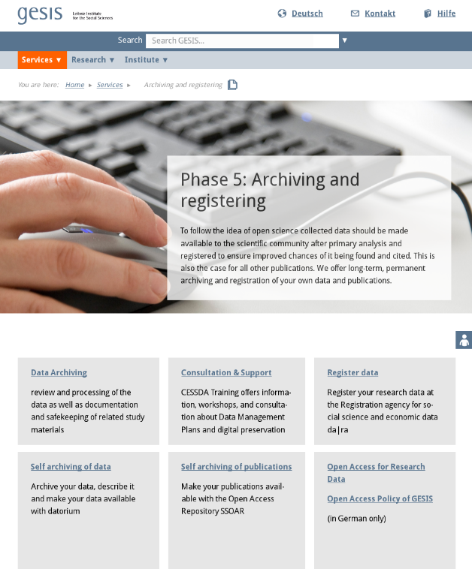
Disciplinary / Domain Repositories
for one scientific discipline / domain
usually fixed metadata schema
a central place to look for data in a domain
Use it, if there is one for your domain!
Examples:
Pangaea – Geodata repository - https://www.pangaea.de/
Nomad Repository - Novel Materials Discovery Repository - http://nomad-repository.eu/cms/

Slide 16
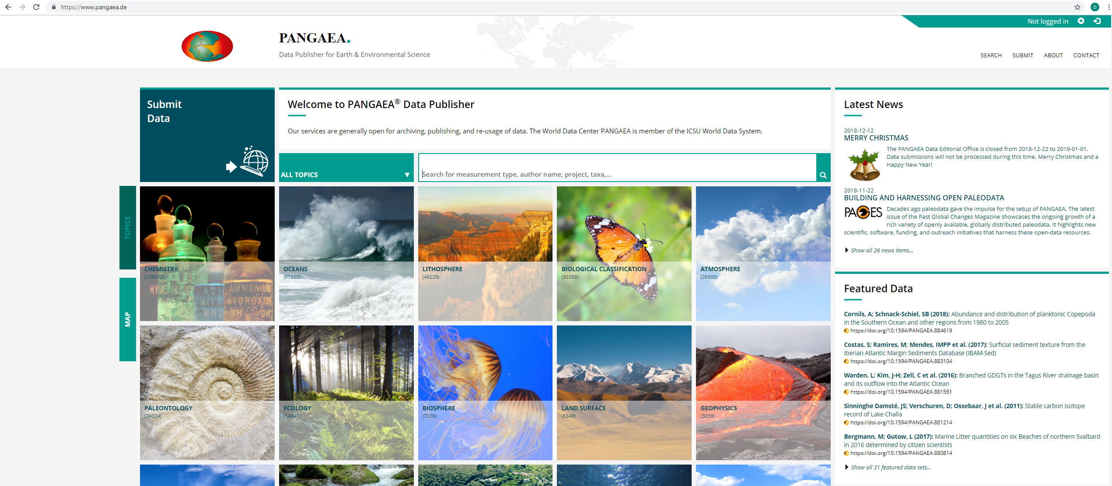
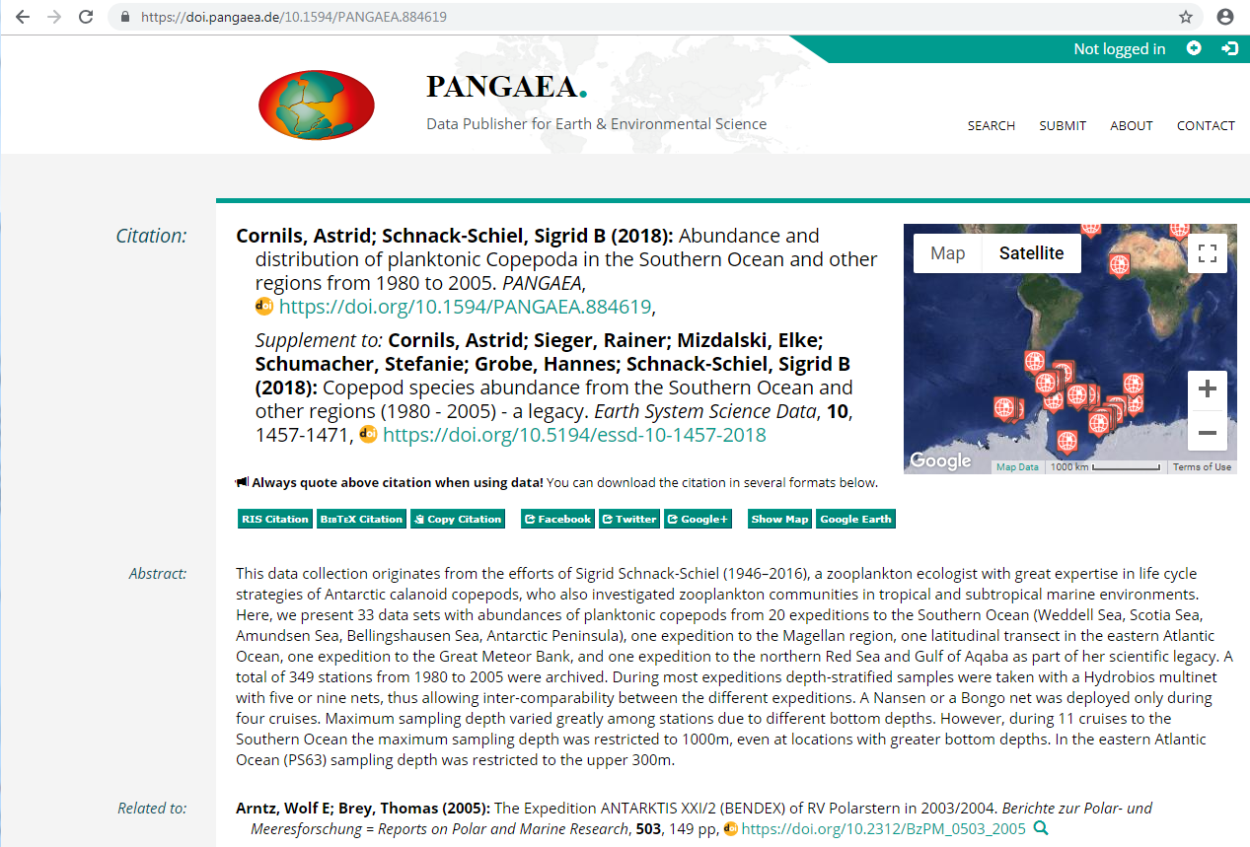
A Discipline-Specific Repository: Pangaea.de
https://www.pangaea.de
data publisher for earth & environmental science
DOIs for datasets
quality control by professional data curators
disciplinary metadata (parameters, spatial coverage, events)
free of charge for data submitters (funded by the European Commission, BMBF, DFG, International Ocean Discovery Program (IODP))
hosted in Germany (Alfred Wegener Institute & University of Bremen)

Slide 17
Generic and Institutional Repositories
open for various subject-specific data
metadata schemata usually more general (DataCite, Dublin Core)
for domains without subject-specific repositories
Generic: examples of public repositories
Zenodo (CERN) - https://zenodo.org/
Figshare - https://figshare.com/
Institutional: e.g. for a university
pure research data repositories, e.g.
OpARA – the TU Dresden repository - https://opara.zih.tu-dresden.de/
TUdatalib (TU Darmstadt) - https://tudatalib.ulb.tu-darmstadt.de/
repositories for both documents and research data, e.g.
RWTH Publications - http://publications.rwth-aachen.de/
KITopen - https://www.bibliothek.kit.edu/cms/kitopen.php
DepositOnce (TU Berlin) - https://depositonce.tu-berlin.de/

Slide 18
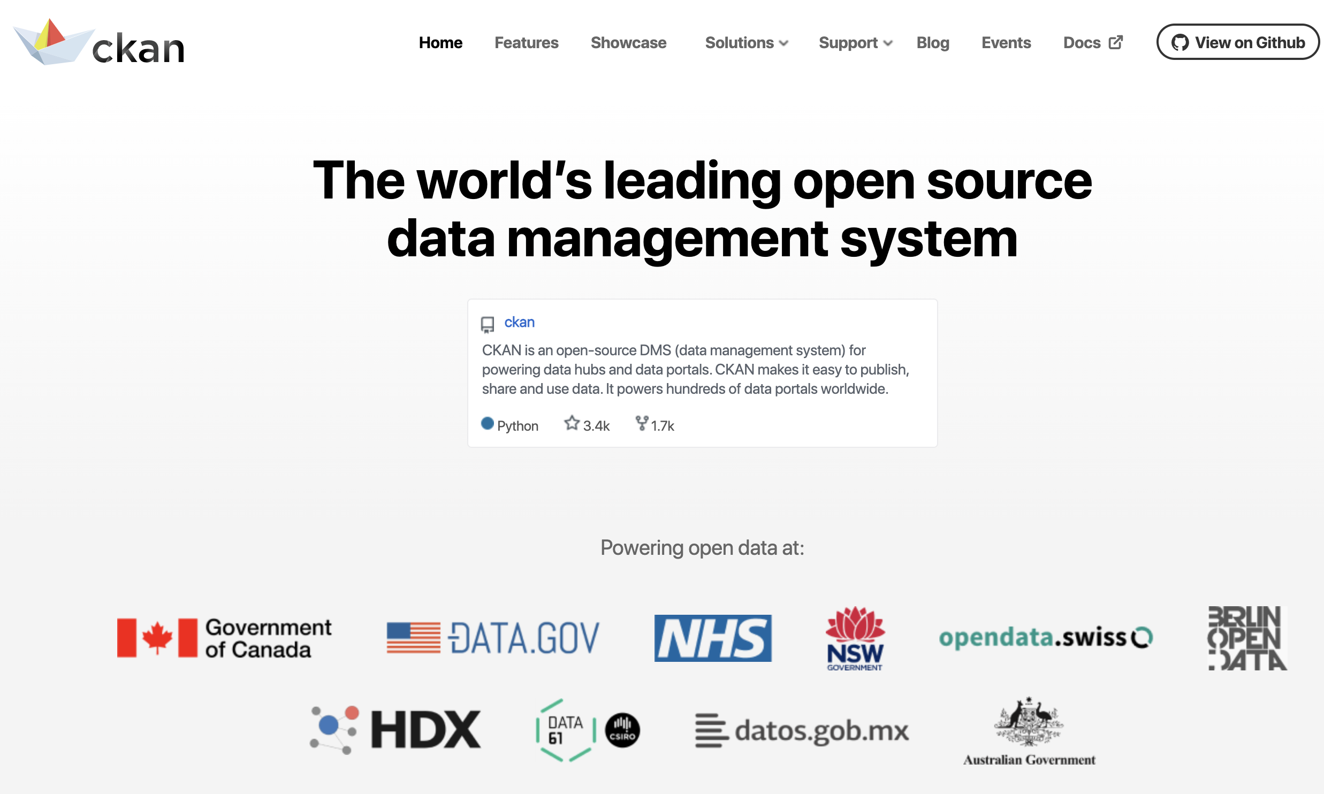
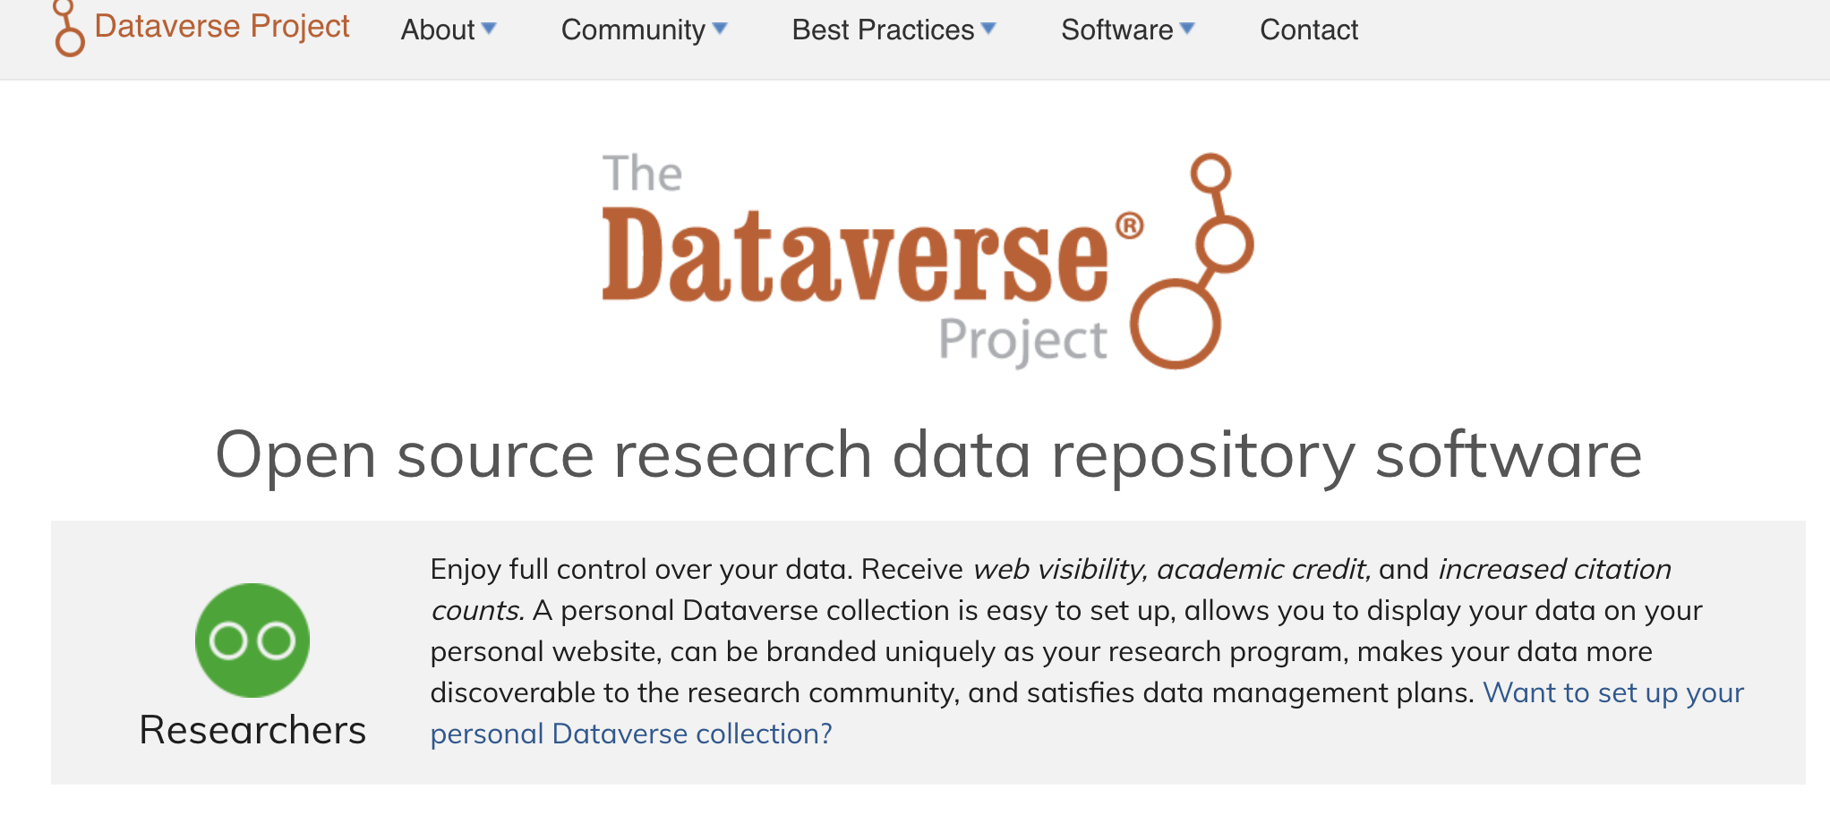
Institutional repositories

Slide 19
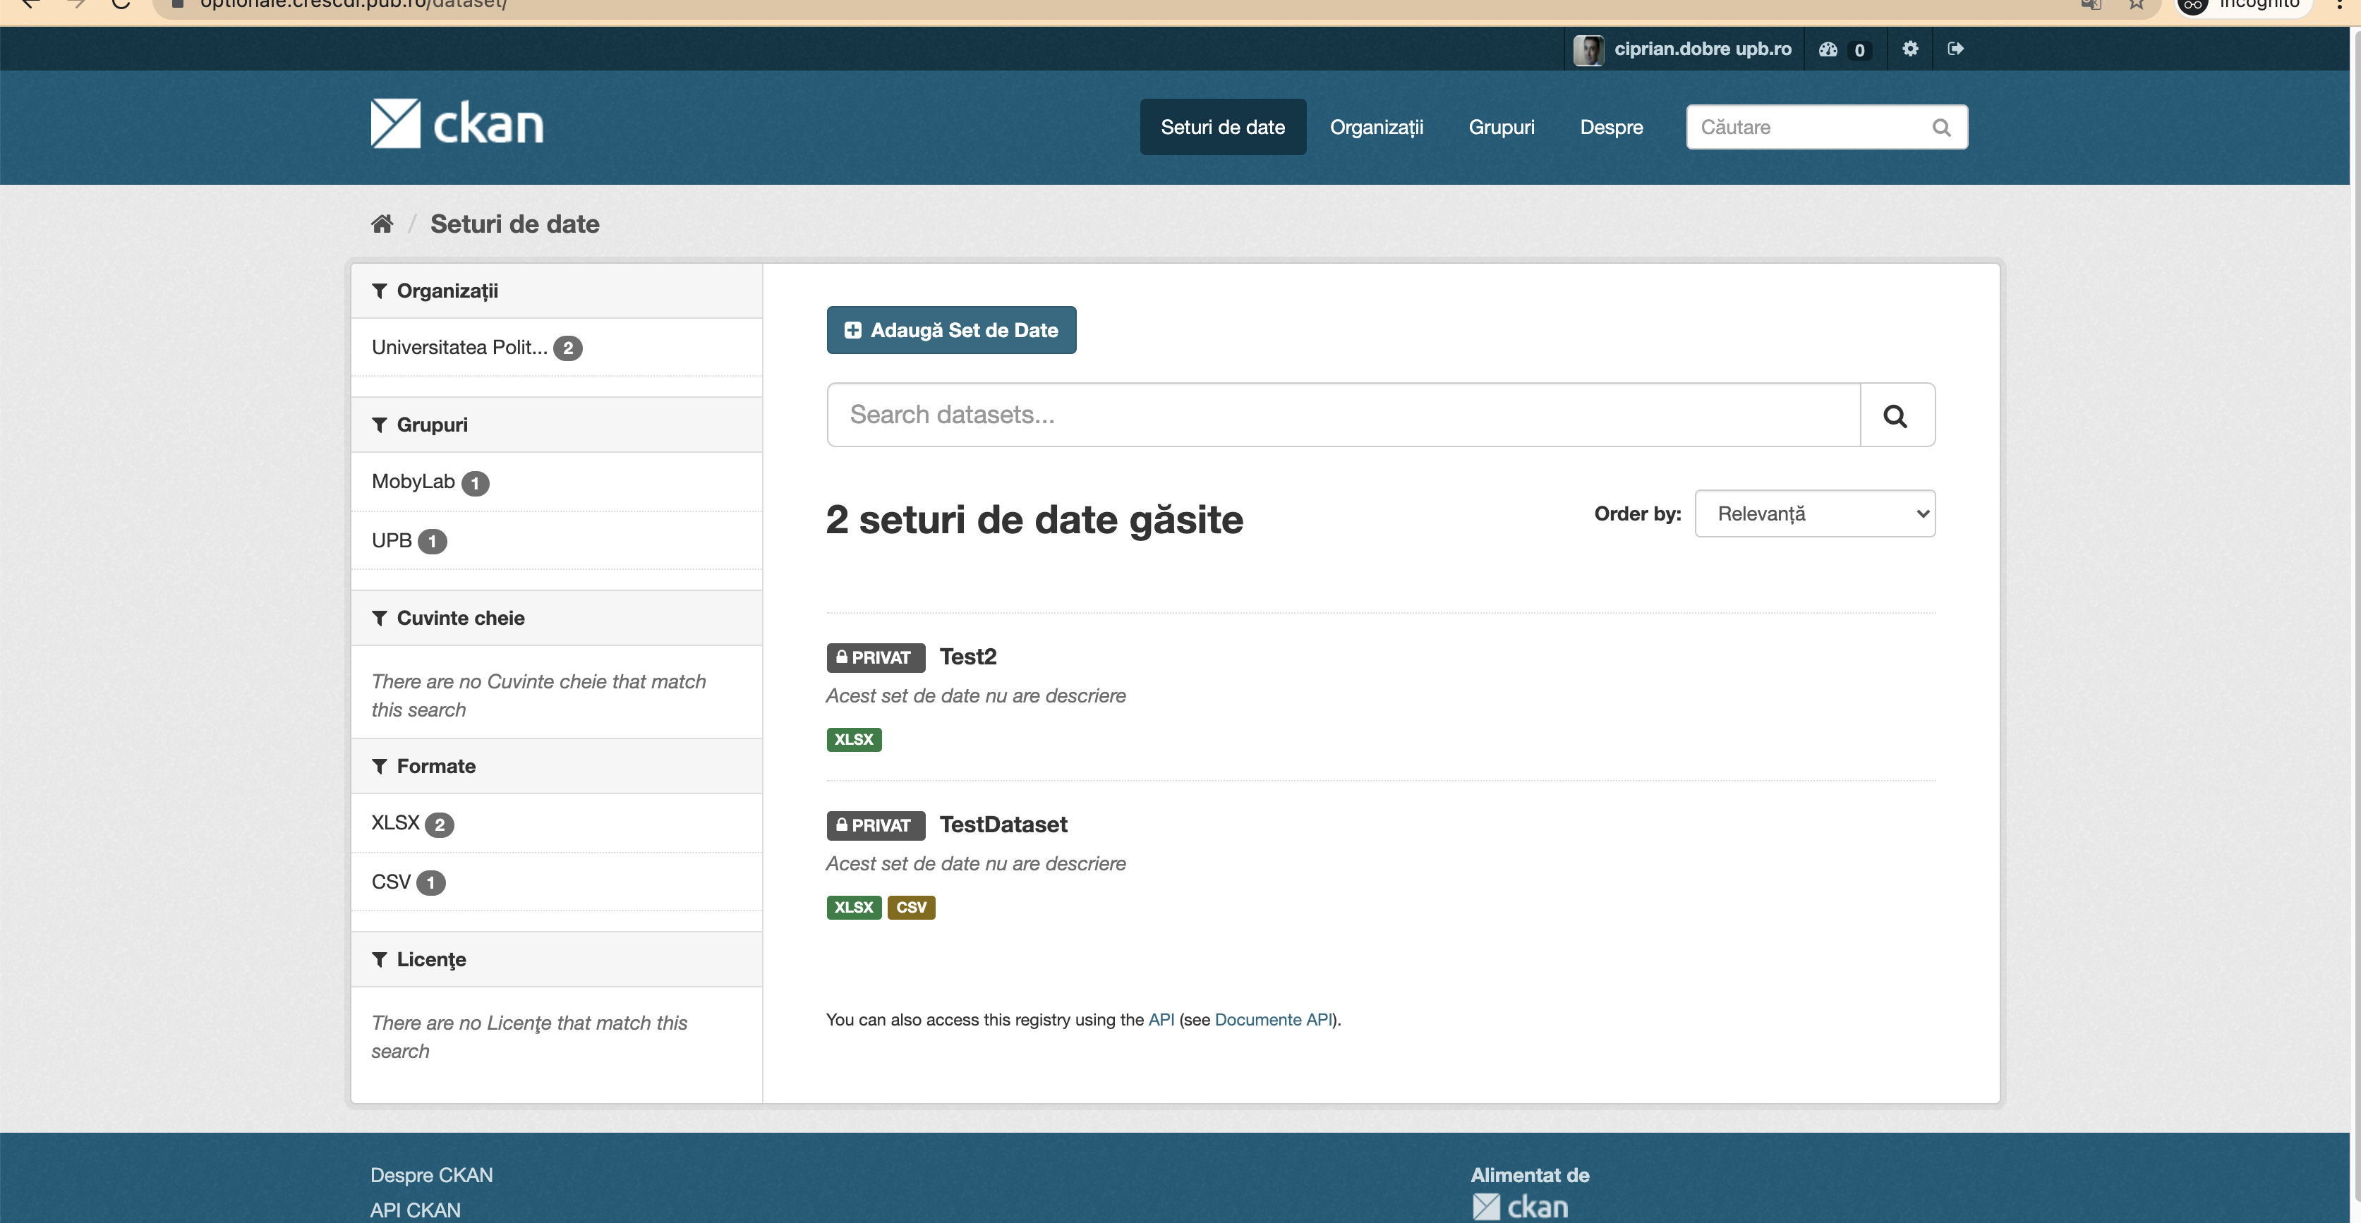
Example at UPB...

Slide 20
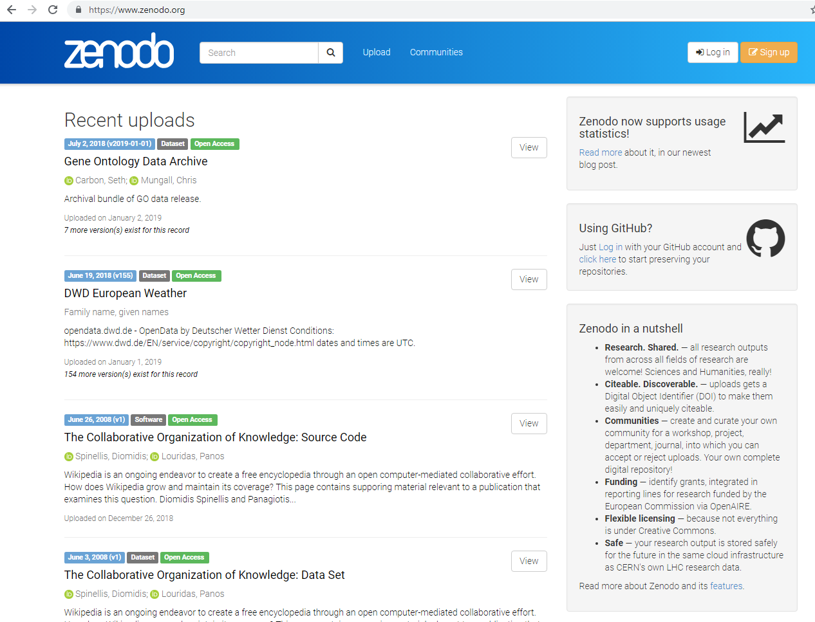
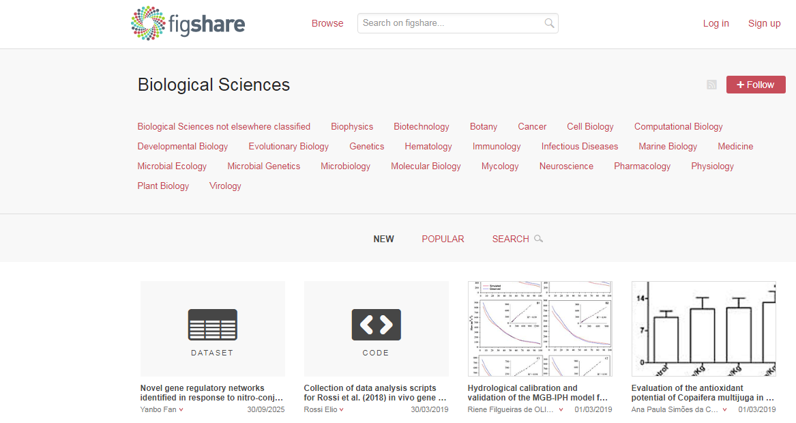
Public Repositories: Zenodo, Figshare
Zenodo.org
Figshare.com
public repository
integration with GitHub
public and institutional offer
DOIs

Slide 21
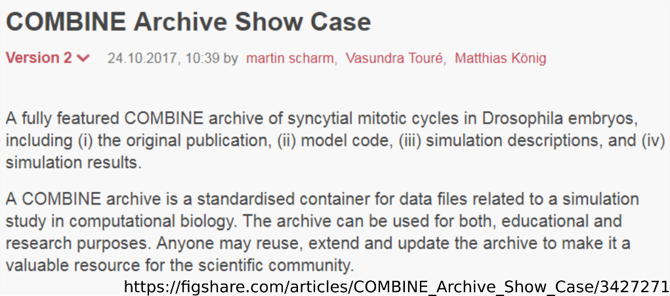
Figshare – a Service
Figshare is a commercial offer for scientists and institutions.
open to all fields of research
open to all types of research data
Freemium model
File size up to 5 Gigabyte

Slide 22
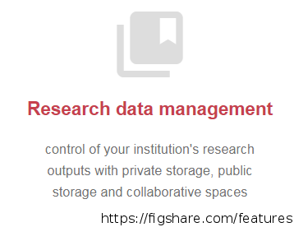
Figshare – Special Features
Services:
offers repositories and other services for universities
cooperates with publishers, e.g. PLOS or also:
https://springernature.figshare.com

Slide 23
Task: Zenodo versus Figshare
Please compare the offer of Zenodo and Figshare.
Which provider would you confide your data to?

Slide 24
Architecture
Class | Feature | DSpace | CKAN | Figshare | Zenodo | Dataverse
Architecture | Deployment | Installation package | Installation package | Service | Service | Installation package
 | Storage location | Local or remote | Local or remote | Remote | Remote | Local or remote
 | Maintenance costs | Infrastructure management | Infrastructure management | Monthly fee | Monthly fee | e-mail based-free of cost
 | Open Source | √ | √ | × | × | √
 | Platform customization | √ | √ | × | Community policies | √
 | Embargo period | √ | Private storage | Private storage | √ | √
 | Content versioning | × | √ | × | × | √
 | Pre-reserving DOI | √ | × | √ | √ | √

Slide 25
Architecture…
Class | Feature | DSpace | CKAN | Figshare | Zenodo | Dataverse
Metadata | Required fields | Title, Date of issue | Title | Author, title, categories description | Type, DOI, author, title, description | Title, Author, Description, Contact Email, Subject, and DOI
 | Exporting schemas | Any pre-loaded schema | × | DC | DC, MARCXML | XML
 | Schema flexibility | Flexible | Flexible | Fixed | Fixed | Flexible
 | Validation | √ | × | × | √ | √
 | Versioning | × | √ | × | × | √

Slide 26
Architecture…
Class | Feature | DSpace | CKAN | Figshare | Zenodo | Dataverse
Dissemination | API | √ | √ | √ | √ | √
 | OAI-PMH Compliance | √ | With ckanext-harvest installer | √ | √ | √
 | Faceted search | √ | √ | √ | √ | √

Slide 27
Architecture
Most of the mentioned software are open source based and have given some flexibility to the users.
Speedy and simple deployment of the used software is a crucial part for the implementation.
Open-source software can be installed in house whereas platforms like Figshare and Zenodo are to be installed and implemented by the help of the developer.
Dspace, Dataverse & CKAN have better control in the recorded data as they are open source.

Slide 28
Metadata
Zenodo and Figshare software are able to export records that comply with established metadata schemas (Dublin Core and MARC-XML respectively).
DSpace goes further by exporting DIPs (Dissemination Information Package) that include METS metadata records, thus enabling the ingestion of these packages into a long-term preservation workflow.
Although CKAN and Dataverse metadata records do not follow any standard schema, the platform allows the inclusion of a dictionary of key-value pairs that can be used to record domain specific metadata as a complement to generic metadata descriptions.

Slide 29
Repositories: How do I find them?
This will help you to find a suitable repository to ...
... archive or publish your own data.
... search for interesting data of other researchers.
Registry of Research Data Repositories = re³data
Search filters (selection):
scientific discipline
countries
content types
licenses
identifiers
terms of use
data access

Slide 30
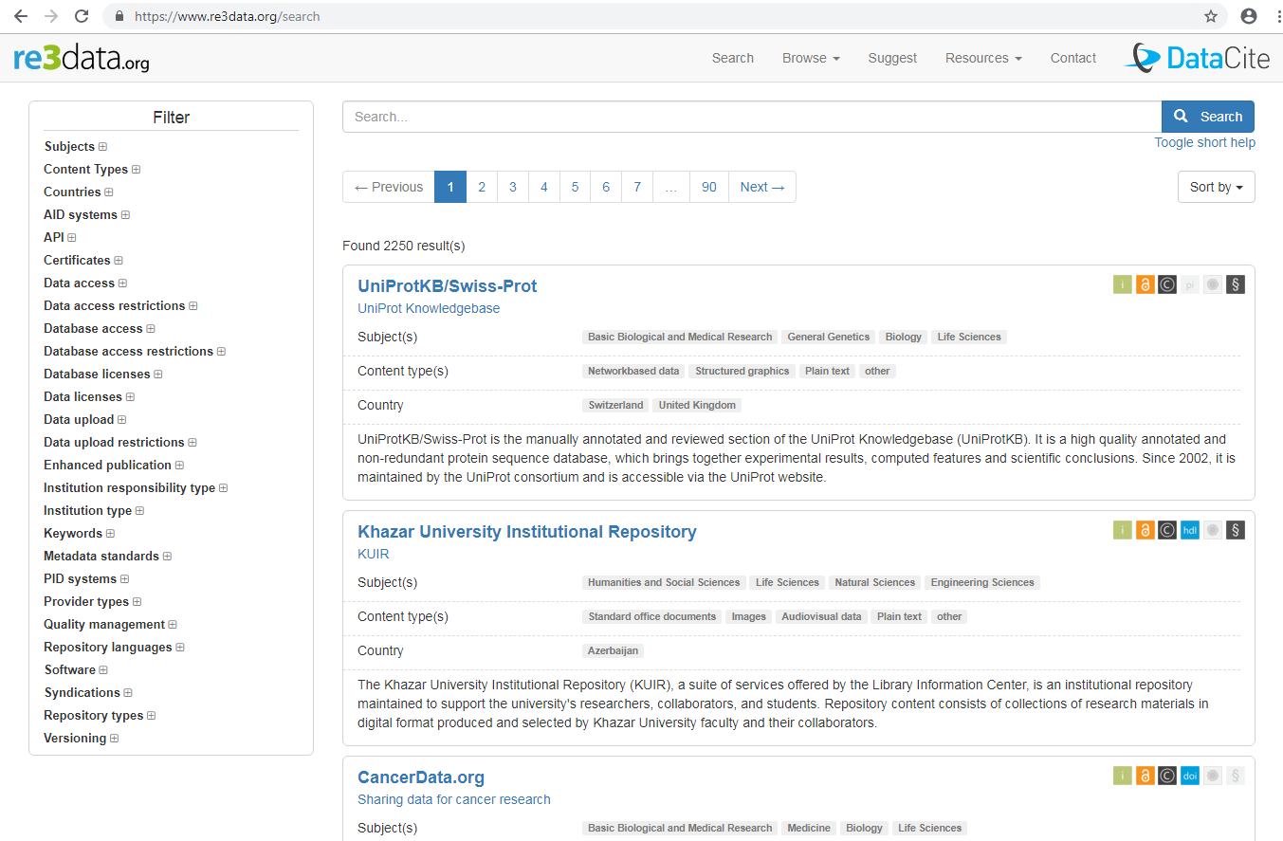
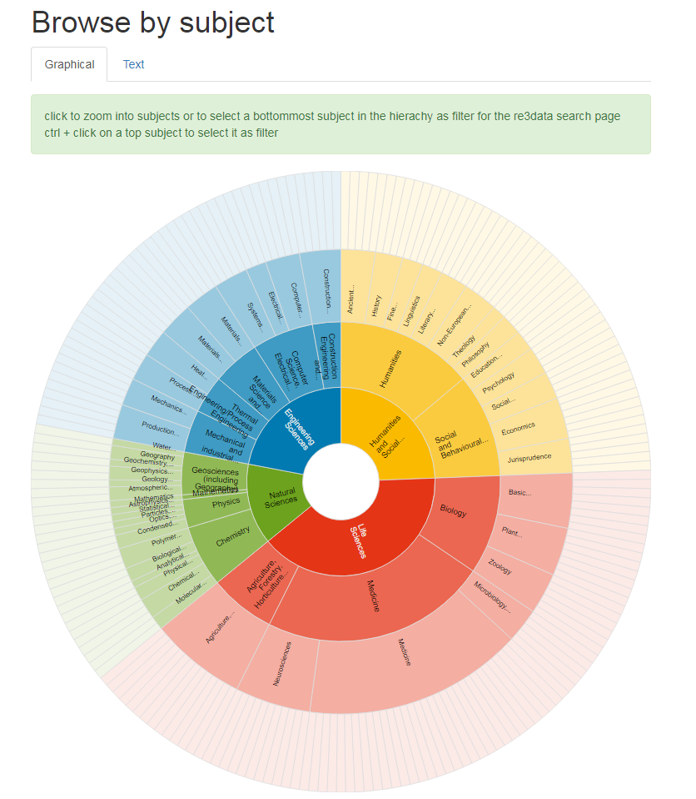
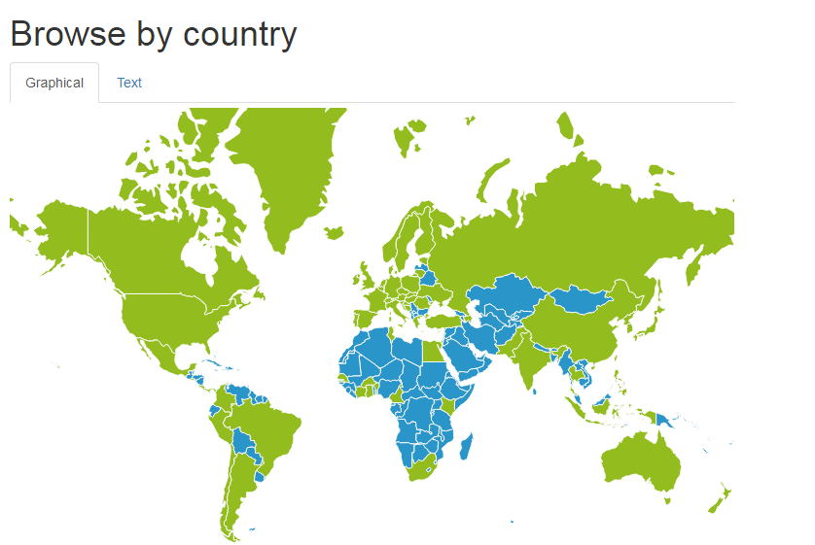
re3data.org Registry of Institutional and Discipline-Specific Repositories
lists 2000+ repositories
searchable and filterable according to many criteria
allows you to browse by subject, country, and content type
graphical categorization of the most important features
closed or open access
assigned PID
terms of use existing
information about the repository available
information about the use of the data available (licenses)
certification of the repository

Slide 31
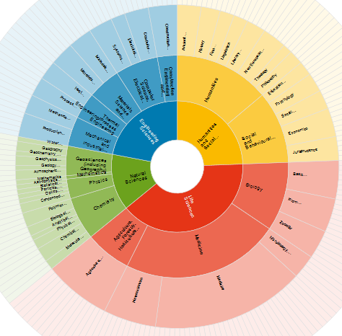
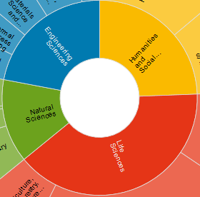
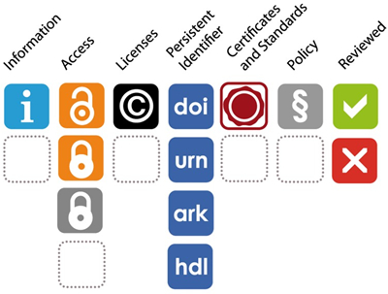
Re3data – Registry of Research Data Repositories
https://www.re3data.org/
[Bild] http://www.forschungsdaten.org/index.php/Datei:Re3data_icons.jpg

Slide 32
Steps To Share Your Data
Step 1: Select what data you want to share
Not all data can be made openly available, due to ethical and commercial concerns, and you may decide that some of your intermediate data is too large to share. As such, you first need to decide which data you need to share for others to be able to reproduce your research.
Step 2: Choose a data repository or other sharing platform
Data should be shared in a formal, open, and indexed data repository where possible so that it will be accessible in the long run. Suitable data repositories by subject, content type or location can be found at Re3data.org, and in FAIRsharing where you can also see which standards (metadata and identifier) the repositories implement and which journal/publisher recommend them. If possible use a repository that assigns a DOI, a digital object identifier, to make it easier for others to cite your data.
Step 3: Choose a licence and link to your paper and code
So that others know what they can do with your data, you need to apply a licence to your data. The most commonly used licences are Creative Commons, Open Government Licence, or an Open Data Commons Attribution License. To get maximum value from data sharing, make sure that your paper and code both link to your data, and vice versa, to allow others understand your project better.
Step 4: Upload your data and documentation
In line with the FAIR principles, upload the data in open formats as much as possible and include sufficient documentation and metadata so that someone else can understand your data. It is also essential to think about the file formats in which the information is provided. Data should be presented in structured and standardised formats to support interoperability, traceability, and effective reuse. In many cases, this will include providing data in multiple, standardized formats, so that it can be processed by computers and used by people.

Slide 33
What Is the Right Place for My Research Data?
Criteria:
secure storage of data
assignment of a persistent identifier
landing page with descriptive metadata
accessible and visible for all relevant users
Ideal would be a place …
… that is well-known within the relevant community.
… that offers the possibility to describe the data with relevant properties (subject-specific metadata).
… where the data is made available to the (relevant) public in a form that can be easily found and quoted.

Slide 34
Differentiation between Repositories and Digital Preservation
Repositories
document servers to make research data accessible to third party users
access to the data can be restricted by rights and role management
hosting usually through universities or other academic institutions
usually free access
description of the data by metadata, including a persistent identifier.
Digital Preservation
time-unlimited storage
two safety aspects:
Substance conservation
Strategy: Bitstream-Preservation
Preservation of usability
Some files require special hardware or software with which they can be read.
changing file formats over time
Strategies: migration or emulation
Data can often only be understood when their context is known.
Strategies: Persistent Identifiers, Semantic Web Technologies
Digital preservation platforms: e.g. Rosetta, Archivematica
Notes:
References: https://www.forschungsdaten.info/themen/bewahren-und-nachnutzen/langzeitarchivierung/
http://www.forschungsdaten.org/index.php/Kategorie:DLZA

Slide 35
Which Data Should Be Stored in the Repository?
According to visibility
data intended for publication
data for exchange within a project / research group / Collaborative Research Centre
internal data not intended for publication
According to processing stage
raw data
analyzed and aggregated data
visualized data (plots)

Slide 36
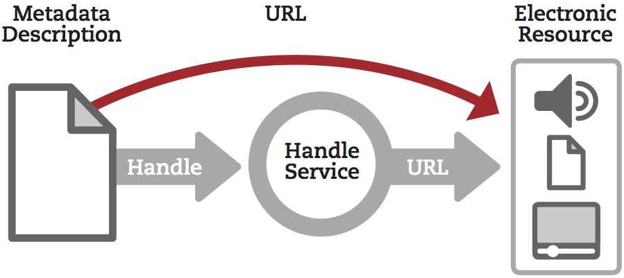
Attach persistent identifiers (PID)
A PID is a long-term reference to a document, file, or other object
PIDs come in various forms, e.g. ARK, DOI, URN, PURL, Handles ...
They are usually actionable, meaning they can be typed in the web browser to access them
Many deposits will be allocated directly to the repository

Slide 37
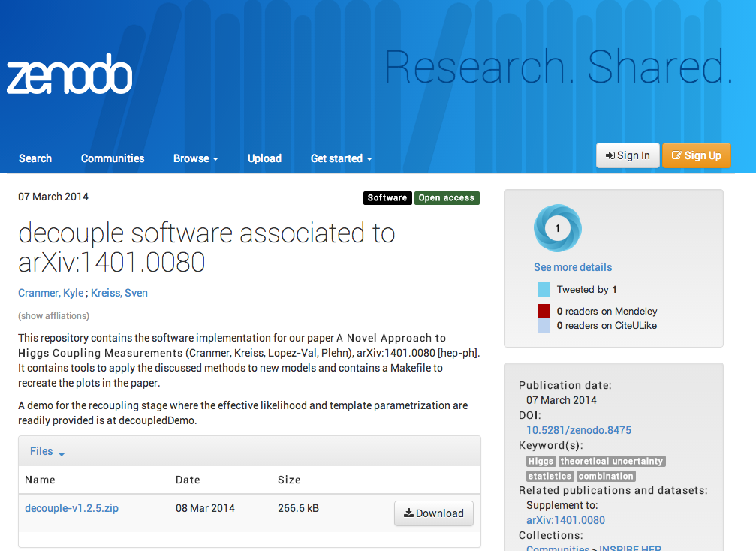
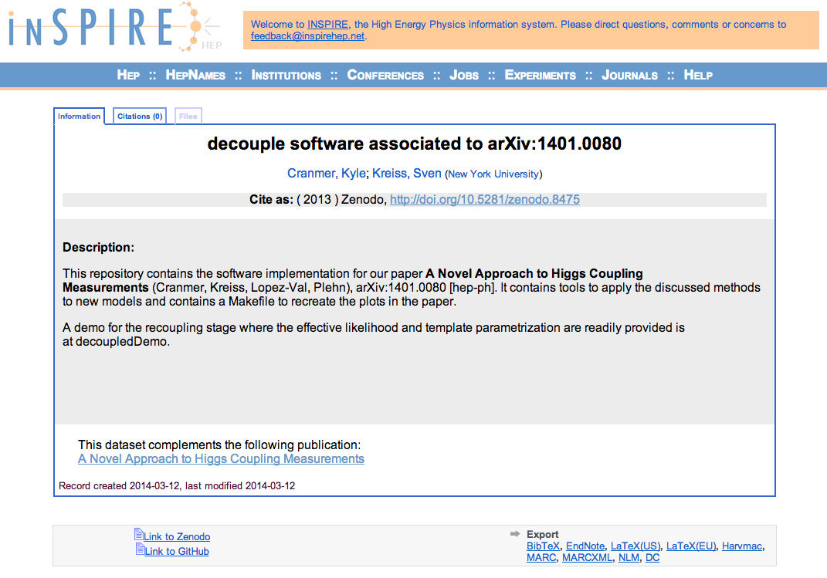
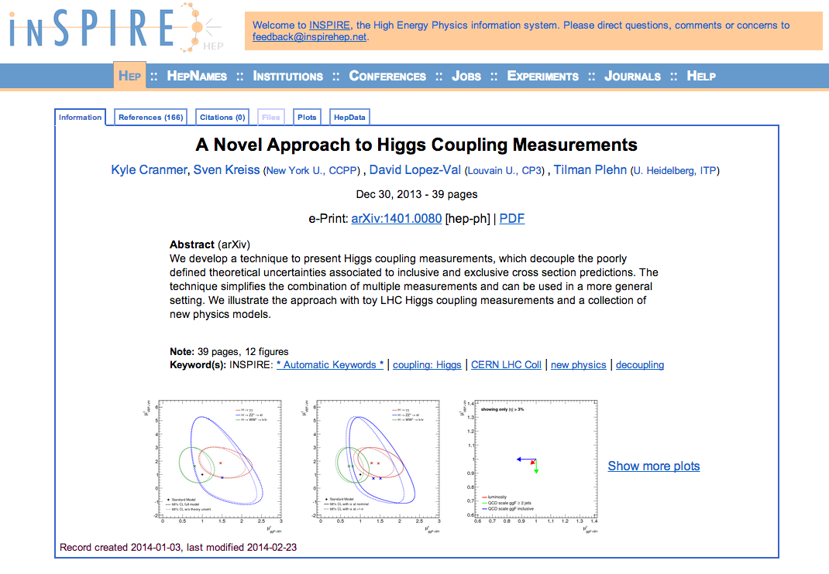
Code ↔ Data ↔ Paper

Slide 38
2. Collaborative platforms

Slide 39
Open Science Framework - OSF
Collaborative OS platform that brands itself as "a scholarly commons to connect the entire research cycle"
OSF enables researchers to work on projects privately with a limited number of collaborators and make any part or the whole of their project public.
It connects directly with many other collaborative systems like dropbox, GitHub and Google Docs, and can be used to store and archive research data, protocols, and materials.

Slide 40
Tool: Open Science Framework
Topic | OSF feature
Metadata | Wiki
Hierarchical organization | Components
Storage | OSF and Add-ons
Access | Contributors
Versioning | Built in version control

Slide 41
Creating an account
Go to http://osf.io
Notes:
Demo 1:
· To create an OSF account, go to http://osf.io, and click sign up in the upper right.
· Then fill in your name, email and a password.
· That’s it!

Slide 42
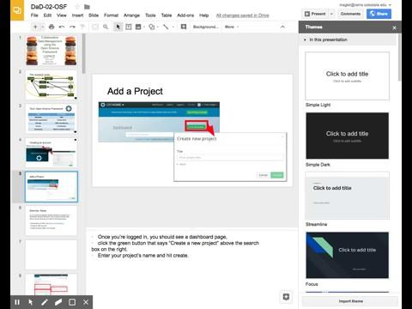
Add a Project
Notes:
· Once you’re logged in, you should see a dashboard page,
· click the green button that says “Create a new project” above the search box on the right.
· Enter your project’s name and hit create.

Slide 43
Notes:
Let’s go over the general layout of an OSF project.
You’ve got your title at the top, in this case Lou’s Project
You’ve got other information like when it was created, and a place to put a description.
Additionally, you have the wiki panel, where you describe your project.
A files panel where you can view associated files
And a Components panel, where you can see what components are part of your project

Slide 44
Context: Wiki
Describe the project
Evolves during project
Progress report
Goals
Code book:
ID systems (for records)
Variable systems
Notes:
Let’s start with the wiki.
· This is a good place to present a broad overview of your project.
· It’s meant to evolve over the course of your project, so you can also add things like where you are in the course of the project, and what your near-term goals are.
· As you collect the data, it’s also useful to put things like variable and ID definitions in this section.

Slide 45
Wiki page
Notes:
· To add content, but the “Edit” button in the upper right.
· You can use the tools above the right panel to add formatting. The wiki is written in Markdown language, so if you want to see the formatted text, look in the middle panel.
· When you’re done, hit save in the lower right.
Demo 3:
· Open the wiki
· Hit edit

Slide 46
Hierarchical Organization
“folders in folders”
So you can find things!
Agree on a standard with your collaborators
my_project
Data
Notes
protocols
manuscripts
Paper1
Paper2
Figures
Text
References
Notes:
Now that we have some information describing our project, we can start to think about how to organize the files.
· On our computers, we typically organize things using folders. If you have subfolders in a folder, you’re already organizing things hierarchically.
· Organizing your files and folders hierarchically makes it easier to find things, especially if you and your collaborators agree on a standard.
· To organize research data, we recommend having one folder per project, and subfolders for distinct aspects of that project.
· For example, you could have folders for data, notes, protocols and manuscripts. Then within manuscripts, you could have folders for each paper, and then sections of that paper.
· No matter how you organize it, you should agree on a standard format within your research group and with your collaborators to make your data interoperable.

Slide 47
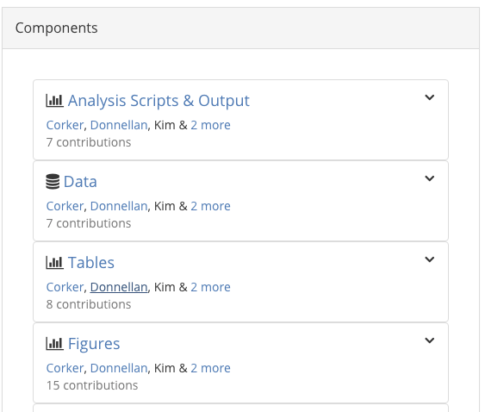
Components
“Subprojects”
Separate privacy settings, contributors, wiki, add-ons, and files.
Examples:
Different projects: https://osf.io/82fba/
Clinical: https://osf.io/gq4mz/
Manuscript: https://osf.io/if7ug/
Collaboration: https://osf.io/ezcuj/
Notes:
Components are essentially “sub projects” or subfolders. Each component has separate privacy settings, wiki, add ons and files. Here are some examples of how to separate your content into components. Let’s look at some examples

Slide 48
Notes:
Let’s add components based on the organizational structure we’ve chosen. To add a new component, I will click on add component in the components panel.

Slide 49
Add files to OSF
Click on OSF storage
Click upload
Select files from file browser
Notes:
To add files to OSF,
first select the storage space you want to add files to.
Since we haven’t linked any add ons yet, the only choice you have is OSF storage.
This action will make an upload button appear.
Once you click this button, you can choose which files to add

Slide 50
Storage Add ons
http://help.osf.io/m/addons/l/524149-storage-add-ons
Notes:
OSF Storage isn’t the only option for adding files to OSF.
You can also use storage add ons, which include many cloud services you might already be using.
I’ll show you how to use storage add ons with google drive as an example.

Slide 51
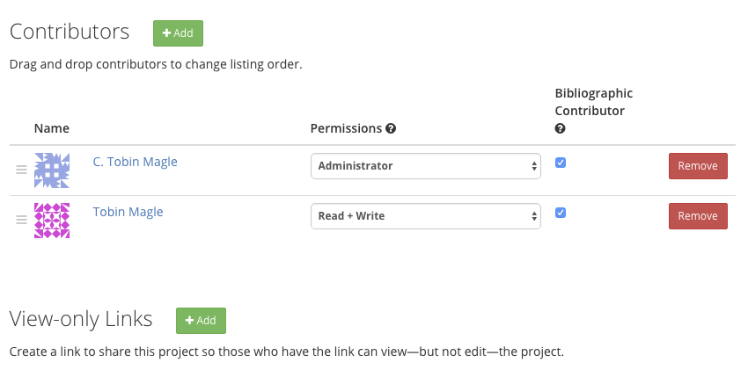
Contributors
Control who can see what
Administrator
Read/Write
Read only
Separate for each component
Notes:
Now that we have some data loaded, let’s look at how to add collaborators to our project using the contributors feature.
· A contributor can be anyone with an OSF account
· When you add a contributor, you can control what parts of your project they can see
· Additionally, you can decide whether they can read content only, change content, or administer content, which gives them the rights to make components and add other contributors
· You can have different sets of contributors for every component.

Slide 52
Version control
Who did what when?
Native in OSF
GitHub Integration
One file name,
many versions
Notes:
OSF’s version control feature tracks who did what when,
and also interfaces nicely with more complex version control systems like git and github.
Every time you make a change to a file in OSF, the version control features archives a hidden instance of the previous version, called a revision.
But you only see one file in your directory.

Slide 53
Version history
Open the file by clicking
Notes:
: If I click on the file name, the contents of the text file appear in a new window.

Slide 54
Other Collaborative Platforms...
Collaborative writing platforms
Online tools and platforms for researchers to work together on documents in real-time, and so avoid the versioning-hell of emailing Word documents back and forth.
Platforms include Overleaf, Authorea, Fidus Writer, ShareLaTeX and Google Docs.
Many of these tools are based on proprietary technologies and some require payment for advanced features.
Reference management & discovery
There are plenty of tools which enable groups to store and manage references.
Examples include Zotero, Citavi and CiteUlike. Mendeley incorporates a sharable reference manager, as well as a social network and article visualization tools. Relatedly, BibSonomy allows researchers to share bookmarks and lists of literature.
Annotation and review
The power of the Web enables new modes of post-publication collaborative review through services like PubPeer and Academic Karma, as well as annotation tools like Hypothes.is and PaperHive.
Academic social networks
Researchers have long made use of the Web for social networking - either via mainstream social networks like Twitter, Facebook and Linkedin or dedicated academic social networks like ResearchGate, Academia.edu and Loop.

Slide 55
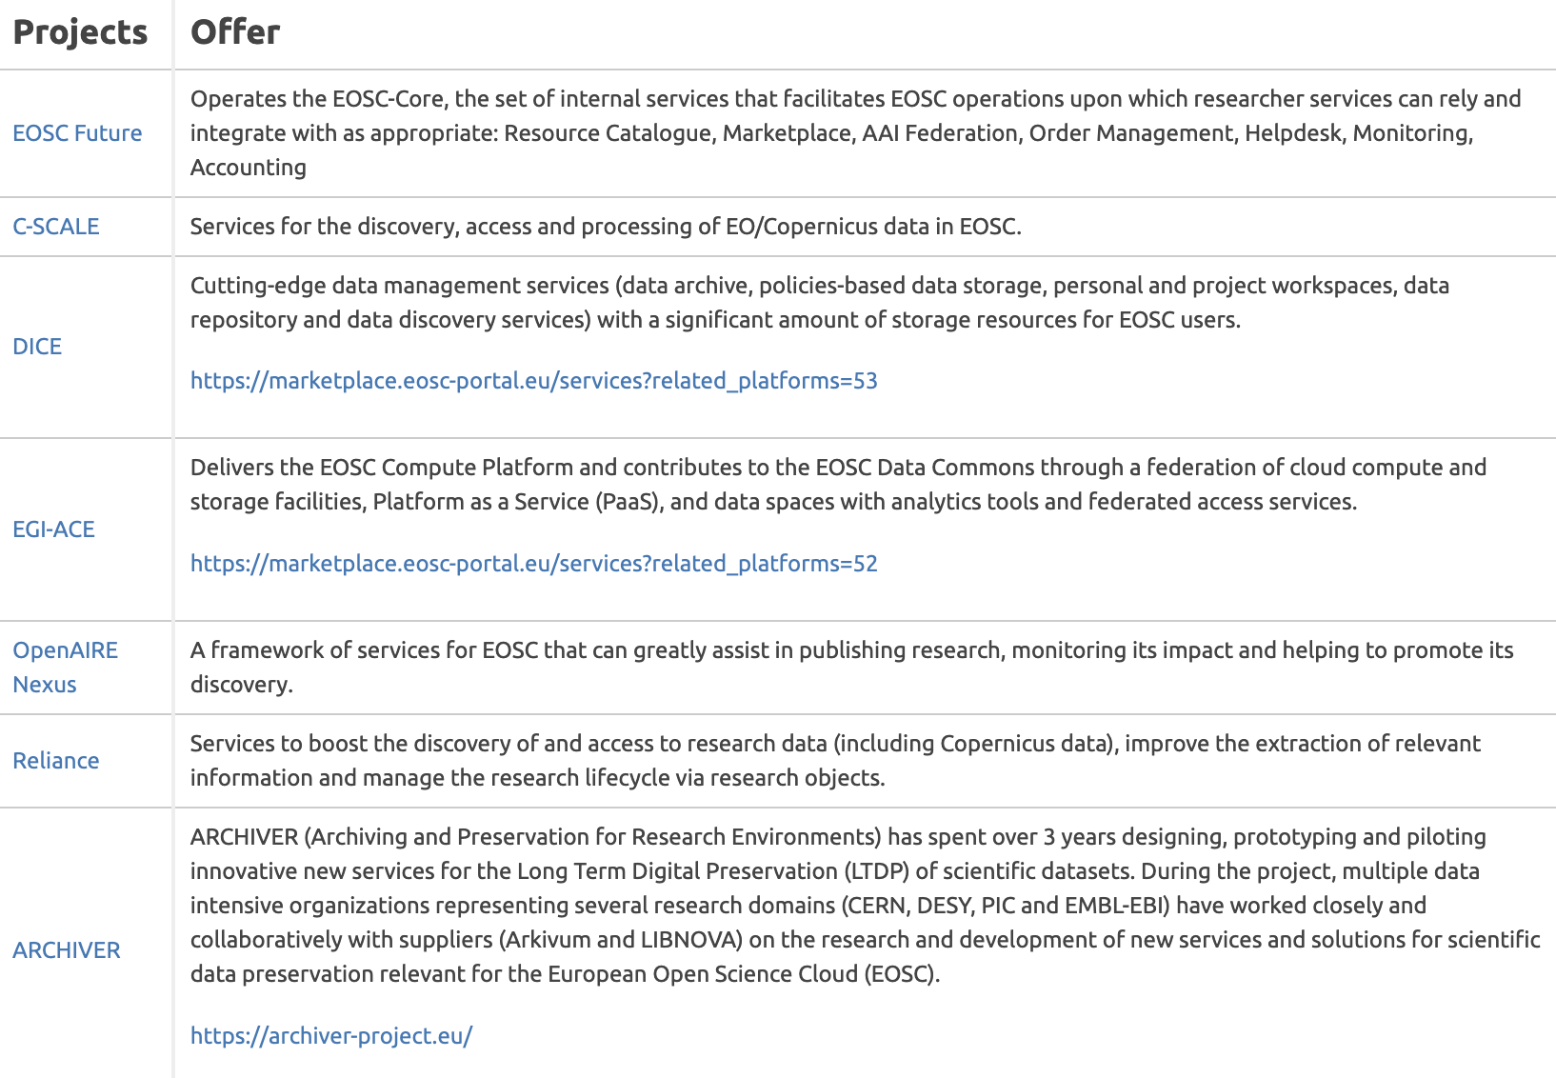
The future... EOSC

Slide 56
THANK YOU!
Follow us

