Slide 1
Open Research Data and Materials
This module is part of
„Early Stage Researchers' Training Week ”
within the project TrainRDM
University POLITEHNICA of Bucharest
Roma 12 – 16 September 2022
Based on: https://open-science-training-handbook.github.io/
This work is licensed under the Creative Commons Attribution 4.0 International License. All images are public domain unless otherwise noted.

Slide 2
Contents
Research Data
Types of research data
Definition
Research data types
Research data COVID-19 challenge
Open Research Data
What is it? - Understanding Open Data
Rationale
Learning objectives
Key components
Questions, obstacles, and common misconceptions
Further reading

Slide 3
Research data

Slide 4
What would you associate research data with specifically?
Texts
Images
Audiovisual data
Profit
Source code
Statistical data
Geodata
Genetic sequences

Slide 5
Definition
Several definitions are possible based on specific fields, institutions and organizations.
Research data are defined as factual records (numbers, texts, images and sounds), which are used as principal sources for scientific research and which are often recognized by the scientific community as being necessary to validate research results.
Organization for Economic Cooperation and Development (OECD)

Slide 6
Why would you make your research data available in a repository?
To make them visible
To make them reusable
To make money
To be able to publish
To receive grants

Slide 7
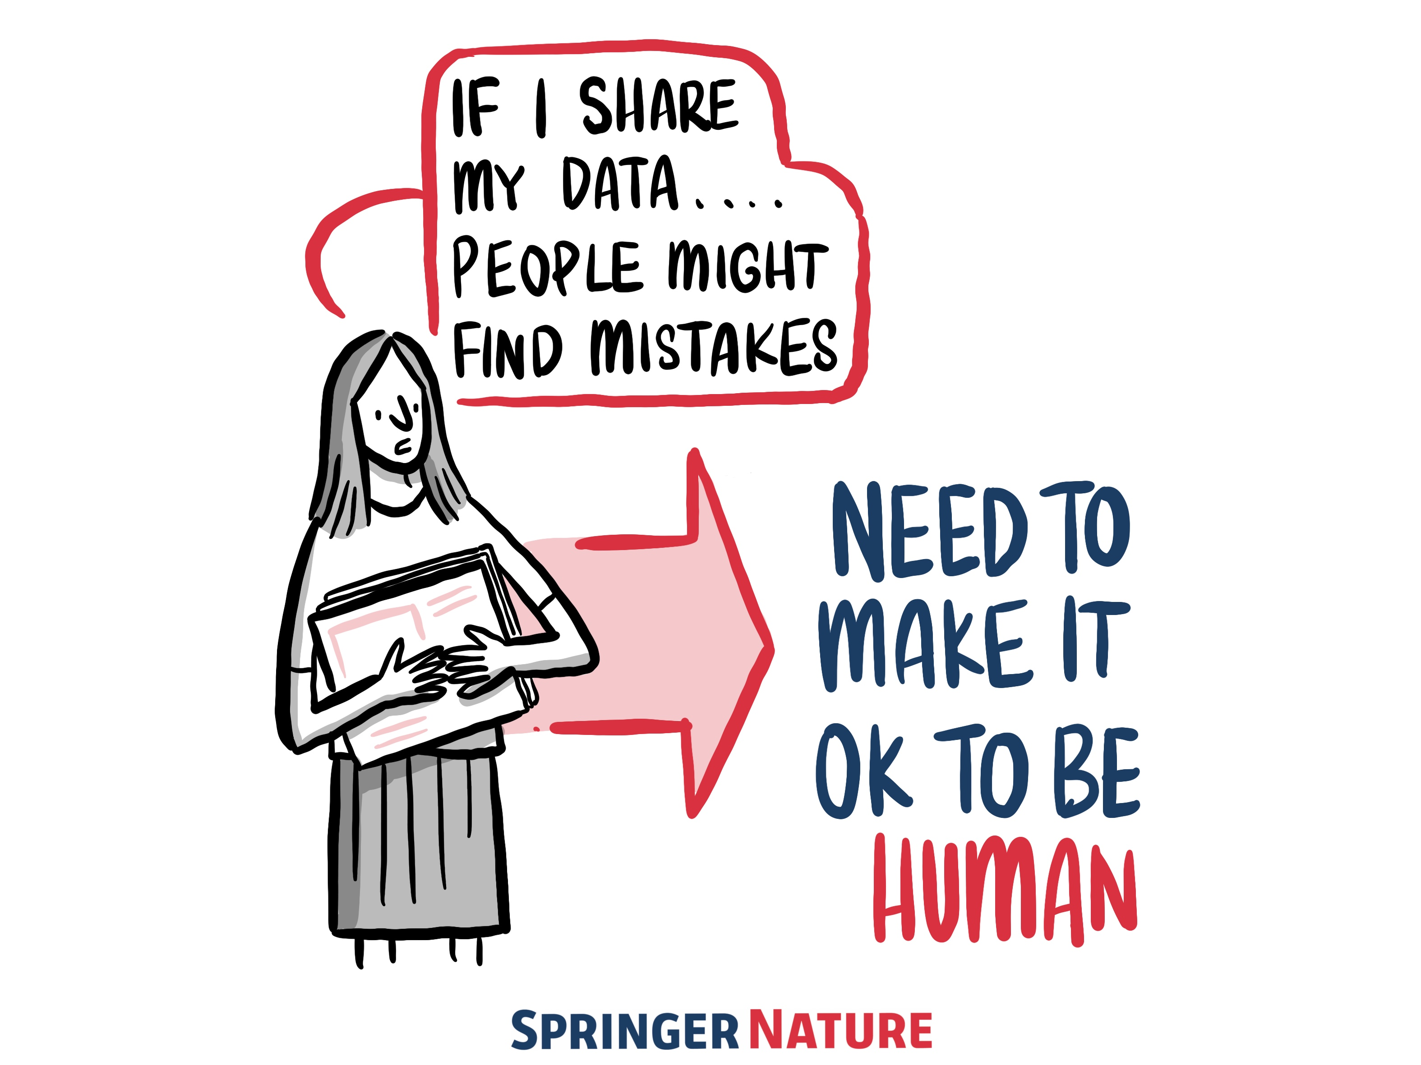
Limited incentives to give evidence against yourself
We know that no one wants to incriminate themselves, and also that no one is infallible.
The Fifth Amendment to the United States Constitution includes a clause that no one “shall be compelled in any criminal case to be a witness against [them]sel[ves]”. (Edited to gender-neutral language.)
To “plead the fifth” means that someone chooses not to give evidence that there might have been something wrong in their past behaviour. They have the right to remain silent.
Putting your code and data online can be very revealing and intimidating, and it is part of the human condition to be nervous of being judged by others.
Although there is no law governing the communication of reproducible research - unless you commit explicit fraud in your work - sharing errors that you find in your work is heavily disincentivised.

Slide 8
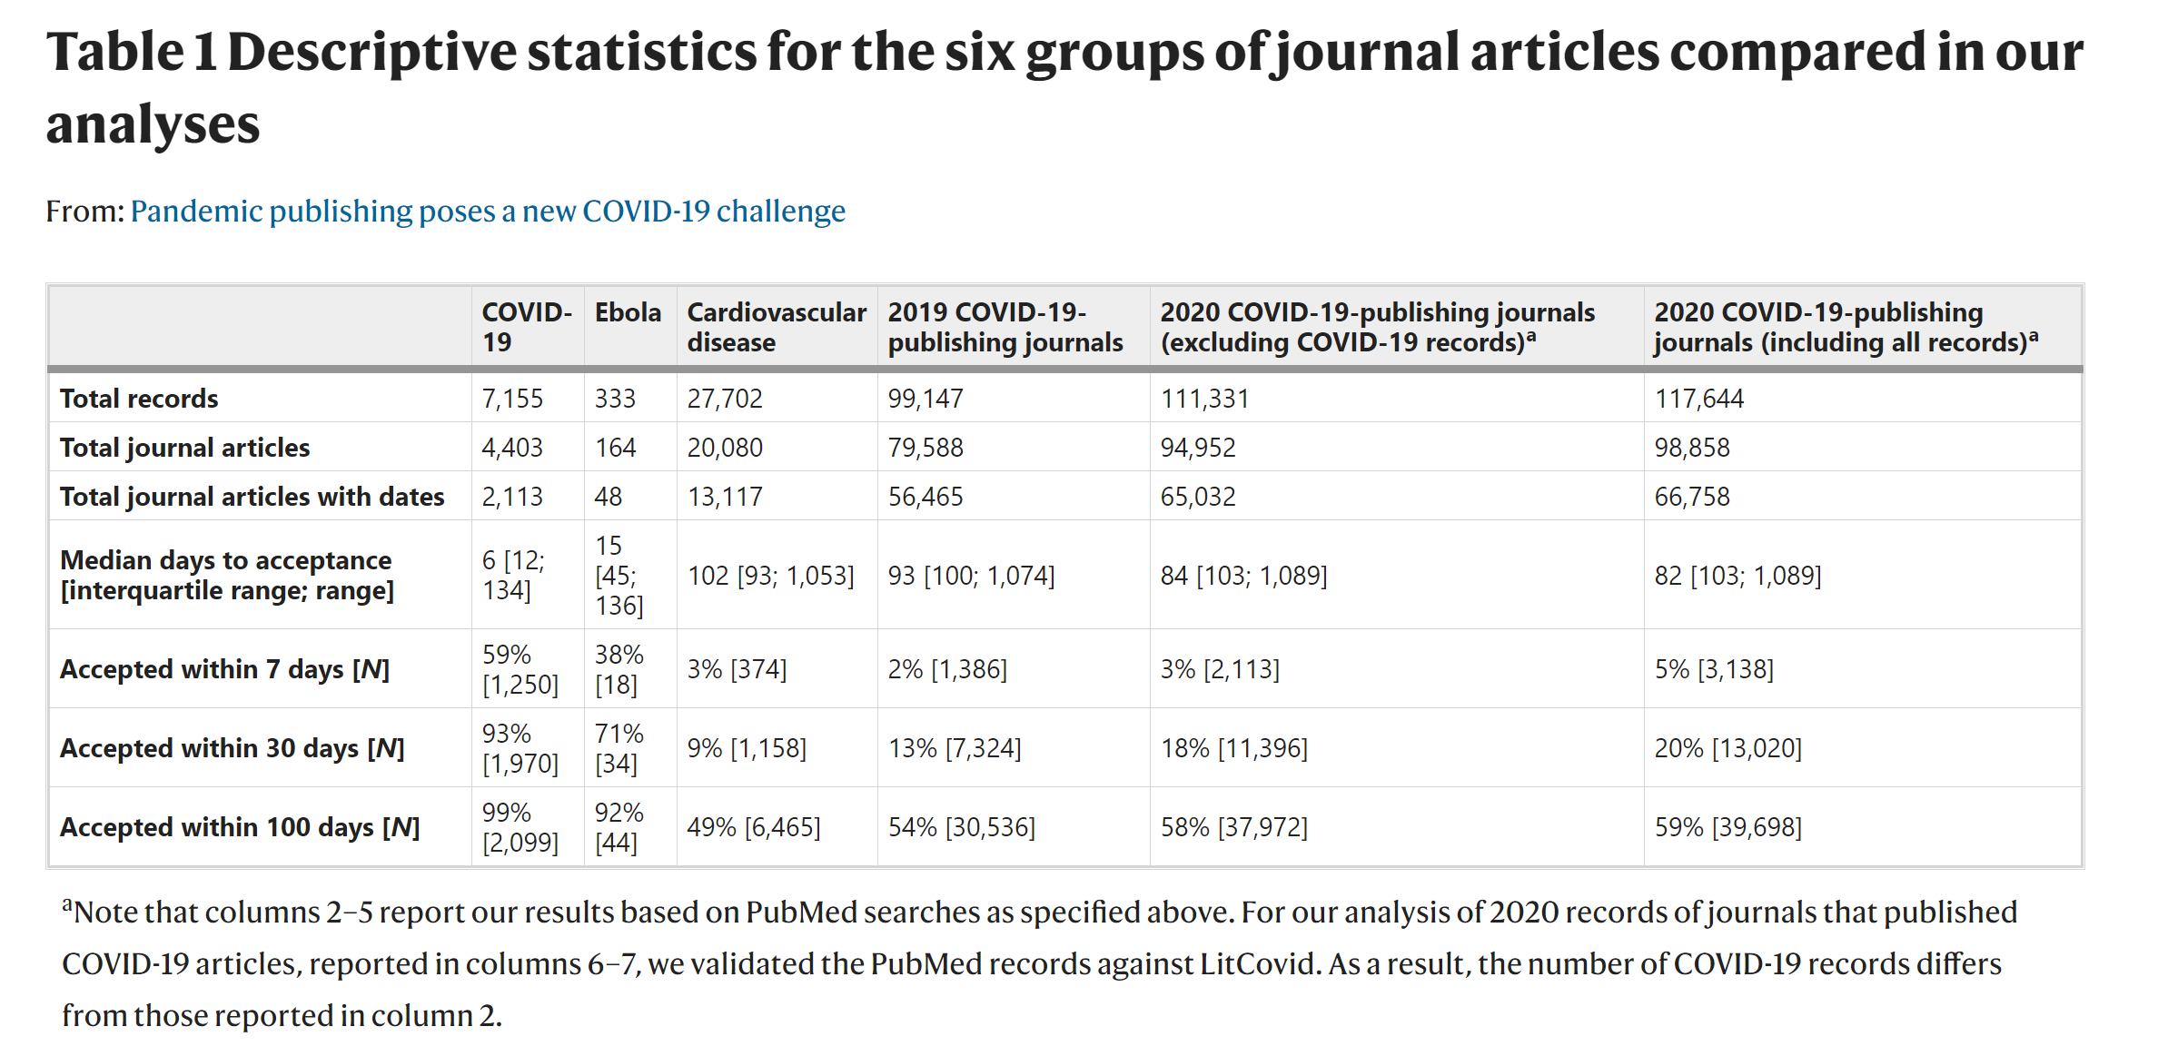
Nature Human Behaviour, vol. 4, pp. 666–669, (2020)

Slide 9
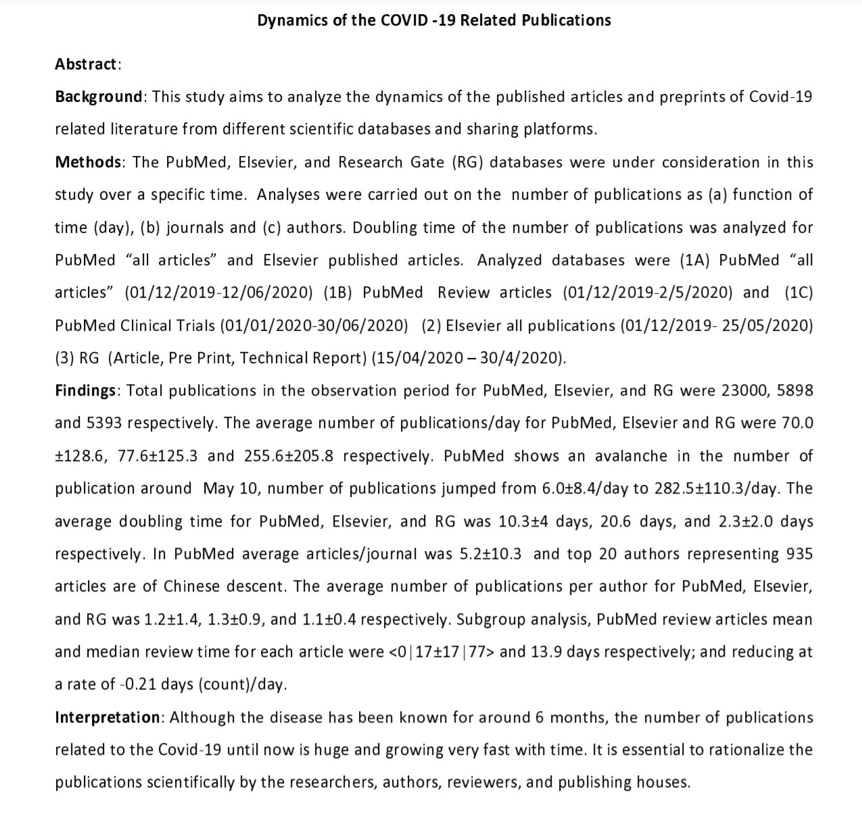
Dynamics of the COVID -19 Related Publications
Findings
Total publications in the observation period for PubMed, Elsevier, and RG were 23000, 5898 and 5393 respectively.
The average number of publications/day for PubMed, Elsevier and RG were 70.0 ±128.6, 77.6±125.3 and 255.6±205.8 respectively.
PubMed shows an avalanche in the number of publication around May 10, number of publications jumped from 6.0±8.4/day to 282.5±110.3/day.
The average doubling time for PubMed, Elsevier, and RG was 10.3±4 days, 20.6 days, and 2.3±2.0 days respectively.
Publication pipeline is at extraordinary speed – 6 days for COVID-19 article
Measures are required to safeguard the integrity of scientific evidence
doi: https://doi.org/10.1101/2020.08.05.237313

Slide 10
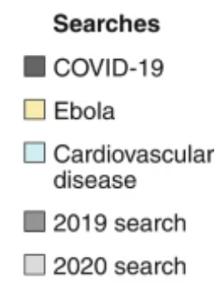
Nature Human Behaviour, volume 4, pp. 666–669(2020)

Slide 11
Open Research Data
Understanding Open Research Data

Slide 12
What is open data
Definition by Open Definition : “Open data is data that can be freely used, re-used and redistributed by anyone - subject only, at most, to the requirement to attribute and share alike”.
The full definition here
Most important characteristics:
Availability and Access: the data must be available as a whole and at no more than a reasonable reproduction cost, preferably by downloading over the internet. The data must also be available in a convenient and modifiable form.
Re-use and Redistribution: the data must be provided under terms that permit re-use and redistribution including the intermixing with other datasets.
Universal Participation: everyone must be able to use, re-use and redistribute - there should be no discrimination against fields of endeavour or against persons or groups. For example, ‘non-commercial’ restrictions that would prevent ‘commercial’ use, or restrictions of use for certain purposes (e.g. only in education), are not allowed.

Slide 13
What is it? - Understanding Open Data
Open data, especially open government data, is a tremendous resource that is as yet largely untapped.
Many individuals and organisations collect a broad range of different types of data in order to perform their tasks.
Government is particularly significant in this respect, both because of the quantity and centrality of the data it collects, but also because most of that government data is public data by law, and therefore could be made open and made available for others to use.
Why is that of interest?
The key point is that when opening up data, the focus is on non-personal data, that is, data which does not contain information about specific individuals.
Similarly, for some kinds of government data, national security restrictions may apply.

Slide 14
Rationale
Research data are:
often the most valuable output of many research projects,
used as primary sources that underpin scientific research and enable derivation of theoretical or applied findings.
used to make findings/studies replicable, or at least reproducible or reusable (reference to Reproducible Research and Data Analysis) in any other way,
The best practice recommendation for research data is to be as open and FAIR as possible, while accounting for ethical, commercial and privacy constraints with sensitive data or proprietary data.

Slide 15
Learning objectives
Gain an understanding of the basic characteristics and principles of open and FAIR research data, including appropriate packaging and documentation, to enable others to understand, reproduce, and re-use in alternative ways.
Familiarity with the sorts of data that might be considered sensitive, and the restrictions or constraints on openly sharing them.
Be able to:
convert a ‘closed’ dataset into one which is ‘open’ by implementing the necessary measures in a data management plan, with appropriate data stewardship and metadata.
to use research data management plan and to make your research results findable and accessible, even if it contains sensitive data.
Understand:
the pros and cons of openly sharing different types of data (e.g., privacy, sensitivity, de-identification, mediated access).
the importance of appropriate metadata for sustainable archiving of research data.
the basic workflows and tools for sharing research data.

Slide 16
Key components
Knowledge & Skills
Questions, obstacles, and common misconceptions
Learning outcomes
Further reading

Slide 17
Knowledge & Skills
FAIR principles
Data publishing
Data citation
Data packaging
Sharing sensitive and proprietary data
Data brokers
Analysis portals
De-identified and synthetic data
DataTags
Open Materials
Reagents
Protocols
Notebooks, containers, software, and hardware

Slide 18
FAIR principles
A core set of principles to optimize the reusability of research data or any digital object:
Findable - It should be easy to find the data and the metadata for both humans and computers. Depends on machine-readable persistent identifiers (PIDs) and metadata.
Accessible - The (meta)data should be retrievable by their identifier using a standardized and open communications protocol, possibly including authentication and authorisation. Also, metadata should be available even when the data are no longer available.
Interoperable - The data should be able to be combined with and used with other data or tools. The format of the data should therefore be open and interpretable for various tools, including other data records.
Re-usable - To achieve this, metadata and data should be well-described so that they can be replicated and/or combined in different settings. Also, the reuse of the (meta)data should be stated with (a) clear and accessible license(s).

Slide 19
Data publishing
There are several distinct ways to make research data accessible:
Publishing data as supplemental material associated with a research article, typically with the data files hosted by the publisher of the article.
Hosting data on a publicly-available website, with files available for download.
Depositing data in a repository that has been developed to support data publication, e.g., Dataverse, [Dryad] (https://en.wikipedia.org/wiki/Dryad_(repository)), figshare, Zenodo.
A large number of general and domain or subject specific data repositories exist which can provide additional support to researchers when depositing their data.
Publishing a data paper about the dataset, which may be published as a preprint, in a journal, or in a data journal that is dedicated to supporting data papers. The data may be hosted by the journal or hosted separately in a data repository.

Slide 20
Data citation
Data citation services help research communities discover, identify, and cite research data (and often other research objects) with confidence.
This typically involves the creation and allocation of Digital Object Identifiers (DOIs) and accompanying metadata through services such as
DataCite (https://www.datacite.org), and can be integrated with research workflows and standards.
This is an emerging field, and involves aspects such as conveying to journal publishers the importance of appropriate data citation in articles, as well as enabling research articles themselves to be linked to any underlying data.
Through this, citable data become legitimate contributions to the process of scholarly communication, and can help pave the way for new metrics and publication models that recognize and reward data sharing.

Slide 21
Data packaging
Data packages are containers for describing and sharing accompanying data files, and typically comprise a metadata file describing the features and context of a dataset.
Include aspects such as: creation information, provenance, size, format type, field definitions, as well as any relevant contextual files, such as data creation scripts or textual documentation.
Data are forever: Datasets outlive their original purpose. Limitations of data may be obvious within their original context, such as a library catalog, but may not be evident once data is divorced from the application it was created for.
Data cannot stand alone: Information about the context and provenance of the data--how and why it was created, what real-world objects and concepts it represents, the constraints on values--is necessary to helping consumers interpret it responsibly.
Structuring metadata about datasets in a standard, machine-readable way encourages the promotion, shareability, and reuse of data.

Slide 22
Sharing sensitive and proprietary data
With appropriate data management planning much sensitive and proprietary data can be shared, reused, and FAIR.
The metadata can almost always be shared.
Guidance and best practices for sharing sensitive data are necessarily region-specific because of differing regulations

Slide 23
Data brokers
Data brokers are knowledgeable, independent parties who act as data stewards for sensitive data.
Researchers can transfer their sensitive data and jurisdiction over access to that data to the broker.
This is especially common with patient-level data from clinical studies.
Brokers provide a level of independence in the evaluation of whose data requests are scientifically valid and will not violate the privacy of research participants.

Slide 24
Analysis portals
Analysis portals are platforms that allow approved analysis of data without allowing full access (viewing or downloading) or controlling where and who gets access.
Some data brokers also use analysis portals. Analysis portals control what additional datasets can be pooled with the sensitive data as well as what analyses can be run to ensure that personal information is not revealed during reanalysis.
Examples of virtual analysis portals include Project Data Sphere, Vivli, RAIRD, Corpuscle, and INESS.
Social science and other researchers with sensitive data use a single-site analysis portal that can be accessed only under controlled regime.
Approved researchers can access the data on-site, in a safe room, for scientific purposes. However, the metadata describing the data should be openly available and adhering to the FAIR principles.

Slide 25
De-identified and synthetic data
Many datasets containing participant-level private information can be shared once the dataset has been de-identified (Safe Harbor method) or a expert has determined that the dataset is not individually identifiable (Expert Determination method).
Consult with your Research Ethics Board / Institutional Review Board to learn how to do this with your data. We also recommend the CESSDA Expert Tour Guide on Data Management, which provides information and practical examples on how to share personal data. However, some datasets cannot be safely de-identified and shared.
Researchers can still improve the openness of research on such data by creating and sharing synthetic data.
Synthetic data is similar in structure, content, and distribution to the real data and aims to attain "analytic validity": statistical analysis will return the same results for the synthetic data as the real data.
The United States Census Bureau, for example, uses synthetic data and analysis portals in combination to allow reuse of highly sensitive data.

Slide 26
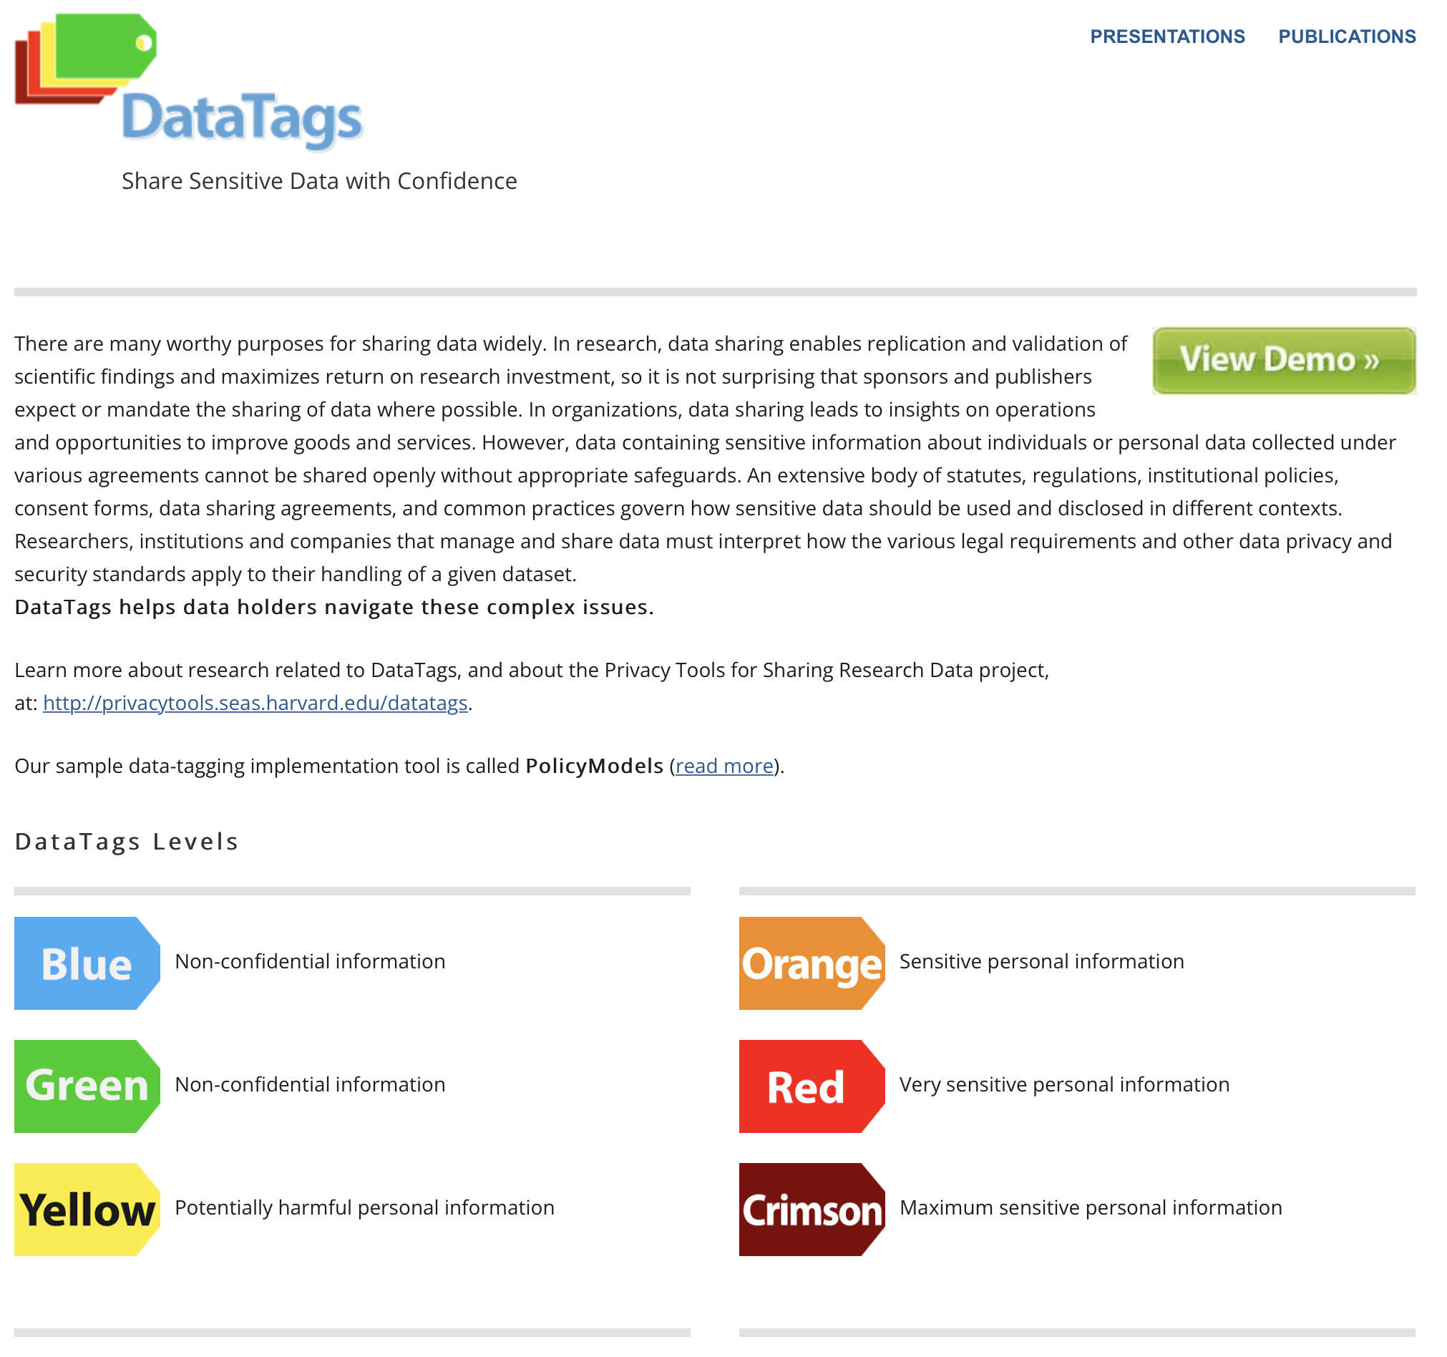
DataTags
DataTags is a framework designed to enable computer-assisted assessments of the legal, contractual, and policy restrictions that govern data sharing decisions.
The system asks a user a series of questions to elicit the key properties of a given dataset and applies inference rules to determine which laws, contracts, and best practices are applicable.
The output is a set of recommended DataTags, or simple, iconic labels that represent a human-readable and machine-actionable data policy, and a license agreement that is tailored to the individual dataset.
It is being designed to integrate with data repository software, and it will also operate as a standalone tool.
Developed at Harvard University. In Europe, DANS is working on adjusting DataTags to European legislation / General Data Protection Regulation (GDPR) (cf. DANS GDPR DataTags).

Slide 27
Open Materials
In addition to data sharing, the openness of research relies on sharing of materials. What materials researchers use is discipline-specific and sometimes unique to a lab.
Below are examples of materials you can share, although always confer with peers in your discipline to identify which repositories are used:
Reagents
Protocols
Notebooks, containers, software, and hardware
When you have materials, data, and publications from the same research project shared in different repositories, cross-reference them with a link and a unique identifier so they can be easily located.

Slide 28
Reagents
A reagents is a substance, compound or mixture that can be added to a system in order to create a chemical or other reaction.
Reagents can be deposited with repositories like Addgene, The Bloomington Drosophila Stock Center, and ATCC to make them easily accessible to other researchers.
License your materials so they can be reused by other researchers.

Slide 29
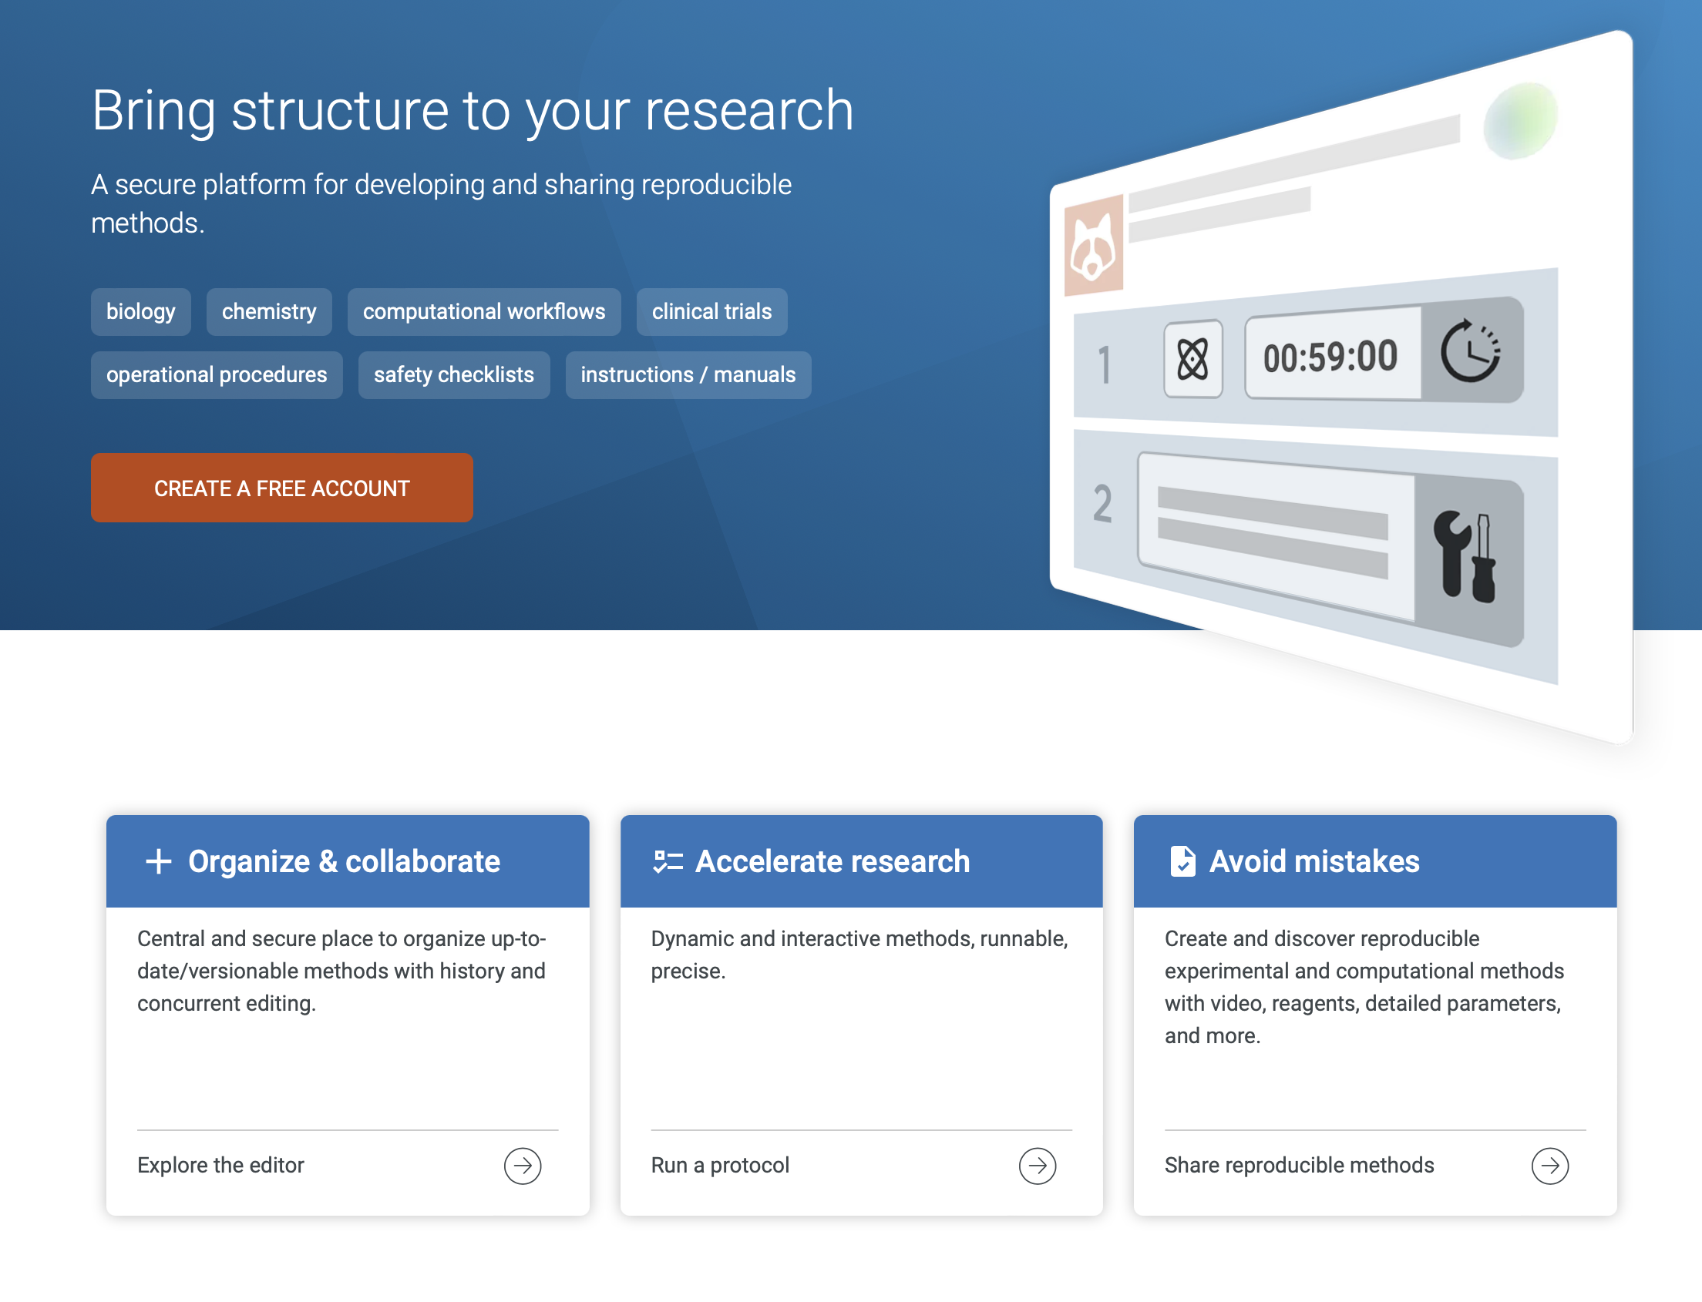
Protocols
A protocol describes a formal or official record of scientific experimental observations in a structured format. Deposit virtual protocols for citation, adaptation, and reuse using Protocols.io.
Read-only protocols should be deposited in your disciplines registry such as ClinicalTrials.gov and SocialScienceRegistry or a general registry like Open Science Framework.
Many journals, such as Trials, JMIR Research Protocols, or Bio-Protocol, will publish your protocol.

Slide 30
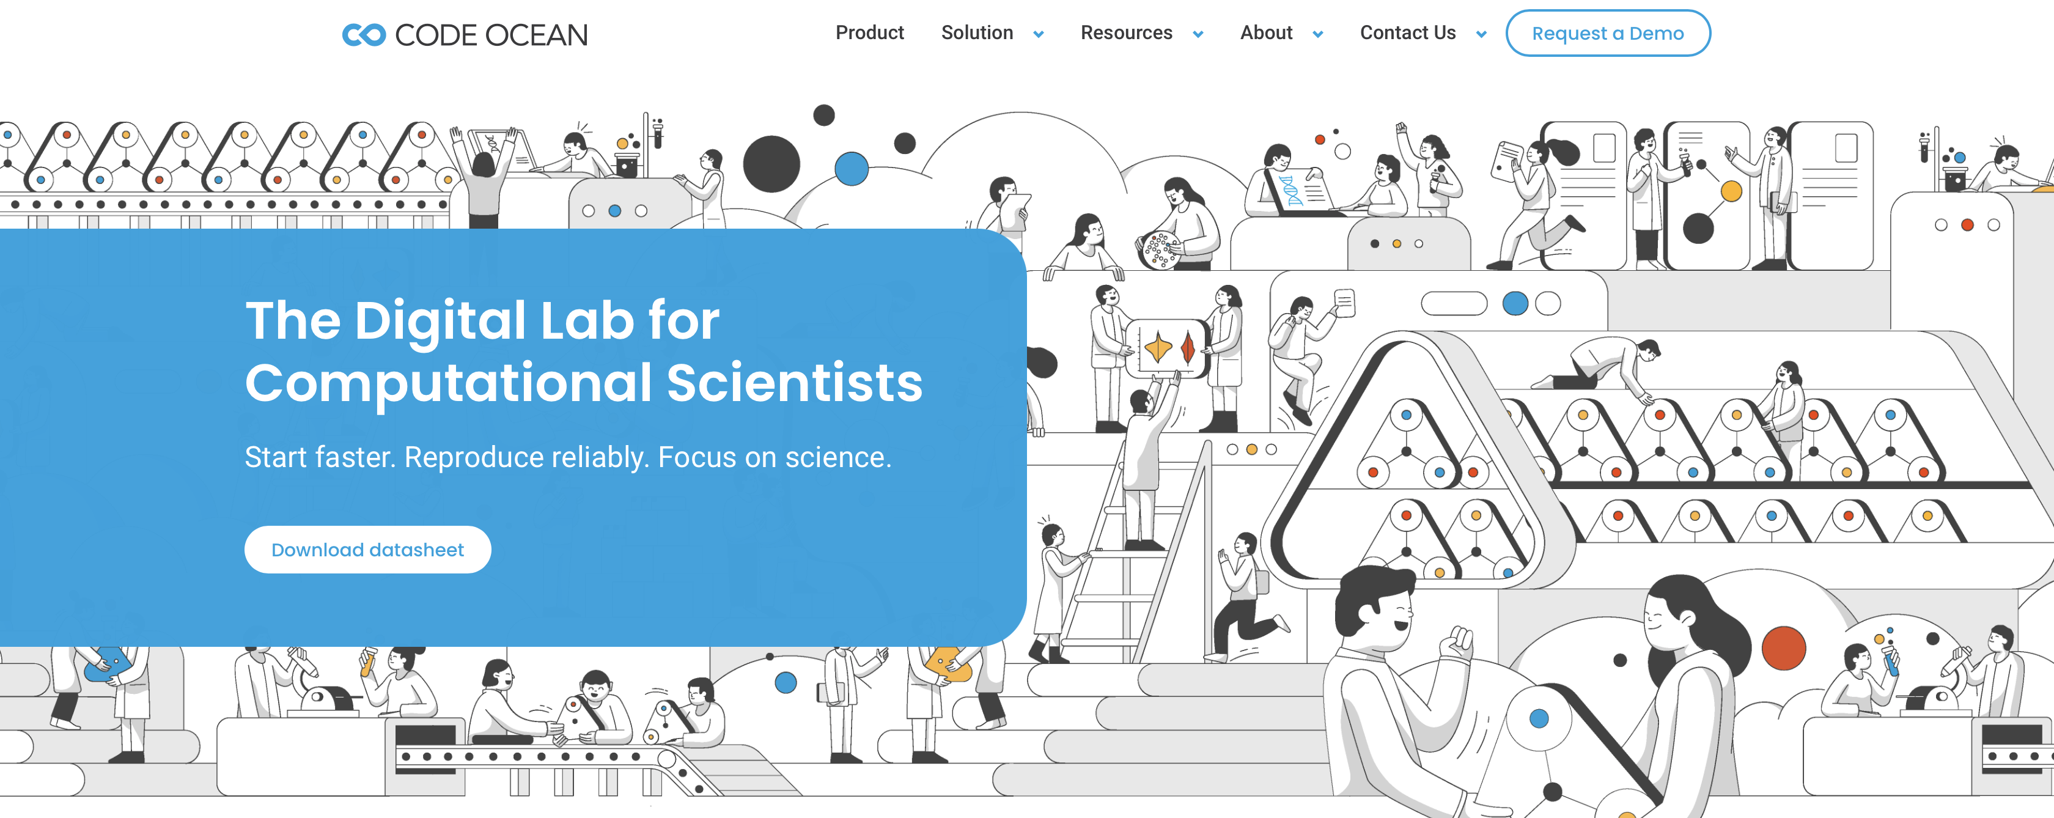
Notebooks, containers, software, and hardware
Reproducible analysis is aided by the use of literate programming, container technology, and virtualization.
Besides code and data, you can also share
Jupyter notebooks, Docker images, or other analysis materials or software dependencies.
Share notebooks with Open services such as mybinder that allow for public viewing and execution of the entire notebook on shared resources.
Containers and notebooks can be shared with Rocker or Code Ocean.
Software and hardware used in your research should be shared following best practices for documentation as outlined in Section 3.

Slide 31
Questions, obstacles, and common misconceptions
Is it sufficient to make my data openly available?
What do the FAIR principles mean/imply for different stakeholders / audiences?
Is making my data FAIR a lot of extra work?
I want to share my data. How should I license them?
I cannot make my data directly available—they are too large to share conveniently / have restrictions related to privacy issues. What should I do?

Slide 32
Question
Would you consider publishing your research data?
after completion of the project for which the data were collected
After „traditional“ publication of the results
at a later date
never

Slide 33
Learning outcomes
Understand the characteristics of open data, and in particular the FAIR principles.
Be familiar with some of the arguments for and against open data.
Be able to differentiate and address sensitive data and open FAIR data; these two categories are not necessarily incompatible.
Be able to transform a dataset into one that is sufficient for open sharing (non-proprietary format), meets the standards of the FAIR principles, and is designed for maximized accessibility, transparency and re-use by providing sufficient metadata.
Know the difference between raw and processed (or cleaned) data, and the importance of version labels.
Know commonly used file formats and community standards for maximum re-usability.
Be able to write a data management plan.

Slide 34
Further reading
Averkamp et al. (2018). Data packaging guide. github.com/saverkamp/beyond-open-data/blob/master/DataGuide.md.
Barend et al. (2017). Cloudy, increasingly FAIR; revisiting the FAIR Data guiding principles for the European Open Science Cloud. doi.org/10.3233/ISU-170824
Brase et al. (2009). Approach for a joint global registration agency for research data. doi.org/10.3233/ISU-2009-0595
Candela et al. (2015). Data journals: A survey. doi.org/10.1002/asi.23358
CESSDA Training Working Group (2017-2018a). CESSDA Data Management Expert Guide. Bergen, Norway: CESSDA ERIC. cessda.eu/DMGuide
CESSDA Training Working Group (2017-2018b). CESSDA Data Management Expert Guide: Citing your data. Bergen, Norway: CESSDA ERIC.cessda.eu/DMGuide/citingdata
FAIRsharing.org (2016). FAIR. The FAIR Principles. doi.org/10.25504/FAIRsharing.WWI10U
Force 11 (n.y.). Guiding principles for Findable, Accessible, Interoperable, and Re-usable data publishing Version B1.0. force11.org/fairprinciples
Gorgolewski et al. (2013). Making data sharing count: a publication-based solution. doi.org/10.3389/fnins.2013.00009
Kratz and Strasser (2015). Making Data Count. doi.org/10.1038/sdata.2015.39
Piwowar and Vision (2013). Data reuse and the open data citation advantage. doi.org/10.7717/peerj.175
Wilkinson et al. (2016). The FAIR Guiding Principles for scientific data management and stewardship. doi.org/10.1038/sdata.2016.18
Wilkinson et al. (2918). A design framework and exemplar metrics for FAIRness. doi.org/10.1038/sdata.2018.118

Slide 35
THANK YOU!
Follow us

