Slide 1
All materials are located here: ......... This work is licensed under the Creative Commons Attribution 4.0 International License. All images are public domain unless otherwise noted. Roma 12 – 16 September 2022
Open Science-Open Access
This module is part of
„Early Stage Researchers' Training Week ” within the project TrainRDM

Slide 2
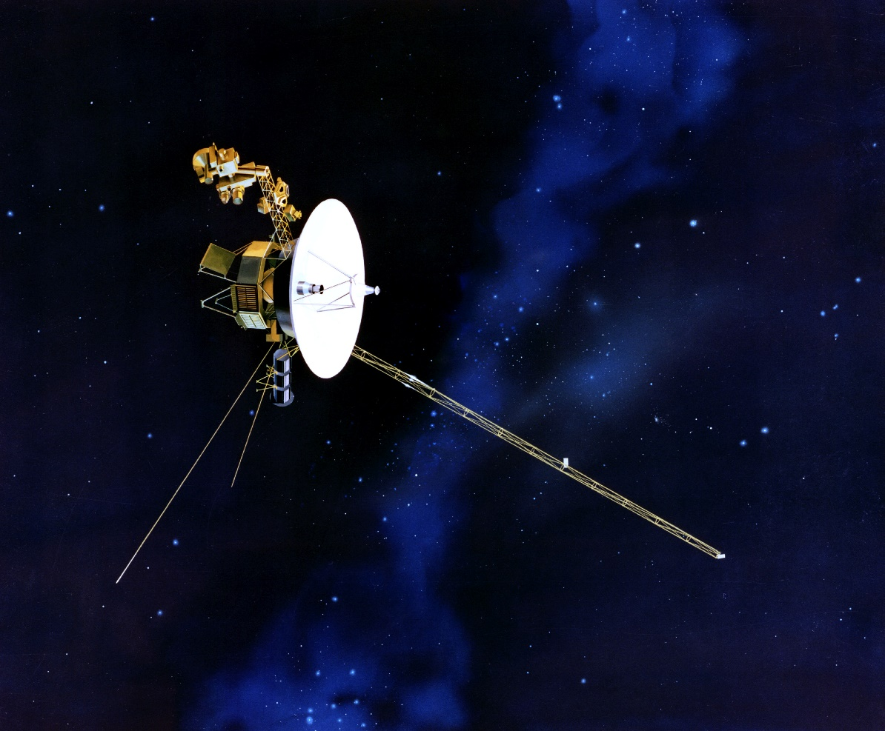
Engineers Investigating NASA's Voyager 1 Telemetry Data
https://voyager.jpl.nasa.gov/news/details.php?article_id=124
Voyager 1 is currently 14.5 billion miles (23.3 billion kilometers) from Earth, and it takes light 20 hours and 33 minutes to travel that difference.
Voyager 1's twin, Voyager 2 (currently 12.1 billion miles, or 19.5 billion kilometers, from Earth), continues to operate normally.
© NASA/JPL
Launched in 1977, both Voyagers have operated far longer than mission planners expected, and are the only spacecraft to collect data in interstellar space. The information they provide from this region has helped drive a deeper understanding of the heliosphere, the diffuse barrier the Sun creates around the planets in our solar system.

Slide 3
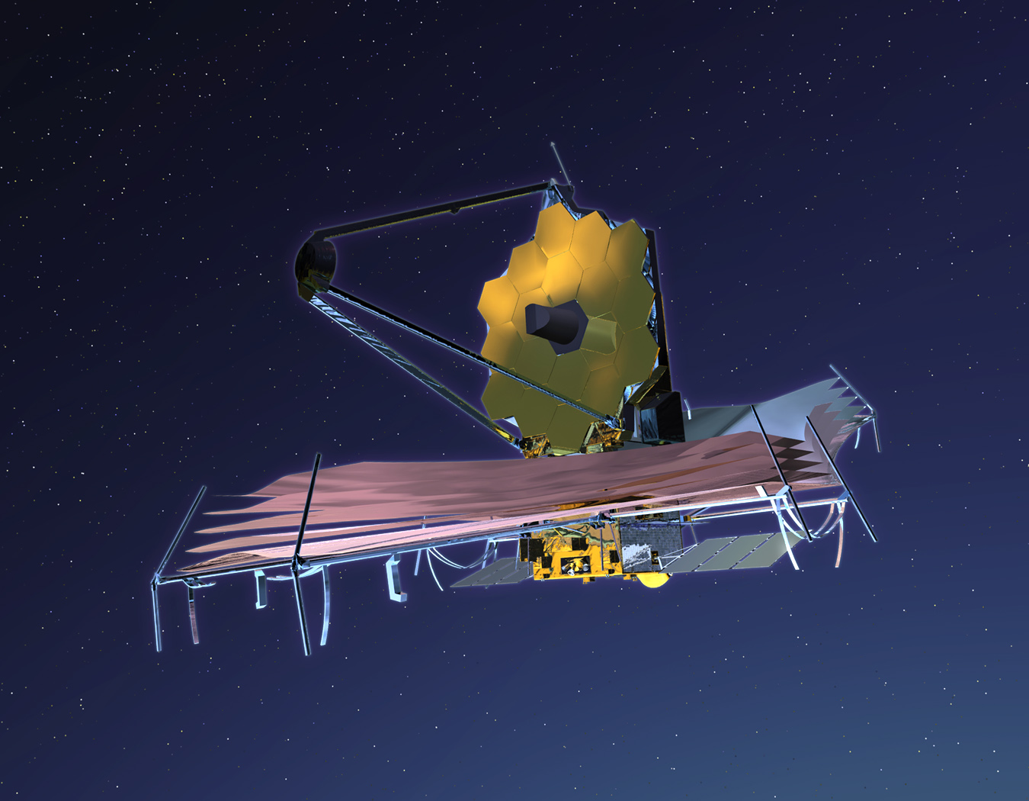
James Webb Space Telescope
The James Webb Space Telescope has been launched.
It is the largest, most powerful and most complex observatory ever launched by humans and promises to revolutionize the observation of the Universe.
It can study the light of the most distant galaxies in the universe.
It can observe the formation of new stars.
It can analyze in detail the chemical composition of the atmospheres of certain extrasolar planets (orbiting other stars and can find any signs of the presence of life on these planets.
It can photograph some extrasolar planets directly.
© NASA/JWST

Slide 4
„The City and the Stars”
Today rudimentary or sophisticated weapons are used by us for our own destruction. These tragic events support the phrase „closed as necessary” in science.
When will the end of our “childhood” come? When will this „Russian roulette” game with planet Earth stop?
What would it be like to live in a city made up only of images, data, information about the past and the future stored in databases managed and processed by supercomputers? (e.g. The City and the Stars by Arthur C. Clarke)
© Euronews
© gettyimages.com/gremlin

Slide 5
As Open as Possible and as Closed as Necessary
Science and its openness have enabled us to continuously push the frontiers of knowledge either step-by-step or through scientific breakthroughs that have revolutionized everything we knew until then.
The openness of our scientific discoveries should be unlimited in order to allow science to go further through all those who have the opportunity to discover.
Unfortunately, humanity is not mature enough to use scientific knowledge and technology only for improving our lives, surpassing our limits and protecting our planet.
The impact of science on the social world and on human nature has been limited.
We must now close certain information resulting from the scientific activity so as not to be used by those who have a different way of thinking and, therefore, undermine the principle of open use of knowledge by stating that science should be as open as possible and as closed as necessary.

Slide 6
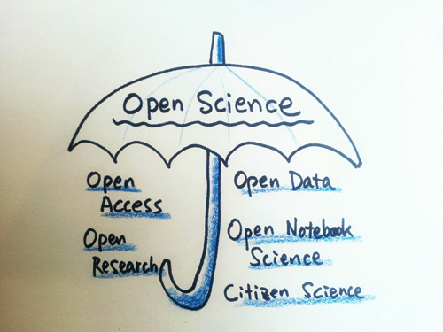
What is Open Science?
‘Open Science is an inclusive construct that combines various movements and practices aiming to make multilingual scientific knowledge openly available, accessible, and reusable for everyone, to increase scientific collaborations and sharing of information for the benefits of science and society, and to open the processes of scientific knowledge creation, evaluation, and communication to societal actors beyond the traditional scientific community’ (UNESCO, 2021, p. 7)
This Photo by Unknown Author is licensed under CC BY

Slide 7
Open Science a „Grouping of Principles and Practices”?
According to the FOSTER taxonomy, "Open science is the movement to make scientific research, data and dissemination accessible to all levels of an inquiring society." It can be defined as a grouping of principles and practices:
Principles: Open Science is about increased transparency, re-use, participation, cooperation, accountability and reproducibility for research. It aims to improve the quality and reliability of research through principles like inclusion, fairness, equity, and sharing. Open Science can be viewed as research simply done properly, and it extends across the Life and Physical Sciences, Engineering, Mathematics, Social Sciences, and Humanities (Open Science MOOC).
Practices: Open Science includes changes to the way science is done - including opening access to research publications, data-sharing, open notebooks, transparency in research evaluation, ensuring the reproducibility of research (where possible), transparency in research methods, open source code, software and infrastructure, citizen science and open educational resources.
A note on language: As the English word "science" traditionally does not include the humanities and social sciences, more explicitly inclusive terms like “open scholarship” or “open research” are often used. As “Open Science” is the more common term, we shall use it here, but it should be read as referring to research from all scholarly disciplines.

Slide 8
Open Science „a Core Value of Modern Science” ?
Open Science to the Rescue? Open Science is presented as a policy strategy to achieve better and more efficient scientific knowledge, as well as closer citizen participation in the scientific process.
Openness is also frequently portrayed as a core value of modern science, with an almost mandatory appeal to Robert Merton’s ethos of science (Schroeder, 2007). According to Merton’s rule of communism or communalism, “The substantive findings of science are a product of social collaboration and are assigned to the community,” making secrecy “the antithesis of this norm” (Merton, 1974: 271).
The ideal of Open Science is thus aligned with the traditional scientific ethos, only to be further supported by the ICT revolution. In other words, Open Science policies in the 21st century would instantiate the scientific value of communalism granting access through different types of ICTs, such as open access journals (e.g., PLOS), open electronic archives (e.g., arXiv), collective intelligence projects (e.g., Polymath), public computing projects (e.g., Rosetta@home), citizen science projects (e.g., the Galaxy Zoo Project), collaborative research environments (e.g., Open Science Grid), academic social networks (e.g., ResearchGate and academica.edu), and social reference managers (e.g., Mendeley and Zotero), among others

Slide 9
Purpose of the Training Course
"When all researchers are aware of Open Science, and are trained, supported and guided at all career stages to practice Open Science, the potential is there to fundamentally change the way research is performed and disseminated, fostering a scientific ecosystem in which research gains increased visibility, is shared more efficiently, and is performed with enhanced research integrity." Open Science Skills Working Group Report Hand Book (2017)
Open Science, the movement to make scientific products and processes accessible to and reusable by all, is about culture and knowledge as much as it is about technologies and services. Convincing researchers of the benefits of changing their practices, and equipping them with the skills and knowledge needed to do so, is hence an important task. Hand Book (2017)

Slide 10
Open Science Training Course Development
The eight pillars of Open Science identified by the European Commission* and used by LERU** in their advice paper on Open Science (OS) and the role of universities „A Roadmap of cultural change”:
1/ The future of scholarly publishing
2/ FAIR data
3/ The European Open Science Cloud (EOSC)
4/ Education and skills
5/ Rewards and incentives
6/ Next-generation metrics
7/ Research integrity
8/ Citizen science
The Eight Pillars of Open Science

Slide 11
Open Science Training Course Development
„An Operational OS Approach” given by FOSTER, which describes the topics of each OS theme in a detailed taxonomy:
https://www.fosteropenscience.eu/foster-taxonomy/open-science-tools
Open Science
Research Data Management
Legal Issues
Text And Data Mining
TDM Methods
Research Workflow
RRI

Slide 12
Structure Proposed for the TrainRDM Toolkit
Data Management
TU VIENNA
Open Science
UPB
Ethics, Data Governance & Compliance
NCI
Open Innovation
LA SAPIENZA
Research Project
ALL PARTNERS
Fig.1. The five pillars of TrainRDM training

Slide 13
Open Science Taxonomy
https://www.fosteropenscience.eu/resources

Slide 14
Organisation of the Training Course
This training course is designed in a modular way.
Day 1 - „Open Science Basics”. The topics pertaining to Open Science are presented and explained in this part of the course
Day 2 - Ethics, Data Governance & Compliance
Day 3 - Open Innovation for HEIs
Day 4 - Research project: Reproducible science using Jupyter Notebooks; The FAIR Principles; Introduction into Data Management Planning
Day 5 - Research project: Reproducible science using Jupyter Notebooks; Persistent Identifiers in the Research Context; Discussion of research projects for researchers’ training weeks
The exercises will give practical insight about theoretical topics or provide feedback from the participants.

Slide 15
Knowledge & Skills
Open Science is the movement to help make the results of scholarly research more accessible, including code, data, and research papers.
It encompasses many different but often related aspects impacting the entire research lifecycle, including open publishing, open data, open source software, open notebook science, open peer review, open dissemination, and open materials (see glossary for definitions).
History of Open Science, and the motivations behind the movement.
The origins of academic publishing began in the 17th century with the first academic journals.
Increasing motivation to share resources between research disciplines, as well as increased transparency for greater efficiency, rigour, accountability, sustainability for future generations, and reproducibility.
Ethical cases whereby increased transparency can reduce fraud, data manipulation, and selective reporting of results.
Notes:
.

Slide 16
Knowledge & Skills
Present state arose from pressure from research academies and governments for publicly-funded research to be shared more openly, often for the purpose of accelerated societal or economic growth and innovation.
Publicly funded research outputs should be publicly available.
Need to drive cultural change in research and amongst researchers.
Embracing of Web-based tools and technologies to facilitate scientific collaboration.
Differences and commonalities within Open Science practices, principles and communities.
It is generally accepted that Open Science leads to increased impact associated with wider sharing and re-use (e.g., the so-called „open access citation advantage”).
Open Science could increase trust in science and in the reliability of scientific results.
Open Science and relations to licensing, copyright issues.
Typically, open research outputs are openly licensed in order to maximize re-use while allowing the creator to retain ownership and receive credit for their work.

Slide 17
Questions, Obstacles, and Common Misconceptions
Q: "What is the difference between Open Science and ‘science’?"
A: Open Science refers to doing traditional science with more transparency involved at various stages, for example by openly sharing code and data. Many researchers do this already, but don’t call it Open Science.
Q: "Does ‘Open Science’ exclude the Humanities and Social Sciences?"
A: No, the term Open Science is inclusive. Indeed, the case is that sometimes Open Science is more broadly referred to as ‘Open Research’ or ‘Open Scholarship’ to be more inclusive of other disciplines, principles and practices. However, Open Science is a commonly used term at multiple levels and so it makes sense to adopt it for communication purposes, with the proviso that it includes all research disciplines.
Q: "Does Open Science lead to misuse or misunderstanding of research?"
A: No, the application of Open Science principles is in fact a safeguard against misuse or misunderstanding. Transparency breeds trust, confidence and allows others to verify and validate the research process.
Q: "Will Open Science lead to too much information overload?"
A: It is better to have too much information and deal with it, than to have too little and live with the risk of missing the important parts. And there are technologies such as RSS feeds, machine learning and artificial intelligence that are making content aggregation easier.

Slide 18
Open Access vs Open Research
Open Access (OA) refers to all electronic resources that are made widely available on the internet without licensing and copyright restrictions. Open Access resources can include articles, journals, books, conference proceedings, theses, videos, music
Open access (OA) meant the free, immediate, online availability of research outputs such as journal articles or books, combined with the rights to use these outputs fully in the digital environment. OA content is open to all, with no access fees.
Open research goes beyond the boundaries of publications to consider all research outputs – from data to code and even open peer review. Making all outputs of research as open and accessible as possible means research can have a greater impact, and help to solve some of the world’s greatest challenges.
https://www.springernature.com/gp/open-research/about/the-fundamentals-of-open-access-and-open-research

Slide 19
Open Access is More than Free Access
When people think about open access (OA), to knowledge resources they immediately relate it with free access. And yes, free access is an important asset of open access publications.
However, there is more to open access, which is especially worthwhile when you consider to publish open access yourself. According to the Open Definition “knowledge is open if anyone is free to access, use, modify, and share it”,
3 features of OA has to be highlighted:
free access is an important asset of open access publications
providing reuse rights is another important asset of open access and
a third feature of OA is that the author of an open access publication holds copyright on it instead of transferring all rights to the publisher.

Slide 20
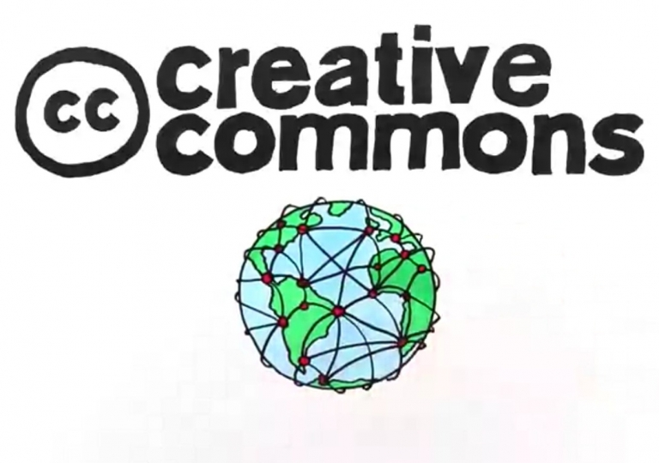
Open Access is More than Free Access
Keeping copyright on a publication means that you as an author can do anything with the publication without having to seek for permissions. You can republish it on a personal website, in a repository, such as Staff Publications, as a chapter in a PhD thesis, use it in a course and distribute it to all course members, or reuse and modify parts of it. However, when others want to reuse your paper, they need to ask your permission, except when you provided your publication with a Creative Commons license.
Creative Commons licenses give everyone from individual creators to large institutions a standardized way to grant the public permission to use their creative work under copyright law. From the reuser’s perspective, the presence of a Creative Commons license on a copyrighted work answers the question, “What can I do with this work?”
This Photo by Unknown Author is licensed under CC BY

Slide 21
The Movement Named Open Access
Rationale
One of the most common ways to disseminate research results is by writing a manuscript and publishing it in a journal, conference proceedings or book.
However, at the turn of the 21st century a new movement appeared with a clear objective: make all the research results available to the public without any restriction. This movement took the name of Open Access and established two initial strategies to achieve its final goal:
The first: to provide tools and assistance to scholars to deposit their refereed journal articles in open electronic repositories with the self-archiving practices: researchers depositing and disseminating papers in institutional or subject based repositories.
The second: to launch a new generation of journals using copyright and other tools to ensure permanent open access to all the articles they publish with the creation of the open access journals that provide free access to readers and allow reuse of their contents without almost any restriction.
A new OA approach stablished in the Budapest Open Access Initiative in 2002: the growth of new methods of dissemination: the publication of preprints through institutional repositories and preprint servers.
Preprints are documents that have not been peer reviewed but are considered as a complete scientific publication in a first stage. Some of the preprints servers include open peer review services and the availability to post new versions of the initial paper once reviewed by peers.
Issue: The choice of a journal or a publishing platform may affect the availability and accessibility of the research results. There are several options for researchers when deciding where, when, and how to publish their findings. It is fundamental to know all the implications to avoid future problems.

Slide 22
Open Access to Published Research Results and the Main Routes
Open access is a publishing model for scholarly communication that makes research information available to readers at no cost, as opposed to the traditional subscription model in which readers have access to scholarly information by paying a subscription (usually via libraries). At the very least, the publications (articles and books) can be read online, downloaded and printed. Ideally, additional rights such as the right to copy, distribute, search, link, crawl and mine should also be provided
Open Access can be realised through two main non-exclusive routes:
Green Open Access (self-archiving): The published work or the final peer-reviewed manuscript that has been accepted for publication is made freely and openly accessible by the author, or a representative, in an online repository. Some publishers request that Open Access be granted only after an embargo period has elapsed. This embargo period can last anywhere between several months and several years. For publications that have been deposited in a repository but are under embargo, usually at least the metadata are openly accessible.
Gold Open Access (Open Access publishing): The published work is made available in Open Access mode by the publisher immediately upon publication. The most common business model is based on one-off payments by authors (commonly called APCs – article processing charges – or BPCs – book processing charges). Where Open Access content is combined with content that requires a subscription or purchase, in particular in the context of journals, conference proceedings and edited volumes, this is called hybrid Open Access.

Slide 23
Repositories and Self-archiving
More than 4600 repositories are available for researchers to self-archive their publications according to the Registry of Open Access Repositories.
These are: institutional repositories or CRIS, subject based or thematic repositories. Repositories have always been seen as an alternative way to access to scientific publications when accessing to the original source is not affordable. Currently there are tools like the Unpaywall browser extension that facilitates this alternative.
The jourrnal policy regarding the transfer of copyright (will be explain) and some uses already granted has to be known when choosing a journal to publish research results. Among those granted uses it can find teaching purposes, sharing with colleagues, and especially how researchers can self-archive their papers in repositories.
When looking at the self-archiving conditions it must identify two key issues: the version of the paper that can be deposited and when it can be publicly available.
The journal can allow for the submitted version, also known as preprint, to be disseminated, and also its replacement for a reviewed version once the final paper has been published. Due to the increase of policies requiring access to research results, most of the journals allow to deposit the accepted version of the paper, also known as the author manuscript or postprint. The postprint is the final text once the peer review process has ended but it has not the final layout of the publication. Finally some journals allow researchers to deposit the final published version, also known as the Version of Record.

Slide 24
Repositories and Self-archiving
https://open-science-training-handbook.github.io/Open-Science-Training-Handbook_EN/02OpenScienceBasics/05OpenAccessToPublishedResearchResults.html

Slide 25
Repositories and Self-archiving
Repositories and self-archiving (2)
In relation to the moment to make the paper publicly available, many journals establish a period of time from its original publication: the embargo period, which can range from zero to 60 months. Some journals include or exclude embargoes depending on the versions. For instance the accepted version could be made publicly available after publication but the published version must wait 12 m onths.
Regarding self archiving, researchers are confused by the different requirements established by the publishers in relation with version of a paper that they can deposit in a repository and when this version can be available to the public. This delay in allowing public access to the full text is often called embargo period and it is not uniform for all the journals. Institutions who provide a repository for its researchers should facilitate self archiving practices by digesting all those publisher requirements.

Slide 26
Open Access Publishing
Journals
The number of Open Access Journals has increased during the last years becoming a real option for researchers when deciding where to publish their findings. According to the Directory of Open Access Journals (DOAJ), currently there ar
Nevertheless is important to remark that an open access journal must provide free access to its contents but it also must license them to allow reusability. No legal notice must be legally understood „as all rights reserved” more than 11,000 journals. Although the definition of an open access journal does not include any condition about the business model, there is a fact that those journals are commonly known as journal where you have to pay to publish.
Currently many paywalled journals offer individual open access options to researchers once the paper is accepted after peer review. Those options include the publication under a free content license and free accessibility to anyone since its first publication. This model is commonly known as the hybrid model because in the same issue of a journal, readers can find open access and paywalled contributions. Usually publishers ask for a fee to open individual contributions. Free content license and free accessibility to anyone since its first publication.

Slide 27
Open Access Publishing
Books
Some disciplines prefer to use other formats than journals to publish results, for instance books. Initially, publishers were very reluctant to allow researchers to self archive a full book or even a book chapter. However, some publishers have begun to adopt policies to facilitate it. On the other hand, some university presses have shifted their publication model to open access to increase the visibility of their contents, especially monographs. This change can be explained as an answer to the cuts in some of the expenditures in monographs due to the restrictions in library budgets. A common model for this open access university presses is to provide a free version in PDF and sell paper or e-pub versions (see for instance UCL). Moreover, the creation of the Directory of Open Access Books have increased their discoverability. In a similar way than other journal initiatives, there have appeared some projects to join forces to establish a common fund to build open access monographs, for instance Knowledge Unlatched.

Slide 28
Types of Open Access
https://oaaustralasia.org/2021/05/25/what-are-the-different-types-of-open-access/
https://peerj.com/articles/4375/
A. Self achieving
Repository-based or “Green” open access(self-archiving)
B. Open Access Publishing
Journal-based or “Gold” Open Access. (Open Access publishing):
“Diamond” Open access. ...
“Hybrid” open access. ...
“Bronze” open access. ...
“Black” open access. ...

Slide 29
Creative Commons License
When you publish a paper as an Open Access publication, the publisher might use a standard CC licence (e.g. PLoS), or gives you a choice of three or more Creative Commons licenses (e.g. Wiley).
A Creative Commons license is a way to give permission for reuse in advance. They are commonly used in OA publishing. There are six different Creative Commons licenses (type description, how to choose) : CC BY, CC BY-SA, CC BY-NC, CC BY-ND, CC BY-NC-SA, CC BY-NC-ND. The most open license is the license CC BY which allows the user to redistribute, to create derivatives, such as a translation, and even use the publication for commercial activities, provided that appropriate credit is given to the author and that the user indicates whether the publication has been changed. Another open license is CC BY-SA in which the letters SA (share alike) indicate that the derivative work should be shared under the same reuse rights, so with the same CC license. Adding the conditions only non-commercial use (NC) and/or no derivative works (ND) makes the Creative Commons licenses more restrictive and therewith less open
If you have a choice, it would be to avoid any license with a non-commercial restriction in it, because in practice the term commercial turns about to be very vague and confusing. For scientific articles, it don’t see a reason for the clause No Derivatives, unless if you want to be notified and asked for permission when somebody intends to translate your paper. I am in favour of the most open license: CC BY, because it allows unrestricted use of the publication in all forms of education including MOOCs.

Slide 30
Defining Open Access for Journals
A truly Open Access article is an immediately free, online article with reuse rights. However, between open and closed access papers, a whole range of articles exist with different degrees of openness.
Open Access shifts the costs of publishing so that readers, practitioners and researchers obtain content at no cost. However,Open Access is not as simple as “articles are free to all readers.” Open Access encompasses a range of components such as readership, reuse, copyright, posting, and machine readability.
Open Access encompasses a range of components such as readership, reuse, copyright, posting, and machine readability. Within these and funding agencies have adopted many different policies, some of which are more open and some less open
Journals can be more open or less open, but their degree of openness is intrinsically independent from their:
When choosing a journal to publish research results, researchers should take a moment to read the journal policy regarding the transfer of copyright. Many journals still require for publication that authors transfer full copyright. This transfer of rights implies that authors must ask for permission to reuse their own work beyond what is allowed by the applicable law and unless there are some uses already granted. Among those granted uses we can find teaching purposes, sharing with colleagues, and especially how researchers can self-archive their papers in repositories. Sometimes there a common policy among all the journals published by the same publishers but in general journals have their own policy, especially when they are published on behalf of a scientific society.
If you want to know more I recommend the guide HowOpenIsIt? (PLoS/SPARC, 2014) for a concise overview of all the shades of open access.
This guide will help you move beyond the seemingly simply question, “Is this journal Open Access?” and toward a more productive alternative, „How OpenISIT” https://www.plos.org/files/HowOpenIsIt_English.pdf
Impact
Prestige
Quality of Peer Review
Peer Review Methodology
Article Quality
Sustainability
Effect on Tenure & Promotion

Slide 31
Defining Open Access for Journals
HowOpenIsIt?
https://www.plos.org/files/HowOpenIsIt_English.pdf

Slide 32
Categories of OA Publishing Deals
Transformative agreements - attempt to shift our spending on scholarly resources away from a subscription model of access towards open access publishing. Other names for them are read-and-publish deals, publish-and-read deals or transitional agreements
Read-and-publish deal - the publisher is paid so that one can read their articles and publish articles in their journals. Publishing costs are brought together in a single contract, which means authors don’t have to pay article processing charges (APCs) in an ad hoc manner when choosing to publish open access
Publish and read deals - we pay the publisher to publish articles with them, and access to articles is included in that cost
repository-based or “green” OA- when the author accepted version of a published work is deposited into a subject-based repository or an institutional repository
journal-based or “gold” open access - refers to publishing in a fully open access scholarly journal, one where the publisher of the journal provides free and immediate online access to the full content of the journal and the final published versions of articles in that journal are fully open access
“diamond” open access – refers to open access journals that are free for readers to access and for authors to publish in. These journals are often community-driven and supported by institutions or by national or regional infrastructure
hybrid open access - an article processing charge is paid for an individual journal article to be made open access in an otherwise subscription journal. This type of open access always has an APC associated with it and these APCs are usually higher than for fully open access journals. Universities and research-performing organizations are their own policy regarding Hybrid open access, they may not be in favour or supportive of such an open access
“bronze” open access - refers to a freely available journal article that has no open license (and hence cannot be considered fully open access)
“black open access” - illegal open access

Slide 33
Learning Objectives
Learn about the different options a researcher has when deciding where to publish a paper, including funder requirements.
Be able to decide if a paper can be published before peer review, for example in a preprint server. Trainees will learn how to determine which options they have according to their disciplines/journal policies, and if there would be consequences afterwards that might jeopardize final publication in a peer-reviewed journal.
Trainees will learn how to discover the differences between policies of peer-reviewed journals, particularly when submitting something available as a preprint. They will learn the differences among open-access journals, such as which require a fee for submission/publication and which licenses they use.
Trainees will learn about the implications of publishing in paywalled journals for future self-archiving in a repository, and the publisher requirements in terms of version and embargo. Trainees will also learn about hybrid open-access journals.
(optional depending on audience) Trainees will learn about open-access opportunities when publishing in books, since this is the main avenue of dissemination for some disciplines.
Trainees will learn about different business models used by open-access journals, and opportunities for obtaining funds to support publishing if needed.

Slide 34
Questions, Obstacles, and Common Misconceptions
Q: "If I publish my work as a preprint, it won’t be acknowledged - I will only receive credit for a peer-reviewed journal article."
A: Many funders are acknowledging the growing presence of preprint publishing in their policies: Howard Hughes Medical Institute (HHMI), Wellcome Trust, the Medical Research Council (UK) and the National Institutes of Health (NIH) announced policies allowing researchers to cite their own preprints in grant applications and reports (Luther 2017). In addition, preprints help establish priority of results and may increase the impact - and citation count - of a later peer-reviewed article (McKiernan 2016).
There are still some researchers reluctant to deposit other versions than the final published version. It is important to inform them about the copyright implications when they sign a transfer document.
Avoid the misconception of understanding an open-access journal as a journal where authors must pay to publish. The author-pay model is just one of the existing business models for an open-access journal. You might show data about the number of journals that do not ask for a publication fee (for example, as of 31 January 2018, DOAJ reports that 71% of the 11,001 open-access journals listed require no publishing charge). You may want to show other business models like the SCOAP3 Initiative, the LingOA project, or the Open Library of Humanities.
The use of publishing platforms has implications for research evaluation, the peer-review process, and the role of publishers. There are still many research assessments based on journal metrics and therefore this new way of publishing challenges those evaluations. Moreover the fact that peer review is completely transparent allows readers to identify reviewers and track the versioning of the paper. Finally, if those platforms become the common tool to publish results, publishers would need to redefine their role in the scholarly communication process.
The hybrid model is very controversial and it could raise a lot of questions about the costs, possible double-dipping, and the use (or lack) of licensing.
You may discuss the future of the scholarly communication by presenting some of the offsetting models or transition projects like OA2020 global alliance proposed by the Max Planck Society.

Slide 35
References
FOSTER. (2018). The Open Science Training Handbook https://github.com/Open-Science-Training-Handbook/Open-Science-Training-Handbook_EN
Masuzzo, P., & Martens, L. (2017). Do you speak open science? Resources and tips to learn the language. PeerJ Preprints, 5, e2689v2681. https://doi.org/10.7287/peerj.preprints.2689v1
United Nations Educational Science and Cultural Organization. (2021). Intergovernmental Meeting of Experts (Category II) Related to a Draft UNESCO Recommendation on Open Science. https://en.unesco.org/science-sustainable-future/open-science/recommendation
Watson, M. (2015). When will ‘open science’ become simply ‘science’? Genome Biology, 16(1), 101. https://doi.org/10.1186/s13059-015-0669-2

Slide 36
Thank you for your attention!

