Slide 1
Day 3, Topic 1 Data Governance and Management This module is part of the training session “Train for trainers” within project TrainRDM
National College of Ireland, Dublin Ireland
This work is licensed under the Creative Commons Attribution 4.0 International License.
All images are public domain unless otherwise noted.

Slide 2
Introduction, Concepts, Rationale
Part I

Slide 3
Aims of presentation
Provide overview of DGM section of Data Governance and Ethics module (normally 6 contact hours)
Introduce DGM Concepts and Definitions
Provide DGM Rationale and Goals
Show strategic overview of DGM (who, how, what etc)
Illustrate DGM building blocks
Roles and responsibilities
Operating Model
Explain implementation method (using Ladley model)
Consider DGM in a research organisational context
Consider how to get getting your students involved with DGM

Slide 4
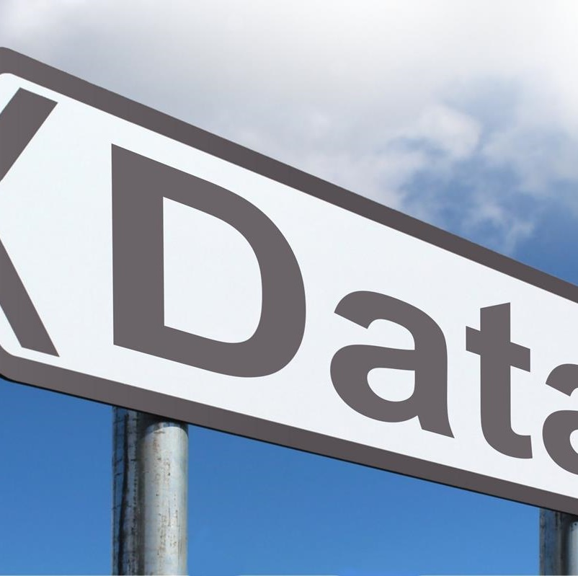
2.1.1 Module aims and objectives
This module aims to provide learners with the knowledge and skills around the complex issues of data management and governance in an organisational context, including ethical and compliance issues that these present. Learners will explore the ethical, legal, and social implications of using data-driven technologies such as big data, analytics, internet of things, and machine learning. The students will learn how to establish processes and systems that consider best practices for data governance and adhere to ethical and regulatory requirements for data handling.
This Photo by Unknown Author is licensed under CC BY-SA

Slide 5
2.1.2 Minimum intended module learning outcomes
LO1 Demonstrate critical understanding of the governance and regulatory frameworks associated with the key data lifecycle stages for an effective management of data assets.
LO2 Demonstrate critical awareness and interpretation of the data privacy and data protection regulatory landscape in socio-technical environments.
LO3 Critically analyse and evaluate the main ethical, legal, and social implications of using data-driven technologies.
LO4 Investigate and appraise the interplay of fairness, accountability, and transparency in algorithmic decision-making systems and demonstrate awareness of technical solutions to enhance these concerns.

Slide 6
Sources and resources
DAMA International (2017). DAMA-DMBOK: Data Management Body of Knowledge (2nd ed.). Technics Publications. [ISBN:978-1634622349].
Ladley, J. (2019). Data governance: How to design, deploy, and sustain an effective data governance program. Academic Press.
Smallwood, R. F. (2019). Information Governance: Concepts, Strategies and Best Practices. Wiley. [ISBN: 978-1119491446].

Slide 7
Overview of DGM section
Topic | Lecture Topic | Lecture Detail
1 | Data Governance and Data Management I | Data governance and data management; Data management principles; Data lifecycle; Data quality; Data provenance; Data integrity and security
2 | Data Governance and Data Management II | Data governance frameworks; Data governance within the DAMA Wheel; Policies, principles, rules, procedures, and standards; Data governance operating models and tools
3 | Data Governance and Data Management III | Roles and responsibilities; Maturity levels; Ladley’s 8-phase implementation process for data governance; Data risk identification and management

Slide 8
What do we mean by corporate governance?
Corporate governance is the structure of rules, practices, and processes used to direct and manage a company.
A company's board of directors is the primary force influencing corporate governance.
The basic principles of corporate governance are accountability, transparency, fairness, and responsibility.
Corporate governance goes beyond day-to-day management by considering for instance ethical behavior, corporate strategy and risk management.
Bad corporate governance can cast doubt on a company's operations and its ultimate profitability.
Directors
Owners
Management
Corporate Governance Definition: How It Works (investopedia.com)

Slide 9
Strategic Overview
Part II

Slide 10
Data Governance: What?
Data governance (DG) is the process of
managing the availability, usability, integrity and security of the data in enterprise systems,
based on internal data standards and policies that also control data usage.
What
How
Source: https://www.techtarget.com/

Slide 11
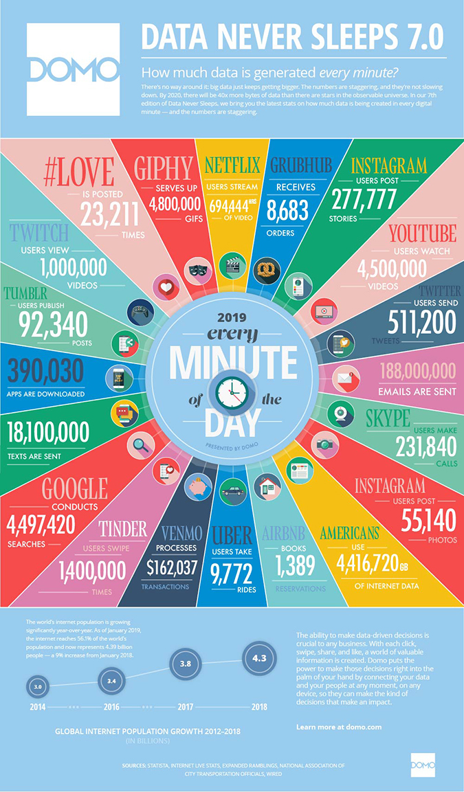
“Rust never sleeps”
Data
The amount of data in the world is estimated to double every 18-24 months
How much of it is used (or useful?)
In 2019, every internet minute saw
4.5 million Google searches
55,000 Instagram posts
694,000 Netflix streams
4.5 million YouTube views
Enormous increase in corporate data
Source: https://www.domo.com/learn/data-never-sleeps-7

Slide 12
Data growth and the need for corporate governance
More data presents opportunities for organisations to improve…
Business intelligence
More efficient and better-quality control in manufacturing and service delivery
More effective provision of supports within organizations such as planning, IT etc
Customer relationship management
Strategic and business planning
… but also to higher risks from …
Data losses and data breaches leading to loss of reputation and financial losses including fines
Threats of hacking, ransomware, system failure
Existential threats to business models from competitors

Slide 13
Example of poor corporate and research data governance
https://www.theguardian.com/uk-news/2020/sep/24/cambridge-analytica-directorship-ban-alexander-nix?CMP=Share_AndroidApp_Other
https://www.penguinrandomhouse.com/books/604375/mindfck-by-christopher-wylie/

Slide 14
Some examples of goals that a DG programme might seek to achieve
Data Governance: Why?
Improve strategic direction of organisation
Get better value out of customer and client information
More effective operational processes
Reduce costs by removing duplicated effort in data collection and maintenance
All for better data analysis and better decisions
Reduce organisational friction
Set clear data responsibilities between different business and support areas
Protect the needs of various data stakeholders within and without organisation
Ensure organisational accountability and compliance
Improve organisational capacity to address data issues through education and trainings
Allow for transparency by adoption of standard, repeatable data processes

Slide 15
Data Governance: How?
Effective data governance operates through policies, standards and tools that seek to
Facilitate and improve the internal and external communication about data
Provide for the identification and minimization of data-related risks
Establish and control internal rules for data use
Ensure the implementation of industry, national or international compliance requirements
Set data rules
Maintain data discipline
Expect consequences

Slide 16
Data Governance vs Data Management
Data Management is the process of gathering, storing, organizing and maintaining data created and collected by an organization.
Data Governance determines the overall practice of data management. It is regarded as the “management of data management” and envisages a separation between those governing and those managing
“Doing things right” vs “Doing the right thing”
Even if an organisation has no specific Data Government practices, things still get done. But are the right things being done?
The issue is whether a clear structure and roles need to defined through agreed policies, operational processes and procedure
Why the importance of documenting what these are?
Induction and training of staff
Accountability and audit
External consumption (media, regulators)
separation between those governing and those managing (Illustration from Ladley)

Slide 17
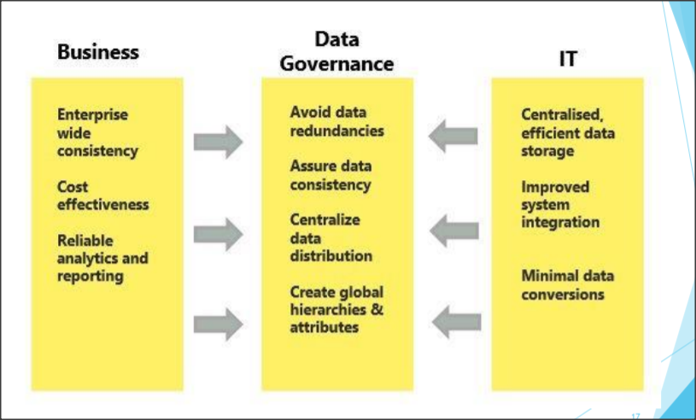
Data Governance as partnership
DG requires a partnership between business and IT to
Provide an effective and consistent means of distributing data to those who need it for business purposes
Calibrate and empower access to appropriate use of data
Providing quality assurance about data
Avoid retaining or gathering redundant data

Slide 18
Data Governance should be business led with IT input not the other way around
Data Governance should be business led with IT input not the other way around
Like other management processes, it must balance strategic and operational needs.
This balance can best be struck by following a set of principles that recognize salient features of data management and guide data management practice.
An organisations management should start with identifying its data principles that might include
Effective data management requires leadership commitment
Data is an asset that needs to be planned and accounted for like other assets
Managing data includes managing the risks associated with data not just the opportunities
Data management requires an organisation-wide perspective that must drive Information Technology decisions, not the other way around

Slide 19
Data management knowledge areas
Data governance enables an organization to determine proper action regarding data and data processing, clear definitions, decision making rights and responsibilities and then escalation path or mediation process where issues arise.
The Data Governance function guides all other data management functions.
DG includes the people, processes and technologies required to ensure good quality data, its effective management and overall governance
These can be grouped in a number of knowledge areas
Should reflect the organisational circumstance; not a case of “one size fits all”.

Slide 20
DGM Building Blocks
Part III

Slide 21
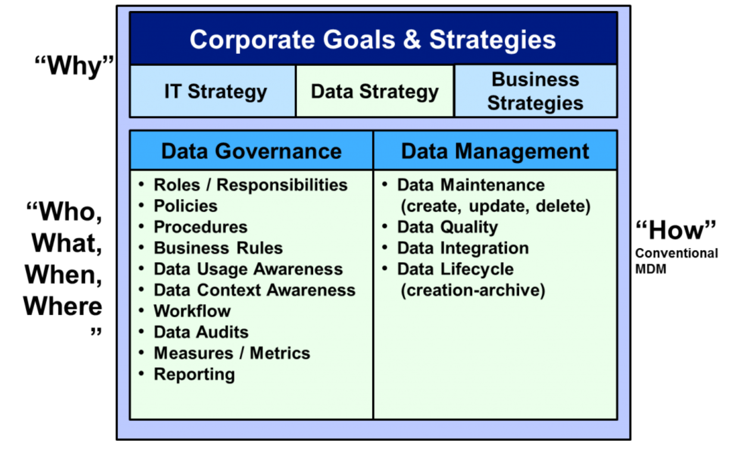
Data Strategy
A strategy is “a set of choices and decisions that together chart a high-level course of action to achieve high-level
goals. … A strategic plan is a high-level course of action to achieve high-level goals.” (DMBOK)
“Data strategy must come from an understanding of the data needs inherent in the business strategy: what data
the organization needs, how it will get the data, how it will manage it and ensure its reliability over time, and how it
will utilize it.”

Slide 22
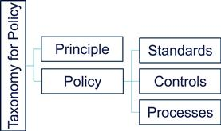
Data principles
The DMBOK defines (organisational) data principles as:
A fundamental law, doctrine, premise, or assumption
A rule or code of conduct
Principles are statements of philosophy (or core beliefs) around policies and behaviours around data governance to be used as guidance for procedures and decision-making efforts (Ladley)
While principles are to some extent generic (e.g. “data should be treated as an asset”), they must be adapted to the circumstances of an organisation.
They should be combined with policies to produce specific standards, controls and processes that make up DG&M operations.

Slide 23
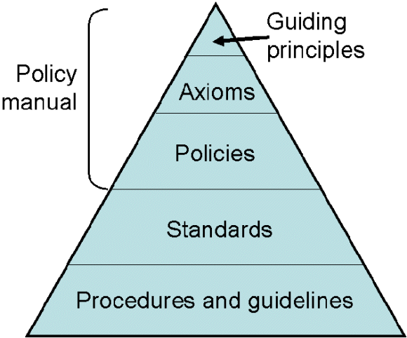
What is a data management policy?
A data management policy addresses the operating policy that focuses on the management and governance of data assets and is a cornerstone of governing enterprise data assets.

Slide 24
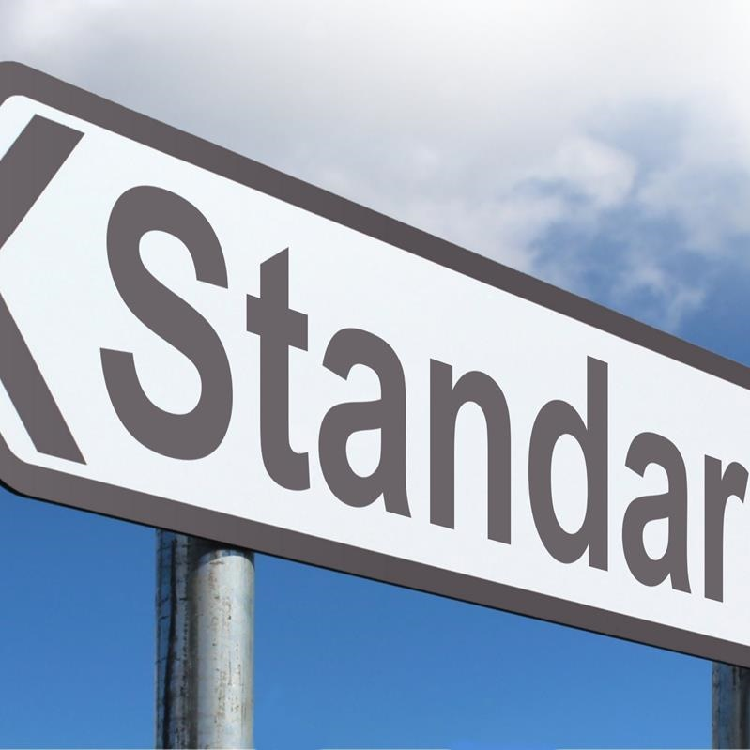
Data Standards
A standard is defined as “something set up and established by authority as a rule for the measure of quantity, weight, extent, value, or quality.”
By adopting a standard, an organization makes a decision once and codifies it in a set of assertions (the standard). It does not need to make the same decision all over again for each project.
DG standards should be mandatory. Enforcing standards should promote consistent results from the processes using them.
Drafted by data management professionals but reviewed, approved and adopted by the Data Governance Council.
Data standards must be effectively communicated, monitored, and periodically reviewed and updated.
Examples of data standards might include:
Data Architecture: Enterprise data models, tool standards, and system naming conventions
Acceptable use policies
Data Quality standards (timeliness, accuracy)
Data security standards
Use of data for data analytics and presentation purposes
Text source: DMBOK (2017)
This Photo by Unknown Author is licensed under CC BY-SA

Slide 25
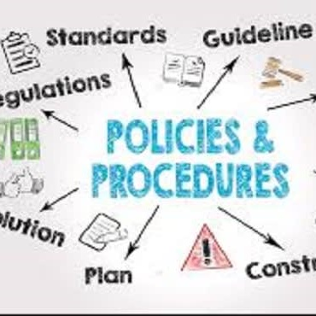
Data Procedures
Data management procedures assign responsibility for custody and security of all company data, allowing the company to control data consistently across various departments.
Can take several forms depending on data type and purpose (regulations, guidelines, constraints, documentation, access, disposal, standards)

Slide 26
DGM Operational Model
Part IV

Slide 27
DG operating model
So far, we’ve considered a range of artefacts that might be developed as part of a DG programme such as data strategy, principles, policies and standards.
But how are we going to implement a DG/DM system in practice?
We need to consider an operating model or framework that sets out
Defined roles and responsibilities,
Clear decision-making processes.
In short, we need to describe how people and functions will collaborate to deliver the aims and principles of the DG programme.
Remember, “one size doesn’t fit all” and while the DG have common goals, their operating models will vary according to an organisation's functions, its geographical scope, its culture, its organisational structure, the “maturity” of its data systems, its motivation for change etc. etc.
This Photo by Unknown Author is licensed under CC BY-SA

Slide 28
Importance of assigning roles and responsibilities to DG
“Like any other activity within a company or government entity, there needs to be a formal statement of roles. The official designation of accountability and responsibility are key factors to the survival of DG. Most important to new DG programs is the concept of accountability for data. This is most likely a very new role. … In many organizations, the responsible parties have a formal role as designated “stewards” or “custodians.”
The organization around DG also requires a hierarchy of some sort to enable issue resolution, monitoring, and direction setting. Rarely does this hierarchy of DG become a stand-alone area (i.e., there is rarely a data governance “department”). Most of the time, the DG organization is a virtual organization made up of business and IT personnel.” (emphasis added)
Chapter 3. Overview of a data governance program | Data Governance (oreilly.com)

Slide 29
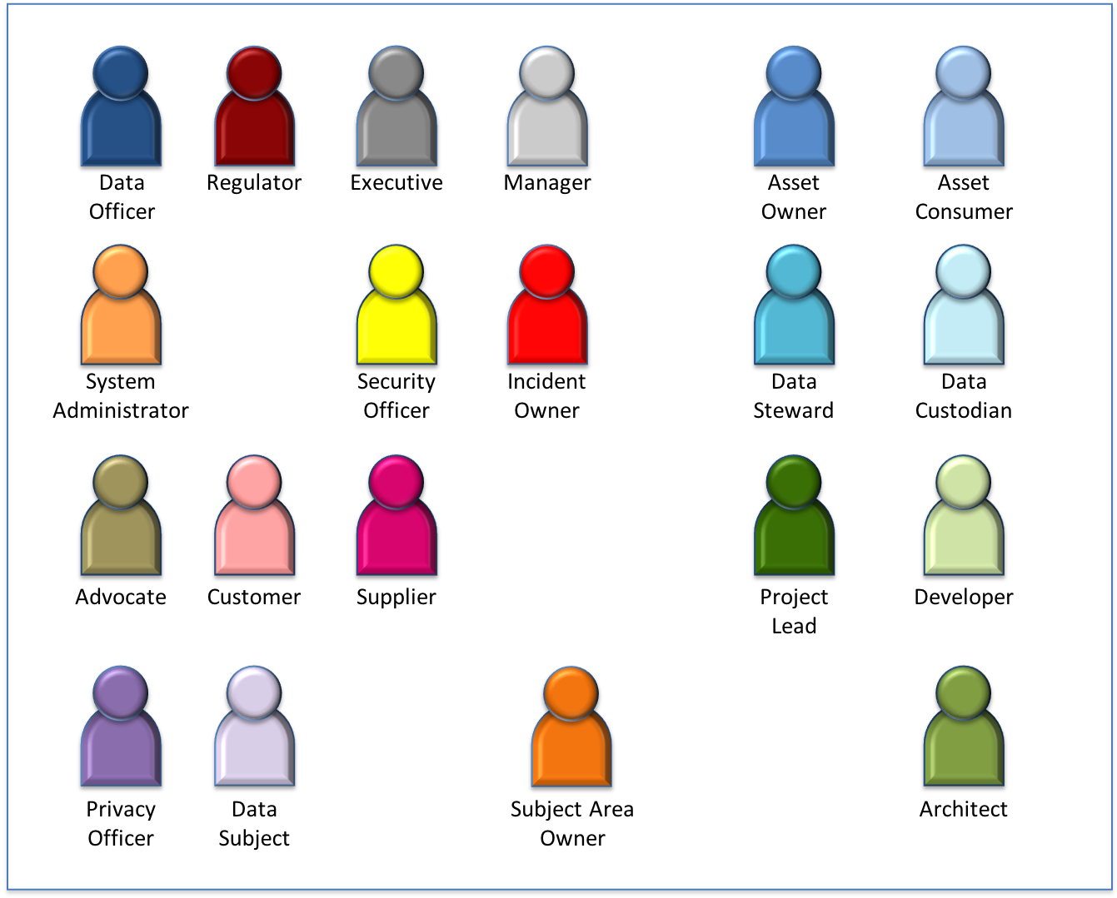
Wide variety of Roles and responsibilities around data
An organisation’s data roles will vary depending of many factors including size of organisation
The smaller the organisation, the more likely it is that roles will multi-task.
In a larger organisation, you might find a range of roles that are business, IT or data management specific:
Chief Data Officer – covered in following sides
Data Protection/Privacy Officer – to be covered in Privacy and Data Protection
Data Steward – covered in following sides
Data Architect - designs technical plans for a construction of data
Data Policy Officer - implements new regulations or processes that help improve efficiency or ensure an organization remains compliant

Slide 30
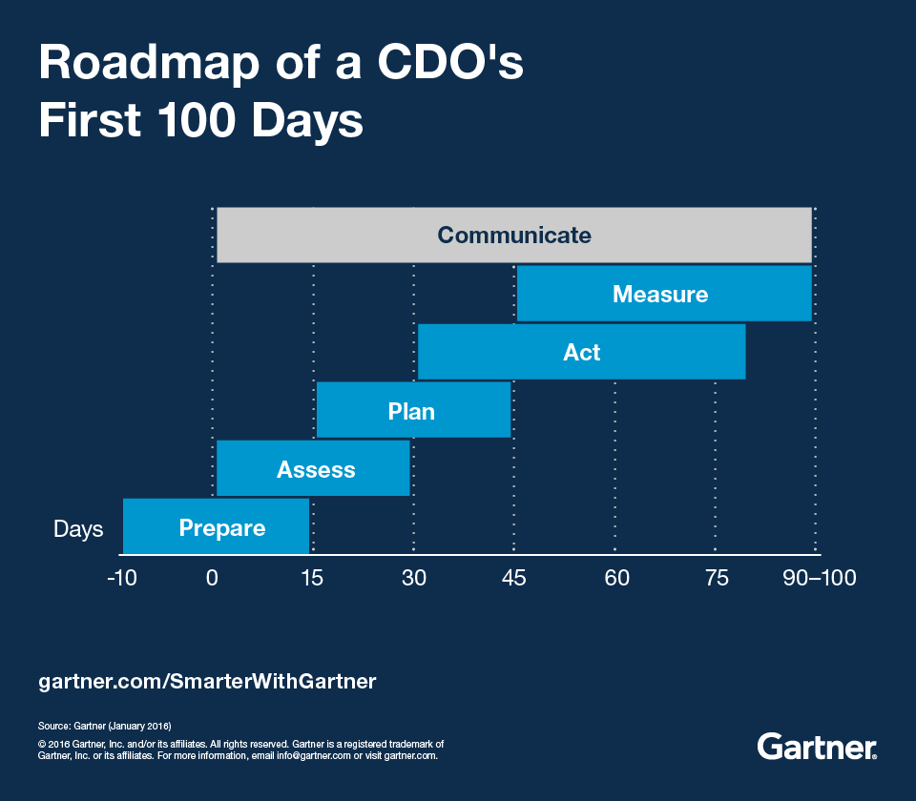
Chief Data Officer
Not all (or indeed many!) organisations have a CDO but industry analysis suggests increasing interest in the role especially in regulated sectors
Research shows a range of functions for CDO
Establishing an organizational data strategy
Aligning data-centric requirements with available IT and business resources
Establishing data governance standards, policies and procedures
Providing advice (and perhaps services) to the business for data-dependent initiatives, such as business analytics, Big Data, data quality, and data technologies
Evangelizing the importance of good information management principles to internal and external business stakeholders
Oversight of data usage in analytics and Business Intelligence
In effect, CDO (and their division) provides an interlocutor role between the data infrastructure functions (typically IT) and data consumers (typically business users)
Source: DATAVERSITY Launches Research Paper, “Status of the Chief Data Officer: An Update on the CDO Role in Organizations Today” - DATAVERSITY

Slide 31
Data Stewardship
A steward is some who manages property on behalf of others.
Data Stewards therefore represent the interests of all stakeholders to ensure enterprise data is of high quality and can be used effectively.
Effective Data Stewards are accountable and responsible for data governance activities and have a portion of their time dedicated to these activities.
Data steward roles activities will change depending on organisational circumstances but may include:
Creating and managing core metadata such as business terminology, data dictionary.
Documenting rules and standards in order to have organisational consensus and consistent use.
Managing data quality issues such as their identification, analysis and resolution
Executing operational data governance activities such as participating in data management projects, data governance monitoring
Text Source: DMBOK (2017) 1.3.4

Slide 32
Maturity levels of Data Governance
Reactive Governance Model (driven by issues arising)
Tactical effort to respond to a problem arising such as a data leak or disaster
Preemptive Governance Model (driven by upcoming planned event)
Organisation facing major change (merger, legislative change)
Approach tries to blunt issues
Proactive governance (driven by organisational capability and structure)
Driven by an information management strategy
Continual Focus on improving capabilities (processes, technologies) to address and resolve anticipated risks and issues
Alignment of governance and management process formalising a culture of issue and risk awareness
Source: Adler

Slide 33
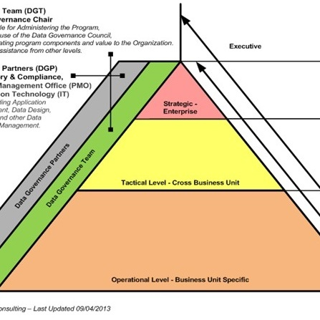
Decision making processes
Recall that the operating model is defined by the roles and responsibilities and the processes that determine decisions
We will go into this in more detail in the lab using the operating model shown but for now it’s enough to say that processes are related to
Nature of decisions required (strategic, tactical or operational level)
Decentralised to business areas of centralized to the Data Governance Team
Business or technical in nature

Slide 34
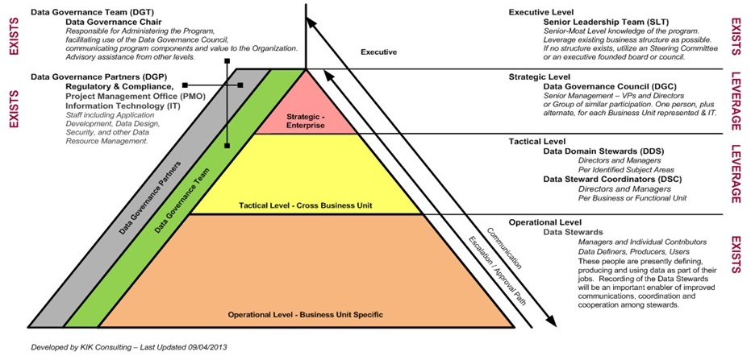
Data Governance Operating Model of Roles and Responsibilities

Slide 35
Data Governance Operating Model of Roles and Responsibilities
The space represents the rough percentage of instances that organizations expect decisions to be made about the data; decisions should be made at the operational level if the decisions only affect that level of the organization.

Slide 36
Data Governance Operating Model of Roles and Responsibilities
The escalation path does not extend into the executive level because data issues are not typically escalated to the senior-most management of an organization.

Slide 37
Data Governance Operating Model of Roles and Responsibilities
Architecting the solution and framework
Assisting in defining data quality metrics
Supporting data quality issue analysis
Conducting audits to ensure that policies, procedures and metrics are in place

Slide 38
Data Governance Operating Model of Roles and Responsibilities
Providing technical support for ensuring data quality and for data governance and data cleansing
Securing IT infrastructure, Technical handling of data

Slide 39
Data Governance Operating Model of Roles and Responsibilities
Identifying and classifying data access levels.
Identifying and documenting regulatory and legal/risk issues

Slide 40
Data Governance Operating Model of Roles and Responsibilities
Documenting data classification rules, compliance rules, and business rules for data in their domain
Identifying and classifying data access levels.
Identifying and documenting regulatory and legal/risk issues

Slide 41
Data Governance Operating Model of Roles and Responsibilities
Approving things that need to be approved – i.e., data policy, data role framework, methods, priorities, tools, etc.
Making decisions at a strategic level in a timely manner
Documenting data classification rules, compliance rules, and business rules for data in their domain
Identifying and classifying data access levels.
Identifying and documenting regulatory and legal/risk issues

Slide 42
Data Governance Operating Model of Roles and Responsibilities
Sponsoring, approving, championing the enterprise strategic plan and policy.
Communicating with lines of business the expectations and requirements for data governance
Approving things that need to be approved – i.e., data policy, data role framework, methods, priorities, tools, etc.
Making decisions at a strategic level in a timely manner
Documenting data classification rules, compliance rules, and business rules for data in their domain
Identifying and classifying data access levels.
Identifying and documenting regulatory and legal/risk issues

Slide 43
DGM Scope and Implementation
Part V

Slide 44
Scope of Typical DG programme
Strategy
Policy
Standards and quality
Oversight
Compliance
Issue management
Data management projects
Data asset valuation
Defining, communicating, and driving execution of Data Strategy and Data Governance Strategy
Setting and enforcing policies related to data and Metadata management, access, usage, security, and quality
Setting and enforcing Data Quality and Data Architecture standards
Providing hands-on observation, audit, and correction in key areas of quality, policy, and data management (often referred to as stewardship)
Ensuring the organization can meet data-related regulatory compliance requirements
Identifying, defining, escalating, and resolving issues related to data security, data access, data quality, regulatory compliance, data ownership, policy, standards, terminology, or data governance procedures
Sponsoring efforts to improve data management practices
Setting standards and processes to consistently define the business value of data assets

Slide 45
DG implementation 8-phase process
1. Scope and initiation
2. Assess org. capability
3. Establish Vision of what DG will bring
4. Align data and business value
5. Establish DG functional design (principles, policies, and processes)
6. Establish framework design (org structure, roles and responsibilities)
7. Decide on roadmap (incl links with other initiatives)
8. Roll-out, sustain
Your organisation thinks that it has a data problem (e.g. poor data quality, risk of data breaches)
Yet, in DG, we’ve said that “It’s not one size fits all”
So how do you “do Data Governance” for your organisation?
Where do you start and how do you know when its done?
DG implementation 8-phase process (Derived from Ladley (2012) Chapter 5)

Slide 46
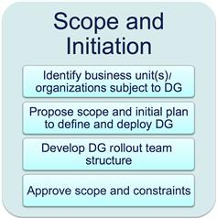
1. Scope and initiation
Understand options/Decide on Span and Depth
Is there a full understanding in organisation of nature and scope of DG
What business areas are to be covered in the programme?
DG is ultimately an organisation-wide process but may need to take into account a realistic assessment of effort required, timing, market conditions, government regulations
How deep into the organisation does the programme need to go?
Set- up temporary, organisational steering group important to ensure “not seen just as IT project”, right balance of skills and politics is available, at senior enough level to ensure taken seriously (led by executive DG sponsor)
Is there a process to approve scope, acknowledge and address constraints?
Ladley (2012) Chapter 6

Slide 47
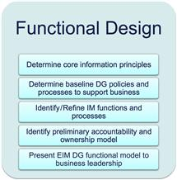
5. Establish DG functional design (principles, policies, and processes)
Addresses the what and how questions of DG – moving from concept to operational (“logical model design”)
Established principles that provide the foundation of effective policies and therefore processes, protocols and standards.
Identify functions for plan, design, management and operation (e.g., plan assessment info maturity, design data standards, manage data architecture, operate data controls)
Seek buy-in from organisation/DG business leadership
Ladley (2012) Chapter 10

Slide 48
Some examples of GAIP (Generally Accepted Information Principles)
Data content as assets
Data and content of all types are assets with all the characteristics of any other asset.
Data assets as having Real Value
There is value in all data and content, based on its contribution to an organization's business/operational objectives,
Data as presenting risk
There is risk associated with data and content.
Asset value as determined by Data Quality
The relevance, meaning, accuracy and lifecycle of data and content can affect the financial status of an organization.
They should be managed, secured and accounted for as other materials or financial assets.
And to its intrinsic marketability, and/or its contribution to the organization's goodwill (balance sheet) valuation.
This risk must be formally recognized, either as a liability or through incurring costs to manage and reduce the inherent risk.

Slide 49
DG implementation 8-phase process
1. Scope and initiation
2. Assess org. capability
3. Establish Vision of what DG will bring
4. Align data and business value
5. Establish DG functional design (principles, policies, and processes)
6. Establish framework design (org structure, roles and responsibilities)
7. Decide on roadmap (incl links with other initiatives)
8. Roll-out, sustain
Your organisation thinks that it has a data problem (e.g. poor data quality, risk of data breaches)
Yet, in DG, we’ve said that “It’s not one size fits all”
So how do you “do Data Governance” for your organisation?
Where do you start and how do you know when its done?
DG implementation 8-phase process (Derived from Ladley (2012) Chapter 5)

Slide 50
DGM in a research organisational context
Part VI

Slide 51
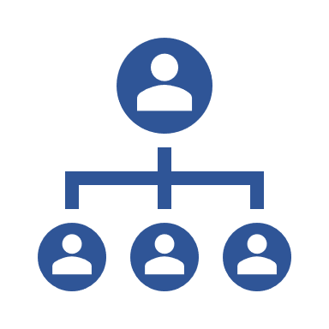
Is research different?
What aspects of DGM can be applied in a research context?
Concepts, rationale, principles, standards etc?
Building blocks
Defined roles and responsibilities?
Individual researcher (and their supervisors)
Research partnership team
Faculty or institutional based team
Cross-institutional team (national, international)
Clear decision making processes?
Organisational structure more complex than organisational decentralised model?
Decision making structures
Who “does governance” as opposed to manage?

Slide 52
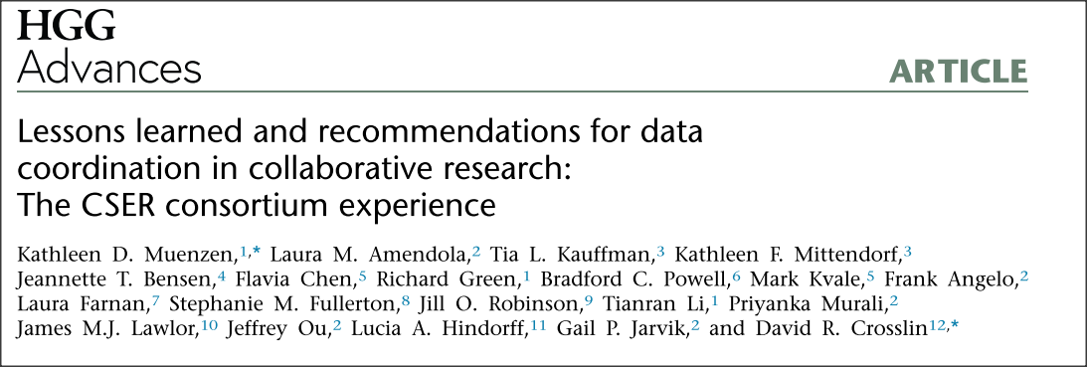
Some lessons from a genomics research study
Planning
Communications
Informatics
Analytics
Source: Muenzen, K. D. et al. (2022) ‘Lessons learned and recommendations for data coordination in collaborative research: The CSER consortium experience’, Human Genetics and Genomics Advances, 3(3), pp. 1–15.
doi: 10.1016/j.xhgg.2022.100120.
Available at: https://pubmed.ncbi.nlm.nih.gov/35707062/

Slide 53
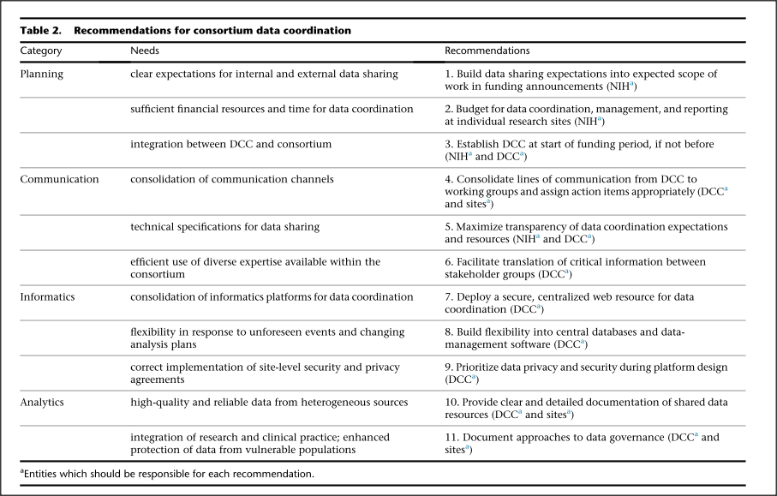
Study recommendations
(Muenzen et al., 2022)

Slide 54
Can lessons be generalised?
“While there is an understanding among scientific communities worldwide that sharing research data is a necessary component of scientific progress, the mechanisms for protecting against potential harm while maximizing usefulness are not well-defined. These two aims are often in tension and lend themselves to diverse data governance strategies across research projects within and between scientific disciplines.”
“As funding agencies increasingly expect research projects to contribute high-quality, harmonized data to public repositories, funders and researchers alike should recognize these dedicated groups as an essential component of any research program and provide appropriate budget support accordingly”
Source: Muenzen, K. D. et al. (2022) ‘Lessons learned and recommendations for data coordination in collaborative research: The CSER consortium experience’, Human Genetics and Genomics Advances, 3(3), pp. 1–15.
doi: 10.1016/j.xhgg.2022.100120.

Slide 55
OECD recommendations on research networks
“Recommendation 5
In establishing, developing, operating, and supporting international data networks the following 'organisational' aspects should be taken into account:
Networks should have a clearly defined user and data provider community. At the same time potential requirements of new users, e.g. in terms of interoperability, should not be ignored;
Networks should have a clear understanding of how they relate to other networks and how they fit into the global research and data sharing landscape;
Different governance models can succeed, but there is need to define clearly what is to be governed and to involve the data users and providers;
Roles and responsibilities across a network, e.g. for data curation versus service provision, must be clearly defined and, where possible, data champions identified;
The necessary level of standardization needs to be clearly defined taking into account user requirements and the need to maintain an appropriate balance of autonomy amongst network nodes and central control;
Objective and transparent mechanisms for network assessment should be based on standard quality management frameworks and certification of participating data repositories;
Consideration needs to be given to regional differences in capacity - infrastructure and human resources - and in culture, community needs and expectations”
DIRECTORATE FOR SCIENCE, T. A. I. and COMMITTEE FOR SCIENTIFIC AND TECHNOLOGICAL POLICY, OECD. (2017) Co-ordination and Support of International Research Data Networks. Available at: https://one.oecd.org/document/DSTI/STP/GSF(2017)5/en/pdf

Slide 56
Getting your class involved with DGM
Part VII

Slide 57
Some suggestions for how to get students involved
Quizzes (MS forms, Kahoot!) particularly suitable definitions, concepts etc
Presentation and discussion of use of case studies from industry, services, public sector etc
Group discussion of issues through review of academic or consultant papers

Slide 58
Review of presentation
Part VIII

Slide 59
Aims of presentation
Provide overview of DGM section of Data Governance and Ethics module (normally 6 contact hours)
Introduce DGM Concepts and Definitions
Provide DGM Rationale and Goals
Show strategic overview of DGM (who, how, what etc)
Illustrate DGM building blocks
Roles and responsibilities
Operating Model
Explain implementation method (using Ladley model)
Consider DGM in a research organisational context
Consider how to get getting your students involved with DGM
Review

Slide 60
Any Comments or Questions?

Slide 61
THANK YOU!
Follow us

