Slide 1
Day 3, Topic 3 Ethical issues relating to Data This module is part of the training session “Train for trainers” within project TrainRDM
John Bohan, National College of Ireland, Dublin, Ireland
This work is licensed under the Creative Commons Attribution 4.0 International License.
All images are public domain unless otherwise noted.

Slide 2
Introduction
Part I

Slide 3
Aims of presentation
Provide overview of module section (“Ethical Issues pertaining to data”)
Nature of ethics
Branches of normative ethics
Ethics in the “real world”
IT and data ethics/socio technical systems
Research ethics, data management and practical implementation
Other issues covered in module section but not covered in presentation
ACM code of ethics
Ethical Impact Assessment
Issues related to Health technology
Getting your class involved

Slide 4
2.1.1 Module aims and objectives
This module aims to provide learners with the knowledge and skills around the complex issues of data management and governance in an organisational context, including ethical and compliance issues that these present. Learners will explore the ethical, legal, and social implications of using data-driven technologies such as big data, analytics, internet of things, and machine learning. The students will learn how to establish processes and systems that consider best practices for data governance and adhere to ethical and regulatory requirements for data handling.
This Photo by Unknown Author is licensed under CC BY-SA

Slide 5
2.1.2 Minimum intended module learning outcomes
LO1 Demonstrate critical understanding of the governance and regulatory frameworks associated with the key data lifecycle stages for an effective management of data assets.
LO2 Demonstrate critical awareness and interpretation of the data privacy and data protection regulatory landscape in socio-technical environments.
LO3 Critically analyse and evaluate the main ethical, legal, and social implications of using data-driven technologies.
LO4 Investigate and appraise the interplay of fairness, accountability, and transparency in algorithmic decision-making systems and demonstrate awareness of technical solutions to enhance these concerns.

Slide 6
Sources and resources
O'Keefe, K. & O Brien, D. (2018). Ethical Data and Information Management : concepts, tools and methods. Kogan Page. [ISBN: 978-0749482046].
Reynolds, George W (2019). Ethics in Information Management (sixth edition). Cengage Learning (Inc.), Boston. [ISBN: 978-337-40587-4]

Slide 7
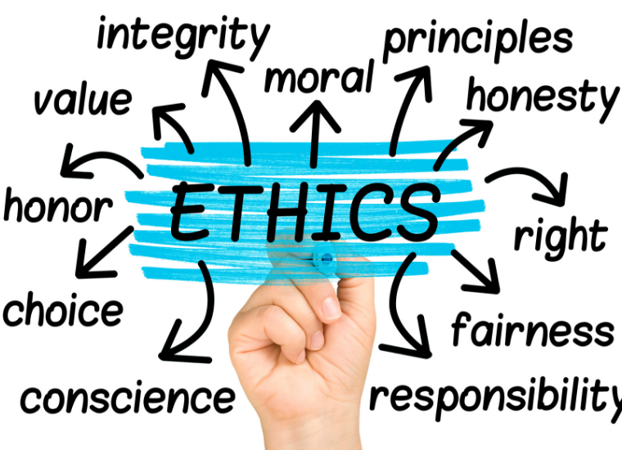
Ethical Issues Pertaining to Data Topics covered in section
Ethics and Computing – examining moral problems when using the Internet - spam, censorship and free speech, anonymity offered by the Internet.
Ethical issues arising from the increasing use and pervasiveness of Information Technology and socio-technical systems.
Health technology.. Pervasive monitoring and tracking.. Image, video and sound capture.. Identity.. Perpetuity of data storage.. Transnationality..

Slide 8
Overview of Ethics section
Topic | Lecture Topic | Lecture Detail
7 | Ethical Issues Pertaining to Data I | Personal, professional, societal, and legal morality; Branches of normative ethics (deontology, utilitarianism, virtue theory, social justice, etc.); IT Ethics including spam, censorship and free speech, anonymity, cyberbullying, copyright, etc.
8 | Ethical Issues Pertaining to Data II | Frameworks for ethical design and decision making (e.g., Ethical Impact Assessment, The data ethics canvas); Ethics in Research: considerations Before, During, and After; Codes of ethics and professional conduct (e.g., ACM)
9 | Ethical Issues Pertaining to Data III | Ethic concerns in health technology, Pervasive monitoring and tracking; Image, video and sound capture; Perpetuity of data storage

Slide 9
Nature of Ethics
Part II

Slide 10
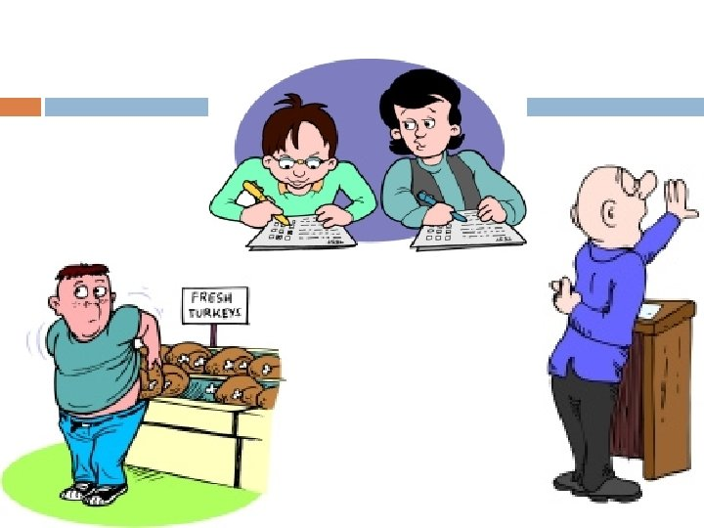
Ethics
Ethics looks at what you should do and, more philosophically, why you should do it.
Ethics is about obligations: it is the study of "should-ing".
https://slidetodoc.com/unit-3-ethics-what-is-ethics-introduction-ethics/

Slide 11
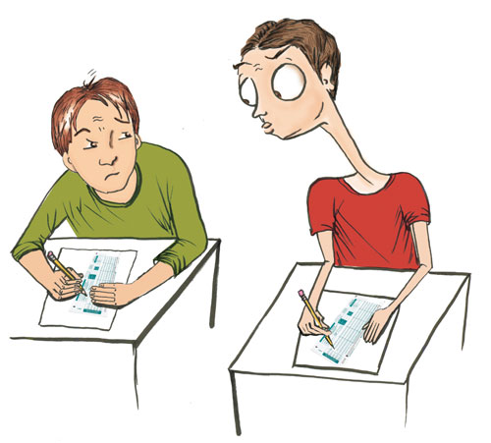
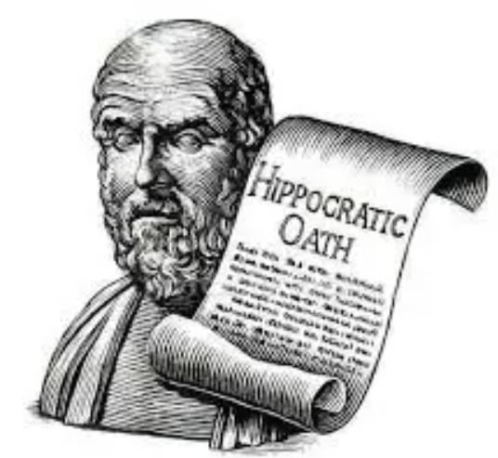
Morality, Ethics and Law (1/2)
Personal Morality
One’s personal beliefs about right and wrong
Influenced by a range of personal, cultural, philosophical, religious and societal concerns
Moral acts are those that conform to what an individual believes is right
Group, Professional or Organisational morality and ethical standards
Codes of conduct. As a member of a group or profession, you may subscribe to or accept certain ethical standards
May be informed by a range of historical, cultural, philosophical, religious, societal, aesthetic concerns
Organisational ethics may be formalized or acknowledged through Code of Ethics or Corporate Social Responsibility
Classical dilemma in literature - Group conflict may bring an individual into conflict with their own personal morality (eg Antigone, Hamlet, Sartre)

Slide 12
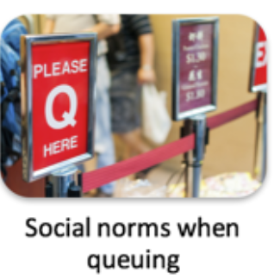
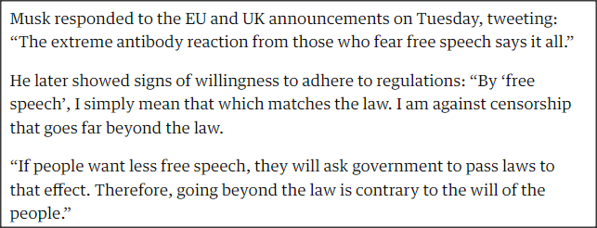
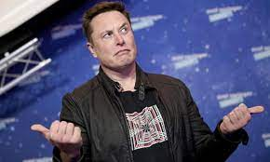
Morality, Ethics and Law (2/2)
Societal Morality
Widely shared social conventions
Form basis for an established societal consensus about what is right and what is wrong
Provide boundaries of generally acceptable behaviour
Resolution of differences between views of what is acceptable a complex process
Law
System of rules that tells us what we can and cannot do
Laws are enforced by a set of institutions
Legal acts are those that conform to the law or at least do not contravene it
Courts exist to resolve contradictions and ambiguities
https://www.theguardian.com/technology/2022/apr/26/twitter-takeover-jack-dorsey-elon-musk

Slide 13
What Is The Subject “Ethics?”
Ethics (or Moral Philosophy) is a branch of philosophy that "involves systematizing, defending, and recommending concepts of right and wrong behavior.”
Metaethics
Study of the meaning of ethics - attempts to answer the fundamental philosophical questions about the nature of ethical theory itself, how truth values may be determined
Normative ethics
Study of moral duties, rules within its social context - what makes actions right or wrong, what makes situations or events good or bad, and what makes people virtuous or vicious
Applied/Comparative ethics
Application of ethical principles - examining specific controversial issues “Ethics in the real world”
Is God or some ultimate arbitrator the ultimate source of moral guidance?
Are ethical rules subjective or objective?
Ethics is typically divided by philosophers into three main areas:
How do we determine what to do and how to act? ?
Is unauthorised computer file-sharing unethical?
Do we have moral obligations to the environment?

Slide 14
Branches of Normative Ethics
Part III

Slide 15
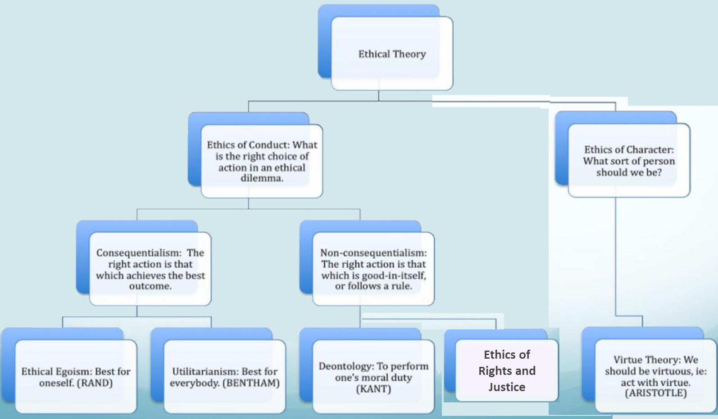
Branches of Normative Ethics
https://slideplayer.com/slide/12451081/

Slide 16
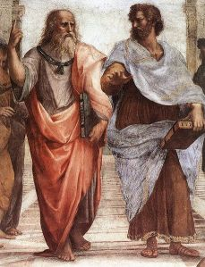
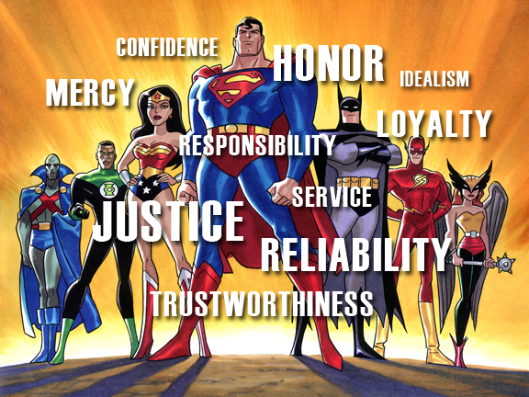
Virtue-based ethics
These theories judge a person by his/her character rather than by an action that may deviate from his/her normal behavior.
The objectively right act is the one a person of a certain type (“the virtuous person”) would choose.
Definition of “good”: Flourishing
It takes the person’s morals, reputation, and motivation into account when rating an unusual and irregular behavior that is considered unethical.
Good behaviour is usually seen in terms of the “golden mean” – virtues are halfway between two vices (courage is a virtue – but is on a spectrum between cowardice and rashness)
How to apply Virtue Theory?
An action is morally permissible, if and only if, it is the action that a virtuous person would have taken in the circumstances.
If a person X, displays the virtues, S1, S2, S3, S4… Sn in action A, then person X is justified in performing action A.
Flourishing is "when people experience positive emotions, positive psychological functioning and positive social functioning, most of the time," living "within an optimal range of human functioning."

Slide 17
The key virtues according to classical philosophers
Cardinal Virtues:
Wisdom,
Courage,
Temperance
Justice.
Courage, Temperance,
Liberality, Charisma,
Generosity, Ambition, Patience,
Friendliness, Honesty
Wit /humour, Modesty,
Justice /Sense of right & wrong
“To be able to practice five things everywhere under heaven constitutes perfect virtue: Gravity, Generosity of soul, Sincerity, Earnest­ness, Kindness”
Plato
Aristotle
Confucius

Slide 18
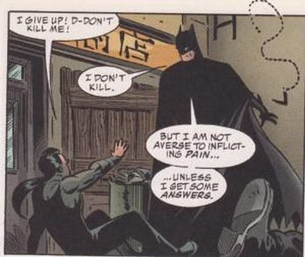
Deontological Ethics
It states that people should adhere to their obligations and duties when engaged in decision making when ethics are in play
Definition of “good”: Fulfillment of moral obligations, duties. A deontologist will always keep his promises to a friend and will follow the law
One flaw is that there is no rationale or logical basis for deciding an individual’s duties
Deontological ethics focus on the intent behind an action (its “rightness”) rather than on its outcomes. Provided you took the right decision, the outcome is less important (Good actions justify what ever happens)
Examples of Deontological Theories:
Divine Command Theory
“The Golden Rule”: “Do to others as you want them to do to you”
Natural Law and Natural Right theories
The Non-Aggression Principle
Kantian Ethics (categorical imperative): Act in such a way that you treat humanity..”

Slide 19
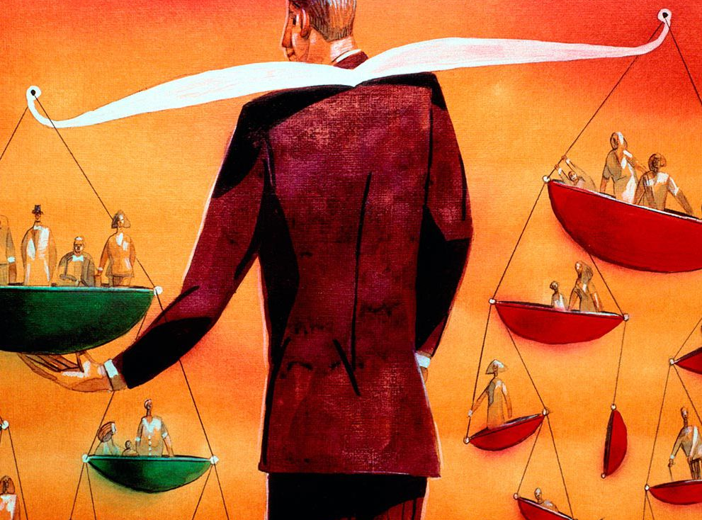
Consequentialist Ethics And Utilitarianism
An action is morally right if it produces a greater quantity of good or happiness than any other possible action. “The greatest good for the greatest number of people”
Definition of “good”: Acting to promote best outcomes
Don’t look at the intent of an action, look at the consequences. This provides a clear contrast with Deontological ethics
Focus on the goals behind an action or decision, not the rules that determine it
Ask the question “What is the greater good?” and respond to objections with “the ends justify the means”
But consider – who is to decide what the greater good is? Is it fair to sacrifice the position of the minority so that the majority can benefit?
Is the context or severity of an action not also relevant (e.g. is it right that some should die to save others?)
Should data privacy be sacrificed for the “greater good of progress”
If Batman would make an exception of his “No killing rule”, just this time, wouldn't that help make the world a better place?

Slide 20
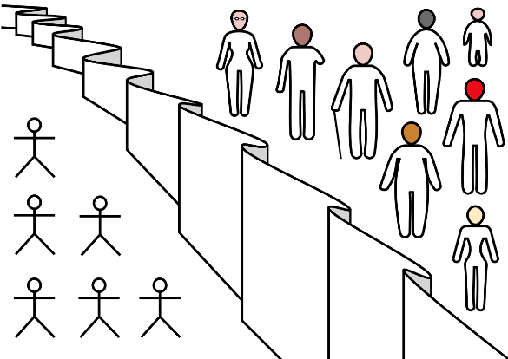
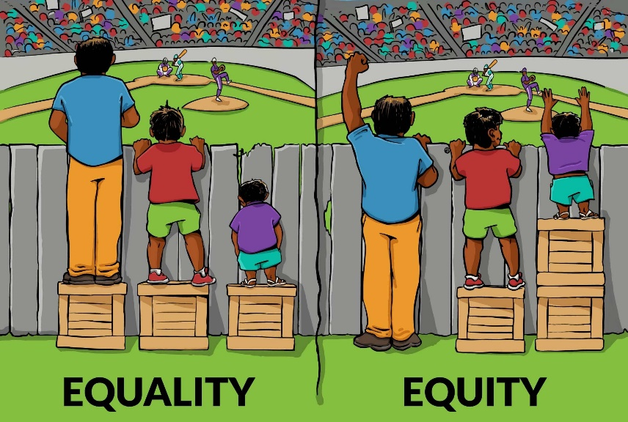
Social Justice based ethics
These also focus on the “common good” but identify the position of the weakest in society as a measure of the common good (that is those whose interests would most likely be less represented because of status, wealth, health etc)
Societal welfare can only therefore be judged by the welfare of its citizens who are in the weakest position.
Those who are not disadvantaged should sacrifice some happiness overall to assure that the distribution is “just”
John Rawls (A Theory of Justice, 1971) argued that the basic rules governing society should be designed to benefit most those least well off. Others (Gauthier, Morality by Agreement, 1986) have argued that, at a minimum, any social policy should not improve the condition of those already better off by making those already worst off worse off yet
How is an action likely to affect their ability to live a good life for those least advantaged in a society?
Do special measures have to be implemented to ensure that their interests are taken into account?
John Rawls (1921-2002) and the “veil of ignorance”
This Photo by Unknown Author is licensed under CC BY-SA

Slide 21
“Real-world” ethics
Part IV

Slide 22
Ethics in the “real world” (1/2)
Theories of Ethics
Utilitarianism-based ethics: An action is morally right if it produces a greater quantity of good or happiness than any other possible action. “The greatest good for the greatest number of people”
Rights-based ethics: Individuals have rights that should not be sacrificed simply to produce a net increase in the collective good.
Relativism: Maintain that truth is subjective, merely a matter of opinion (cultural or personal).
Virtue-based ethics: Is concerned with a person's motivation for action and not with the action itself. Instead of defining moral rules as obligatory duties, the emphasis lies on the individual to develop good habits of character based on these rules, this theory emphasizes moral education.
Example: A company is behind on production due to this Covid19 situation. Should management force employees to work on Saturday just to get caught up?

Slide 23
Ethics in the “real world” (2/2)
Example: A company is behind on production due to this covid19 situation. Should management force employees to work the weekend just to get caught up?
Approach:
Utilitarian based
Rights based approach
Relativist based
Virtue based
Outcomes:
Mngt would mandate Saturday work, a greater number of customers would benefit from having the service
Mngt would not mandate Saturday work, against the employees’ rights
Mngt would not make the employees work on Saturday, if manager were in employees’ position, he wouldn’t want to work
Mngt would make the employees work on Saturday, the strong work culture of the company is very centered around maintaining production

Slide 24
Fundamental ethical values (1/2)
Fundamental values for the knowledge societies are:
Justice/equity: Every individual has an inalienable dignity and is entitled to equal rights; deep respect for each other cultivates justice; fair and equal access to information enables members of civil society to reach for bilateral understanding.
Freedom/Agency: Human dignity calls for the development of various freedoms: in the Internet context, for example, the freedom of expression, of beliefs and of access to information might conflict. As a consequence, freedom, equality and responsibility must balance each other.
Care and compassion: A capacity for empathy and respect leads to solidarity and reciprocal support.
Source: Ethics in the Information Society: The Nine “P” s. (2013)

Slide 25
Fundamental ethical values (2/2)
Participation: The right and ability to participate in societal life and in important decision-making processes are core values.
Sharing: The sharing of information and knowledge in the Internet context enables and leads to sustainable relationships between human beings, and, as a result, strengthens communities.
Sustainability: In the long term, sustainable projects are significant for the protection of a viable environment for all human beings.
Responsibility: Assuming accountability for one’s own actions is a core requirement in a societal setting. The level of responsibility must correspond to the levels of the individual’s power, capacity and capability
Source: Ethics in the Information Society: The Nine “P” s. (2013)

Slide 26
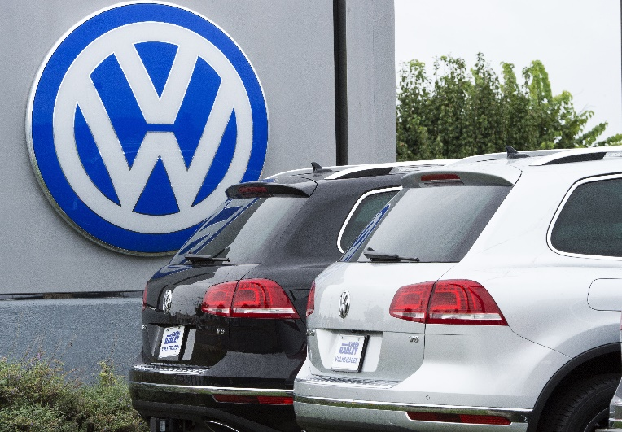
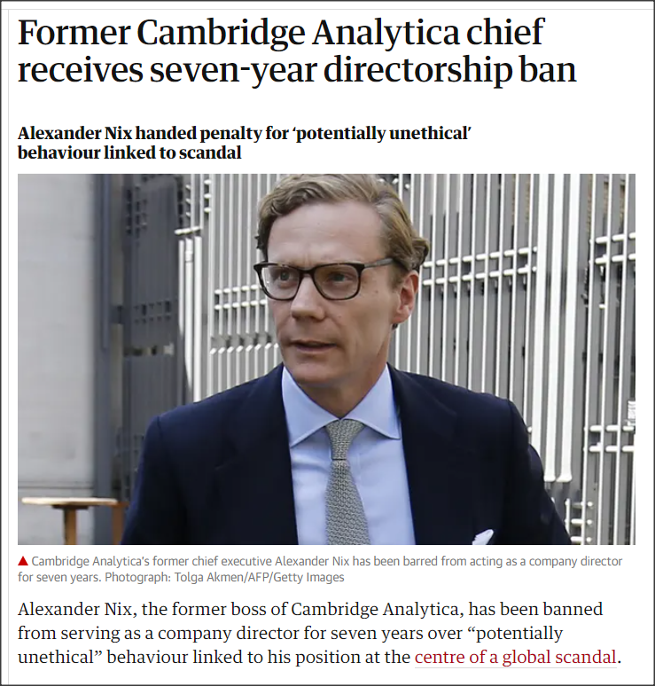
… and yet, ethics in the business world …
Several trends have increased both the risks of and the potential negative impact of inappropriate or unethical behaviour in business. Why?
Globalization creating complex work environments
Increased competition mean organizations challenged to maintain profits / revenue
New services and products enhance capacity for negative consequences for certain groups
Heightened vigilance by stakeholders:
Employees
Shareholders
Regulatory agencies
Researchers!

Slide 27
“Principle-based” ethics
We build on the discussion of sources to consider ethics for data systems based on first principles.
We know that it is unlikely that any set of rules can cover every eventuality especially given the pace at which technology evolves. To do this we consider
The application of Ethics as part of a broad perspective of IT as being part of a broader “Socio-technical” system particularly in related to how we might approach an ethics impact assessment
The application of ethics as part of a broader research approach. (This will be particularly relevant to the course project that asks students to review these issues in relation to their own work).

Slide 28
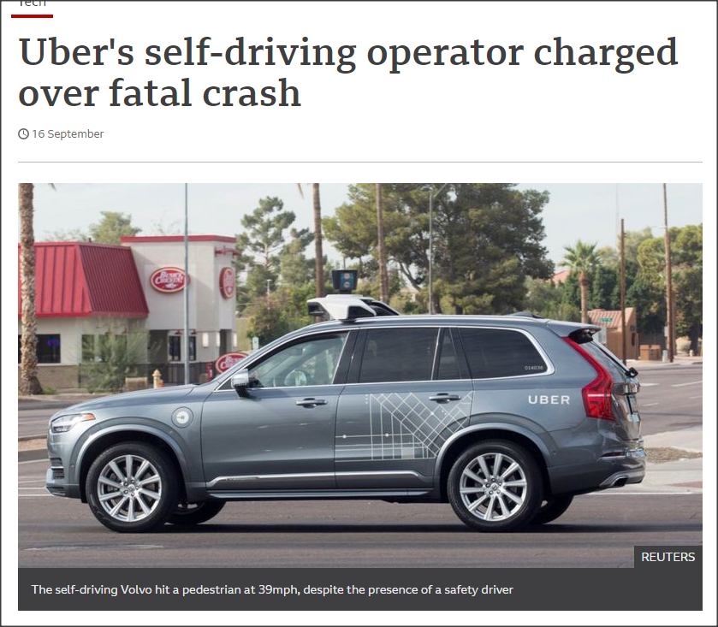
What are Information Technology (IT) ethics?
IT ethics is the study of the ethical issues arising out of the use and development of electronic technologies.
Its goal is to identify and formulate answers to questions about the moral basis of individual responsibilities and actions, as well as the moral underpinnings of public policy.
IT ethics raises new and unique moral problems because IT affects not only how we do things but how we think about them, it challenges some of the basic organizing concepts of moral and political philosophy such as property, privacy, the distribution of power, basic liberties and moral responsibility.”
https://www.bbc.com/news/technology-54175359
Nissenbaum Information Technology and Ethics (1998)

Slide 29
Ethics and Computing
In the recent years, we have witnessed a transformation in our understanding of computer ethics
Computer ethics does not involve a set of rules to follow
Computer ethics is a unique and holistic discipline providing principles for understanding, conceptualization and computer technology use.
Computer ethics focuses on human endeavors influenced or directed by use of computer technologies
Computers have a commonplace influence on decision-making processes assumed by most individuals.
Examples:

Slide 30
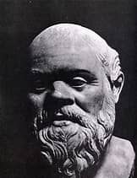
Recall: “the context for IT ethics”
“This discovery of yours will create forgetfulness in the learners’ souls, because they will not use their memories; They will trust the external written characters and not remember of themselves.”
“…the use of information technology in society is creating a rather unique set of ethical issues that requires the making of new moral choices on the part of society and has spawned special implications for its members. Technology itself is not the only, nor necessarily the most responsible, cause of these issues. All ethical questions arise initially out of human agency. Technology, due to its capability to augment mental and physical powers of human beings, does stand in the role of co-conspirator. The lure of power-enhancing capabilities makes technology an inducer of sorts, a necessary but not sufficient underpinning to many of the ethical issues we face today.”
Socrates (469-399 B.C.) on the latest Greek technology – Writing!
Mason “Applying Ethics to Information Technology Issues” (1995) 38 Communications of the ACM 55

Slide 31
Ethics of IT and data
Part V

Slide 32
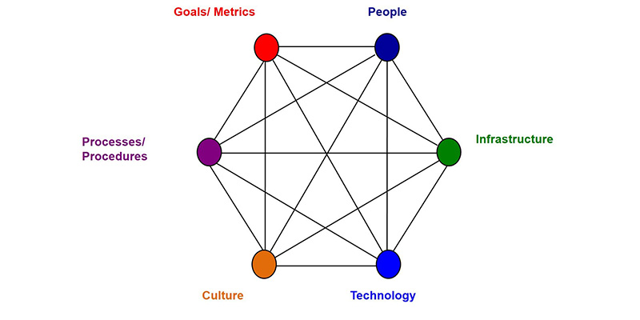
Information Technology and socio-technical systems
An Information technology system requires the use of computers to store, retrieve, transmit, and manipulate data or information.
A socio-technical system (STS) is one that considers requirements spanning hardware, software, personal, and community aspects.
It implies an understanding of the social structures, roles and rights (from the legal and social sciences) to inform the design of systems that involve communities of people and technology.

Slide 33
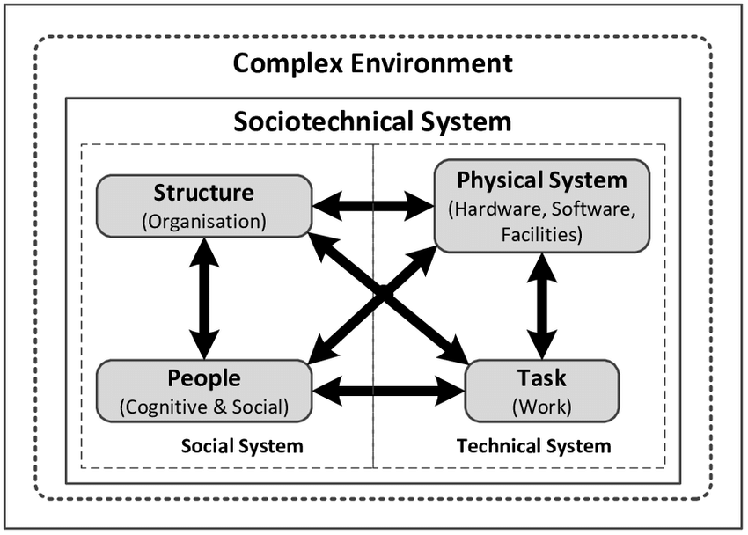
Modelling Complex Socio-Technical Systems
Bostrom and Heinen’s model
Technical system
Technology
Business processes and tasks
Social system
Management practices
Organization culture
People (cognitive and social behaviour)
Bostrom, R.P. & Heinen, J.S. 1977. MIS problems and failures: A socio-technical perspective. Part I: The causes. MIS Quarterly, 1(3), pp. 17.

Slide 34
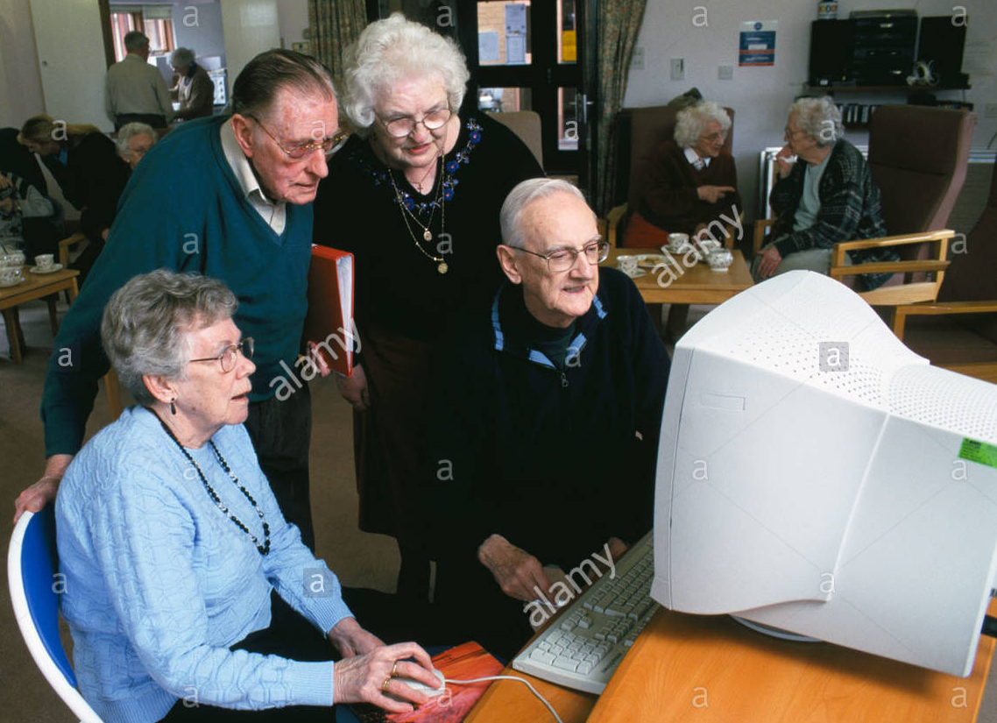
Socio-Technical Systems Illustration
STS are systems that include technical systems but also operational processes and people who use and interact with the technical system. Socio-technical systems are governed by organisational policies and rules.
Illustration:
Software engineers in Silicon Valley may build a software with all sorts of bells and whistles expecting everyone to be tech-savvy.
People are in fact elderly and unaccustomed to the interface
That’s the reason we are interested not only in technical dimension but also domain of Socio-technical systems

Slide 35
Improving organisational ethics
Data Governance
Roles and responsibilities: Appoint corporate ethics officer
Board of Directors to set and model higher level of ethical standards
Establish a corporate code of ethics
Data management
Undertake social audits
Employees should take ethics training
Employee appraisals and recruitment to include ethical criteria
Ensure an ethical work environment
This Photo by Unknown Author is licensed under CC BY-SA
Source: adapted from Reynolds (2019)

Slide 36
Research and data ethics
Part VI

Slide 37
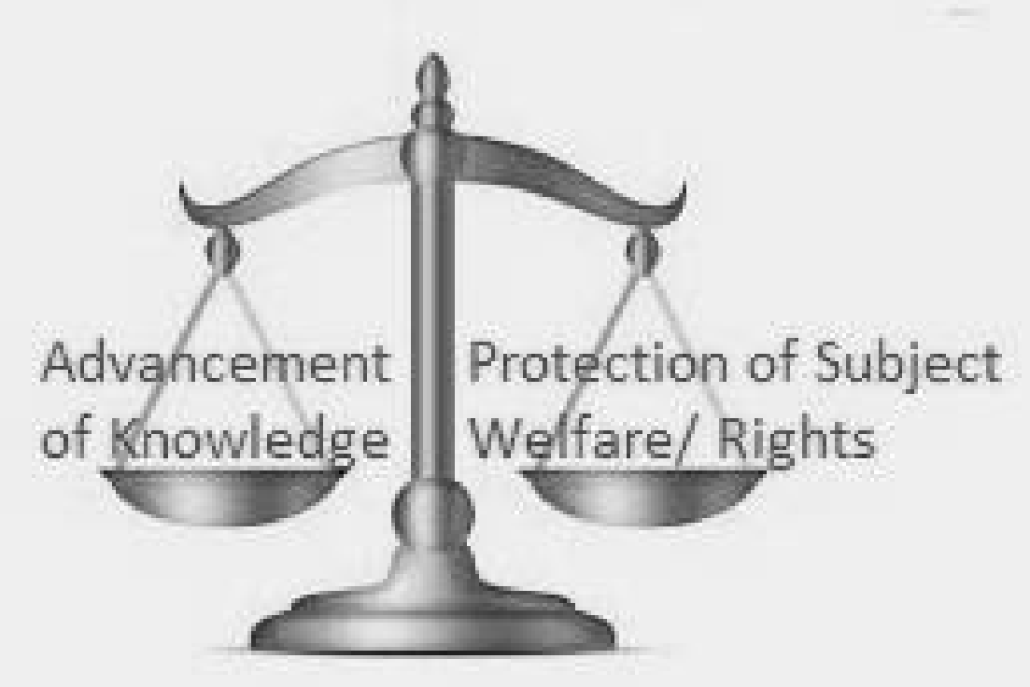
Research Ethics
“Research is a formal, systematic application of the scientific approach to the study of a problem to discover new information or expand and verify existing knowledge”
Different ethical emphasis between the protection of the subject of the research and the general advancement of knowledge

Slide 38
So it’s “just grabbing the data” (?)
“For one computer scientist mining data for aggregation and data modelling, data was generally thought of as usable without the need for any form of permission: ‘the idea of just grabbing the data, maybe six months, maybe potentially years after it was written, I don’t think that requires ethical approval or necessarily the consent of the people involved’” (researcher 9)
Authors showed that most researchers adopt a “personal ethics” approach to decision-making about the use of social media (SM) sites as a source of data for research
Samuel, G., Derrick, G. E. and van Leeuwen, T. (2019) ‘The Ethics Ecosystem: Personal Ethics, Network Governance and Regulating Actors Governing the Use of Social Media Research Data’, Minerva. Springer Netherlands, 57(3), pp. 317–343. doi: 10.1007/s11024-019-09368-3.

Slide 39
Why Be Concerned About Ethics In Research?
If the objective of research is to “discover new information or expand and verify existing knowledge” it is important when conducting research involving people that this knowledge does not come at the expense of their welfare or rights.
Research ethics provide a guideline or set of principles that support researchers in conducting research so that it is done justly and without harming anyone in the process.
It is the duty of the researcher to ensure they are carrying out their research project in line with established ethical standards.
Every step of the research project, from formulating your research question to publication, needs to be informed by ethics to ensure integrity of the project.
This Photo by Unknown Author is licensed under CC BY-SA

Slide 40
Ethics Consideration
To be considered when your project falls into one scenario or both of them
Scenario 1
Scenario 2
Human participants are involved in your study
Requirement specification stage
App Interface design feedback
Evaluation and Testing stage
Surveys and Interviews
Etc.
Secondary Dataset(s) is used in your study
Data is/was collected by someone
Data is taken from a web site(s)
Data is provided by a company
Etc.
Primary data – data collected by the investigator conducting the research/work (e.g. measurements, interviews, tests)

Slide 41
What is a human participant?
“A living individual about whom an investigator (professional or student) conducting research obtains;
1.Data or
2.Identifiable private information
Through intervention or interaction with the individual.”

Slide 42
Universal Guiding Ethical Principles for researchers
1.Respect Others’ Autonomy
5.Privacy and Confidentiality
2.Free and informed consent
Information,
Voluntariness and
Comprehension
3.Veracity
4.Respect for Vulnerable Persons
6.Justice and Inclusiveness
7.Consider Harms and Benefits
Minimising Harm (Non-maleficence)
Maximising Benefit (Beneficence)
https://www.nih.gov/health-information/nih-clinical-research-trials-you/guiding-principles-ethical-research

Slide 43
Practical implementation of Ethics in Research
https://libguides.ucd.ie/data/intro

Slide 44
Ethical Principles: Before The Research Process
What are the ethical strengths and limits of the methods?
Have the data been used ethically in a similar context before?
Are the methods respectful of your respondents’ capacity and willingness to participate? Some methods will work better with some groups than with others.
Are there any potential unintended consequences of your research, e.g. disclosures of sensitive information, that may arise through those methods, potentially causing stress or embarrassment?
Do the methods proposed fit with the ethics principles mentioned earlier? If not, can the exception be justified? Is what you are proposing to do justifiable in terms of the benefits, risks and harms of your research?

Slide 45
Sampling
Selecting samples or groups of people to study is one of the first tasks in designing your study, and the first ethics question you face in sampling is who you include, or exclude.
You should be clear about why the people you want to study need to be involved.
You should also reflect on who is left out of your study, and why.
Your sample will often determine which ethics committee you need to go to, and who you need to seek permission from, so it is critically important to think through the ethical implications of the sampling strategy you develop.
If your sample includes particular groups in the population, such as children and young people, or vulnerable adults (a person aged 18 years or over who may require assistance to care for themselves, or protect themselves from harm or from being exploited)
You will have additional requirements and considerations to address; for example getting consent from guardians, as well as the participants.

Slide 46
Information & Consent
To recruit potential participants, you need to provide them with information about your project, in order for them to be able to give you their fully informed consent.
Informed consent comprises three major elements:
Information-When providing information researchers must ensure that participants are given sufficient detail about the nature of the research and the procedures involved; the information should highlight the objectives of the study, and any potential risks and benefits.
Voluntariness-Consent must be freely given and may be withdrawn at any time. Undue influence may take the form of inducement or authority over prospective participants.
Comprehension -Voluntary participation implies that participants make an informed choice while informed consent assumes that the information given is accurate. Both principles are underpinned by the principle that participant understands what it is they are being asked to participate in.

Slide 47
Ethical Principles: During The Research Process
Ethical issues of using group-based methods:
Participants should be recruited ethically by providing them with the appropriate information about your research so that they can make an informed decision.
Researchers need to be aware of the risks associated with research methods that allow for unpredictable interaction between participants or when potentially sensitive topics are being investigated.
There is a risk of limited confidentiality when participants participate in the research process as they might accidently repeat sensitive information they learn about other participants to those not involved in the project.
There is also a risk that participants may overshare or contribute sensitive information during the data collection process that may put them in danger of being ridiculed by their peers later on.

Slide 48
Managing Your Data
Dealing with data is a key element of research ethics, regardless of whether you are collecting new data, or if you are using existing data for secondary analysis or review
Data management is also increasingly highlighted by funders and research ethics committees as an explicit priority for researchers
In part this reflects the legal requirements of the GDPR, but this concern is fundamentally rooted in key ethics principles, about the anonymity and confidentiality that participants are promised when they give their informed consent

Slide 49
Anonymizing Your Data
Remove direct identifiers, e g personal information such as names and addresses
Aggregate or reduce the precision of variables that might be identifiable, e g recode postcode or neighbourhood data to Dublin North, Dublin South Galway urban, Galway rural
Generalise text variables to reduce identifiability
Restrict continuous variables to reduce outliers
Pay particular attention to anonymising relational data, for example, some anonymised variables may become identifiable when considered in combination, combining location with special educational needs
Be aware of case studies where research results have been “de-anonymized” (see case study on Moodle Sweeney, Latanya (2000) “Simple Demographics Often Identify People Uniquely”

Slide 50
Data Storage And Security
Whether you are collecting new data or accessing existing data, you need to consider:
Your planning should take account of what you need to do with hard copies, such as, paper notes of interviews; computer files with anonymised data that are not identifiable; and computer files with personal or identifiable data.

Slide 51
Data Storage and Security
Files -including computer files -that contain personal or identifiable data (such as names) come under the terms of the Data Protection Act.
If your research involves data that comes under the remit of the GDPR -and most research does -then it is a good idea to check with the Data Protection Officer in your organisation, to see if there are any standard protocols you should be following.
Computer files including those that have been anonymised still need to be held securely and can only be shared according to the terms of your consent from participants. Thus -for example -you need to get prior consent from participants if you plan to archive data for use by other researchers.
These files need to be encrypted or password protected, and only accessed by agreed members of the team.
Particular care needs to be taken if you are sharing files within the research team -e.g., on shared computer drives, or by email -or if you are transferring personal data beyond the research team (e.g. if a gatekeeper is giving you a list of contacts).

Slide 52
Ethics Principles: After Research
Data sharing and long-term preservation
Data should be made “as open as possible, as closed as necessary”.
Think about sharing data before you begin your project, do not share what was not authorised.
The length of time you store data depends on the nature of the research project and the resultant data (most researchers will store data for at least 5 years after final publication)
​A Data Repository allows researchers to upload and publish their data, thereby making the data available for other researchers to re-use

Slide 53
Getting your class involved with DGM
Part VII

Slide 54
Some suggestions for how to get students involved
Discussion of contemporary issues – from press, reports
Presentation and discussion of use of case studies from industry, services, public sector etc
Group discussion of issues through review of academic or consultant papers

Slide 55
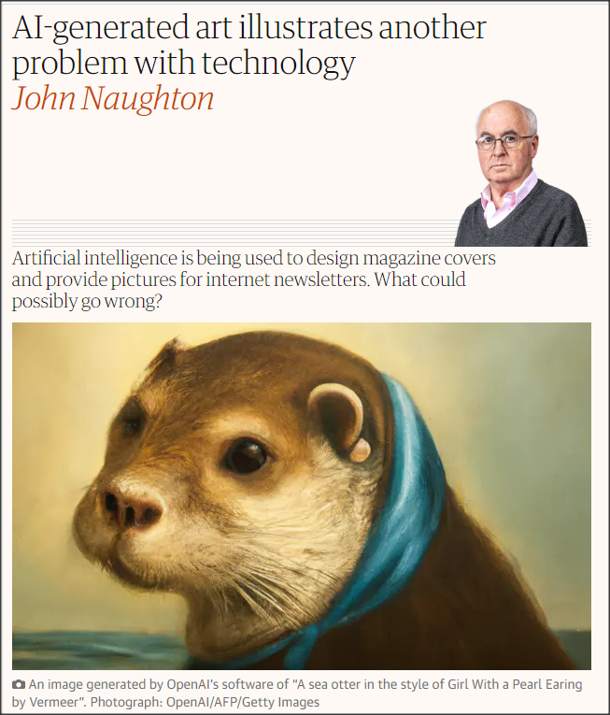
Contemporary ethical issues arising from technology
Provides opportunity to engage students in real world technology issues
What are positives with use of this technology?
Potential Negatives?
Augmentation or Replacement?
Intellectual property loss
Abuse of deep fake images
Biased representation
Carbon footprint
etc
AI-generated art illustrates another problem with technology | John Naughton | The Guardian

Slide 56
Conclusion
Source: https://theodi.org/wp-content/uploads/2021/06/AdobeStock_410183096-scaled.jpeg
This Photo by Unknown Author is licensed under CC BY-SA

Slide 57
Aims of presentation
Provide overview of module section (“Ethical Issues pertaining to data”)
Nature of ethics
Branches of normative ethics
Ethics in the “real world”
IT and data ethics/socio technical systems
Research ethics, data management and practical implementation
Getting your class involved
Review

Slide 58
Any Comments or Questions?

Slide 59
THANK YOU!
Follow us

