Slide 1
Fairness, Accountability, and Transparency of Algorithmic Systems
This module is part of Early-Stage Researchers' Training Week
within the TrainRDM project
National College of Ireland
This work is licensed under the Creative Commons Attribution 4.0 International License.
All images are public domain unless otherwise noted.

Slide 2
About Me
Areas of interest: Data Analytics, Machine Learning, Cloud Computing, Quantum Computing
Lecturer in the School of Computer Science at National College of Ireland
Background in enterprise systems
Michael Bradford
michael.bradford@ncirl.ie

Slide 3
Module aims and objectives
This module aims to provide learners with the knowledge and skills around the complex issues of data management and governance in an organisational context, including ethical and compliance issues that these present. Learners will explore the ethical, legal, and social implications of using data-driven technologies such as big data, analytics, internet of things, and machine learning. The students will learn how to establish processes and systems that consider best practices for data governance and adhere to ethical and regulatory requirements for data handling.
This Photo by Unknown Author is licensed under CC BY-SA

Slide 4
Minimum intended module learning outcomes
LO1 Demonstrate critical understanding of the governance and regulatory frameworks associated with the key data lifecycle stages for an effective management of data assets.
LO2 Demonstrate critical awareness and interpretation of the data privacy and data protection regulatory landscape in socio-technical environments.
LO3 Critically analyse and evaluate the main ethical, legal, and social implications of using data-driven technologies.
LO4 Investigate and appraise the interplay of fairness, accountability, and transparency in algorithmic decision-making systems and demonstrate awareness of technical solutions to enhance these concerns.

Slide 5
Agenda
Lecture Topic | Lecture Detail
Fairness, Accountability, and Transparency in Algorithmic Systems I | The meaning of fairness with respect to algorithmic systems. Techniques and models for fairness-aware data mining, information retrieval, recommendation, etc. Legal, social, and philosophical models of fairness. Specification of mathematical objectives with respect to fairness. Perceptions of algorithmic bias and unfairness. Interventions to mitigate biases in systems, or discourage biased behaviour from users.
Fairness, Accountability, and Transparency in Algorithmic Systems II | The meaning of accountability with respect to algorithmic systems. Processes and strategies for developing accountable systems. Methods and tools and standards for ensuring that algorithms comply with fairness policies (e.g., IEEE P7003 TM).
Fairness, Accountability, and Transparency in Algorithmic Systems III | The meaning of transparency with respect to algorithmic systems.. Explanations for algorithmic logic and outputs. Trade-offs between privacy and transparency. Tools and methodologies for conducting algorithm audits. Frameworks for conducting ethical and legal algorithm audits. Empirical results from algorithm audits.

Slide 6
Fairness, Accountability, and Transparency in Algorithmic Systems I
The meaning of fairness with respect to algorithmic systems.
Techniques and models for fairness-aware data mining, information retrieval, recommendation, etc.
Legal, social, and philosophical models of fairness.
Specification of mathematical objectives with respect to fairness.
Perceptions of algorithmic bias and unfairness.
Interventions to mitigate biases in systems or discourage biased behaviour from users.

Slide 7
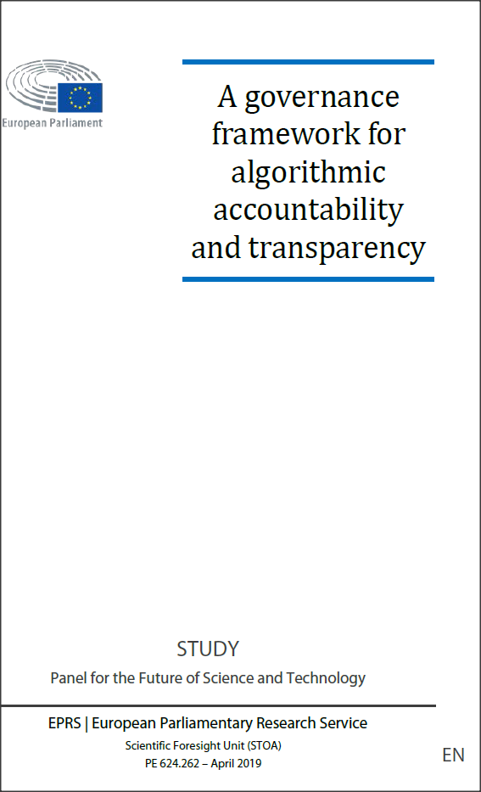
European Context
Algorithmic fairness is of concern in Europe …
“Algorithmic systems are increasingly being used as part of decision-making processes in both the public and private sectors, with potentially significant consequences for individuals, organisations and societies as a whole.
… A significant factor in the adoption of algorithmic systems for decision-making is their capacity to process large amounts of varied data sets (i.e. big data), which can be paired with machine learning methods in order to infer statistical models directly from the data.
The same properties of scale, complexity and autonomous model inference however are linked to increasing concerns that many of these systems are opaque to the people affected by their use and lack clear explanations for the decisions they make.”

Slide 8
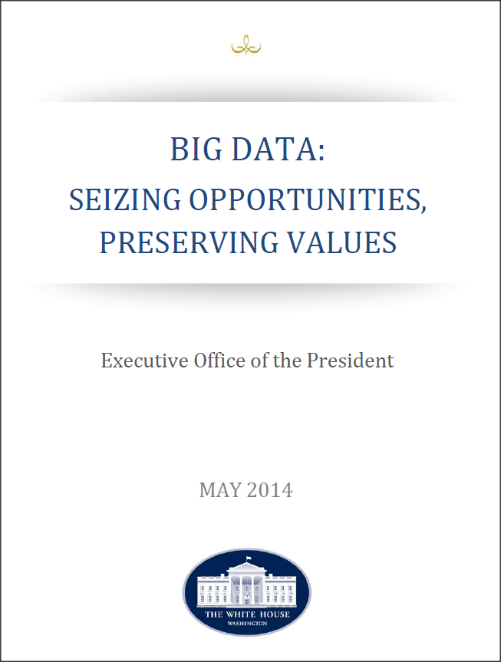
US Context
and the US …..
“In addition to creating tremendous social good, big data in the hands of government and the private sector can cause many kinds of harms. These harms range from tangible and material harms, such as financial loss, to less tangible harms, such as intrusion into private life and reputational damage.
An important conclusion of this study is that big data technologies can cause societal harms beyond damages to privacy, such as discrimination against individuals and groups. This discrimination can be the inadvertent outcome of the way big data technologies are structured and used. It can also be the result of intent to prey on vulnerable classes.”
big_data_privacy_report_may_1_2014.pdf (archives.gov)

Slide 9
Shared Concerns
… leading to common concerns
“This lack of transparency risks undermining meaningful scrutiny and accountability, which is a significant concern when these systems are applied as part of decision-making processes that can have a considerable impact on people's human rights (e.g., critical safety decisions in autonomous vehicles; allocation of health and social resources, etc.).”
“Because of this lack of transparency and accountability, individuals have little recourse to understand or contest the information that has been gathered about them or what that data, after analysis, suggests. … the civil rights community is concerned that such algorithmic decisions raise the specter of “redlining” in the digital economy—the potential to discriminate against the most vulnerable classes of our society under the guise of neutral algorithms.”

Slide 10
Fairness, Accountability and Transparency of Algorithms
openness
Fairness, Accountability and Transparency – way of examining critically one of the principal concerns about the use of algorithms in society (as part of the broader socio-technical system)
“In principle, fairness is the absence of any bias based on an individual’s inherent or acquired characteristics that are irrelevant in the particular context of decision-making.”
To assess fairness, we need transparency
To enforce fairness, we need accountability
Transparency
Accountability
Fairness
absence of bias
responsibility

Slide 11
An Algorithmic System
An algorithmic system is a system comprised of one or more algorithms used in a software to collect and analyze data as well as draw conclusions as part of a process designed to solve a pre-defined problem
Algorithmic decision-making systems (AD-M sys) are ubiquitous across a wide variety of services. They rely on:
on complex learning methods
vast amounts of data
There is a growing concern that these automated decisions can lead to a lack of fairness

Slide 12
An Algorithmic System
“Algorithm” refers to a set of precise instructions or rules regarding actions to be taken in solving a predefined problem
An algorithmic system is a system comprised of one or more algorithms used in a software to collect and analyze data as well as draw conclusions as part of a process designed to solve a pre-defined problem

Slide 13
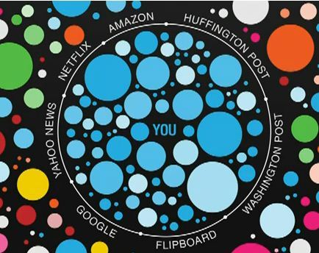
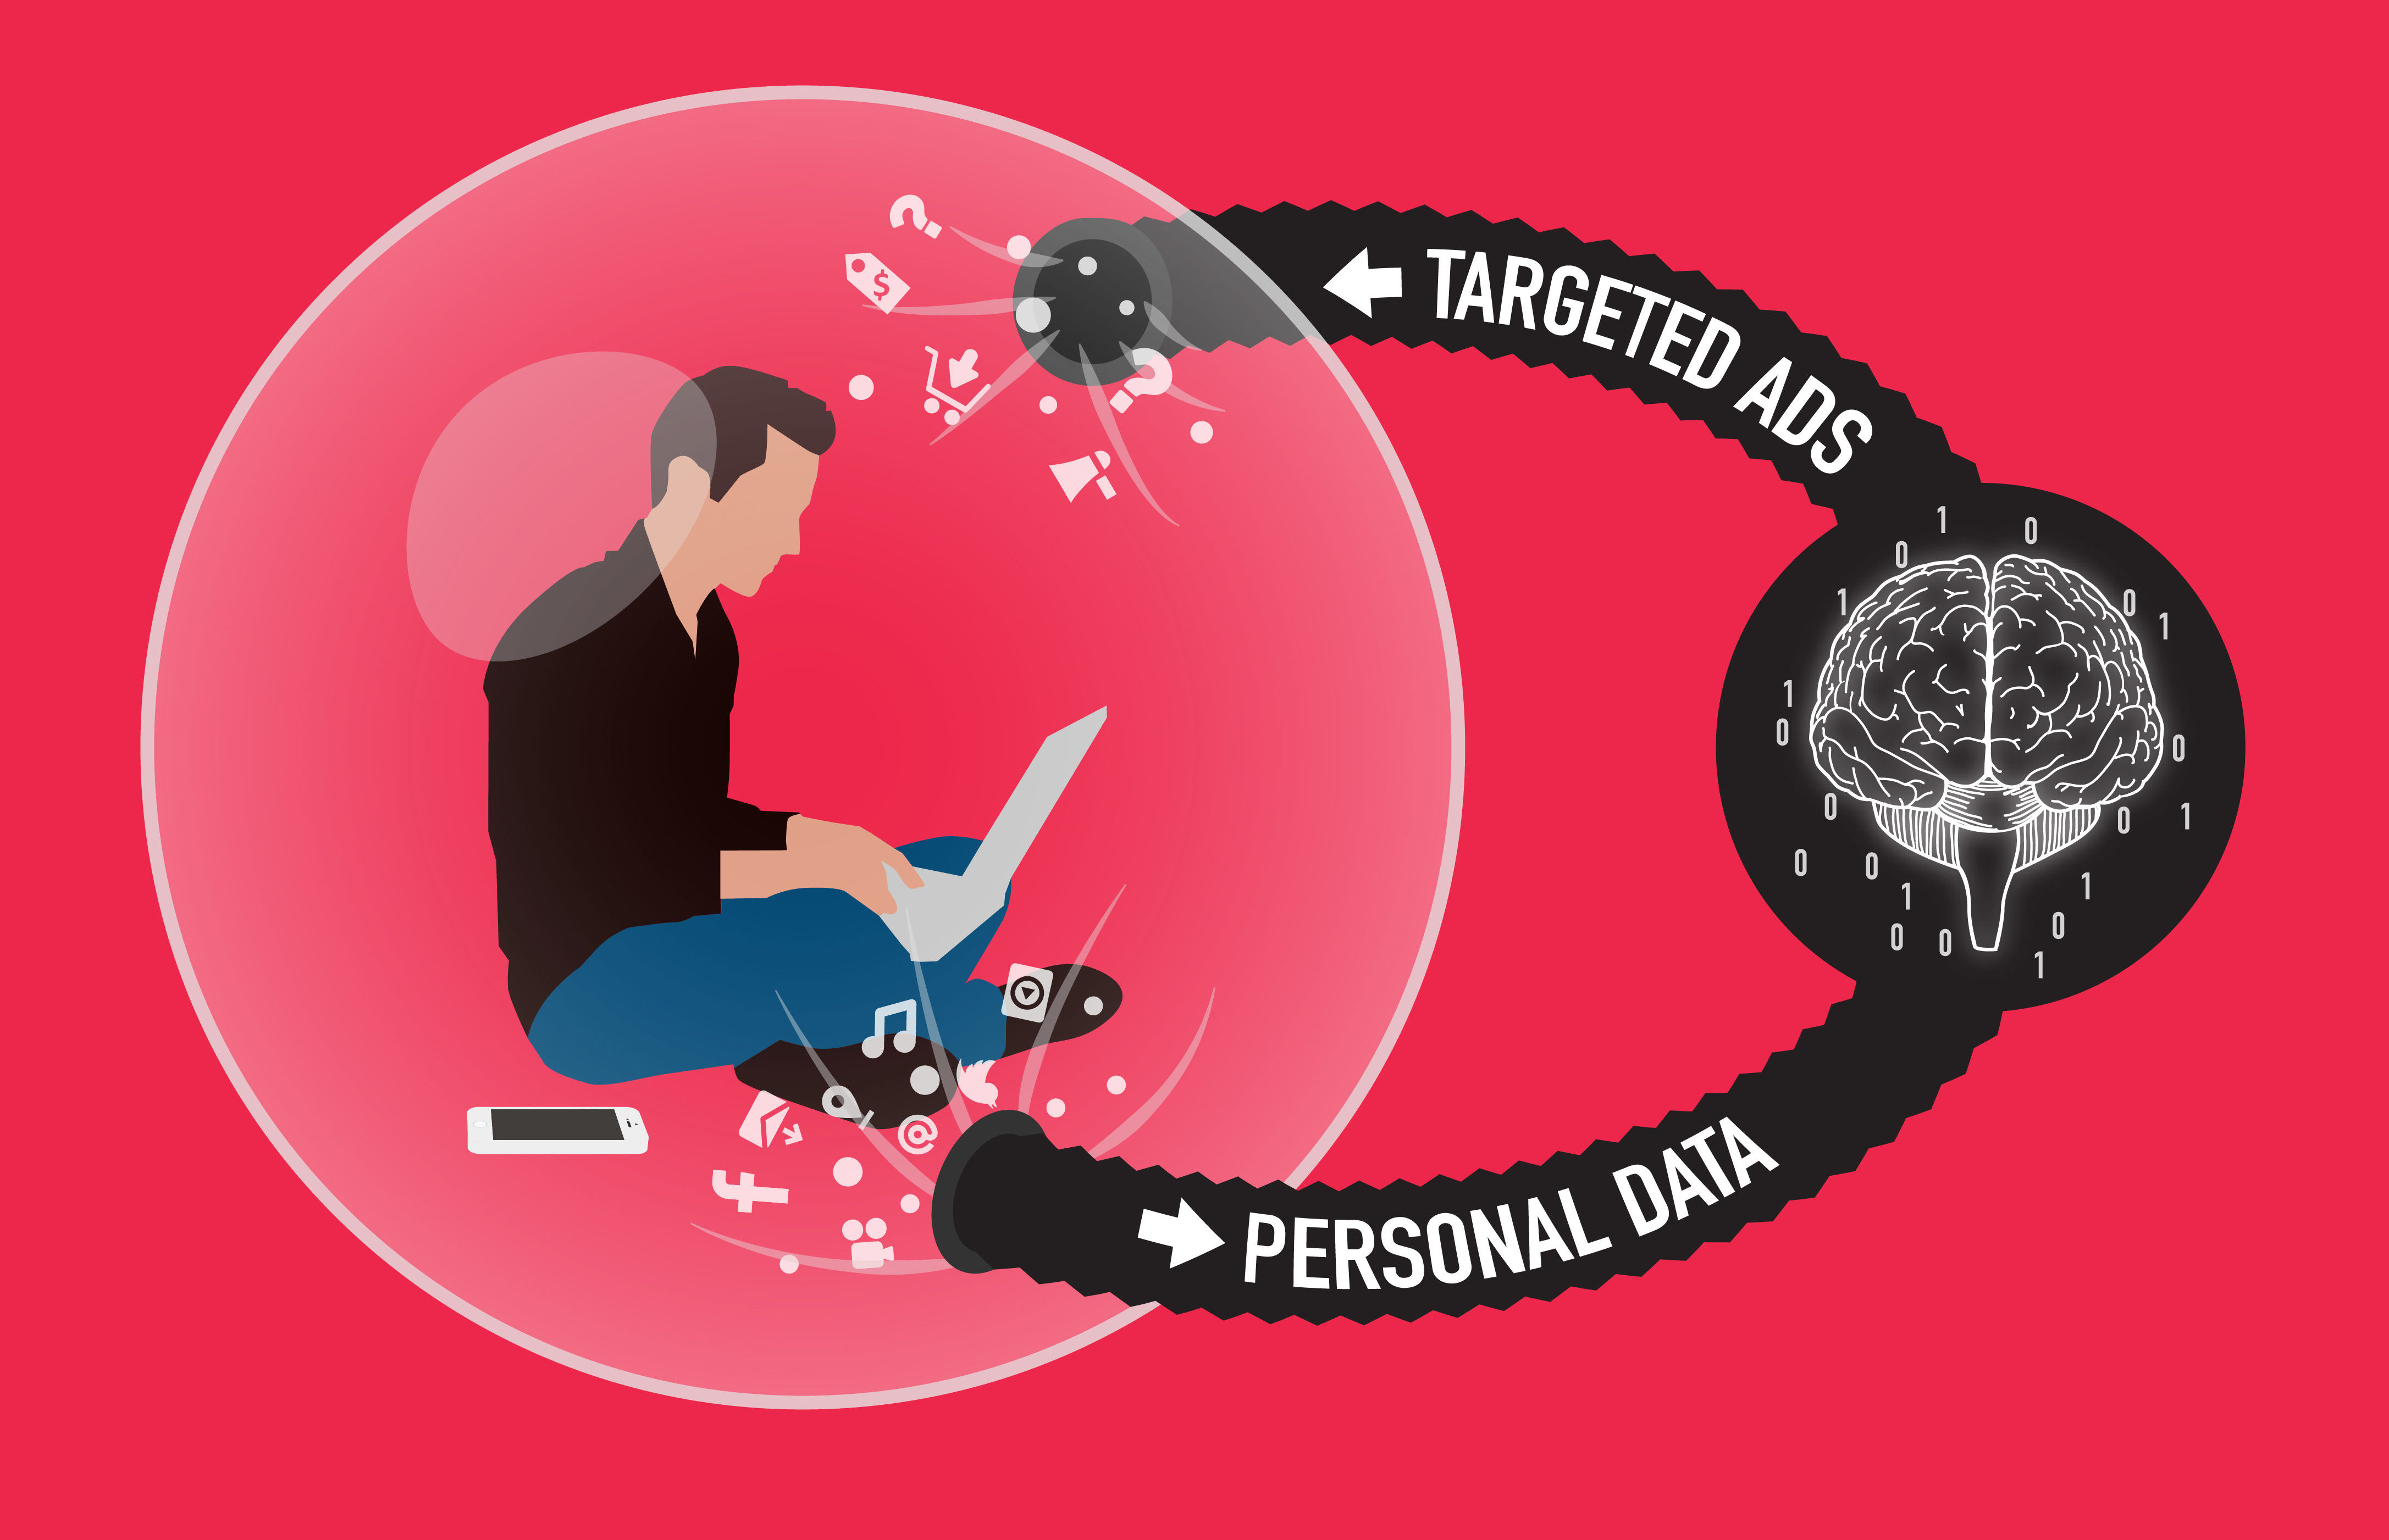
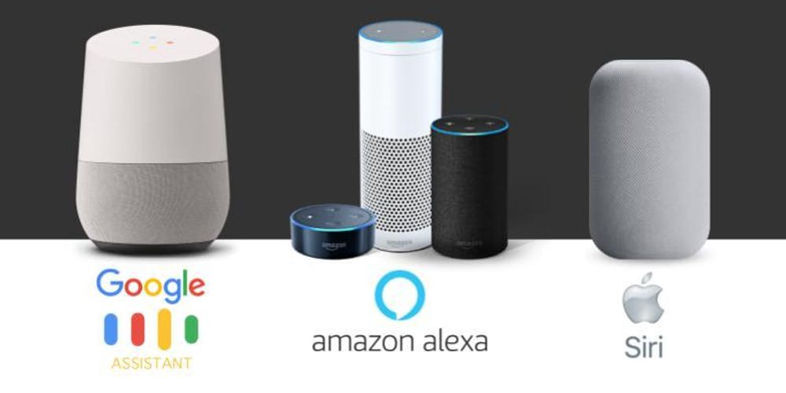
The Use of Algorithms
Algorithms can be used for:
Mapping your online world
Analyzing what is in your personal filter bubble
Not everyone gets the same results online
To predict what customers might want to buy/watch
To conduct sentiment analysis of posts
To enable smart assistants

Slide 14
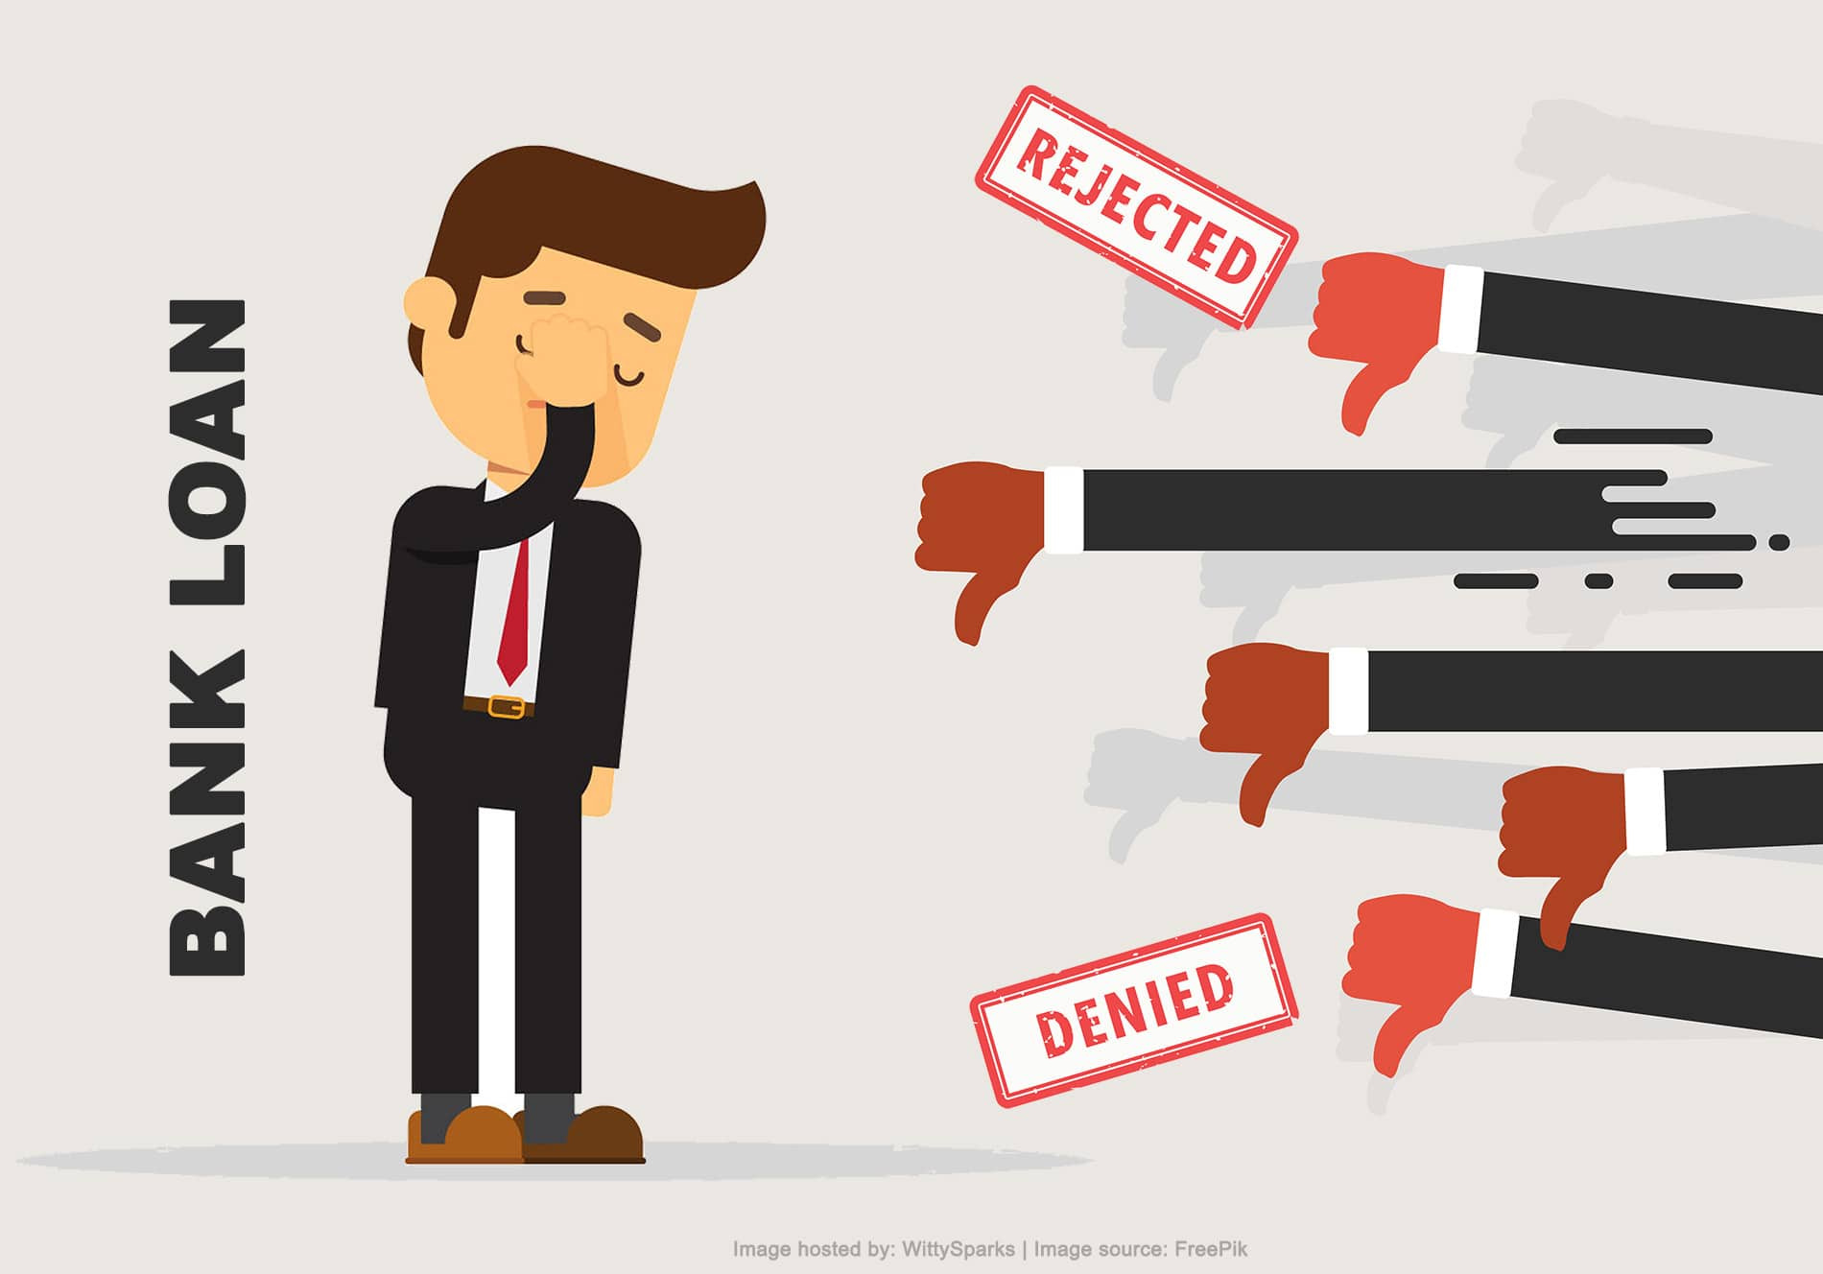
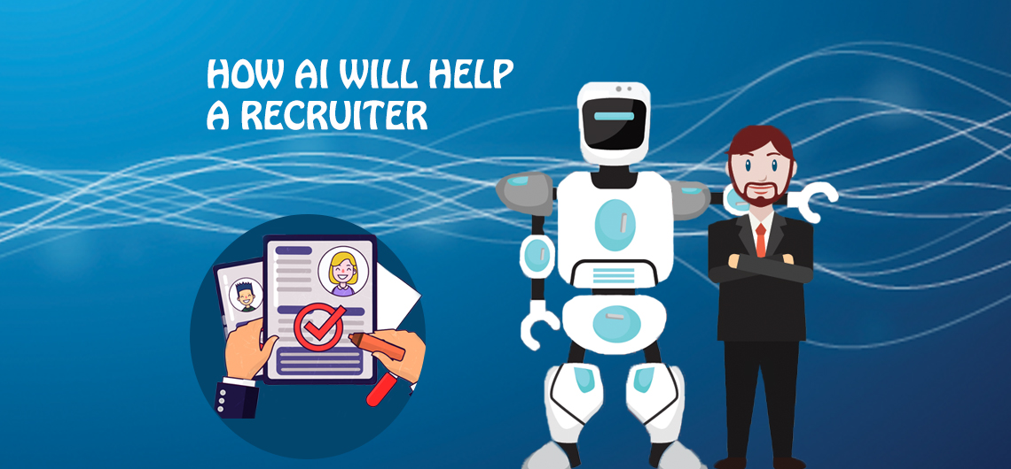
The Use of Algorithms
What happens when the output of decision-making algorithms have significant societal impact?
Loans
Hiring
Issues have arisen regarding the fairness of these algorithmic decisions
University Admissions
Bails

Slide 15
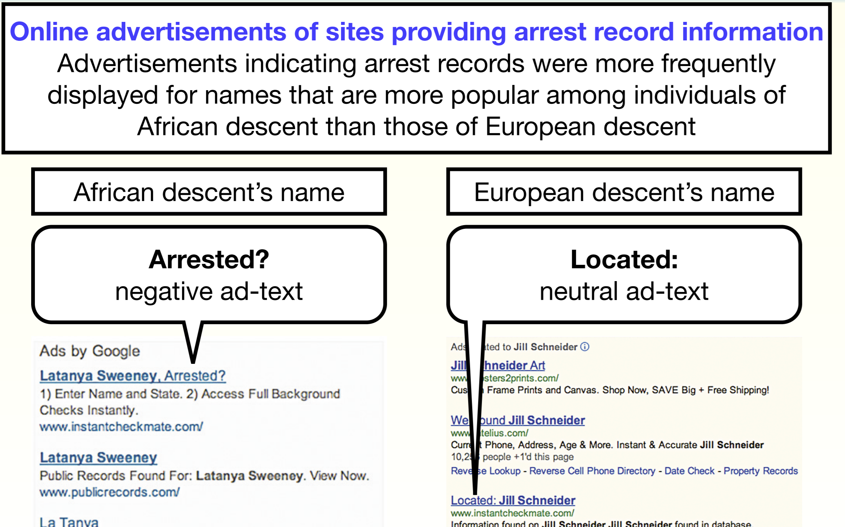
Examples Of Algorithmic Biases
Bias in online ads
Latanya Sweeney, Harvard researcher and former chief technology officer at the Federal Trade Commission (FTC), found that
online search queries for African-American names were more likely to return ads to that person from a service that renders arrest records, as compared to the ad results for white names.
the same differential treatment occurred in the micro-targeting of higher-interest credit cards and other financial products when the computer inferred that the subjects were African-Americans, despite having similar backgrounds to whites.
Sweeney, Latanya. “Discrimination in online ad delivery.” Rochester, NY: Social Science Research Network, January 28, 2013. Available at https://papers.ssrn.com/abstract=2208240 (last accessed April 12, 2019).

Slide 16
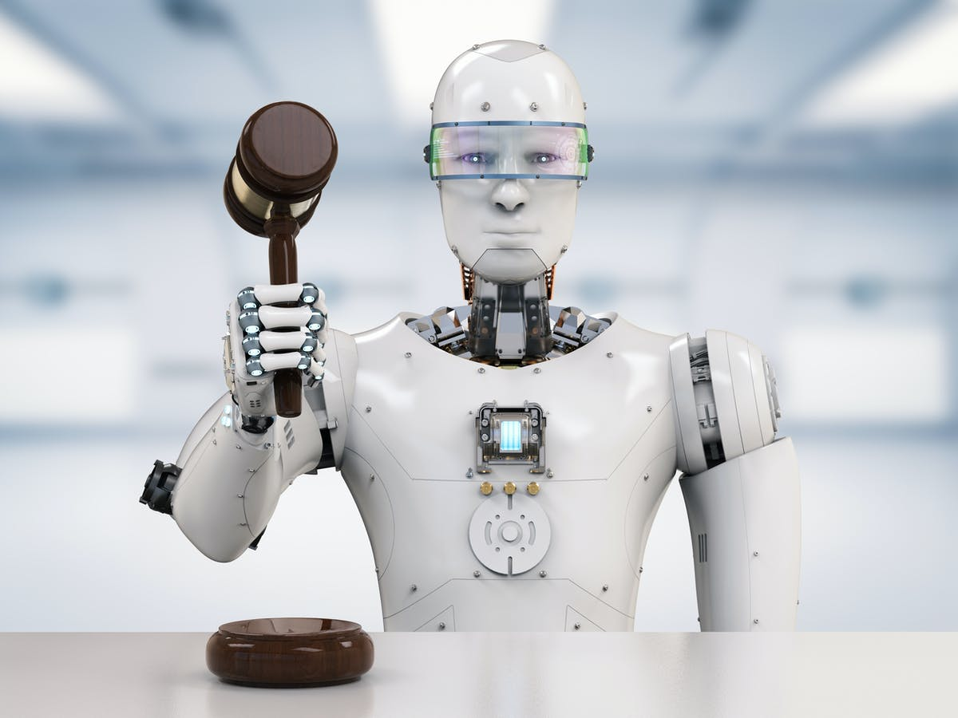
Examples Of Algorithmic Biases
Bias in facial recognition technology
the algorithms powering three commercially available facial recognition software systems were failing to recognize darker-skinned complexions
most facial recognition training data sets are estimated to be more than 75% male and more than 80% white.
When the person in the photo was a white man, the software was accurate 99% of the time at identifying the person as male.
Bias in criminal justice algorithms
COMPAS algorithm, which is used by judges to predict whether defendants should be detained or released on bail pending trial, was found to be biased against African-Americans
The algorithm assigns a risk score to a defendant’s likelihood to commit a future offense, relying on the voluminous data available on arrest records, defendant demographics, and other variables.
Compared to whites who were equally likely to re-offend, African-Americans were more likely to be assigned a higher-risk score, resulting in longer periods of detention while awaiting trial
Hardesty, Larry. “Study Finds Gender and Skin-Type Bias in Commercial Artificial-Intelligence Systems.” MIT News, February 11, 2018. Available at http://news.mit.edu/2018/study-finds-gender-skin-type-bias-artificial-intelligence-systems-0212 (last accessed April 19, 2019).
Corbett-Davies, Sam, Emma Pierson, Avi Feller, Sharad Goel, and Aziz Huq. “Algorithmic Decision Making and the Cost of Fairness.” ArXiv:1701.08230 [Cs, Stat], January 27, 2017. https://doi.org/10.1145/3097983.309809

Slide 17
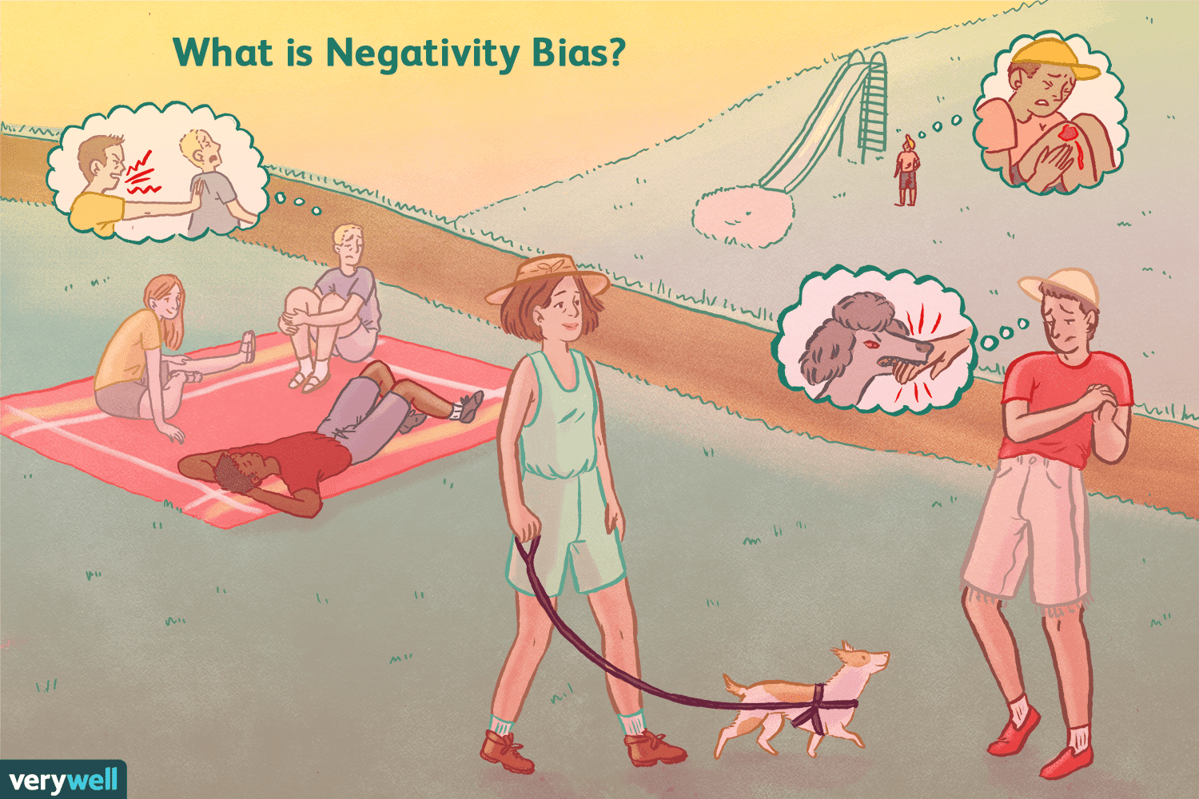
Historical Human Biases
Historical human biases are shaped by pervasive and often deeply embedded prejudices against certain groups, which can lead to their reproduction and amplification in computer models.
As humans, we tend to:
Remember traumatic experiences better than positive ones
Recall insults better than praise.
React more strongly to negative stimuli.
Think about negative things more frequently than positive ones.
Respond more strongly to negative events than to equally positive ones.
these realities will be reflected in the training data
If historical biases are factored into the model, it will make the same kinds of wrong judgments that people do.

Slide 18
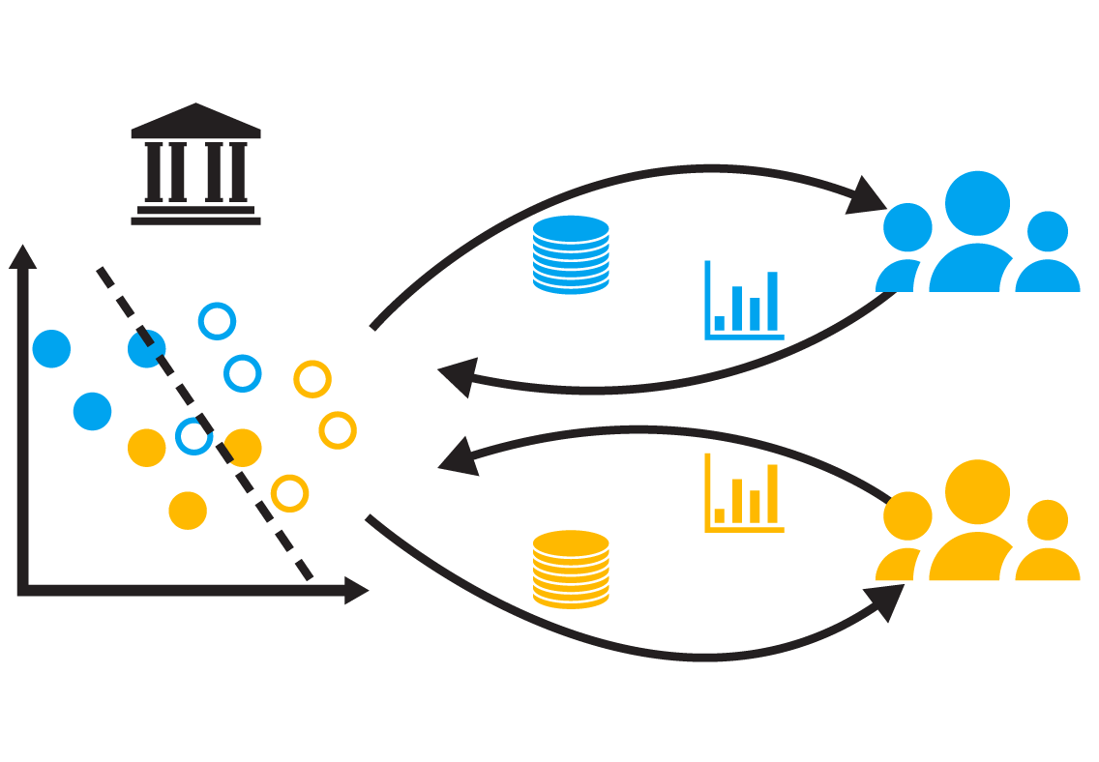
Results of Historical Human Biases
Further, human biases can be reinforced and perpetuated without the user’s knowledge.
For example, African-Americans who are primarily the target for high-interest credit card options might find themselves clicking on this type of ad without realizing that they will continue to receive such predatory online suggestions.
In this and other cases, the algorithm may never accumulate counter-factual ad suggestions (e.g., lower-interest credit options) that the consumer could be eligible for and prefer.
Thus, it is important for algorithm designers and operators to watch for such potential negative feedback loops that cause an algorithm to become increasingly biased over time.

Slide 19
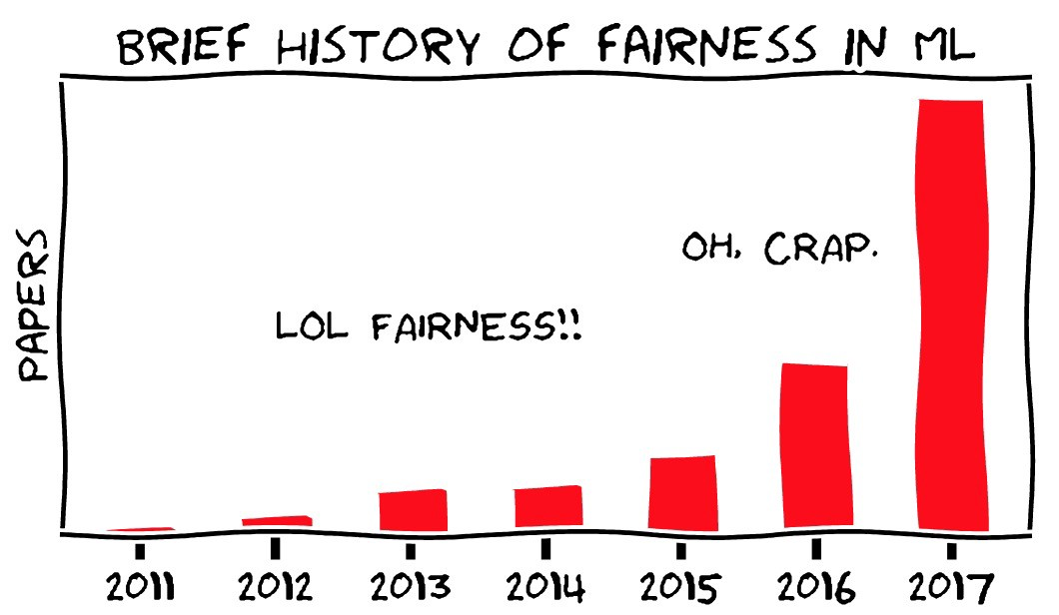
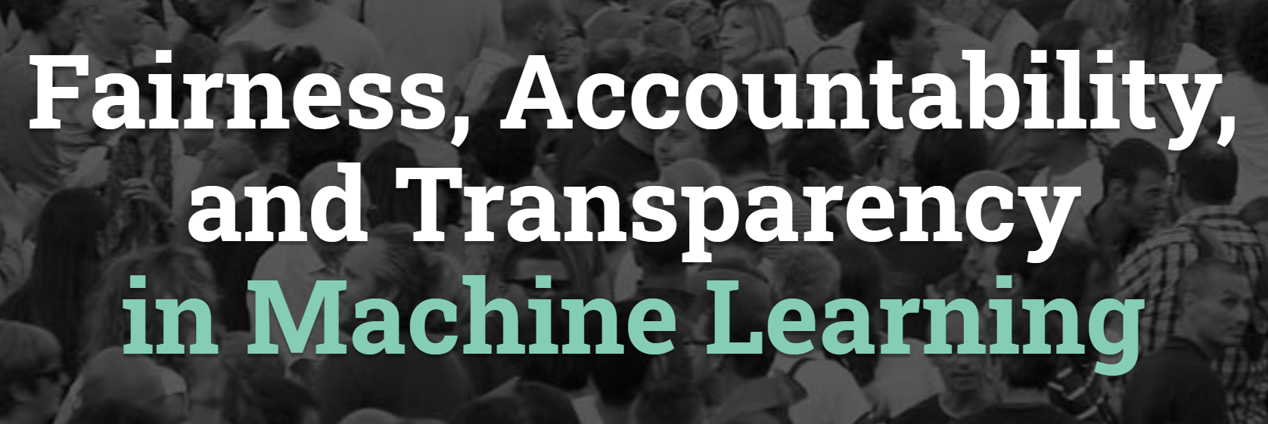
Fairness in Machine Learning Research
The number of publications on fairness from 2011 to 2017

Slide 20
Definition of Fairness
How People Perceive The Fairness?
In principle, fairness is the absence of any bias based on an individual’s inherent or acquired characteristics that are irrelevant in the particular context of decision-making
#1 Treating similar individuals similarly: This is determined by a similarity distance metric (applied to certain attributes) which represents a notion of ground truth in regard to the decision context.
->Individuals with similar repayment rates should receive similar amounts of money
#2 Never favor a worse individual over a better one: This definition promotes meritocracy with respect to the candidate’s inherent quality
-> An individual with a higher repayment rate should obtain at least as much money as her peer
#3 Calibrated fairness: selects individuals in proportion to their merit
-> two individuals with repayment rates r1 and r2, respectively, should obtain r1/(r1 + r2) and r2/(r1 + r2) amount of money, respectively
Saxena, N.A., Huang, K., DeFilippis, E., Radanovic, G., Parkes, D.C. and Liu, Y., 2019, January. How do fairness definitions fare? Examining public attitudes towards algorithmic definitions of fairness. In Proceedings of the 2019 AAAI/ACM Conference on AI, Ethics, and Society (pp. 99-106).

Slide 21
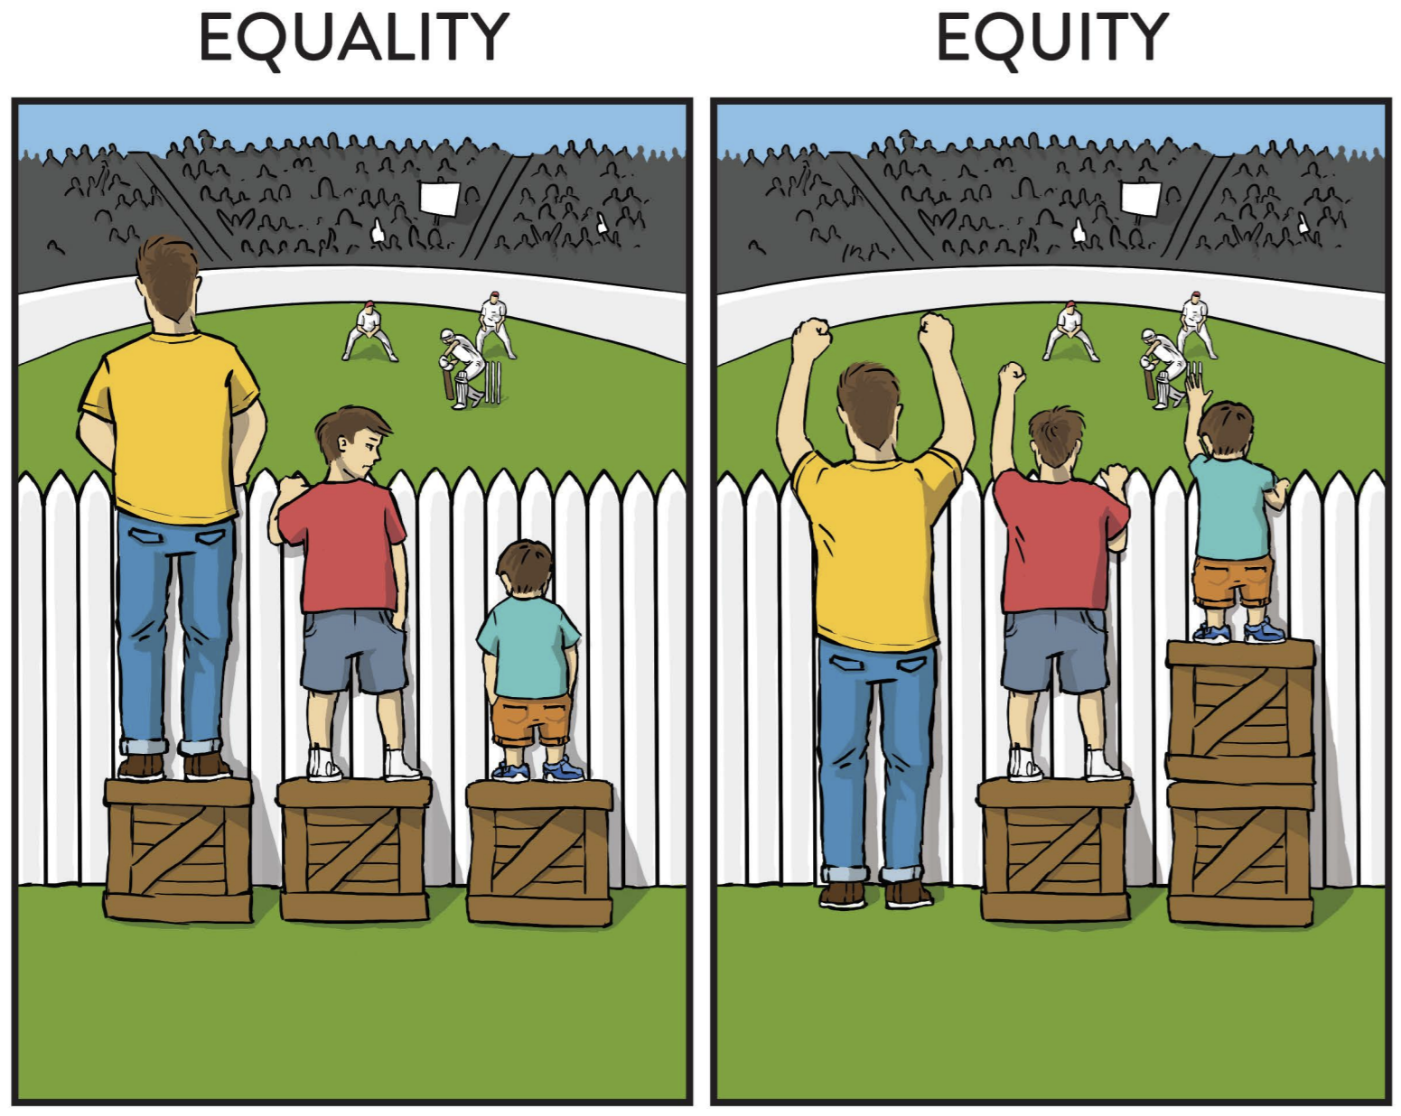
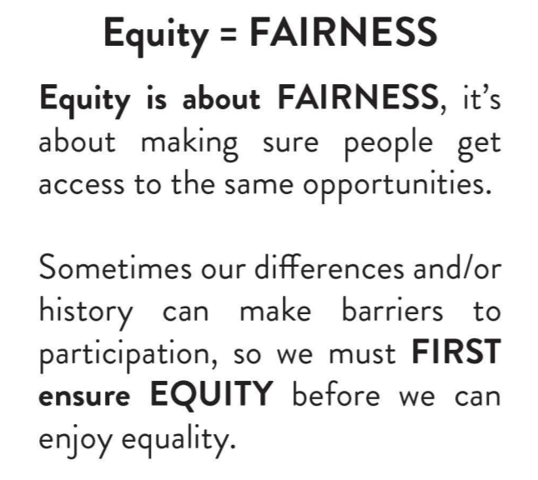
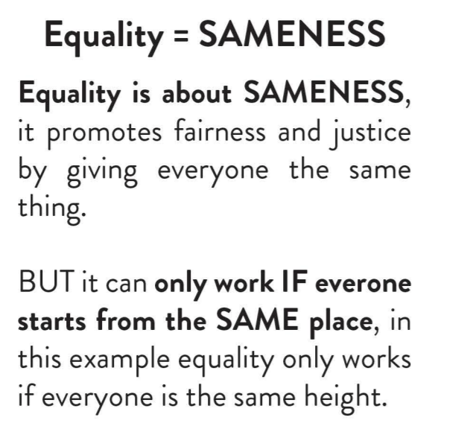
What Is Fairness?

Slide 22
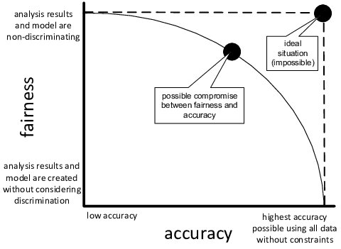
The Meaning Of Fairness With Respect To Algorithmic Systems
Studying fairness in ML decision-making algorithms means studying the algorithms not only from a perspective of accuracy, but also from a perspective of fairness
The difficulty revolves around defining what fairness means
In many cases these definitions have trade-offs with accuracy (i.e, achieving them means necessarily paying a price in terms of the model’s accuracy)
Van Der Aalst, W.M., 2016. Green data science: using big data in an" environmentally friendly" manner. In 18th international conference on enterprise information systems (ICEIS 2016) (pp. 9-21). SCITEPRESS-Science and Technology Publications, Lda..

Slide 23
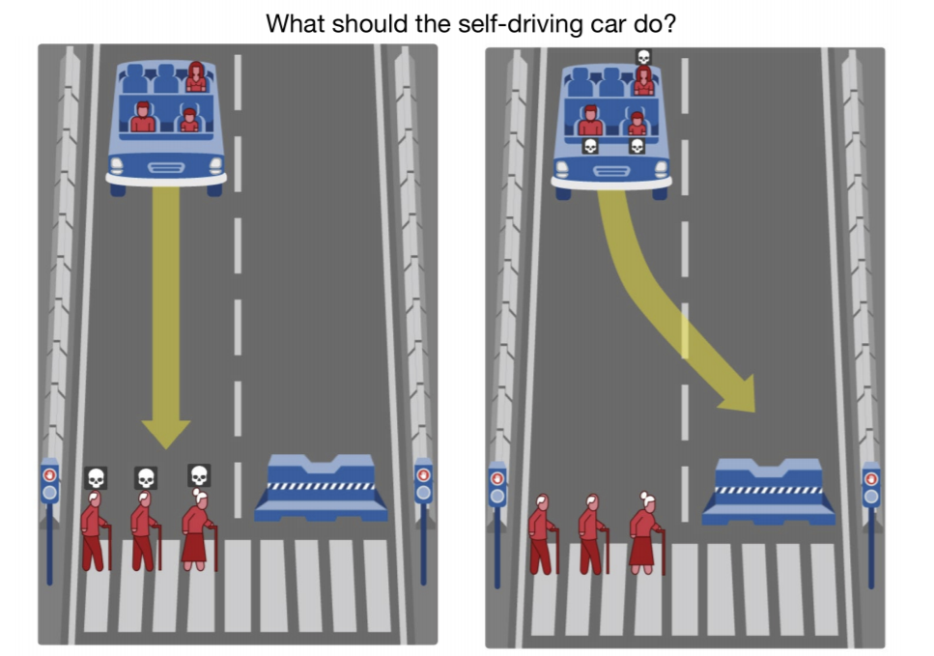
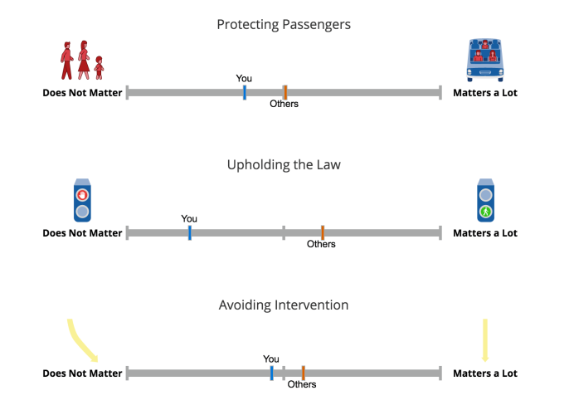
The Moral Machine Experiment
Allowing machines to choose whether to kill humans would be devastating for world peace and security
An online experimental platform designed to gather a human perspective on moral decisions faced by autonomous vehicles
https://www.moralmachine.net/

Slide 24
Potential Causes Of Unfairness
Biases already included in the datasets, which are based on:
biased device measurements
historically biased human decisions - unfair labelling by annotators
erroneous reports or other reasons
Biases caused by missing data
Sample selection bias - datasets are not representative of the target population
Limited features - features may be less informative or reliably collected for minority group
Size disparity – unbalanced dataset
Biases caused by “proxy" attributes (non-sensitive attributes that can be exploited to derive sensitive attribute)
Pessach, D. and Shmueli, E., 2020. Algorithmic fairness. arXiv preprint arXiv:2001.09784.

Slide 25
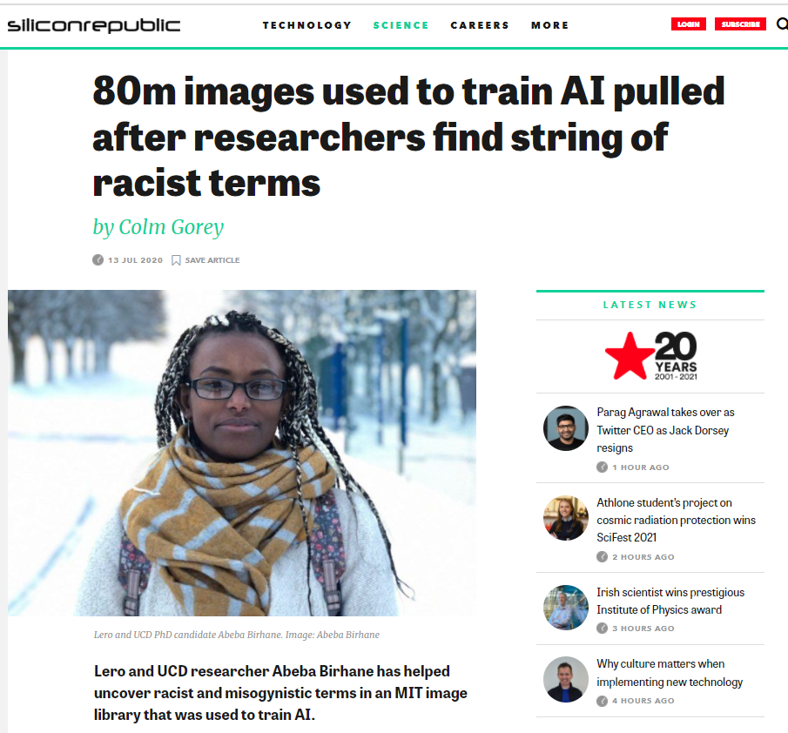
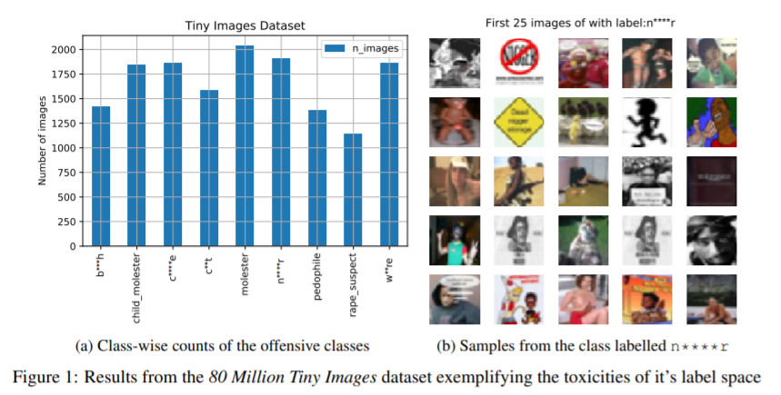
Example of problems in datasets
Birhane, A. and Prabhu, V.U., 2021, January. Large image datasets: A pyrrhic win for computer vision?. In 2021 IEEE Winter Conference on Applications of Computer Vision (WACV) (pp. 1536-1546). IEEE.
https://www.siliconrepublic.com/machines/mit-database-racist-misogynist-discovery-abeba-birhane

Slide 26
Detecting And Mitigating Bias (1/4)
Bias detection should begin with careful handling of the sensitive information of users, including data that identify a person’s membership in a federally protected group (e.g., race, gender).
In some cases, operators of algorithms may also worry about a person’s membership in some other group if they are also susceptible to unfair outcomes.
An example of this could be college admission officers worrying about the algorithm’s exclusion of applicants from lower-income or rural areas; these are individuals who may be not federally protected but do have susceptibility to certain harms (e.g., financial hardships).
Recent research has proposed to use encryption over sensitive attributes to improve fairness while still allowing the model to be trained, checked, or have its outputs verified and held to account

Slide 27
Detecting And Mitigating Bias (2/4)
Computer programmers normally examine the set of outputs that the algorithm produces to check for anomalous results.
Comparing outcomes for different groups can be a useful first step.
This could even be done through simulations
companies consider the simulation of predictions (both true and false) before applying them to real-life scenarios
For example, if a job-matching algorithm’s average score for male applicants is higher than that for women, further investigation and simulations could be warranted.

Slide 28
Detecting And Mitigating Bias (3/4)
Fairness-Aware Data Collection and Curation
improved attention to identifying blind spots, biases and limitations in machine learning team and other actors (such as those responsible for outcome decisions /labelling)
More proactive and holistic auditing processes
Addressing issues detected during machine learning
Holstein, K. et al. (2019) ‘Improving fairness in machine learning systems: What do industry practitioners need?’, Conference on Human Factors in Computing Systems - Proceedings, pp. 1–16.

Slide 29
Detecting And Mitigating Bias (4/4)
Ethical Frameworks
Ethics Guidelines for Trustworthy AI: (1) human agency and oversight, (2) technical robustness and safety, (3) privacy and data governance, (4) transparency, (5) diversity, nondiscrimination and fairness, (6) environmental and societal well-being, and (7) accountability
it is unethical to “unfairly discriminate”
Algorithmic Impact Assessments (AIAs)

Slide 30
Legal, Social, And Philosophical Models Of Fairness
Quantitative restrictions by regulations or laws against discrimination:
Racial Equality Directive of E.U. shall be taken to occur where one person is treated less favorably than another is in a comparable situation on grounds of racial or ethnic origin
Uniform Guidelines on Employee Selection Procedure (US) a selection rate for any race, sex, or ethnic group which is less than four-fifths (or 80%) of the rate for the group with the highest rate will generally be regarded as evidence of adverse impact
Anti-Discrimination Act (Australia, Queensland) a person treats, or proposes to treat, a person with an attribute less favorably than another person without the attribute
D. Pedreschi, S. Ruggieri, and F. Turini. Measuring discrimination in socially-sensitive decision records. In Proc. of the SIAM Int’l Conf. on Data Mining, pages 581–592, 2009. doi: https: //doi.org/10.1137/1.9781611972795.50

Slide 31
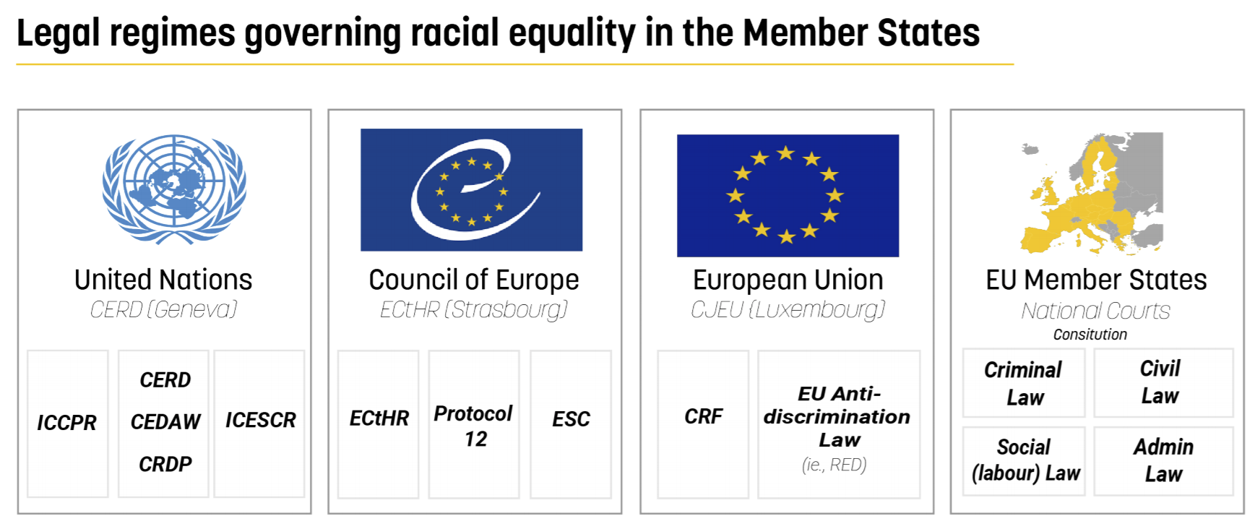
Legal, Social, And Philosophical Models Of Fairness
https://www.migpolgroup.com/wp-content/uploads/2020/09/MINDSET-Handbook-on-the-Racial-Equality-Directive-003-final.pdf

Slide 32
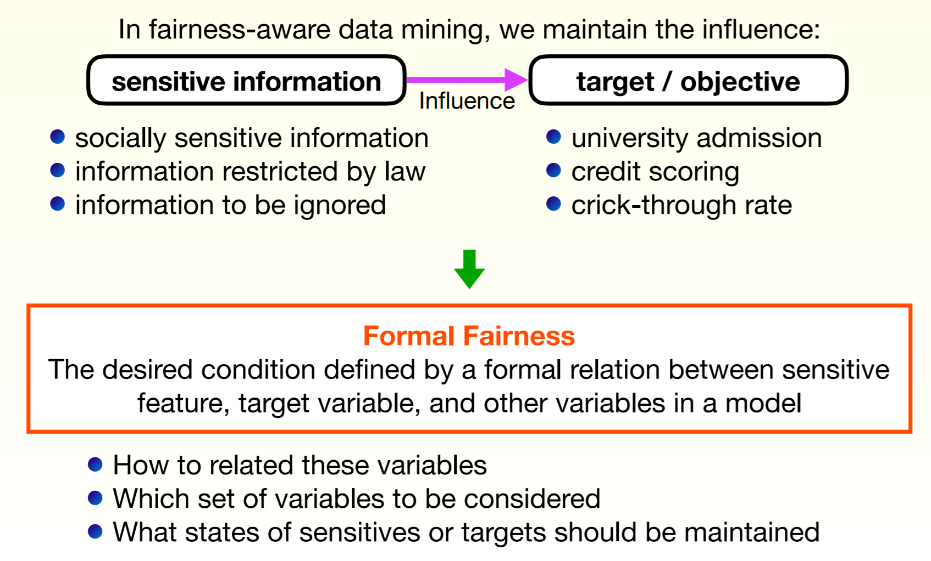
Formalizing Fairness
http://www.kamishima.net/faml/

Slide 33
Fairness, Accountability, and Transparency in Algorithmic Systems II
The meaning of accountability with respect to algorithmic systems.
Processes and strategies for developing accountable systems.
Methods and tools and standards for ensuring that algorithms comply with fairness policies (e.g., IEEE P7003 TM).

Slide 34
The Use of Algorithms
Algorithms silently structure our lives
Algorithms make data sets valuable
Algorithms can affect lives in ways far beyond our choice of nightly entertainment
This Photo by Unknown Author is licensed under CC BY
This Photo by Unknown Author is licensed under CC BY

Slide 35
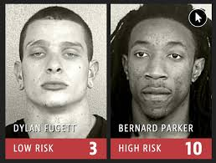
“Algorithms silently structure our lives”
The COMPAS Tool
“Rodríguez was just 16 at the time of his arrest, and was convicted of 2nd degree murder for his role in an armed robbery of a car dealership that left an employee dead. Now, twenty-six years later, he was a model of rehabilitation. He had requested a transfer to Eastern, a maximum-security prison, in order to take college classes. He had spent four and a half years training service dogs for wounded veterans and eleven volunteering for a youth program. A job and a place to stay were waiting for him outside. And he had not had a single disciplinary infraction for the past decade…
(Wexler 2017). Quoted in Martin (2018)
Eastern Correctional Facility in 2015 Source: wikipedia
Yet, last July, the parole board hit him with a denial. It might have turned out differently but, the board explained, a computer system called COMPAS had ranked him “high risk.” Neither he nor the board had any idea how this risk score was calculated; Northpointe, the for-profit company that sells COMPAS, considers that information to be a trade secret.”
Source: https://link.springer.com/article/10.1007/s10551-018-3921-3

Slide 36
Algorithms, Decisions, and Accountability
Computers are expected to provide unbiased calculations insofar they take in points of reference objectively and use algorithmic processes to provide a standard outcome
The conventional wisdom therefore is that there are considerable benefits of using algorithms over human processing and decision making
speed, efficiency and consistency
and even fairness as there a common misconception that algorithms automatically always result in ‘unbiased’ decisions
Algorithms are therefore attractive because they promise speed and neutrality in decision making.

Slide 37
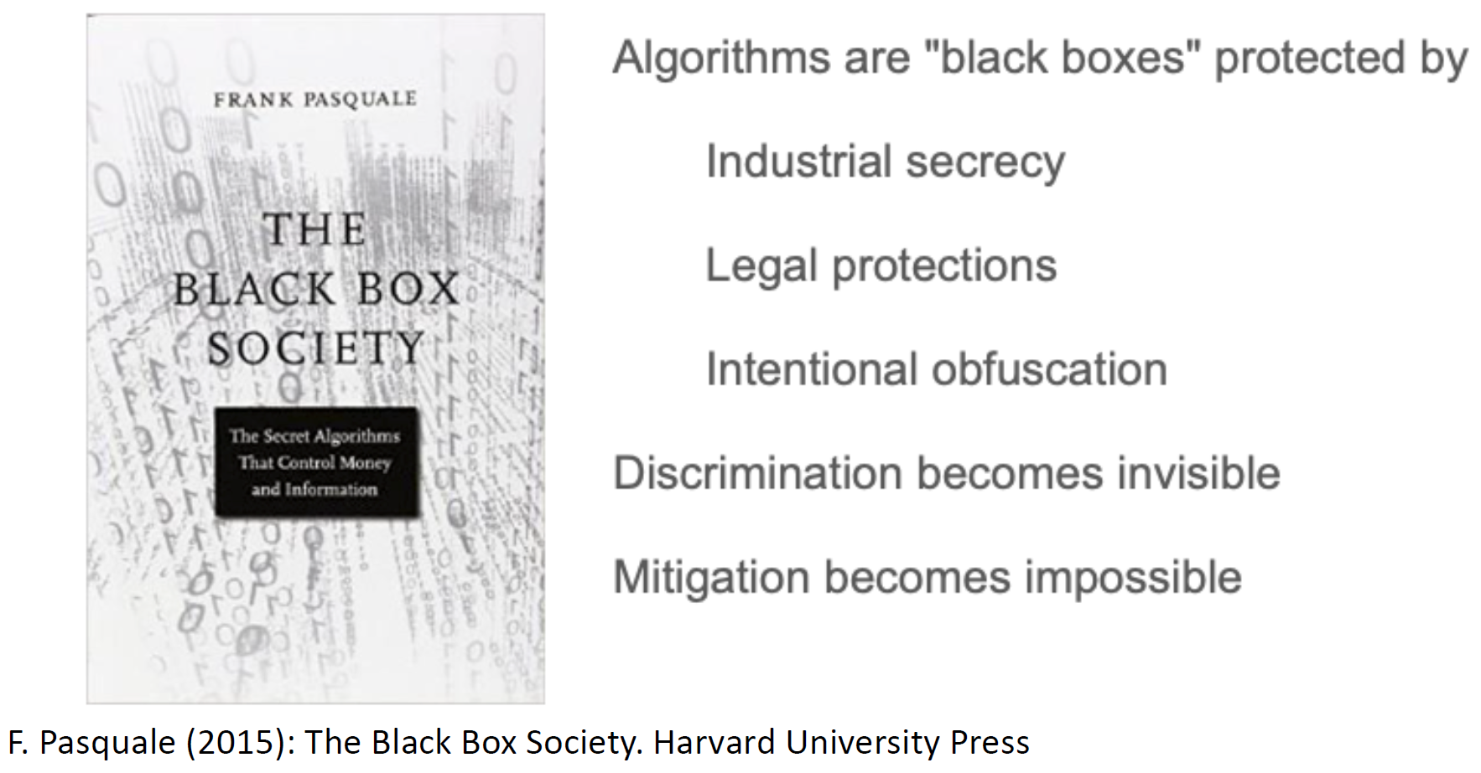
Algorithms, Decisions and Accountability
However algorithmic decision-making is “black boxed” --- Frank Pasquale
what goes into the computer for processing and what the outcome is
inner process remains unknown
We must not assume that algorithms are “neutral” but represent an “opinion embedded in mathematics.” (Data Scientisty Cathy O’Neil – author of Weapons of Math Destruction)
Therefore, accountability for those decisions must remain in an ethical system

Slide 38
Defining Accountability
Accountability - 'A set of mechanisms, practices and attributes that sum to a governance structure which involves committing to legal and ethical obligations, policies, procedures and mechanism, explaining and demonstrating ethical implementation to internal and external stakeholders and remedying any failure to act properly’.
Source: EPRS (2019)

Slide 39
Meaning And Functions Of Accountability
Accountability is primarily a legal and ethical obligation on an individual or organisation to account for its activities, accept responsibility for them, and to disclose the results in a transparent manner
Functions of accountability principle
act as a deterrent to reckless, irresponsible or illegal behaviour on the part of humans deploying/using algorithmic systems
generate a self-reflective feedback loop for citizens and society, exposing existing biases and power dynamics

Slide 40
Algorithmic Accountability
Algorithmic accountability refers to the assignment of responsibility for how an algorithm is created and its impact on society.
The final decisions to put an algorithmic system on the market belongs to the technology’s designers and company. Critically, algorithms do not make mistakes, humans do
Assigning responsibility is critical for quickly remediating discrimination and assuring the public that proper oversight is in place.
In addition to clearly assigning responsibility, accountability must be grounded in enforceable policies that begin with auditing in pre- and post- marketing trials as well as standardized assessments for any potential harms.
Accountability basic function is to act as a deterrent to reckless, irresponsible or illegal behaviour on the part of humans deploying/using algorithmic systems.

Slide 41
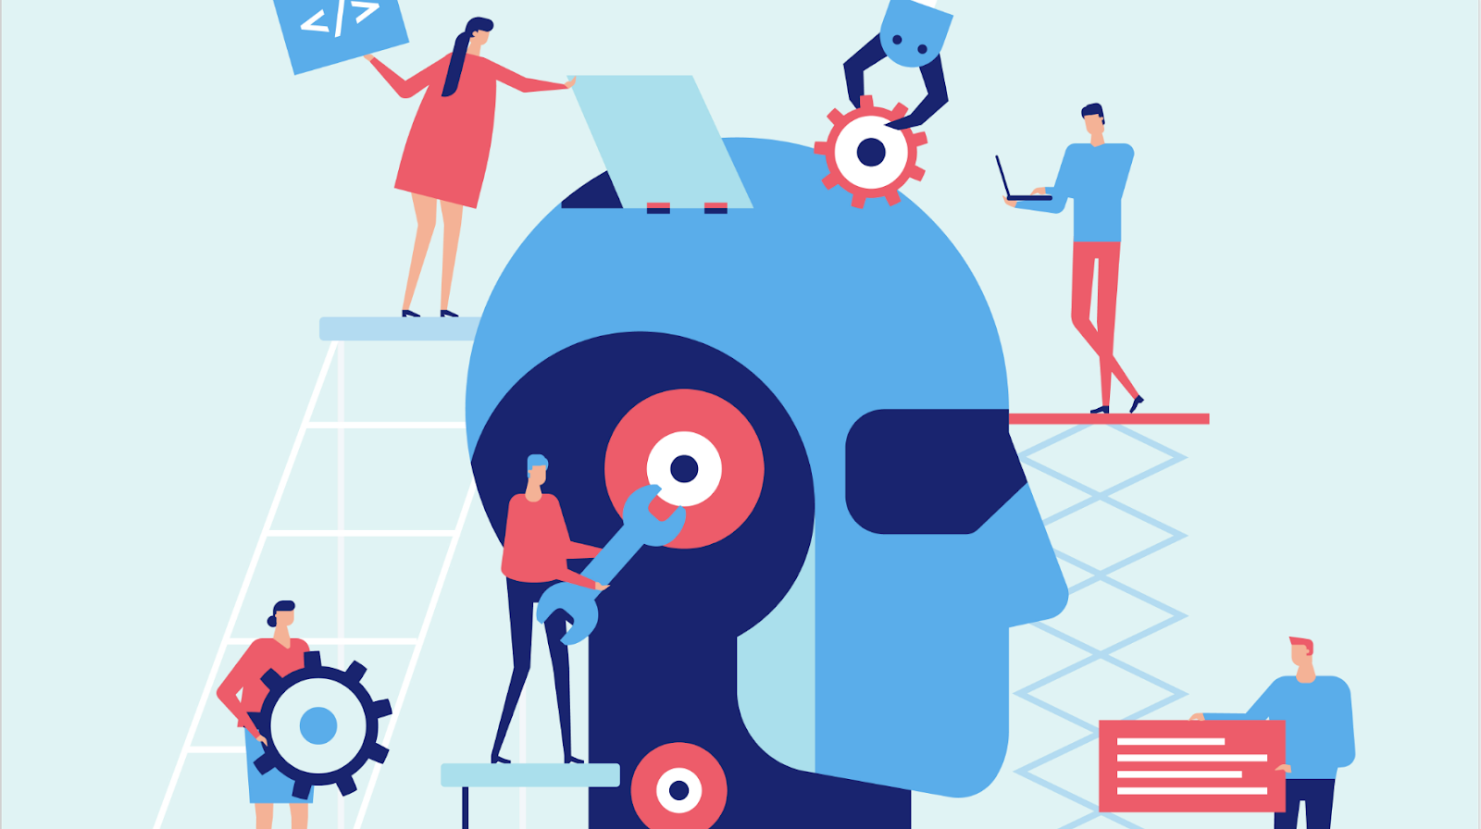
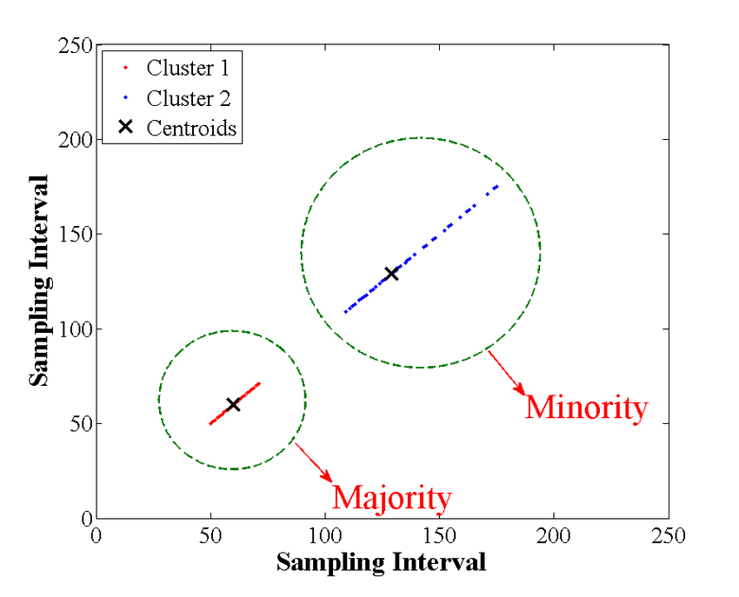
Challenges For Algorithmic Accountability (1/2)
Complex interactions between sub-systems and data sources, some of which might not be under the control of the same entity.
Unexpected outcomes associated with the impossibility of testing against all possible input conditions when there are no methods for generating formal proofs for the system’s performance.
Difficulties in translating algorithmically derived concepts into human understandable concepts resulting in incorrect interpretations of the meaning of algorithmic results.
Src: Koene, A., Clifton, C., Hatada, Y., Webb, H., & Richardson, R. (2019). A governance framework for algorithmic accountability and transparency.

Slide 42
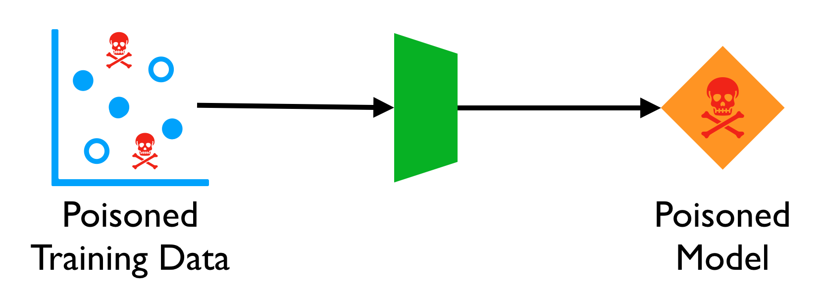
Challenges For Algorithmic Accountability (2/2)
Information asymmetries arising from algorithmic inferences and black box processes
Ubiquity of (small) algorithmic decisions which, if systematically biased, may accumulate to have significant impacts on people
Purposeful injections of adversarial data to fool a system into making errors, often in ways that can be very difficult to detect.
Koene, A., Clifton, C., Hatada, Y., Webb, H., & Richardson, R. (2019). A governance framework for algorithmic accountability and transparency.

Slide 43
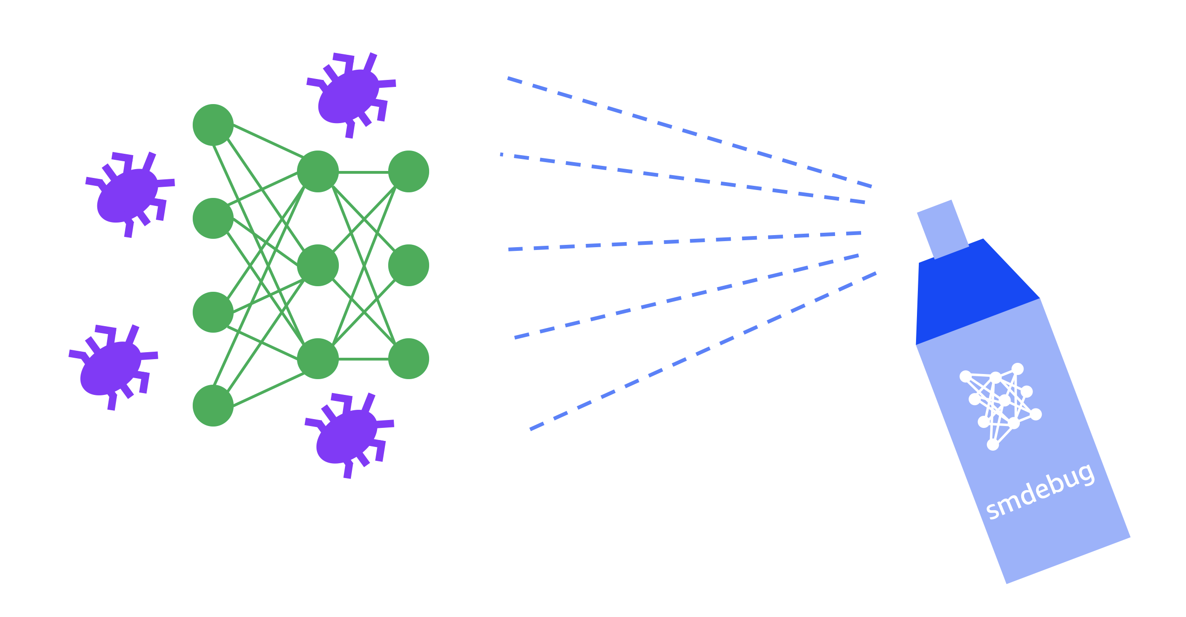
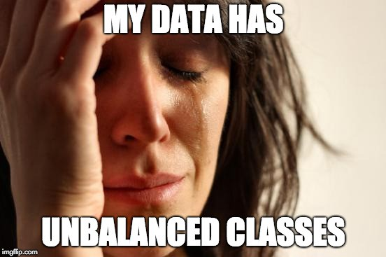
Algorithmic Accountability
Even if algorithms are programmed with specific attention to well-defined legal norms, it is difficult to know whether the algorithm behaved according to the legal standard or not, in any given circumstance.
Algorithms that engage in discrimination offer a good example for this point.
Tracing the discrimination to a problem with the algorithm could be nearly impossible

Slide 44
Algorithmic Accountability
Accountability for actions taken by algorithmic systems may need to be different than for human actions, those differences are largely governed by the particular application.
As a result, we will only look at mechanisms for ensuring that algorithmic systems satisfy specifications
Process standards and certification, such as ISO/IC JTC 1/SC7 standards for software engineering, or the Capability Maturity Model Integration (processes and procedures organisations should follow in systems design)
The IEEE P7000 series addresses specific issues at the intersection of technological and ethical considerations (particularly IEEE P7001 and P7003)
The most recent one is IEEE 7000™-2021: Model Process for Addressing Ethical Concerns During System Design, published in Sep 2021

Slide 45
Principal Of Accountability Is Contested
“Currently, it is difficult to get technology corporations to answer for the harms their products have caused.” (Caplan et al., 2018)
Why should this be?
Developers argue that algorithms are objective, neutral, blank-slates leaving minimal responsibility for the developer. It is the responsibility of users to interpret the results correctly.
Users on the other hand argue that algorithms are black boxes, complicated, difficult to explain.
Algorithms have life-changing implications and therefore moral consequences… Who should be accountable for them particularly for redress if they go wrong?

Slide 46
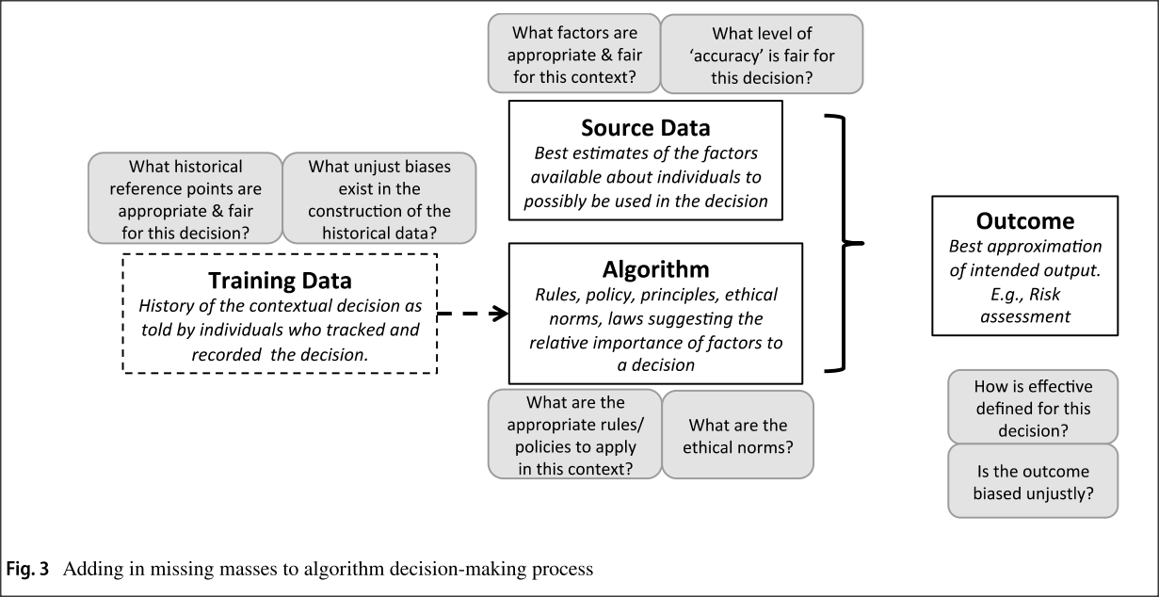
Need For Accountable Development
Algorithms are viewed as maximizing efficiency or accuracy; computer scientists are, therefore, responsible for ensuring efficiency and accuracy
Algorithms are not neutral but are “value-laden” to pre-determine roles and responsibilities to make choices within the algorithmic system
These questions go unanswered leaving the development process ultimately unaccountable
Martin, K. (2019). Ethical implications and accountability of algorithms. Journal of Business Ethics, 160(4), 835-850.

Slide 47
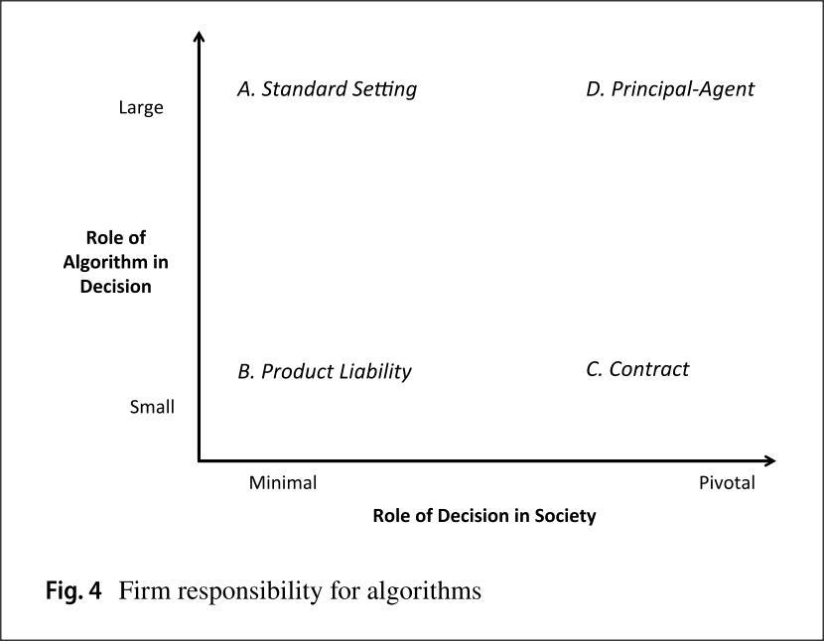
Framework For Appropriate Level Corporate Accountability
Martin (2019) proposes that the level of corporate accountability depends on two decisions that contribute to the appropriate type of accountability expected
Role of the algorithm in a decision (e.g is it deciding to target an advertisement at us or is it being using as the primary basis for granting us a mortgage?) [y-axis]
Significance of the decision in societal terms (e.g., is it suggesting a film to watch or recommending whether we should get released from prison?) [x-axis]
A range of circumstances will determine what the responsibility and accountability of a firm who developed the algorithm. This will depend upon (1)whether the algorithm plays a large or small role in the decision (2) the context in which the algorithm is to be used .

Slide 48
Algorithmic Impact Assessments -AIA-(1/3)
Algorithmic Impact Assessments provide a framework designed to help policymakers and their constituents understand where algorithmic systems are used within government, assess the intended use and proposed implementation, and allow community members and researchers to raise concerns that require mitigation.
The general shape of the process is likely to include the following:
Publication of public authority’s definition of 'algorithmic system'. This allows the public to understand how the authority decides which systems will be subjected to AIAs.
Once the definition has been published and gone through public review, it is used to assess all currently used systems

Slide 49
Algorithmic Impact Assessments -AIA-(2/3)
Public disclosure of purpose, scope, intended use and associated policies/practices, self-assessment timeline/process and potential implementation timeline of the algorithmic system OR publication (and archiving) of the decision not to review a potential system
Publication of plan for meaningful, ongoing access to external researchers to review the system once it is deployed
Public participation period
Publication of final Algorithmic Impact Assessment, once issues raise in public participation have been addressed
Renewal of AIAs on a regular timeline
Opportunity for public to challenge failure to mitigate issues raised in the public participation period or foreseeable outcomes

Slide 50
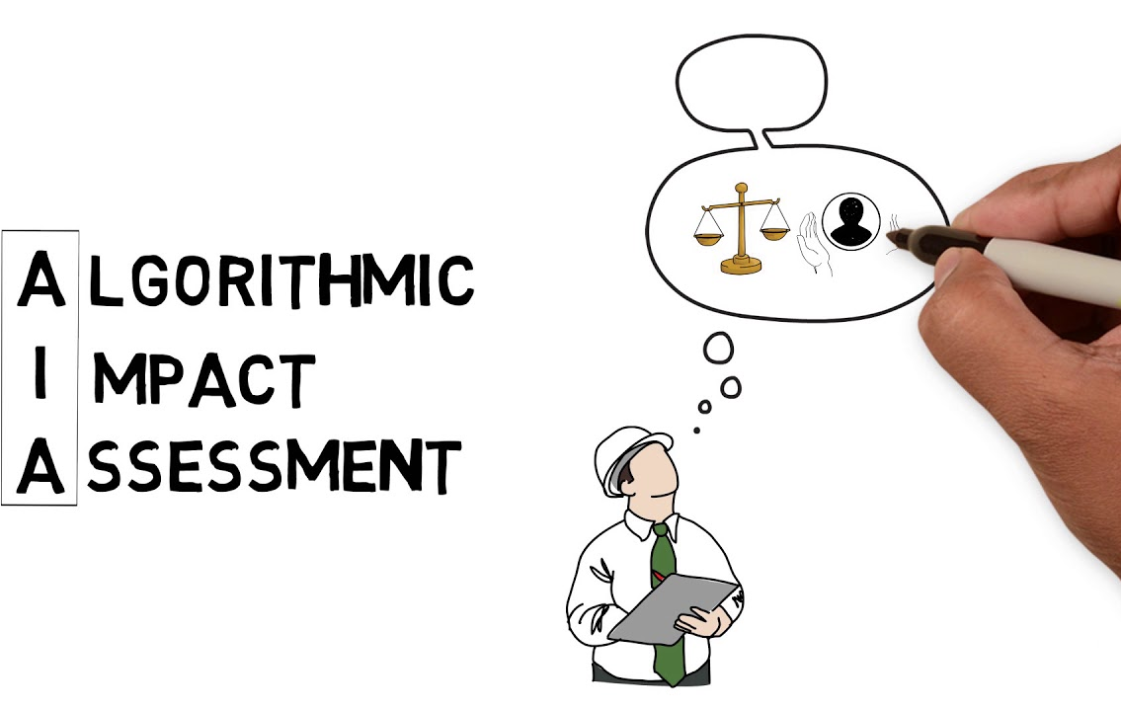
Algorithmic Impact Assessments -AIA-(3/3)
Capture an AI system’s risk. Establishing “risk gating criteria” enables organizations to properly classify the level of scrutiny needed for a specific AI application.
Cover full development life-cycle requirements. An AIA should encompass strategy and planning, ecosystem analysis, implications to model development, issues related to training data, deployment and, finally, ongoing operation, monitoring issues and governance.
Assess impact and increase accountability through a multi-stakeholder analysis. A successful impact assessment engages a broad range of internal stakeholders and may also include external representatives, such as ethics or data review boards.
Facilitate go/no-go decisions. This goal should address whether a model should move to production, determine if it’s ready to be transitioned for business-as-usual operations and decide whether it should continue as-is or be retrained, redesigned or retired.
https://www.pwc.com/us/en/tech-effect/ai-analytics/algorithmic-impact-assessments.html

Slide 51
Principles For Accountable Algorithms
Algorithms and the data that drive them are designed and created by people -- There is always a human ultimately responsible for decisions made or informed by an algorithm. "The algorithm did it" is not an acceptable excuse if algorithmic systems make mistakes or have undesired consequences, including from machine-learning processes.
Responsibility
Make available externally visible avenues of redress for adverse individual or societal effects of an algorithmic decision system and designate an internal role for the person who is responsible for the timely remedy of such issues.
Explainability
Ensure that algorithmic decisions as well as any data driving those decisions can be explained to end-users and other stakeholders in non-technical terms.
Accuracy
Identify, log, and articulate sources of error and uncertainty throughout the algorithm and its data sources so that expected and worst-case implications can be understood and inform mitigation procedures.
Auditability
Enable interested third parties to probe, understand, and review the behavior of the algorithm through disclosure of information that enables monitoring, checking, or criticism, including through provision of detailed documentation, technically suitable APIs, and permissive terms of use.
Fairness
Ensure that algorithmic decisions do not create discriminatory or unjust impacts when comparing across different demographics (e.g. race, sex, etc).
Principles for Accountable Algorithms and a Social Impact Statement for Algorithms :: FAT ML

Slide 52
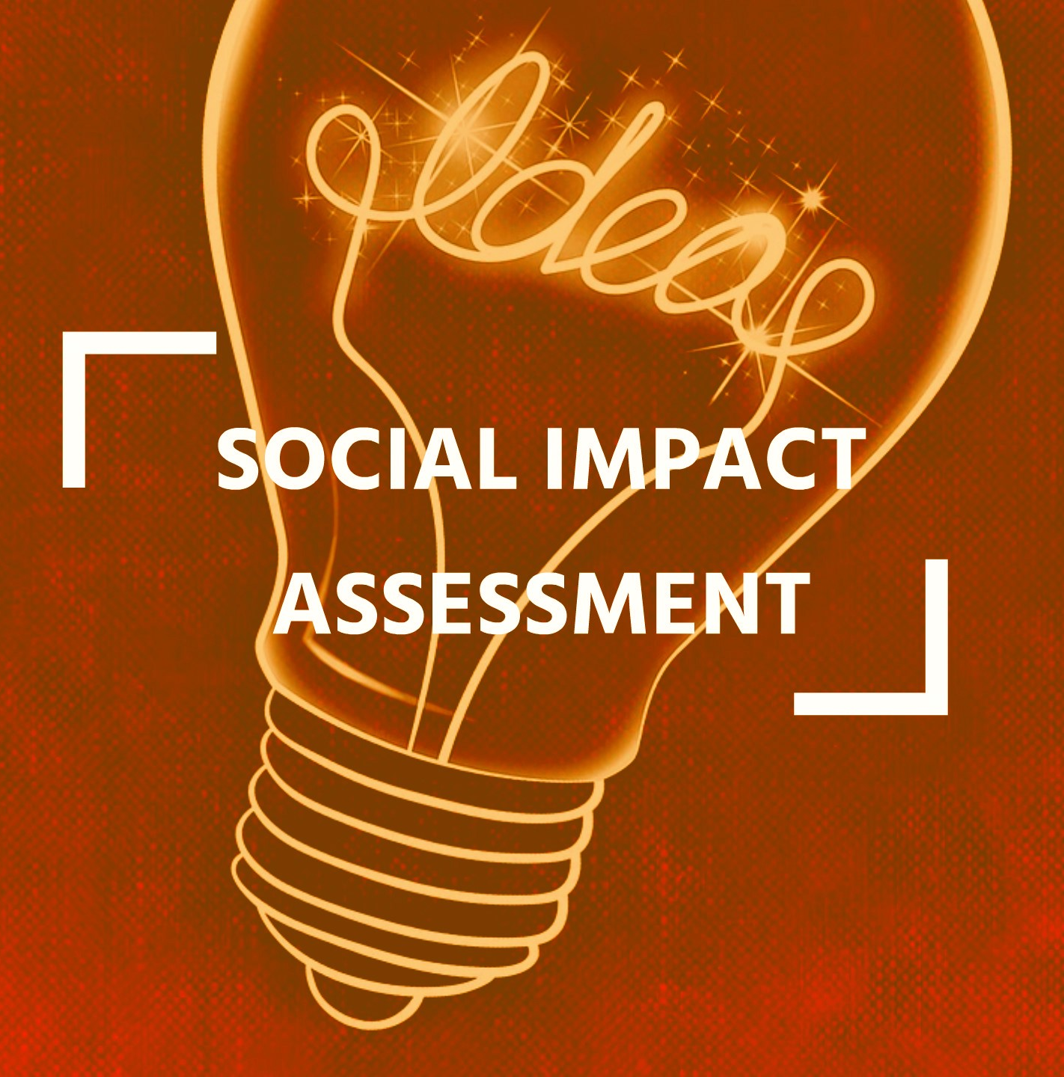
Social Impact Statement for Algorithms
Algorithm creators should develop a Social Impact Statement using the principles as a guiding structure.
This statement should be revisited and reassessed (at least) three times during the design and development process:
design stage,
pre-launch,
and post-launch.
The Social Impact Statement should minimally answer the questions of each principle. It is also included some concrete steps that can be taken, and documented as part of the statement, to address these questions. These questions and steps make up an outline of such a social impact statement.

Slide 53
GDPR And Algorithm Accountability
From GDPR Recital 71 (Profiling): “In order to ensure fair and transparent processing in respect of the data subject, taking into account the specific circumstances and context in which the personal data are processed, the controller should use appropriate mathematical or statistical procedures for the profiling, implement technical and organisational measures appropriate to ensure, in particular, that factors which result in inaccuracies in personal data are corrected and the risk of errors is minimised, secure personal data in a manner that takes account of the potential risks involved for the interests and rights of the data subject and that prevents, inter alia, discriminatory effects on natural persons on the basis of racial or ethnic origin, political opinion, religion or beliefs, trade union membership, genetic or health status or sexual orientation, or that result in measures having such an effect.”

Slide 54
GDPR And Algorithm Accountability
Recall that a data subject has a right to contest an individual algorithmic decision (GDPR Art.22), to receive notice of solely automated decision-making (GDPR Art.13), and to request access to “meaningful information about the logic involved” (GDPR Art.15). In this way, data controllers can be challenged and thus accountable for algorithmic decisions.
GDPR Article 35 (Data protection impact assessment) further provides that where data processing (in particular using new technologies) is likely to result in a high risk to the rights and freedoms of natural persons, the controller shall, prior to the processing, carry out an assessment of the impact of the envisaged processing operations on the protection of personal data. A single assessment may address a set of similar processing operations that present similar high risks and that the controller consult with the data protection officer when carrying out a data protection impact assessment.
It is argued (Kaminski and Malgieri, 2019) that this requirement together with the recital, provides a case that “GDPR’s version of an Algorithmic Impact Assessment (that is DPIA) serves as a central connection between its two approaches to regulating algorithms: individual rights and systemic governance.”
Kaminski, M. E. and Malgieri, G. (2019) ‘Algorithmic Impact Assessments under the GDPR: Producing Multi-layered Explanations’, SSRN Electronic Journal, pp. 1–29

Slide 55
Methods and Tools and Standards for Ensuring that Algorithms Comply with Fairness Policies
How to prevent machine bias
Use a representative dataset. Feeding your algorithm representative data is THE most important aspect when it comes to preventing bias in machine learning.
Choose the right model. Every AI algorithm is unique and there is no single model that can be used to avoid bias. ...
Monitor and review.

Slide 56
IEEE P7003 TM - Algorithmic Bias Considerations
The IEEE P7003 standard will provide a framework, which helps developers of algorithmic systems and those responsible for their deployment to identify and mitigate unintended, unjustified and/or inappropriate biases in the outcomes of the algorithmic system
IEEE P7003 will allow algorithm creators to communicate to regulatory authorities and users that the most up-to-date best practices are used in the design, testing and evaluation of algorithms in order to avoid unjustified differential impact on users.
The standard committed to the support and responsibility of algorithm creators to prioritize accountability and ethics within new frameworks of all levels of design, testing and evaluation, reducing the impact of discrimination and encouraging neutrality and fairness for future technologies
This standard will provide the required accountability to show algorithms are developed and applied without issues of negative bias aimed at protected characteristics of individuals or groups, including such considerations as race, gender and sexuality.

Slide 57
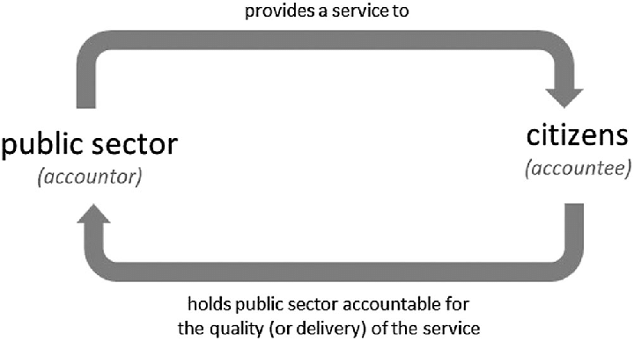
Accountability in Public Sector Use of Algorithmic Decision Making
Algorithmic systems are increasing being used by public authorities to improve efficiencies, implement complex processes and support evidence-based policy making.
Due to the nature of public sector responsibilities, these uses of algorithmic systems have potentially far-reaching impacts sometimes involving the weakest members of society.
The use of algorithmic systems in public services therefore requires extra levels of transparency and accountability.

Slide 58
Fairness, Accountability, and Transparency in Algorithmic Systems III
The meaning of transparency with respect to algorithmic systems.
Explanations for algorithmic logic and outputs.
Trade-offs between privacy and transparency.
Tools and methodologies for conducting algorithm audits.
Frameworks for conducting ethical and legal algorithm audits.
Empirical results from algorithm audits.

Slide 59
Recap – FAT in ML
Fairness, Accountability and Transparency (FAT) – a way of examining critically one of the principal concerns about the use of algorithms in society (as part of the broader socio-technical system)
“In principle, fairness is the absence of any bias based on an individual’s inherent or acquired characteristics that are irrelevant in the particular context of decision-making.”
To assess fairness, we need transparency
To enforce accountability, we need transparency
Transparency
Accountability
Fairness

Slide 60
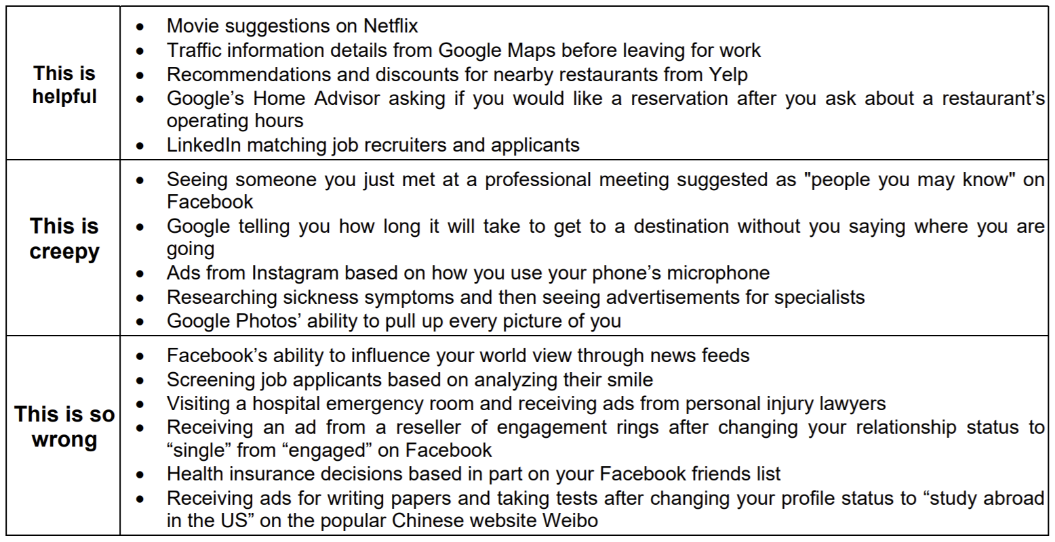
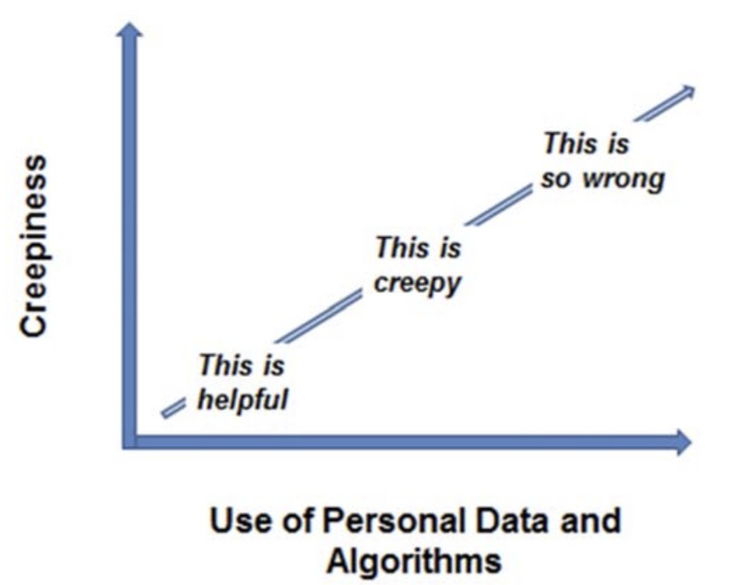
Algorithmic Transparency
Creepiness Scale: People’s reactions to recommendations based on personal data and algorithms
The Creepiness Scale for the Use of Personal Data and Algorithms
Watson, H. J., & Nations, C. (2019). Addressing the Growing Need for Algorithmic Transparency. Communications of the Association for Information Systems, 45(1), 26.

Slide 61
Algorithmic Transparency
If an algorithm can be defined as a set of steps that a computer program follows in order to make a decision about a particular course of action, then
its transparency refers to the degree of openness about these steps, their purpose, structure and underlying actions of the algorithms that are used to search for, process and deliver information.

Slide 62
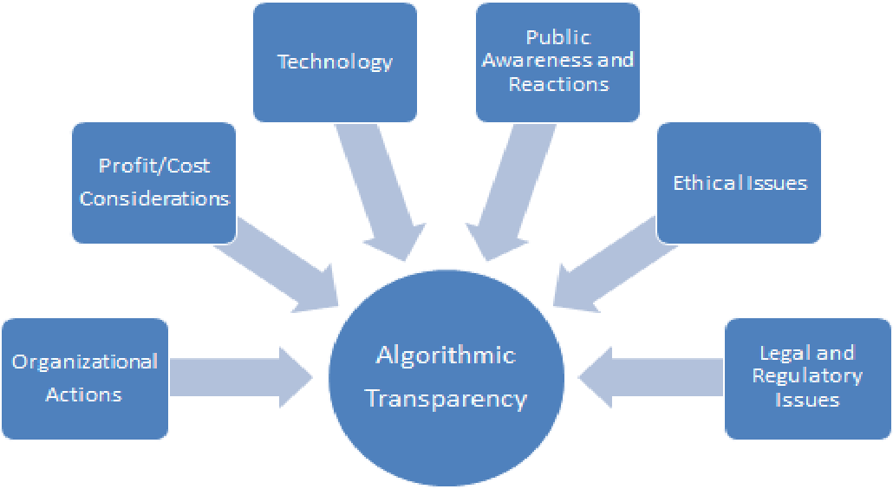
Factors that Affect Algorithmic Transparency
Multiple factors influence algorithmic transparency
With care, companies can benefit from and avoid the penalties associated with using personal data and algorithms inappropriately
Factors that Affect Algorithmic Transparency

Slide 63
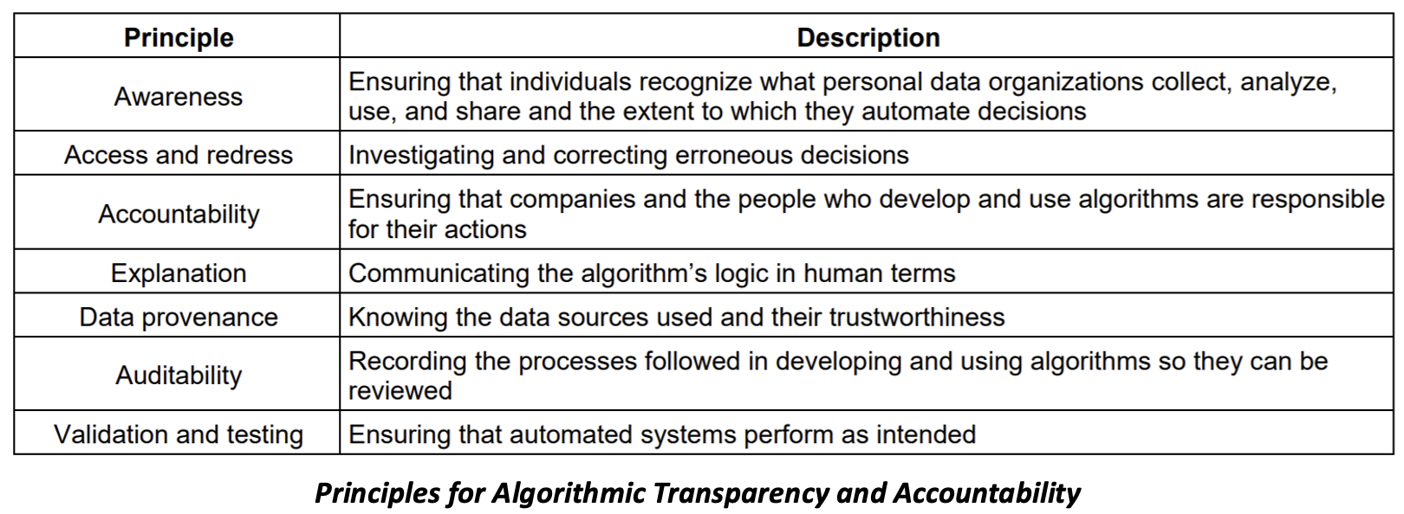
Algorithmic Transparency Principles
ACM principles for ensuring that organizations use personal data and algorithms fairly.
Aim is to minimize potential harms while realizing the benefits of algorithmic decision-making

Slide 64
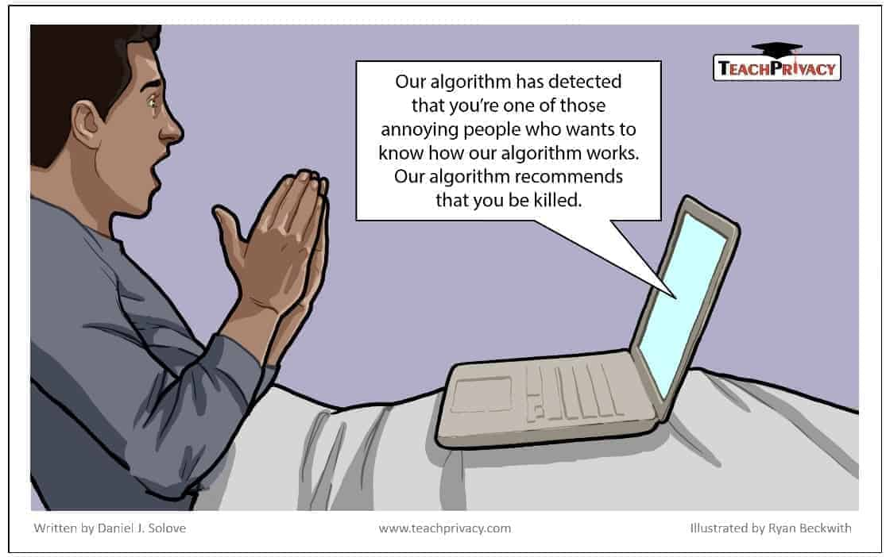
The Uses of Transparency
Theory – relationship to fairness and accountability; how it underpins both
Tool – who, what, why?
Technique – practical methods to implement
As Theory
As Technique
As Tool

Slide 65
Transparency as a tool to answer a range of questions (what, how, who?)
Transparency is a tool to uncover the fairness properties of algorithms
Tools have three dimensions that are directly relevant to the use of transparency as a mechanism of governance of algorithmic systems:
1. What? A tool is valuable not in itself but because of the goals its serves; a can-opener is only useful if there are cans to be opened.
2. Why/purpose? No tool is right for every job. Misusing a tool has costs. Even using it appropriately often requires trade-offs.
3. Who/whom? the motivation of the person who uses the tool and what their ultimate objective is can be an important factor in its effectiveness.

Slide 66
Transparency of what?
Transparency is implied by the most basic conception of accountability: if we cannot know what an organisation is doing, we cannot hold it accountable, and cannot regulate it.
There are seven broad areas of machine learning systems about which transparency might be demanded:
1.Data, 2.Algorithms, 3.Goals, 4.Outcomes, 5.Compliance, 6.Influence, 7.Usage
Source: European Parliamentary Research Service (2019)

Slide 67
Transparency of what? (1. Data)
1. Data
The transparency of the data used by the algorithmic system -- in particular by machine learning and deep learning algorithms -- can refer to knowledge of
the raw data,
the data’s sources,
how the data were preprocessed,
the methods by which it was verified as unbiased and representative (including looking for features that are proxies for information about protected classes),
the processes by which the data are updated and the system is trained on them.

Slide 68
Transparency of what? (2. Algorithms)
2. Algorithms
The transparency of the systems' algorithms can refer to a number of approaches
testing its output against inputs for which we know the proper output,
reducing the variables to the most significant so we can validate them,
testing the system with counterfactuals to see if prejudicial data is infecting the output,
a third party code review, analysis of how the algorithms work, inspection of internal and external bug reports, or assurance the software development processes are sound.

Slide 69
Transparency of what? (3. Goals)
3. Goals
Transparency of Algorithmic systems can also refer to its goal or goals.
What is it aiming to do?
When a system has multiple goals, this would mean being transparent about their relative priorities.
For example, the AI driving autonomous vehicles (AVs) might be aimed at reducing traffic fatalities, lowering the AVs’ environmental impact, reducing serious injuries, shortening transit times, avoiding property damage, and providing a comfortable ride. A manufacturer could be required to be transparent about those goals and their priority.

Slide 70
Transparency of what? (4. Outcomes)
4. Outcomes
Manufacturers or operators of algorithmic systems could be required to be transparent about
the outcomes of the deployment of their algorithmic systems, including the internal states of the system (how worn are the brakes of an AV? how much electricity used?),
the effects on external systems (how many accidents, or times it’s caused another AV to swerve?), and
computer-based interactions with other algorithmic systems (what communications with other AVs, what data fed into traffic monitoring systems?).

Slide 71
Transparency of what? (5. Compliance)
5. Compliance
Manufacturers or operators may be required to be transparent about their overall compliance with whatever transparency requirements have been imposed upon them.
In many instances, we may insist that these compliance reports are backed by data that is inspectable by regulators or the general public.
Compliance with the transparency of data collection is at the heart of the GDPR. Data subjects need to be informed that their data is being collected and for what purpose.

Slide 72
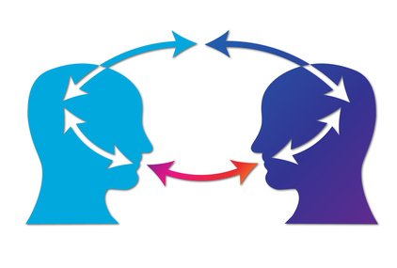
Transparency of what? (6. Influence)
6. Influence
Just as the public has an interest in knowing if an article in a newspaper was in fact paid for by an interested party, the public may have an interest in knowing if any element of the AI process was purposefully bent to favour a particular outcome.
For example, if a trusted search platform is artificially boosting some results because they were paid to, and if it is not flagging that fact to users, users can be manipulated.
Regulators might want to insist that such influence be conspicuously acknowledged.

Slide 73
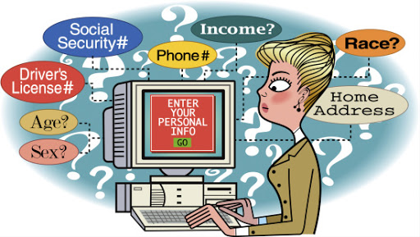
Transparency of what? (7. Usage)
7. Usage
Users may want to know what personal data a system is using, either to personalise outcomes or as data that can train the system to refine it or update it.
Knowing what personal data is used, they may then want to control that usage, perhaps to make their personalised results more accurate, or, more urgently, because they feel that usage violates their privacy, even though the data in question may already be a desired part of the system, such as a purchase or search history.
There are grey areas here as well: collecting anonymized, highly detailed information about trips made by autonomous vehicles — how often the car brakes or swerves, for example — could be important to optimizing traffic for safety or fuel efficiency.
Regulators may face some difficult decisions as well as drawing relatively obvious lines

Slide 74
Transparency by or for whom?
Because transparency has costs and risks, it matters who gets to see what is illuminated. When considering regulating transparency, the potential viewers include:
Everyone: fully open access to data, algorithms, outcomes, etc.
Regulatory authorities .
Third-party forensic analysts whose reports are made public, made selectively public, or kept private.
Researchers, possibly limited to those affiliated with accredited organisations and/or funding bodies.

Slide 75
Transparency - why?
We want systems to be transparent to help achieve important social goals related to accountability.
We want transparency of algorithmic system’s data and algorithms in order to:
Check for bias in the data and algorithms that affects the fairness of the system.
Check that the system is drawing inferences from relevant and representative data.
See if we can learn anything from the machine’s way of connecting and weighting the data
Look for, and fix, bugs.
Guard against malicious/adversarial data injection.

Slide 76
Transparency - why?
We want the hierarchy of goals and outcomes to be transparent so:
It can be debated and possibly regulated.
Regulators and the public can assess how well an algorithmic system has performed relative to its goals and compared to the pre-algorithmic systems it may be replacing or supplementing.
We want an organisation's compliance status to be public so:
Regulators can hold the organisation accountable in case of failure.
The public can evaluate the trustworthiness of the organisation, so people can make informed decisions as users about the services offered, and so citizens can become better informed about the benefits, risks, and trade-offs of algorithmic-based services overall.

Slide 77
Transparency by or for whom?
Some of these potential costs can be mitigated by choosing where and how transparency interventions are necessary.
For example, rather than providing direct public access to the data being used to train a machine learning system, independent data scientists could examine the data in private and publish the conclusions of their forensic research.
Transparency is not an absolute good and thus needs to be negotiated depending on its purpose and the balance of benefits and costs.
if an individual believes that s/he has been discriminated against by a black-box algorithmic system, but there is no evidence of systematic bias, the system might be tested to see if discriminatory factors were determinative in that particular outcome.
Such testing might not require transparency. For example, inputting counterfactual data — say, a loan application in which only a factor is changed at a time — can identify the impact of possibly prejudicial data without requiring full transparency.

Slide 78
Trade-offs Between Privacy And Transparency
Search platforms tend to give little information about exactly what criteria their algorithms use.
Therefore, algorithmic transparency can be at odds with the public (and commercial) interest in producing reliable, accurate search results.
This can be addressed by keeping the algorithmic inspection limited to trusted experts who are not permitted to disclose what they learn. This of course also has some risks: disclosure by accident or corruption.
Data Privacy could be compromised.
The data used to train a model is typically similar to that used by the model -- and in cases where this is data about individuals, the training data may be protected.
It may be possible to 'reverse engineer' a model to determine the data used to construct it, thus violating privacy.

Slide 79
Summary
Transparency is a tool to be used responsibly, which means accepting that applying it means being sensitive to the complex contexts in which it is used, and the balance of benefits and harms its use inevitably entails. Transparency is a tool. As with any tool, whether and how it should best be used depends upon the context:
The goals of requiring transparency.
Which elements of the process should be made transparent.
What type of transparency is most beneficial and least costly.
Alternative ways of achieving the goal.
A judgement of the potential trade-off between risk and the benefit an AI system could bring compared with the system it is replacing or augmenting.

Slide 80
Auditing Algorithms
First, consider that algorithms can be manipulated in ways that do not disadvantage their users directly or obviously.
Second, algorithmic manipulation may be societally problematic and deserving of scrutiny even if it is not illegal.
This is a significant observation because the majority of scholarship that has considered algorithmic discrimination in the past has done so from the perspective of law and regulation.
As algorithms (and computers) become more common in the implementation of all technological systems, studying the world means studying algorithms (auditing).

Slide 81
Auditing Algorithms
There are two modes of algorithmic audit:
Direct auditing consists of code audits and other more traditional efforts, which are effective on machine learning systems and models that human auditors can deconstruct and interpret.
Indirect auditing entails feeding sets of data that vary widely into an algorithm to test the outputs for signs of bias, anomalous behavior or other undesirable results.

Slide 82
Auditing Algorithms
Algorithmic audits are new—so new that standardized methodologies don’t yet exist. For now, researchers generally agree on a few basic guidelines for algorithmic audits.
Check your data: Reduce the bias
Understanding what data has been collected and its relevance to the problem you’re trying to solve, the integrity and accuracy of the data and the process undertaken to clean the raw data.
Having a clear understanding of what data may actually be a proxy for bias
Check how the algorithm works
Understanding the components and weighting of an algorithm makes it significantly easier to perform an audit.
Asking what steps developers have taken to ensure the model is not biased against different protected groups.

Slide 83
Auditing Algorithms
Run your own “sniff test”
Run some test data points through an algorithm and check the result. Running these simple “sniff tests” can often be useful in spotting the worst cases of bias quickly and affordably.
Request a full audit
There are various levels of algorithmic audits. A company can hire an outside firm to come in and lead the effort. If the company has an internal data team that is developing data models, it can institute a basic auditing process that involves an extra layer of testing outcomes to look for signs of bias.
Audit regularly
Bias—or just simply unfair results—may not be obvious initially and may only emerge as a model evolves or is trained on new data. Developers, who are used to writing code, checking it for errors, and then shipping it, aren’t used to having to work this way.

Slide 84
Frameworks for conducting ethical and legal algorithm audits
https://www.scu.edu/media/ethics-center/ethical-decision-making/A-Framework-for-Ethical-Decision-Making.pdf

Slide 85
Benefits and risks from algorithm audits
Positive
find biases
keeping biases out of algorithms
How might the algorithm be abused?’
‘What harm might it cause on a portion of society?’
Negative
exposing your algorithms may destroy your competitive advantage.
for the people who are tech savvy, publishing the algorithm might allow them to understand the decision-making process in detail, thus allowing them effectively to game the system.
https://www.ft.com/content/879d96d6-93db-11e8-95f8-8640db9060a7

Slide 86
Tools for detecting Algorithmic Bias in AI
Pymetrics: Audit AI
DataScience.com Labs: Skater
Google: What-If Tool
IBM: AI Fairness 360 Open Source Toolkit
Accenture: Teach & Test AI Framework

Slide 87
Q & A

