Slide 1
Reproducible Research and Data Analysis
University POLITEHNICA of Bucharest
This resource si released under CC-BY licence

Slide 2
1. Reproducible Research
Why do we need it, what are the challenges, how do we perform it?

Slide 3
Reproducible research
Replication is fundamental in science, but only a small number of scientific studies can be replicated → the replication crisis
many attempted replications of well-known scientific studies have failed (in many different areas)
rates of paper retractions from top journals and conferences are increasing
Replication with new independent data is expensive or methodologically impossible → we need reproducible research to assess the validity of scientific results
Research is reproducible when we can reproduce the results of a scientific study with the original data, code, and documentation

Slide 4
Why perform reproducible research?
It benefits the researchers who perform it
they can repeat the same analysis multiple times with the same results
they can remember how and why they performed specific analyses
they can easily and rapidly modify analyses and figures
they can quickly reconfigure previous research tasks for use in new projects
reproducible research is a strong indicator of rigor, trustworthiness, and transparency in scientific research
reproducible research increases paper citation rates

Slide 5
Why perform reproducible research?
It benefits the research community
research is more accessible to more scientists → faster progress in methodological development and innovation
allows others to learn from a researcher’s work
allows others to understand and reproduce a researcher's work
allows others to detect and avoid a researcher’s mistakes

Slide 6
Challenges in reproducible research
Complexity
scientific research may require specialized (and often proprietary) knowledge and tools
some studies require models and techniques that involve domain knowledge
some analyses may need specific hardware or software configurations (high-performance computing, GPU clusters, licensed software, etc.)
How to address this?
refer to studies and papers that offer the required domain knowledge
annotate code with comments and explanations
provide documentation
use open software where possible

Slide 7
Challenges in reproducible research
Technological change
old tools become obsolete
small changes in software versions can lead to totally different results
How to address this?
use established tools
specify software versions used
run experiments in reproducible conditions → e.g., software containers

Slide 8
Challenges in reproducible research
Human error
we forget small details from the research process
we perform incomplete descriptions of the data collection or analysis
we don’t collect or properly document data that we initially might consider unimportant
we lose or misplace data
How to address this?
record every detail of the data collection and analysis, as inconsequential or minor as it may seem
keep multiple copies of the data
keep raw copies of the data

Slide 9
Challenges in reproducible research
IPR
we don’t share data and code because we are afraid that other researchers might use it incorrectly or unethically
we might not receive proper credit for others using our data
we might want to perform new analyses on our data and we are afraid that others might do this ahead of us
How to address this?
use specific data/code sharing tools that facilitate proper IPR management

Slide 10
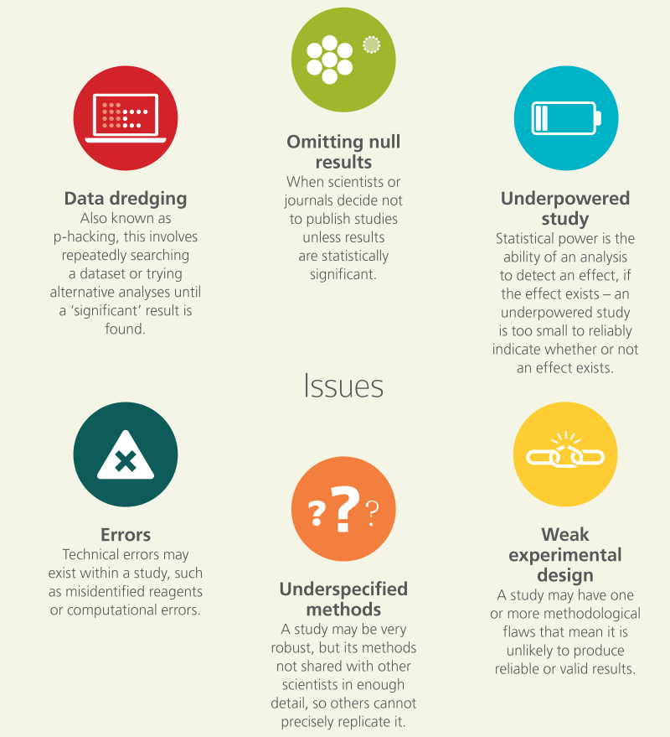
Challenges in reproducible research
https://open-science-training-handbook.gitbook.io/book/open-science-basics/reproducible-research-and-data-analysis (under CC-BY)

Slide 11
Stages of performing reproducible research
Before data analysis
always back up data (of all kinds, from all stages)
always replicate data in multiple locations and on multiple media
if you have physical data (papers, sheets, etc.), make digital copies
use portable, open and flat file formats where possible (e.g., txt or csv)
transform data into tidy formatting
long format
consistent data structure
informative headers
store metadata along with the actual data
organize files in a logical structure and give them informative names
use version control

Slide 12
Stages of performing reproducible research
During data analysis
use scripts instead of visual tools
annotate code with comments
follow a consistent coding style
automate repetitive tasks
avoid using hard-coded values
have someone review your code
create a portable environment for running the analysis (e.g., software containers)
document all software packages, frameworks and libraries used, and their versions

Slide 13
Stages of performing reproducible research
After data analysis
generate figures and tables directly from code
automate data pre-processing, analysis and manuscript generation as “one-button” processes
increase access to publications by posting preprints
use data and code repositories for sharing (instead of personal websites)
create research compendiums → archives of data, code, software and products from a research project
in the published manuscript, offer explicit instructions regarding where to locate data, metadata and code
Notes:
For example, documents written in LaTeX and markdown incorporate figures directly from a directory, so a figure will be updated in the document when the figure is updated in the directory – works for presentations as well
Three commonly used general purpose repositories are Dryad, Zenodo, and Figshare; each of these creates a DOI that allows data and code to be citable by others.
Research compendium – Open Science Framework

Slide 14
2. Research Code
Collaborative working with code: versioning, branching, metadata

Slide 15
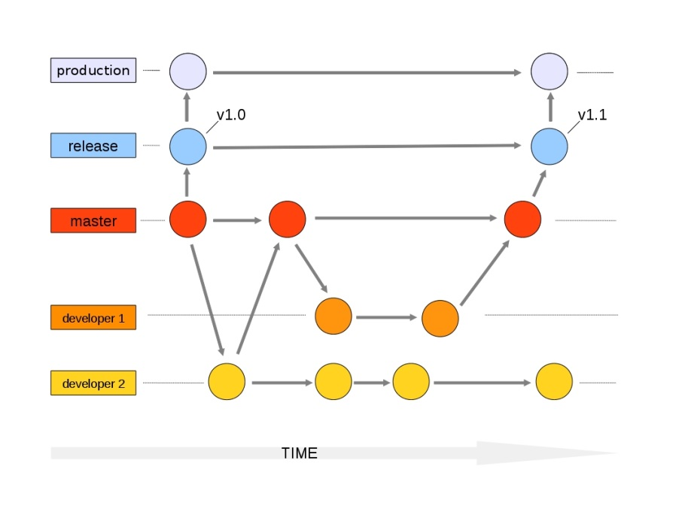
Git - good practice for code management
Versioning
Go back (to previous commits or versions)
Keep track of evolutions (diff)
Decentralized collaboration
Work in parallel (repository, branches)
Merge work with others

Slide 16
Git and GitHub
Git is a distributed version-control system for tracking changes in source code during software development
Written to manage development of Linux
GitHub is a social network for software development
Git repository hosting service + extra features
GitHub provides a web-based interface on top of Git
Collaboration features: access control, wikis, issues, projects, …
Connected with Zenodo:
Get a DOI from a GitHub repo

Slide 17
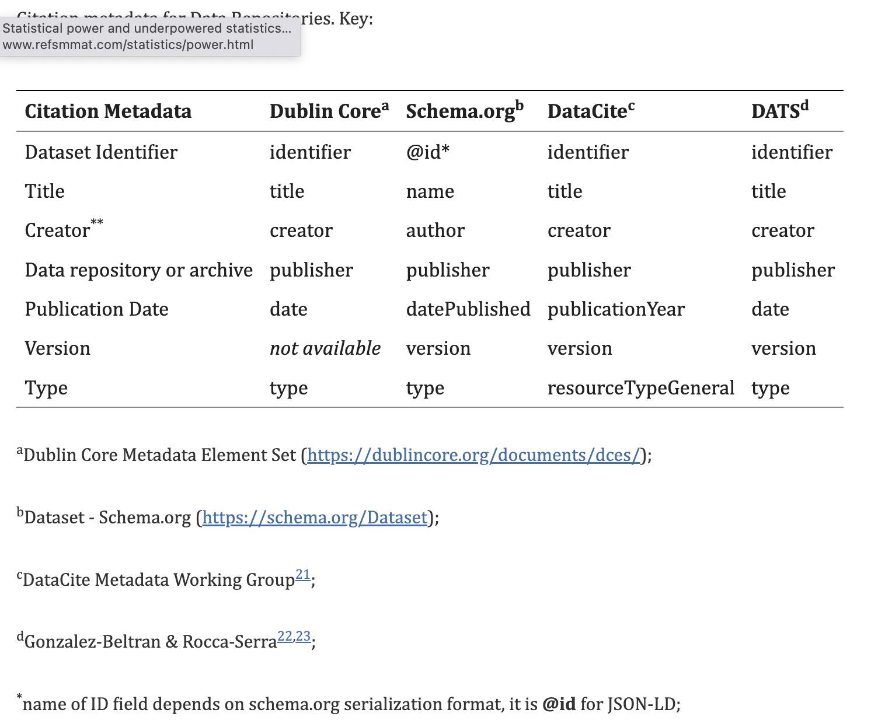
How to create metadata?
Use the Dublin Core Element Schema (dces)
http://dublincore.org/documents/dces/
Fill up the 15 fields
Format: in a new text file in the repository. Enter one field per line, starting with the field name (e.g., «title: »)
Some thoughts:
Is it a good idea to include the institution in the «creators» or not?
How to describe the current branch and version?
What format should you use for the date?
Are there other ambiguous points?

Slide 18
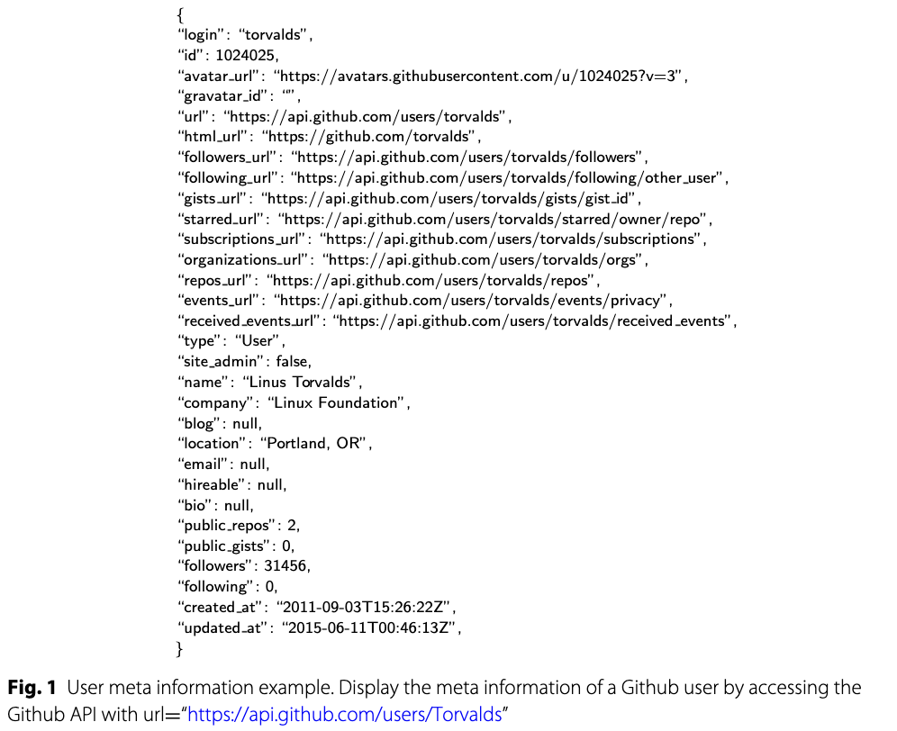
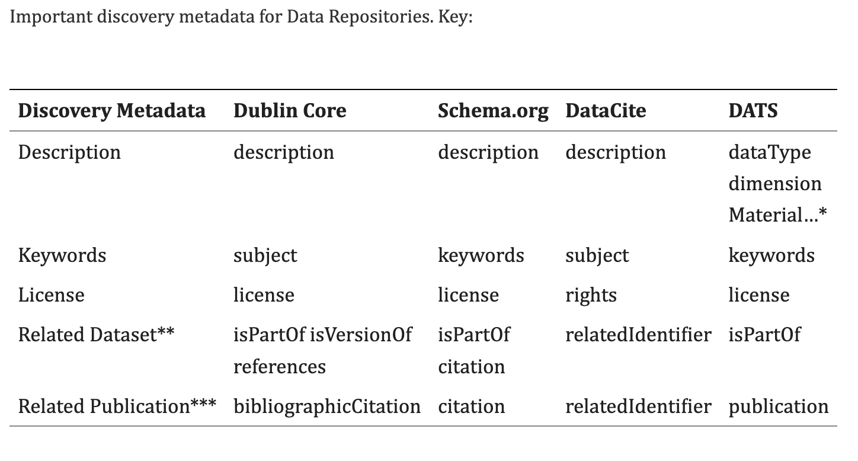
Metadata can use any standard
Figure

Slide 19
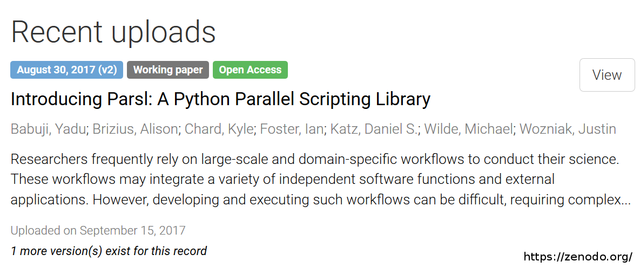
Zenodo
Zenodo is a public repository funded by OpenAire, CERN and the EU Horizon2020 program
open to all fields of research
open to all types of research data
free service
file size up to 50 Gigabyte
integration with GitHub

Slide 20
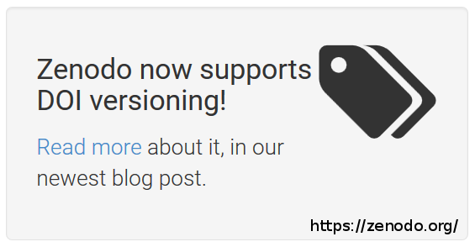
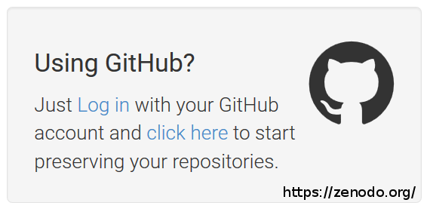
Zenodo special features
DOI-Versioning:
edit/update data after publication
quote a specific version or all versions of a dataset
In combination with GitHub:
archiving of software for the evaluation of data
also with versioning and citable link/identifier

Slide 21
From GitHub to Zenodo
Why
Preserve
Code repositories (including GitHub) are not intended nor equipped for long-term storage and preservation.
Data repositories, like Zenodo, are!
Cite
By archiving your code and software
in Zenodo you will get a DOI
How
Exercise
Discover
Data discoverability enhances the visibility and the impact of your research, and enables a broad dissemination of your research outputs
!!! Every (trusted) data repository helps you in making your data safely stored, easily citeable, and discoverable !!!

Slide 22
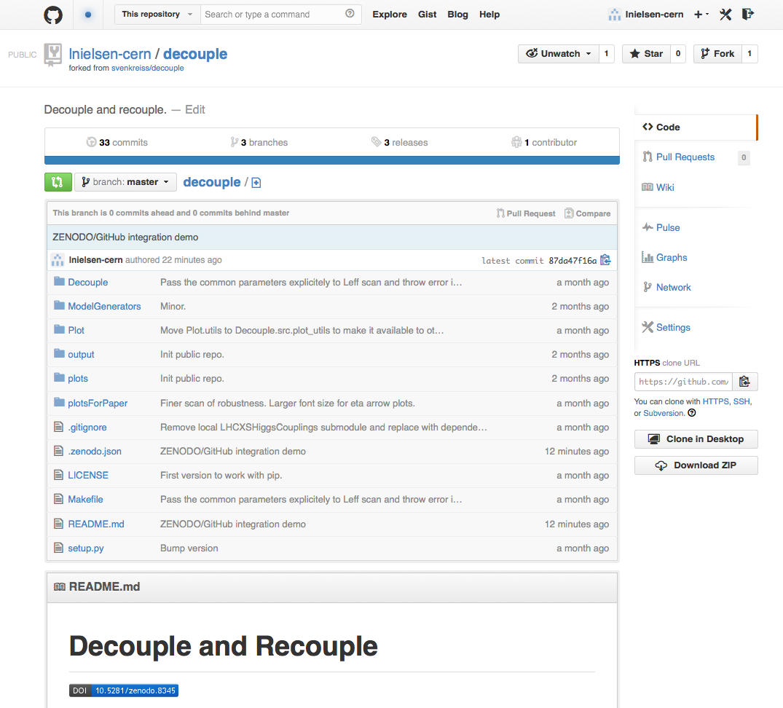
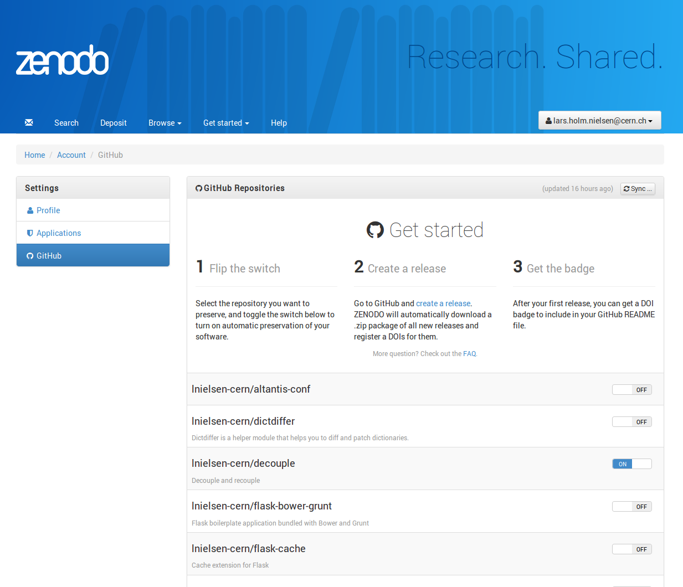
Zenodo-GitHub bridge
.zenodo.json

Slide 23
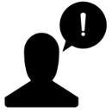
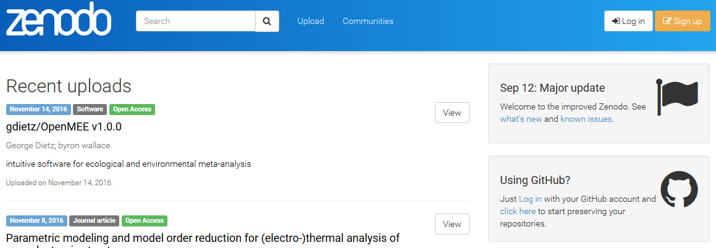
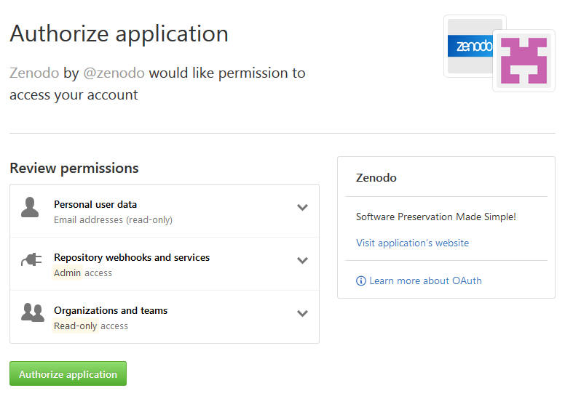
Publish GitHub repo in Zenodo
Exercise
When you write your software, you can make the work you share on GitHub citable:
archive one of your GitHub repositories in Zenodo and assign it a DOI
Preliminary
steps
Use: sandbox.zenodo.org

Slide 24
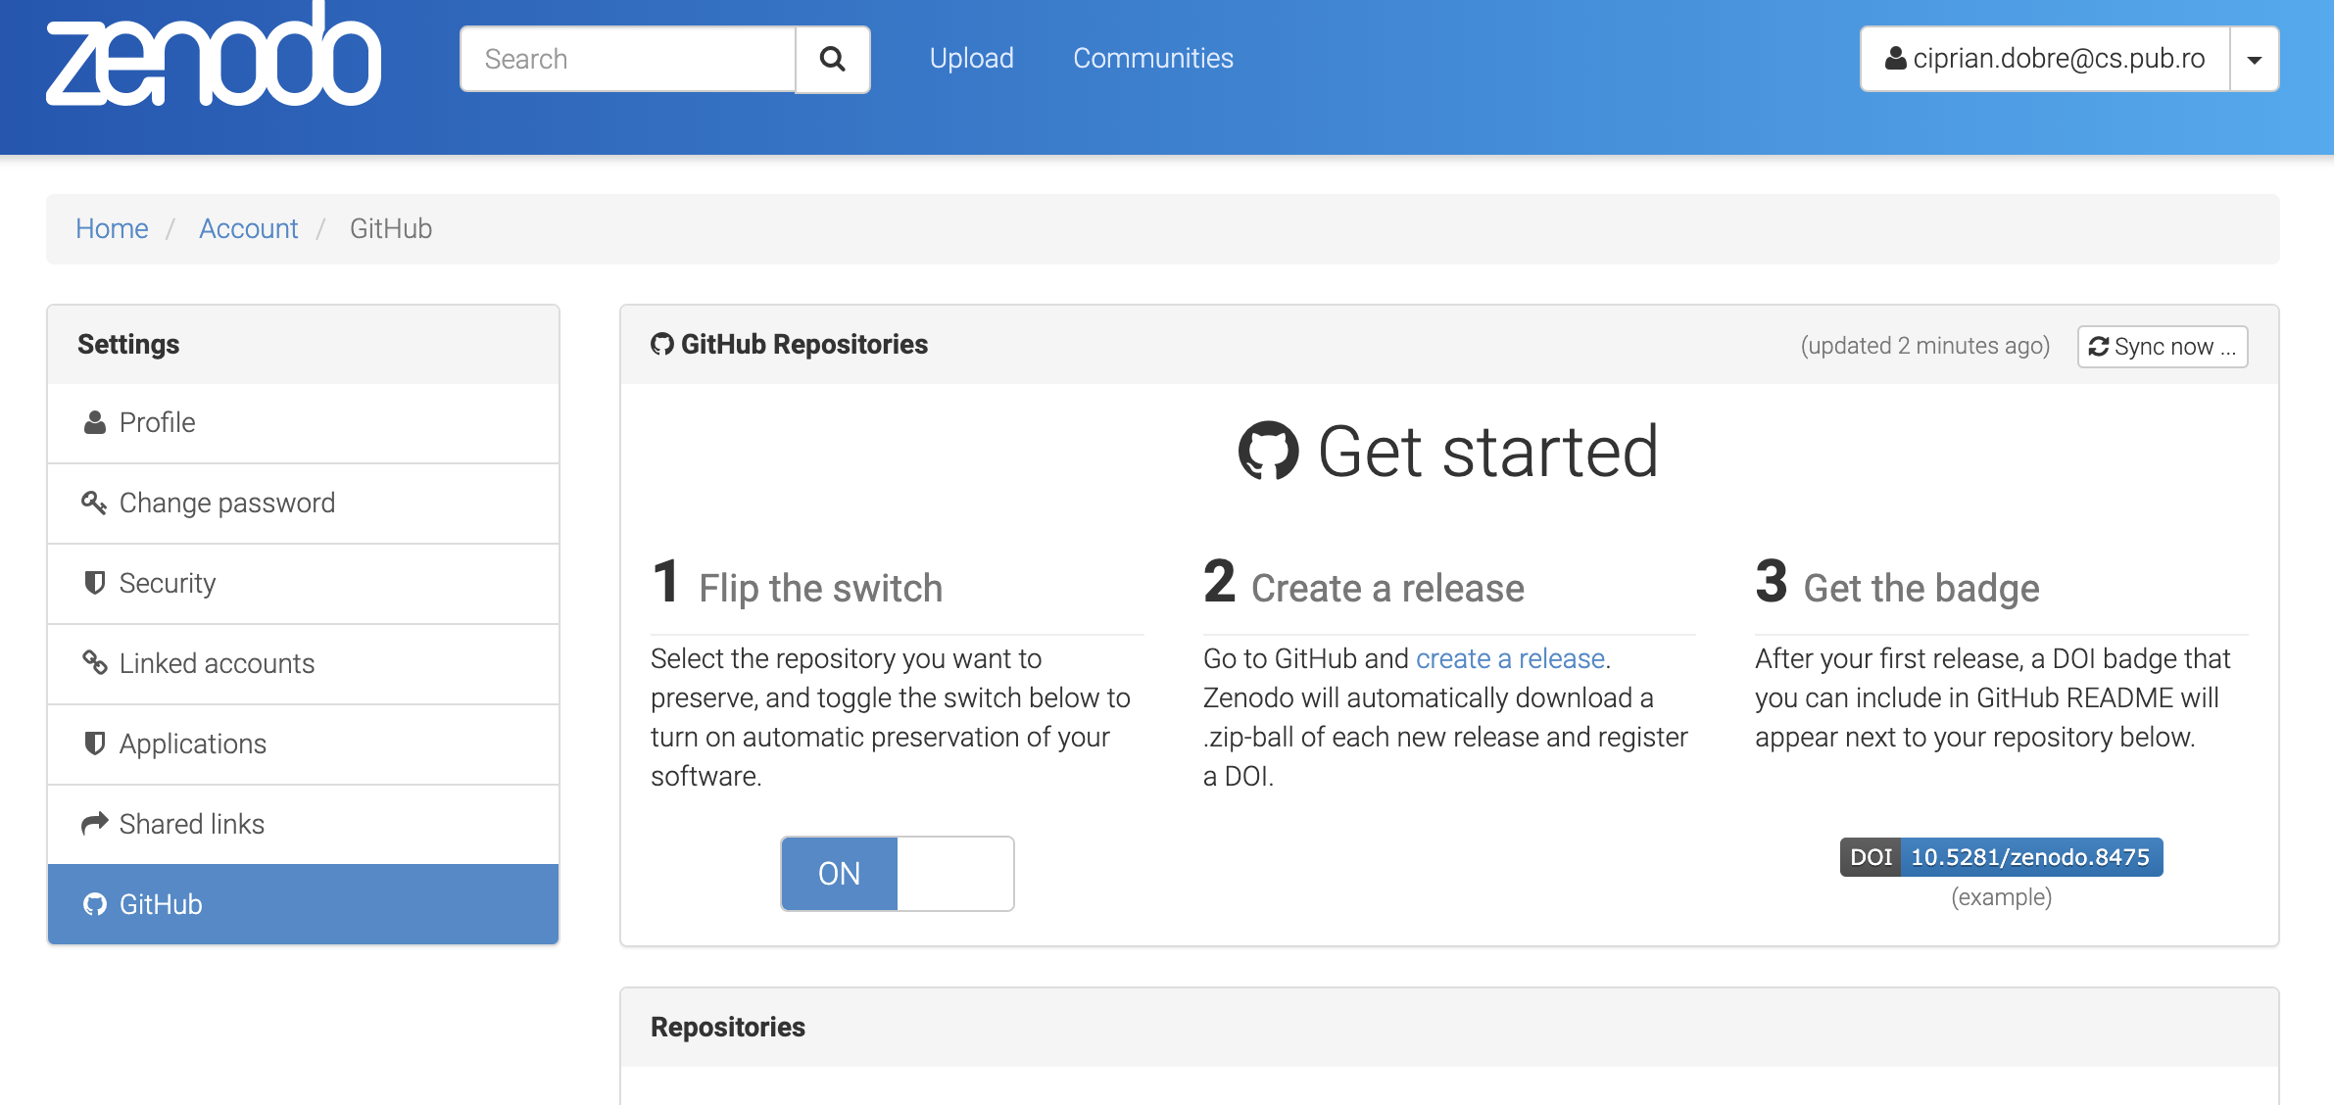
Publish GitHub repo in Zenodo
Exercise

Slide 25
Publish GitHub repo in Zenodo
Exercise
Create a new release
Fill in the release notes
Publish your release
Creating a new release triggers Zenodo into archiving your repository
Go to Upload
Select your Upload
…and edit metadata
Use the metadata
Source: https://guides.github.com/activities/citable-code/

Slide 26
3. Reproducible Environments
Tools for obtaining a reproducible environment

Slide 27
Reproducible environments
Every computer has its unique computational environment consisting of its operating system, installed software, versions of installed software packages, and other features that we will describe later.
Suppose a research project is carried out on one computer but transferred to a different computer. In order for research to be reproducible, the computational environment that it was conducted in must be captured in such a way that others can replicate it.

Slide 28
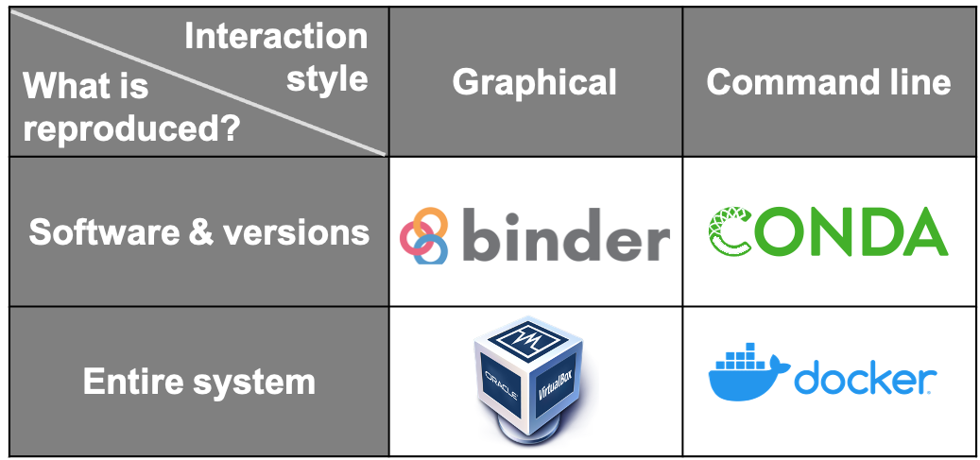
Capturing computational environments
Notes:
Conda is an open source package management system and environment management system that runs on Windows, macOS, Linux and z/OS. Conda quickly installs, runs and updates packages and their dependencies

Slide 29
Open notebooks
Electronic Lab Notebooks (ELNs) enable researchers to organize and store experimental procedures, protocols, plans, notes, data, and even unfiltered interpretations using their computer or mobile device
They are a digital analogue to the paper notebook most researchers keep
ELNs can offer several advantages over the traditional paper notebook in documenting research during the active phase of a project, including:
searchability within and across notebooks
secure storage with multiple redundancies
remote access to notebooks
the ability to easily share notebooks among team members and collaborators
Jupyter Notebooks

Slide 30
Reproducible Open Science
The computational tools to solve a problem
Python, R, Julia, and wide ecosystem of libraries and tools for science
An interface to facilitate coding/creating
Jupyter
A way to communicate your work
notebooks
Leverage on the EGI Cloud to scale-up the resources
A way to share your work
GitHub, Zenodo or other similar repositories
A way to pack it all for replication
Docker (used by Binder)
A way to persistently identify it
DOIs (Digital Object Identifiers)
binder

Slide 31
Implement Open Science
Notebooks
Binder
1. Perform data analysis and visualisation
GitHub
6. Reproduce analysis
Your repository
5. Resolve DOI to Notebook
2. Publish notebook and Generate DOI
3. Cite DOI
in publication
Fellow researchers
Journal paper
4. Discover DOI

Slide 32
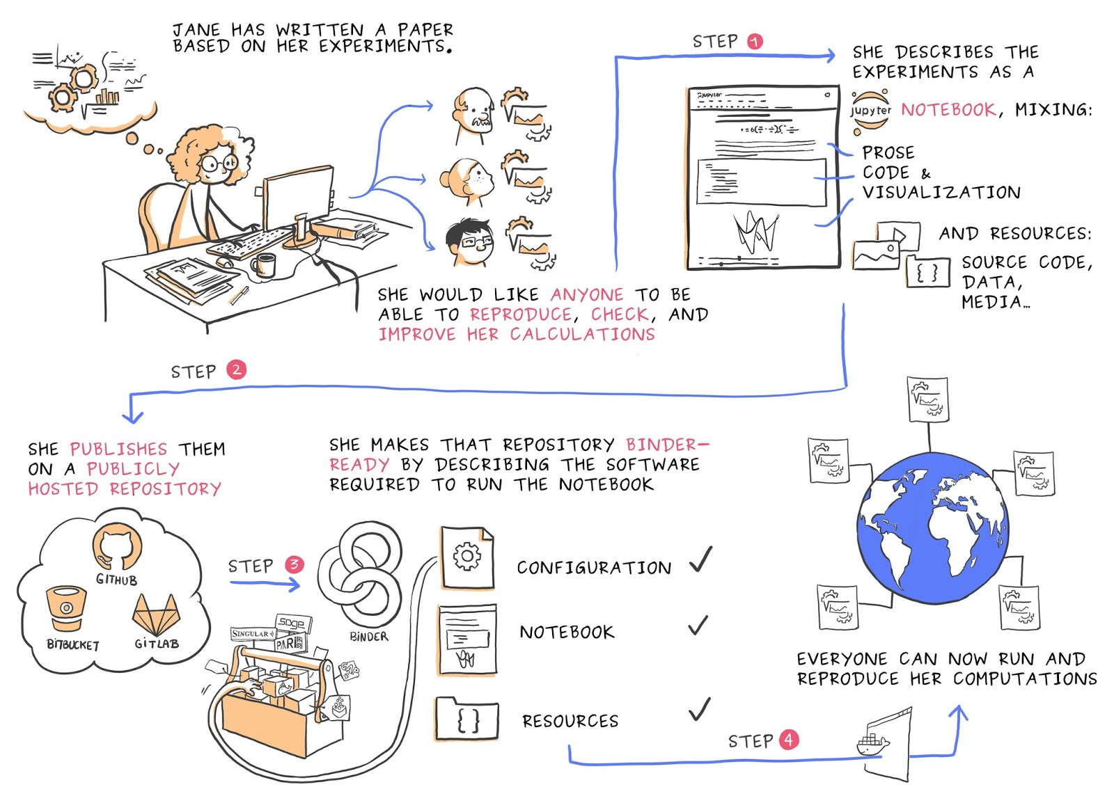
Binder
An open-source web application to turn repositories into interactive notebooks
It uses modern technology in cloud orchestration (Kubernetes), interactive computing (Jupyter), scientific computing (the open-science ecosystem)
Credit: Juliette Taka https://twitter.com/JulietteTaka

Slide 33
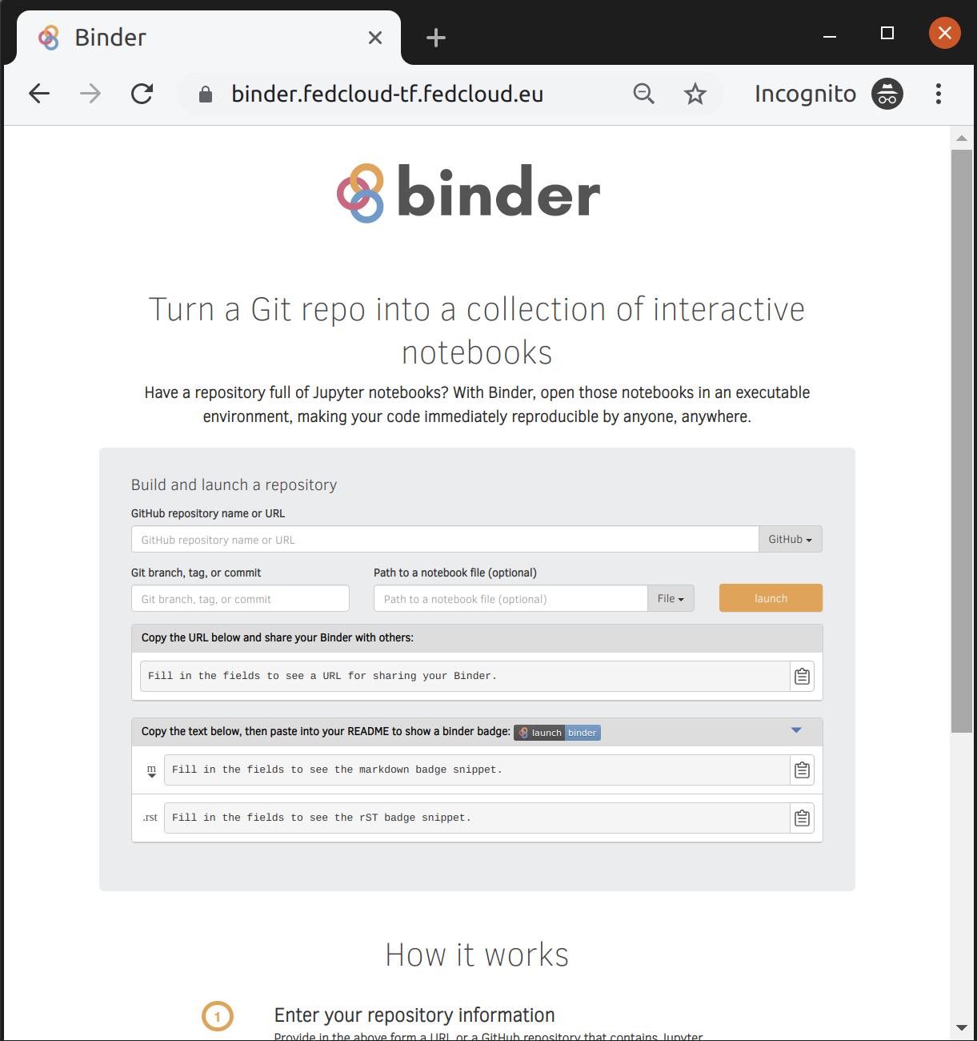
What does Binder do?
Pulls code from repository
repo2docker: Creates reproducible containers from repositories
jupyterhub: Generates user sessions that serve these containers
Kubernetes: manages the computing infrastructure
EGI Binder:
Provides an interface to create, share, and share the sessions

Slide 34
Compute resources
BinderHub is a cloud-based technology that can launch a repository of code (from GitHub, GitLab, and others) in a browser window such that the code can be executed and interacted with
a unique URL is generated allowing the interactive code to be easily shared
The purpose of these Binder instances is to promote reproducibility in research projects by encouraging researchers to document their software dependencies and produce fun, interactive environments!
Binder, as a user interface, is useful for reproducibility because the code needs to be version controlled and the computational environment needs to be documented in order to benefit from the functionality of Binder
Each change to the code repository forces a new build of the Binder instance → this acts as a proxy for continuous integration of the computational environment as the Binder instance will break if the configuration file is not updated
BinderHub relies on different tools and resources in order to create and launch the Binder instances

Slide 35
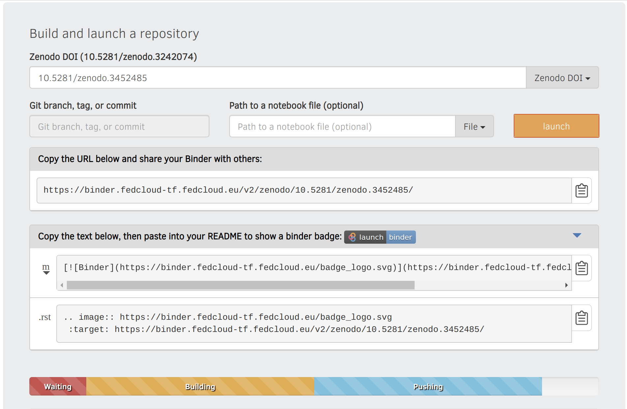
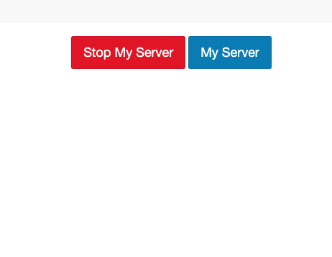
Reproduce your analysis with Binder
WARNING:
Registration of the DOI can take up to 10 minutes
Binder has to wait until registration is finished.
To check whether the DOI is resolved, please use the website: https://dx.doi.org/
Create a LaunchBinder button in your repo
Go to https://cs3.fedcloud-tf.fedcloud.eu/hub/home and stop your server before retry!

Slide 36
What happens when we click a Binder link?
The link to the repository is resolved by BinderHub
BinderHub searches for a Docker image relating to the provided reference (for example, git commit hash, branch or tag)
If a Docker image is not found, BinderHub requests resources from the Kubernetes cluster to run repo2docker to do the following:
fetch the repository
build a Docker image containing the software requested in the configuration file
push that image to the Docker registry
BinderHub sends the Docker image to JupyterHub
JupyterHub requests resources from the Kubernetes cluster to serve the Docker image
JupyterHub connects the user’s browser to the running Docker environment
JupyterHub monitors the container for activity and destroys it after a period of inactivity

Slide 37
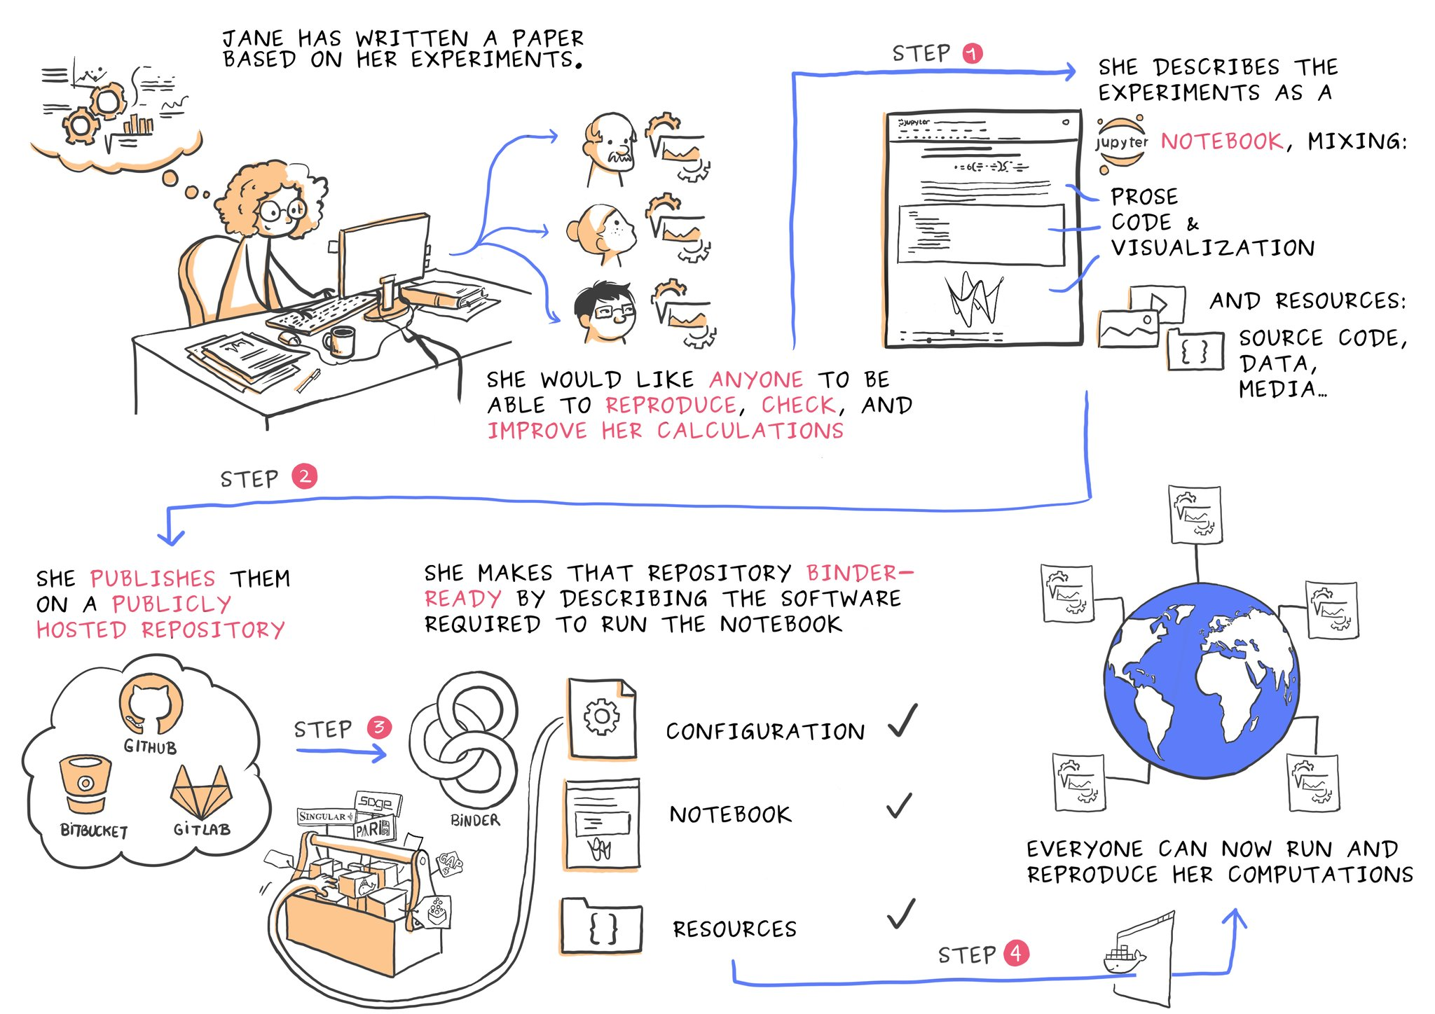
Courtesy of Juliette Belin: https://twitter.com/JulietteTaka/status/1082735653929000960

Slide 38
Courtesy of Juliette Belin: https://twitter.com/JulietteTaka/status/1082735653929000960 and Sarah Gibson

Slide 39
Bibliography and further reading
https://open-science-training-handbook.gitbook.io/book/open-science-basics/reproducible-research-and-data-analysis
https://www.annualreviews.org/doi/10.1146/annurev-publhealth-012420-105110
https://esajournals.onlinelibrary.wiley.com/doi/full/10.1002/bes2.1801
Ioannidis, John PA. "Why most published research findings are false." PLoS medicine 2, no. 8 (2005): e124.
Schooler, Jonathan W. "Metascience could rescue the ‘replication crisis’." Nature 515, no. 7525 (2014): 9-9.
Essawy, Bakinam T., Jonathan L. Goodall, Daniel Voce, Mohamed M. Morsy, Jeffrey M. Sadler, Young Don Choi, David G. Tarboton, and Tanu Malik. "A taxonomy for reproducible and replicable research in environmental modelling." Environmental Modelling & Software 134 (2020): 104753.
Peng, Roger D. "Reproducible research in computational science." Science 334, no. 6060 (2011): 1226-1227.

Slide 40
THANK YOU!
Follow us

