Slide 1
TrainRDM: Open Science and Research Data Management Innovative and Distributed Training Programme
https://rdmtraininghub.eu/ Sep 2021

Slide 2
Erasmus+
TrainRDM is a KA2 Strategic Partnership
30 Months: Nov/2020 – Apr 2023
Erasmus+ KA2 Strategic Partnerships are transnational projects designed to develop and share innovative practices and promote cooperation, peer learning, and exchanges of experiences in the fields of education, training, and youth.

Slide 3
PARTNERS
UNIVERSITATEA POLITEHNICA DIN BUCURESTI
TECHNISCHE UNIVERSITAET WIEN
NATIONAL COLLEGE OF IRELAND
Digital Technology Skills Limited
UNIVERSITA DEGLI STUDI DI ROMA LA SAPIENZA
ICI BUCURESTI

Slide 4
TrainRDM
Empower the Education and Skills dimension of Open Science (OS) through exploring innovative mechanisms and tools to provide the skills training in particular for and Research Data Management (RDM) good practices.

Slide 5
OPEN SCIENCE & RDM
TrainRDM is all about training and skills in Open Science & Research Data Management

Slide 6
OBJECTIVES
Analyse and Map the Skills Training Needs for OS and RDM in existing curricula in partner HEIs taking into account the different OS dimensions, target groups and level of existing knowledge;
Review existing Good Practice in OS and RDM skills training;
Develop a OS and RDM Training Methodological Toolkit;
Develop, validate and diffuse a quality pilot Training Programme for OS and RDM;
Develop a Training Network around OS and RDM concepts;
Encourage, motivate, support and recognise Staff and Students Skills Development in OS and RDM.

Slide 7
Open Science represents a new approach to the scientific process based on cooperative work and new ways of diffusing knowledge by using digital technologies and new collaborative tools (EC (2016)).
The OECD (2015) defines Open Science as: “to make the primary outputs of publicly funded research results – publications and the research data – publicly accessible in digital format with no or minimal restriction”.

Slide 8
NCI
Training Methodological Toolkit
Joint Design of Training Programme
Distributed eLearning Training Platform

Slide 9
Timeliness
Required in the new Horizon Europe

Slide 10
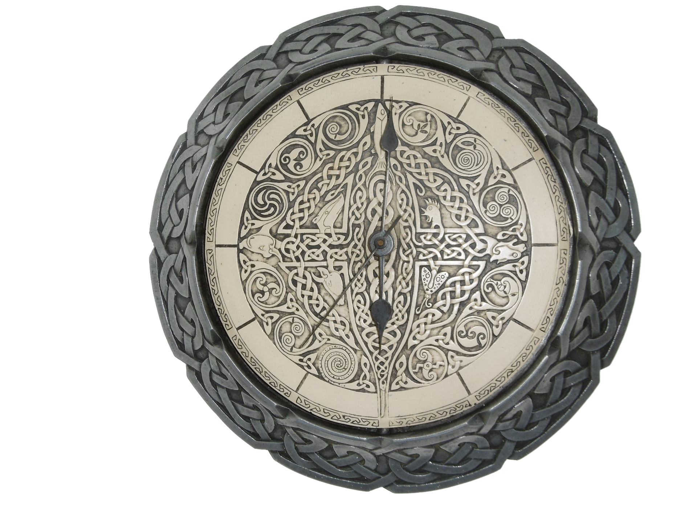
Timeliness
Science Foundation Ireland supports that research data should be Findable, Accessible, Interoperable and Reusable (FAIR)
The Irish Research Council strategy on open access emphasises the central role of the researcher in shaping and facilitating open access
Ireland is also aligned

Slide 12
THANKS!
Questionnaires

Slide 13
REFERENCES
European Commission (2016). Open innovation, Open Science, open to the world. A vision for Europe. Brussels: European Commission, Directorate-General for Research and Innovation. ISBN: 978-92-79-57346-0 Available at: http://dx.doi.org/10.2777/061652 (Last accessed: 6/Apr/21)
OECD (2015). Making Open Science a Reality. (OECD Science, Technology and Industry Policy Papers, 25). Paris: OECD Publishing. Available at: http://dx.doi.org/10.1787/5jrs2f963zs1-en (Last accessed: 6/Apr/21)
SFI (2021). Open Research Policy. Available at: https://www.sfi.ie/funding/sfi-policies-and-guidance/open-research/ (Last accessed: 6/Apr/21)
IRC (2019) Irish Research Council statement on open access and Plan S. Available at: https://research.ie/2019/02/08/irish-research-council-statement-on-open-access-and-plan-s/ (Last accessed: 6/Apr/21)

Slide 14
TrainRDM: Open Science and Research Data Management Innovative and Distributed Training Programme
https://rdmtraininghub.eu/ Sep 2021

