Slide 1
Projekt TrainRDM Alignment of the Output 02 activities 10.11.2021

Slide 2
Projekt TrainRDM
O2 Activities – The Goal
Develop a joint training program on OS and RDM according to the outputs identified in O1 and O3.
The developed training program and its modules will furthermore be determined on the basis of the requirements of the ECTS credits.
The emphasis will be on the development of the optimal training formats (considering and involving modules already offered by the consortium and the ones identified following the variables in IO1 matrix model).

Slide 3
Projekt TrainRDM
O2 Activities – The Program:
Mainly organized either as lectures, workshops or seminars, on-site or online, according to the requirements of O1 and O3
Where identified, supported by suitable educational resources: scripts, books and other written documents, as well as through material which will be also available online in the institutional intranet
In terms of the content, basic courses, as well as specific inter- and disciplinary aspects of OS and RDM will be integrated (based on the results of O1, which will specify the needs for the toolkit)
Integration of skills to the program regarding the output in O1
The corresponding training program in relation to the target groups will be identified: MSc & PhD students, early stage researchers, trainers and further research community stakeholders for each member in the consortium
OS-related content is following the 5 LERU classes (open access, research data sharing, ethics and integrity, citizen science)

Slide 4
Projekt TrainRDM
O2 Activities – The Program:
Other attributes to tailor the training module content in close collaboration to O1 and O3 will be used, such as:
Choice of the best training methodologies for the RDM toolkit developed in O1 and the technical requirements of the training platform developed in O3 (relate to domain specific training needs, skills and gaps and contain corresponding teaching strategies on university level: e.g. strategies for teaching of a large/small audience, flipped classroom/blended learning, problem based teaching)
Apply the international Innovative Doctoral Training Principles (IDTP) within the framework of OS and RDM and consider good training practice (the involvement of attractive and existing institutional environments including OS and RDM infrastructures and policies, international networking and quality assurance etc.)
Objectives (in terms of the toolkit needs identified in O1 and identified technical requirements in O3)
Format and didactics (class size, onsite and online classes, innovative features of teaching)
Duration (in days)
Domain (specific disciplinary, inter-/multidisciplinary, basic content)
Programme target group (target group specific content for MSc & PhD students, early stage researchers, trainers and further stakeholders)

Slide 5
Projekt TrainRDM
O2 Activities – The Program:
Distinguish between awareness raising, the acquisition of basic and innovative knowledge and expertise and skills development (including transferable skills training) and offer broad learning opportunities in OS and RDM for all levels and various target groups
Contain dedicated modules "Train the Trainers“:
Ensure the delivery of the best impact in terms of existing and novel methodologies, materials, competences and skills on OS and RDM.
Permit the exchange and integrate best practices in the context of OS and RDM within all target groups and stakeholders involved in the project
Use the outcomes of the research conducted in O1
Can be adapted to changes during the project phase, such as the integration of novel and innovative aspects due to the use of novel repositories, tools and methods for OS and RDM, as well as changes in legal requirements
Coupled with LTTA C1: Train the trainers Winter Week, LTTA C2: Students Summer School and LTTA C3: Early Stage Researchers Training Week.
Developed and updated constantly in accordance to the outcomes of O1 and O3 to guarantee a flexible response to changes during the project’s implementation

Slide 6
Projekt TrainRDM
Timeframe: Overview
IO2: Design of Training Programme on RDM and OS Co-Lead | TECHNISCHE UNIVERSITAET WIEN DIGITAL TECHNOLOGY SKILLS LIMITED | M10-M13 M13-M18 M17-M18 M19-M36 | A1: Joint definition of teaching and training programmes. A2: Development of training content and delivery of teaching methodology specifications A3: Development of training for the trainers A4: Reporting on training sessions Organise LTTA C1

Slide 7
Projekt TrainRDM
Timeframe
M10 – M13: Joint definition of teaching and training program on OS and RDM
It contains the development of training modules for the training program. The training program will be set up, to guarantee the fulfilment of the content and the framework conditions for it: objectives, format and didactics, duration, basic and domain specific content, content tailored to the project target groups, as well as ensure the compliance of the developed training program and its modules regarding the requirements of the ECTS credits.
M13 – M18: Development of concrete training contents and delivery of teaching methodology specifications
Correspond specific on-site and online teaching/training methodologies and material will be applied for the modules with regard to specific requirements as defined by NCI (lead of O1) and UPB (lead of O3). The training content will be set up for the modules of the toolkit and its target groups also according to the technical requirements. Target group specific content will be developed especially regarding the content (basic and discipline specific knowledge about OS and RDM on university level) while needs of cross-disciplinarity will be combined too. Integrate specific requirements of the toolkit’s modules and maintain regular feedback loops on the technical implementation possibilities.

Slide 8
Projekt TrainRDM
Timeframe
M17 – M18: Development of training of trainers
It contains the development of the "Train the Trainers" modules and its content, with corresponding training methodologies and material of the program needs and the implementation and execution of the "Train the trainers" modules ensure a high knowledge and professional background of the teachers and trainers regarding:
Set up of relevant content for the target groups as defined by the project and ensure the continuous improval of implementing aspects of the Charter & Code within the program, with focus on excellent research environments, training and career development in the area of Open Science. Further set up LTTA C1 Train the Trainers Winter Week, LTTA C2 Students Summer School and LTTA C3 Early Stage Researchers Training Week.
objectives of the program, such as the state of the art and novel knowledge about OS and RDM
proper application of the defined formats and didactics
corresponding duration of the modules regarding the content of the modules
broad range of diverse levels of knowledge in OS and RDM and transferable skills and basic and inter-, multi- and disciplinary knowledge in OS and RDM and beyond
in accordance to the content of the identified project target groups

Slide 9
Projekt TrainRDM
Timeframe
M19 – M36: Update of the training program following the training sessions
Conduct follow-up feedback forms, evaluate them and if needed incorporate into the toolkit, its models and the training program. Work in close collaboration with NCI (O1) and UPB (O3) to guarantee an agile process with flexible responses to changes during the implementation of the project. Ensure the implementation of novel aspects in OS and RDM, such as changes in state-of-the-art and innovative infrastructures, tools, methods and (legal) frameworks, as well as embrace those changes in the on-site and online training materials.

Slide 10
Projekt TrainRDM
Timeframe – Table
Objectives | Activities | Deadline
Define a quality pilot training program for OS and RDM | Joint definition of teaching and training program on OS and RDM | M13: November 2021
Develop the quality pilot training program for OS and RDM | Development of concrete training contents and delivery of teaching methodology specification | M17: March 2022
Validate the quality pilot training program for OS and RDM | Development training of trainers | M18: April 2022 LTTAs: - TUWien (April 2022) - La Sapienza (September 2022) - ICI (June 2022)
Update the quality pilot training program for OS and RDM | Update the training program following the training sessions | M30: April 2023

Slide 11
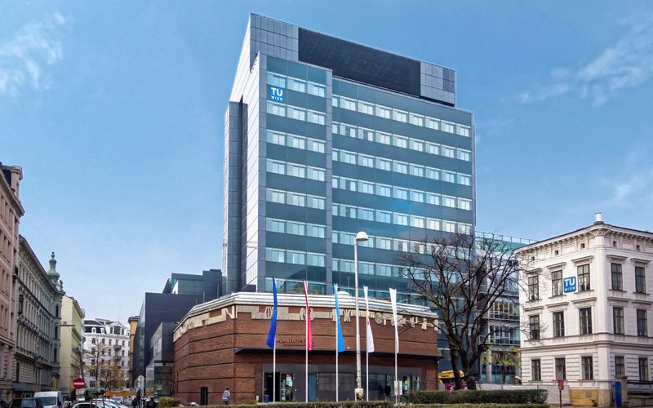
Projekt TrainRDM
Example structure of an application to the study commission at TU Wien:
Lecture description:
Educational goals
Content
Expected prior knowledge
Comparable courses
Applied forms of teaching and learning
Performance evaluation
ECTS-Breakdown
Curricula
Personal Qualifications
Title
Standard Work Effort
Semester hours per week
Type

Slide 12
Projekt TrainRDM
Open questions to discuss:
Target audience (students, researchers, trainers…)
Is there a one fit all concept or shall there be 2-3 different courses
Are we create one concept and adapt it accordingly?
Who will adapt the course and what commission approves it?
If researchers: How will the ECTS System be applied?
How will ECTS be handled? (different rules in different institutions)
→ TU Wien thinks we should not offer ECTS (from what we have learned we will not manage to establish such a course during the project time, and if only for internals)

Slide 13
Projekt TrainRDM
Open questions to discuss:
FOSTER: has a lot of material but not ready made courses (if you know → info)
Costs of courses
Free as long as the Erasmus project lasts?
Lecturers of courses?
Do they need certain qualifications?
Do we provide our concept Open Access?
Zenodo
Timeframe for LTTAs:
Not before September?

Slide 14
Projekt TrainRDM
TrainRDM Steering Meeting: Bukarest
Further Discussion
Points:
AOB:
Next Steps:

