Slide 1
IO3: Distributed eLearning Training Platform for OS and RDM
University POLITEHNICA of Bucharest
National Institute of Research and Development in Informatics (ICI Bucharest)

Slide 2
Overview of IO3
Training Platform to share online digital training materials with Students and Early Stage Researchers
Host online Training Sessions and be able to collect feedback.
Work as a Living Lab for fostering hands-on activities on OS domains, like working with open and accessible data.

Slide 3
Activities
O3/A1.Technical and Functional Specifications and architectural design (M1-M2)
O3/A2. Implementation and first prototype evaluation (M3-M14)
O3/A3. Update and product testing (M15-M30)

Slide 4
O3/A1.Technical and Functional Specifications and architectural design
Analysis of the requirements for the distributed training platform
Investigate the possibility to host at each institution an instance of the platform
Interconnect the authentication credential technologies into one
Or, go towards a more centralised architecture for such a platform
We need to analyse the requirements in terms of hosting training platform
Assess the possibility of developing add-ons on-top of already existing open source software (preference) like Moodle.
UPB to conduct surveys and focus groups to find out what is really needed (e.g., professors, policy makers, research stakeholders) who would be able to use the online platform.

Slide 5
O3/A2. Implementation and first prototype evaluation
UPB, together with partners, develops a first prototype of the online training platform.
This will be put to test in the first set of training activities in the project
... from where it will collect feedback from both Trainees and Trainers.

Slide 6
O3/A3. Update and product testing
The platform will be continuously tested ...
Up-to-the-phase where we take the prototype
The prototype will be able to host one or two training sessions in parallel with a limited number of online Trainees
Scalability up to 50 training sessions in parallel and hundreds of Trainees accessing in the same time the platform.
The backbone runs in the Cloud (within the UPB's and NCI's Data Centers)
The possibility of synchronisation of curricula and activities between hosts.

Slide 7
We conducted a survey between partner to find out technical capabilities
1. Are you using an online learning platform or course management system (CMS) for teaching in your institution? I assume yes, but please let us know.
1.a. If you answered Yes to Question 1 above, please tell us what platform are you using? Moodle seems to be the most frequent one.
2. (Only if you answered Yes in Question 1) Is your institution providing learning courses relevant to TrainRDM online through the platform in Question 1.a? Can you give us three examples of such online classes?
2.a. Is there a specific IPR policy that forbids teachers using the online platform to upload their materials to an external CMS platform (Moodle being the preferred choice)? Please give a short comment on the kind of constraints in place, if any.
3. What kind of authorisation and authentication system is your institution using for user management?
4. Is there an official affiliation of your institution to EduGAIN? Please let us know the details, for example the name of the provider through which the access is provided.
5. Is there a current research information system (CRIS) - a database or other information system to store, manage and exchange contextual metadata for research - in use with your institution? Which one (and a link would be very appreciated if you know it)
6. Is there a data repository (data library or data archive like CKAN or dataverse) in use with your institution? Which one (a like would be very appreciated)
6.a. If you answered yes to Question 6 above, please let us know what Data Management Policy or Open Data policy your institution uses.
7. For the examples of classes in Question 2, can you please describe or give example of tools and learning means teachers use for hands-on activities? This could include the use of simulators (what kind, how are they accessible - locally or remote), Matlab instances or Jupyter Notebooks / Lab containers, docker instances running specific code, etc.

Slide 8
Question 1
1. Are you using an online learning platform or course management system (CMS) for teaching in your institution? I assume yes, but please let us know.
UPB RO: yes, we use Moodle
ICI RO: yes, we use two platforms.
TUW AT: Moodle system (at TU Wien called TUWEL)
DTSL IE: -
UNIROMA IT: yes, we use MOODLE only for students.
NCI IE: a simple Google search revealed that Moodle is being used
1.a. If you answered Yes to Question 1 above, please tell us what platform are you using? Moodle seems to be the most frequent one.
UPB RO: Moodle
ICI RO: We use Moodle and also other platform developed by us.
TUW AT: Moodle
DTSL IE: -
UNIROMA IT: Moodle
NCI IE: Moodle
Moodle is the winner!

Slide 9
Questions 2 and 7
2. (Only if you answered Yes in Question 1) Is your institution providing learning courses relevant to TrainRDM online through the platform in Question 1.a? Can you give us three examples of such online classes?
UPB RO: See below
ICI RO: No.
TUW AT: Yes, but we cannot provide examples because it is an internal platform.
DTSL IE: -
UNIROMA IT: No. However, a short Google search revealed several candidates (next slide)
NCI IE: The courses on the next slide were obtained after a short Google search +
Data Intensive Architectures; Scalable Systems Programming; Data Governance, Compliance and Ethics
At UPB we teach already on Moodle classes such as:
Introduction to Big Data: it includes aspects to deal with open data (and students learn to use proper processing of open data)
Dependable Systems: it includes aspects related to making decisions starting from an exploratory data analysis; it includes aspects for working with Personal and Sensitive Data
Data and system security: it includes aspects related to data protection

Slide 10
Question 2 at UNIROMA
Data Management for Data Science (http://datascience.i3s.uniroma1.it/it/node/5619)
Large-scale data management: Distributed query evaluation, NoSQL databases, graph databases.
Open data management: open data, linked open data, RDF databases
Intellectual Property Competition and Data Protection Law (http://datascience.i3s.uniroma1.it/it/node/5806)
Data, contracts and rights. General principles
IP law: Patents and utility models, Trademarks, Copyright, IP rights in software, IP rights in databases, Trade secrets
Competition law: Anticompetitive agreements. General rules and specific issues (e.g. R&D agreements, licensing agreements, standard setting organizations), Sharing of commercially sensitive information, Big data and competition
Data protection: Data and personal data, Collection, circulation and use of personal data, Specific issues: consent, information, profiling, data transfer, binding corporate rules
The new EU Regulation, Cybersecurity and data protection
Statistical learning (http://datascience.i3s.uniroma1.it/it/node/5602) and Statistical Methods in Data Science and Laboratory (http://datascience.i3s.uniroma1.it/it/node/5802)
Statistical Methods and Applications
Management Engineering
Statistical Methods and Applications

Slide 11
Question 2 at NCI
Data Governance and Cybersecurity: it provides students with the knowledge, skills, and competence around security and data governance, data management, data classification, data quality, and data risk management. (https://www.ncirl.ie/Courses/NCI-Course-Details/course/DGC)
Cybersecurity Concepts, Threats to Information & Data Processing Services
Security Governance, Data Governance, Data Governance Dimensions
Risk Assessment & Risk Management
Legal Aspects
Ethical Issues Pertaining to Data
Data Governance and Ethics (http://courses.ncirl.ie/index.cfm/page/module/moduleId/67150)
Critically interpret the governance and regulatory frameworks associated with the capture, processing, and stewardship of data.
Critically interpret the roles and responsibilities pertaining to data security, privacy, and data protection.
Analyse and evaluate the intersection of data and ethics in socio-technical environments.
Investigate and appraise the interplay of fairness, accountability, and transparency in algorithmic decision making systems.
Data Visualisation (http://courses.ncirl.ie/index.cfm/page/module/moduleId/67179 hello Adriana)
Analyse the theory and concepts relating to visualisation and data representation
Evaluate and distinguish between visualisation techniques for specific problems to enable effective communication of data analysis
Design, develop, and implement processes for data visualisation
Propose a suitable visualisation design for a particular combination of data characteristics and application
Data Architecture (http://courses.ncirl.ie/index.cfm/page/module/moduleId/67279)
Compare different data stores, data models, query languages, data encoding techniques and knowledge discovery techniques
Summarise the constraints and trade-offs of a distributed shared-nothing architecture that is involved in the storage and retrieval of data
Analyse and design a data application architecture that integrates multiple disparate data systems that are optimised for different access patterns
Collaboratively implement an application data architecture
Scalable Data Analytics (http://courses.ncirl.ie/index.cfm/page/module/moduleId/67297 hello Horacio)
Describe and apply MapReduce and extensions for creating parallel applications on large amounts of data
Describe and summarise search techniques including similarity search and search engine technologies.
Distinguish between data-stream processing and specialised algorithms
Develop analytical and ethical skills to employ mining and clustering algorithms on large multi-dimensional datasets

Slide 12
Question 2.a
2.a. Is there a specific IPR policy that forbids teachers using the online platform to upload their materials to an external CMS platform (Moodle being the preferred choice)? Please give a short comment on the kind of constraints in place, if any.
UPB RO: No IPR official policy.
ICI RO: No, it doesn't exist. All materials can be uploaded on the platform because the content does not contain sensitive data. For external institutions, uploading materials needs the approval of the Scientific Committee.
TUW AT: Upload on TUWEL is common practice. Teachers would probably not upload their materials on external platforms. Apart from this they usually do not assign open licenses to their teaching materials.
DTSL IE: -
UNIROMA IT: see below
NCI IE: At NCI, material owners (lecturers) typically retain ownership of materials in Moodle.
In Sapienza there is a specific regulation for the use of the Moodle platform. It seems that there is not a specific IPR policy that forbids teachers using the online platform.
Internal and external teachers can use it for 4 types of courses:
Frontal teaching offered by Sapienza: study courses, single courses and didactic paths provided by Sapienza internal or external teaching staff . It is for Sapienza students.
Training by and for internal staff: training courses by and for Sapienza staff. Use is limited to Sapienza staff.
Services offered for the Sapienza community: courses offered by Sapienza structures or for specific areas (libraries, laboratories, services, orientation, placement), carried out by internal staff. To Sapienza staff; to Sapienza students; to external students (e.g. high school students).
External services offered by Sapienza: courses provided to external organizations / entities by Sapienza staff or by external teachers.
A course, at the author's discretion, can be:
1. with free access, therefore available to anyone;
2. reserved for Sapienza users only;
3. reserved for a specific group of users; in this case the author of the course is responsible for the registration procedures of the users admitted to the course, according to the specific guidelines.

Slide 13
Questions 3 and 4
3. What kind of authorisation and authentication system is your institution using for user management?
UPB RO: We use both SAML 2.0 and OpenID. A common Keycloak solution (login.upb.ro) is currently being deployed.
ICI RO: We use LDAP.
TUW AT: TU Wien authentication System (SSO)
DTSL IE: -
UNIROMA IT: Two ways for user registration on the Moodle platform:
Automatic for Sapienza internal users in possession of credentials (email);
Manual in the case of users external to Sapienza (contract teacher, tutor or student external to Sapienza) at the request of the manager who will indicate the name, surname, tax code, start and end date of the account.
NCI IE: Microsoft Active Directory (internal), Shibboleth for subscriptions and other services
4. Is there an official affiliation of your institution to EduGAIN? Please let us know the details, for example the name of the provider through which the access is provided.
UPB RO: Yes, through RoEduNet and GEANT.
ICI RO: to be verified
TUW AT: Yes, the Austrian branch is called ACOnet
DTSL IE: -
UNIROMA IT: Sapienza is part of EduGAIN but I do not know the details.
NCI IE: a simple search (https://edugate.heanet.ie/rr3/metadatalocations) showed to be part of eduGATE.
Keycloak is an open source software product to allow single sign-on with Identity and Access Management aimed at modern applications and services.

Slide 14
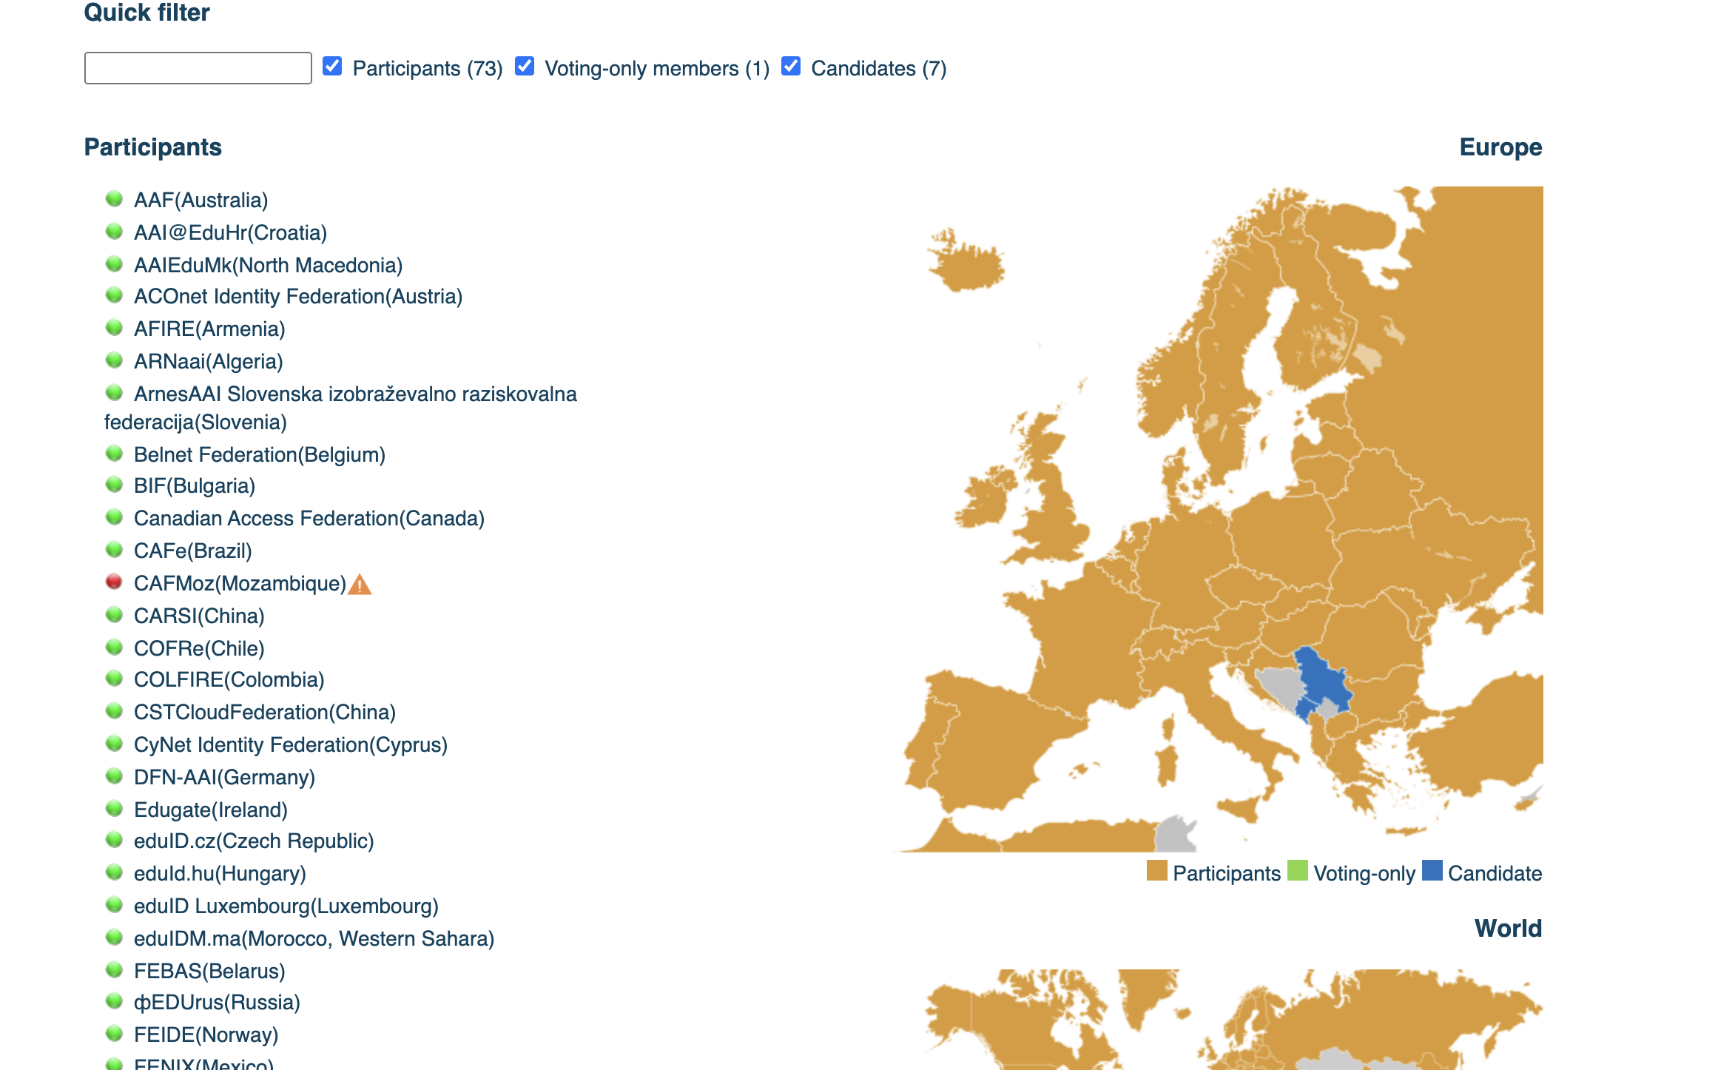
eduGAIN
Conclusion: eduGAIN is already in use by a lot of participants via national federations
https://technical.edugain.org/status (you can filter the list by country).

Slide 15
Questions 5 and 6
5. Is there a current research information system (CRIS) - a database or other information system to store, manage and exchange contextual metadata for research - in use with your institution? Which one (and a link would be very appreciated if you know it)
UPB RO: We made our own solution (https://crescdi.pub.ro/). This allows us to interconnect all databases and data never leaves the premises.
ICI RO: No
TUW AT: Yes, but it is currently being revised (data will be migrated to a DSpace platform)
DTSL IE: -
UNIROMA IT: We use IRIS for publications and their metadata
NCI IE: No answer, but yesterday we found it’s ePrints
6. Is there a data repository (data library or data archive like CKAN or dataverse) in use with your institution? Which one (a like would be very appreciated)
UPB RO: Currently being deployed (CKAN)
ICI RO: No
TUW AT: Currently in implementation (software InvenioRDM). In a simple search we found out also https://researchdata.tuwien.ac.at/
TU Wien Research Data is an institutional repository of TU Wien to enable storing, sharing and publishing of digital objects, in particular research data. It facilitates the funders' requirements for open access to research data and the FAIR principles by making research output findable, accessible, interoperable and re-usable. This service is developed by the TU Wien Center for Research Data Management and hosted by TU.it.
DTSL IE: -
UNIROMA IT: we are adopting DATAVERSE by Harvard
NCI IE: No answer, but we found out NO

Slide 16
Questions 6 and 7
6.a. If you answered yes to Question 6 above, please let us know what Data Management Policy or Open Data policy your institution uses.
UPB RO: No
ICI RO: -
TUW AT: RDM policy [1]
DTSL IE: -
UNIROMA IT: we are working on it
NCI IE: An institutional Data Management Policy will be soon released aligned with the Horizon Europe guidelines
7. For the examples of classes in Question 2, can you please describe or give example of tools and learning means teachers use for hands-on activities? This could include the use of simulators (what kind, how are they accesible - locally or remote), Matlab instances or Jupyter Notebooks / Lab containers, docker instances running specific code, etc.
UPB RO: No official institutional guidelines for teachers is set
ICI RO: -
TUW AT: free course material can be found in the project FAIR Data Austria under https://phaidra.univie.ac.at/o:1168881 (TU Wien is a partner there, but it is not TU Wien specific)
DTSL IE: -
UNIROMA IT: -
NCI IE: AWS EC2 Ubuntu instances, OpenStack Ubuntu instances, Hadoop, Spark
[1] https://www.tuwien.at/index.php?eID=dms&s=4&path=Directives%20and%20Regulations%20of%20the%20Rectorate/Policy%20for%20Research%20Data%20Management.pdf

Slide 17
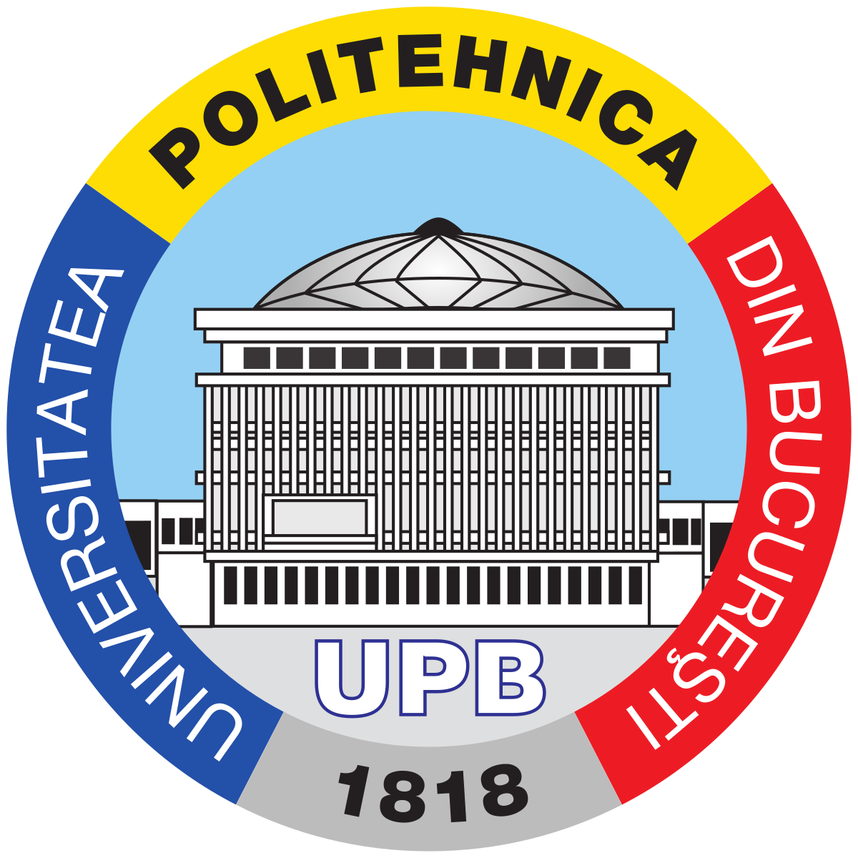
So remember last time the proposal Phase 1 – centralised training platform
Easy to have – everyone is using Moodle
Can work for a comon curricula like the one for Reproductibility Science
Not working when already existing materials need to be moved somewhere else (IPR / GDPR?)

Slide 18
Phase 2: In terms of access, eduGAIN
It solves IPR and security aspects....
Harder to implement and test and deliver on-time...

Slide 19
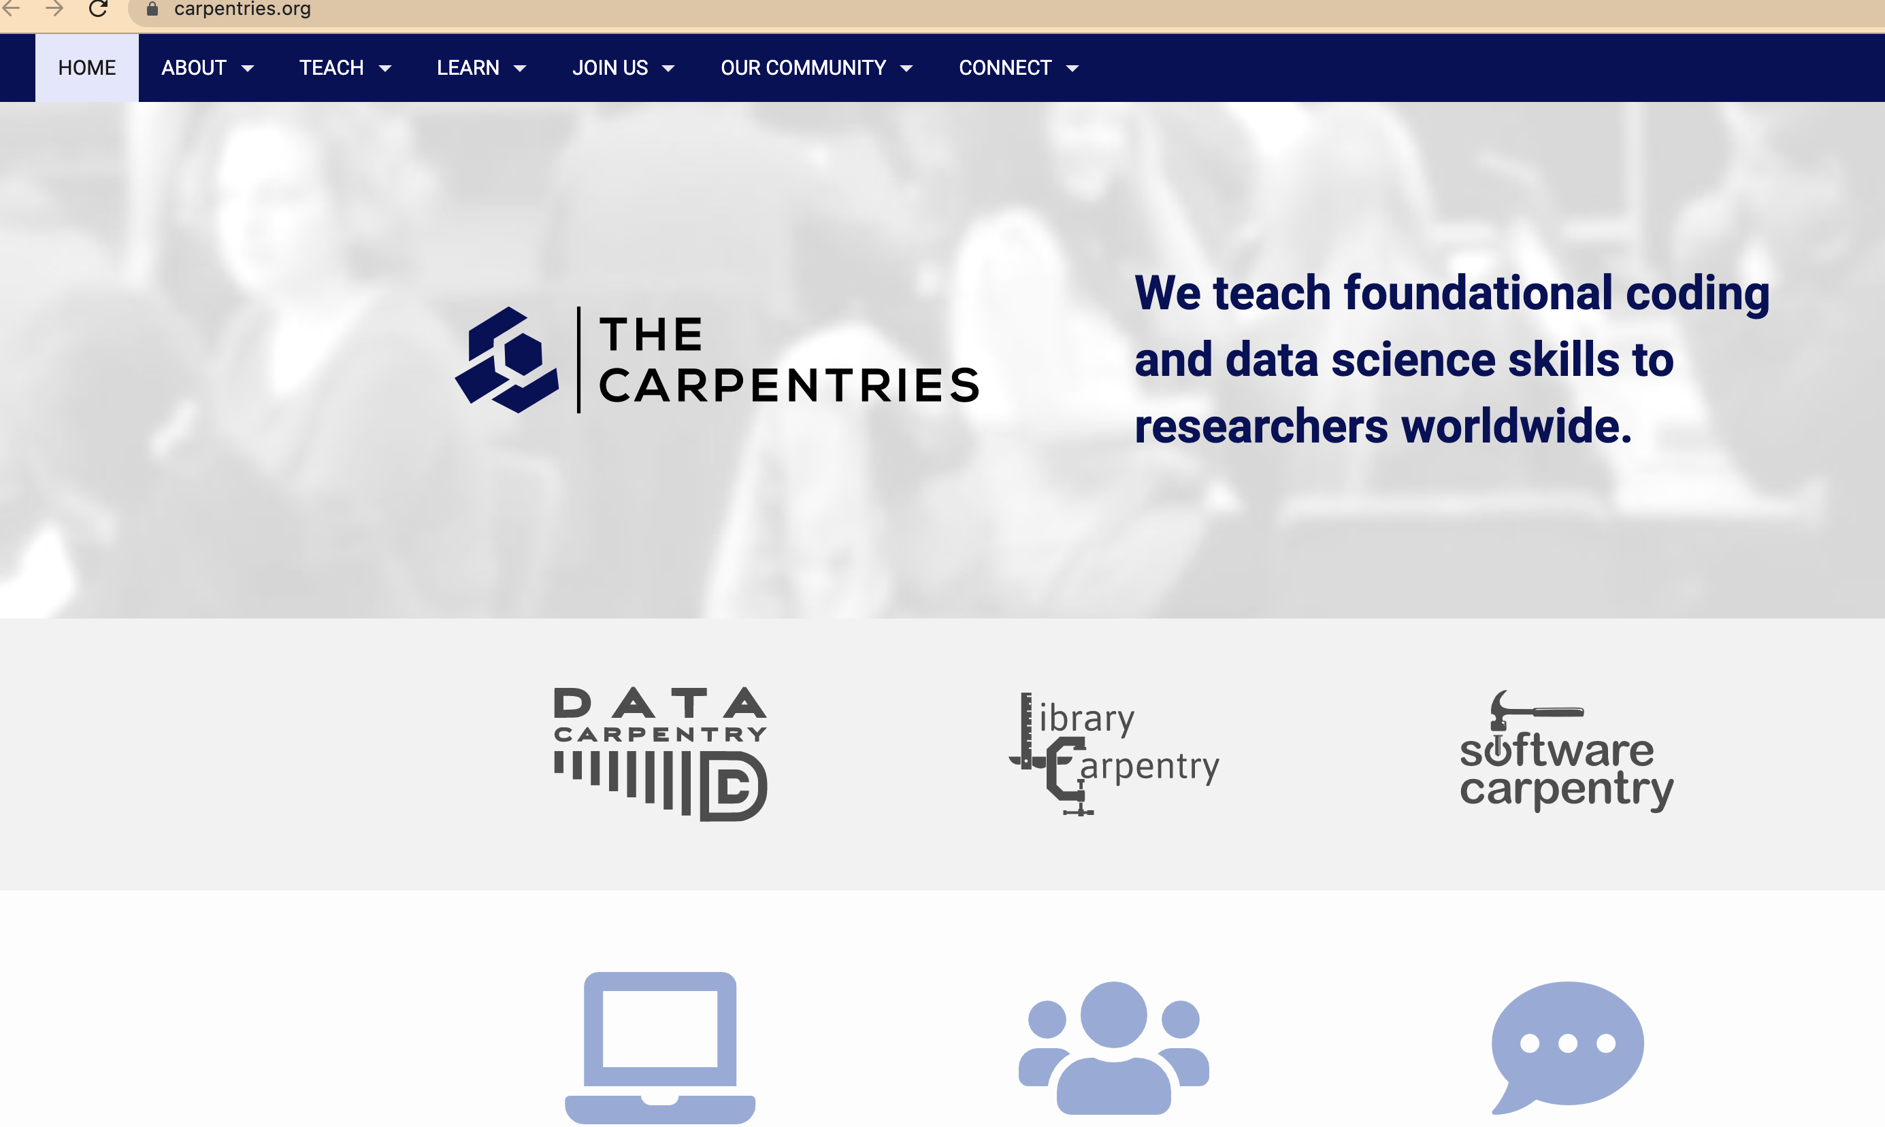
Phase 3: carpentier (catalogue of classes / modules?)

Slide 20
Steps
We started developing the *centralised* Moodle platform at UPB with the first set of classes
To be ready for first training (common) modules → please select classes that do not suffer from IPR / authorisation problems
If classes are *mandatory* tought at the home institution, be prepared to manually enrol outside PhD students into the local authorisation system
We will disseminate and collect data for a questionairre to understand the technical local training conditions for partners
Didn’t do it earlier to not overlap with the effort in IO.1
Develop the eduGAIN connectors with all partners supporting this
Already developing connectors at UPB for the integration between dataverse and SAML 2.0 (local auth system)

Slide 21
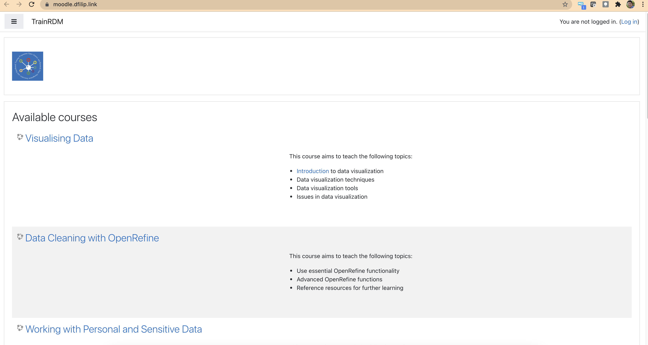
Phase 1: Moodle set-up
https://moodle.dfilip.link/
Visualising Data
Data Cleaning with OpenRefine
Working with Personal and Sensitive Data
Archiving Data
Sharing Data
Working with Data
Data Management Planning
Understanding Research Data

Slide 22
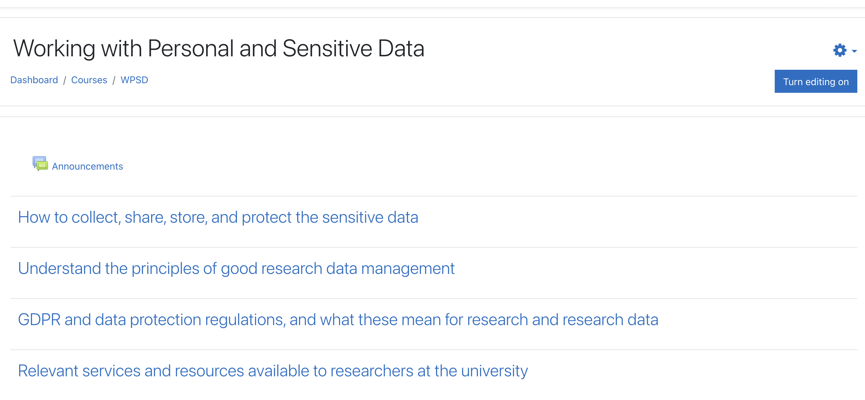
Inside each course has modules

Slide 23
About EduGAIN
We started with the eduGAIN documentation [1] [2]
One can add own identity provider by SAML if the elements from [2] are still specified in the metadata exposed by SAML and be signed with the specifications in that document
Finally, the IDP should appear at [3]
If we expose a service provider in eduGAIN, we have to talk to the member federation we will belong to [4] in order to be exposed to the other federations (UPB has to talk with RoEduNetID)
[1] https://technical.edugain.org/documents [2] https://technical.edugain.org/doc/eduGAIN-saml-profile.pdf [3] https://mds.edugain.org/edugain-v1.xml [4] https://wiki.geant.org/display/eduGAIN/How+to+Join+eduGAIN+as+Service+Provider

Slide 24
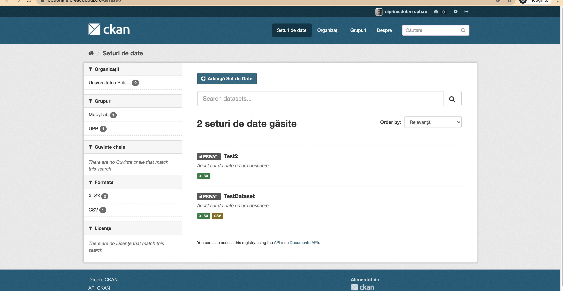
And about data repository....
https://dataverse.org/
https://ckan.org/

Slide 25
Advantages CKAN
Open Source software widely used for open data publications like e.g. European Data Portal, https://www.data.org.uk/ or https://data.gov.ro/
User friendly web interface for all activities associated with data publication and subscription
It is highly customizable in both terms of Look&Feel and functionalities.
Capable of advanced data management
All datasets are organized and described with metadata, which allows it to be easily discoverable, with the use of search phrases and customizable filters (e.g.: tags, categories, data formats)
It is possible to publish one dataset in different data formats, not only as downloadable files but also as links to web service, web API or links to external WWW resources
Datasets can be stored in CKAN, along with version history and dataset statistics, which allows to monitor the interest in datasets
It provides functionalities for collaboration, community participation and providing feedback, such as comments, ratings and sharing
It provides very rich RESTful JSON API, which allows other applications to discover and access the datasets
It can be integrated easily with Semantic Web technologies such as RDF data model and SPARQL.

Slide 26
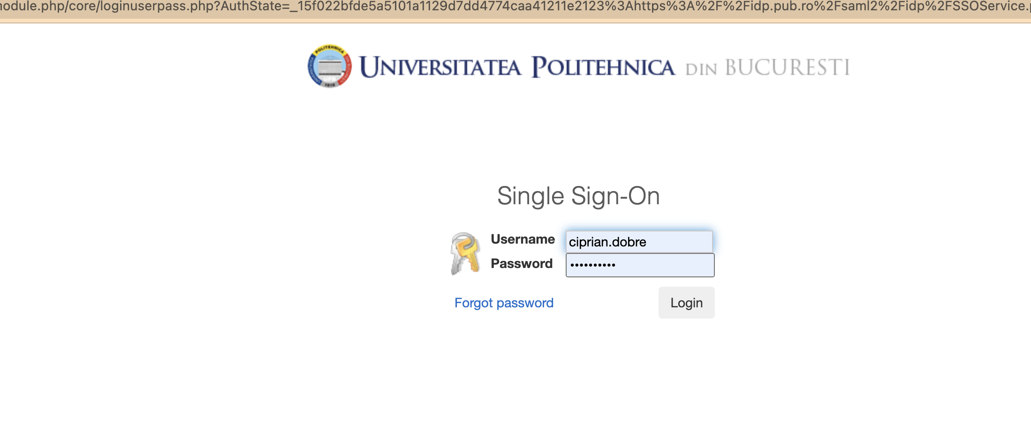
First phase - institutional authorization

Slide 27
Institutional data repository over ckan

Slide 28
What’s next
We aim to finish with eduGAIN connectors (Moodle and ckan)
Institutional channels sometimes take time
We need to finalise the construction of classes
Train of trainers: May 2022 → proposal to host on the centralised Moodle for now the materials (quite soon)
For Train of trainees: let’s collect all course materials and IPR constraints
Carpeenter of course catalogues
Some will be tought using the local Moodle instances (eduGAIN + user registration)
Some will possibly be formed and may be tought over the Carpeenter solution

Slide 29
THANK YOU!
Follow us

