Slide 1
TrainRDM and MSc Open Data Management
H González-Vélez, M Bradford
Dublin Trasnational Project Meting, January 2023
rdmtraininghub.eu
This work is licensed under a Creative Commons Attribution 4.0 International License (CC BY 4.0)

Slide 2
TrainRDM
KA2 Strategic Partnership
30 Months: Nov/20 – Apr/23
Erasmus+ KA2 Strategic Partnerships are transnational projects designed to develop and share innovative practices and promote cooperation, peer learning, and exchanges of experiences in the fields of education, training, and youth.

Slide 3
Partners
UNIVERSITATEA POLITEHNICA DIN BUCURESTI
TECHNISCHE UNIVERSITAET WIEN
NATIONAL COLLEGE OF IRELAND
Digital Technology Skills Limited
UNIVERSITA DEGLI STUDI DI ROMA LA SAPIENZA
ICI BUCURESTI

Slide 4
AIM
Empower the Education and Skills dimension of Open Science to provide the skills training in Research Data Management

Slide 5
Open Science
Cooperative work and new ways of diffusing knowledge by using digital technologies and new collaborative tools (EC (2016)).
Make the outputs of publicly funded research results publicly accessible in digital format with no or minimal restriction (OECD (2015) ).

Slide 6
The FAIR Principles
Findability
Accessibility
Interoperability
Reusability
Wilkinson, M., Dumontier, M., Aalbersberg, I. et al. The FAIR Guiding Principles for scientific data management and stewardship. Sci Data 3, 160018 (2016). https://doi.org/10.1038/sdata.2016.18

Slide 7
Key Outputs
Methodological Toolkit
Joint Design of MSc Programme
Distributed eLearning Platform

Slide 8
Toolkit
rdmtraininghub.eu
This work is licensed under a Creative Commons Attribution 4.0 International License (CC BY 4.0)

Slide 9
Survey
Part 1: Everyone
239 Responses
2.58M Researchers @ 90% +/- 5%
Part 2: Partners only
11 Responses

Slide 10
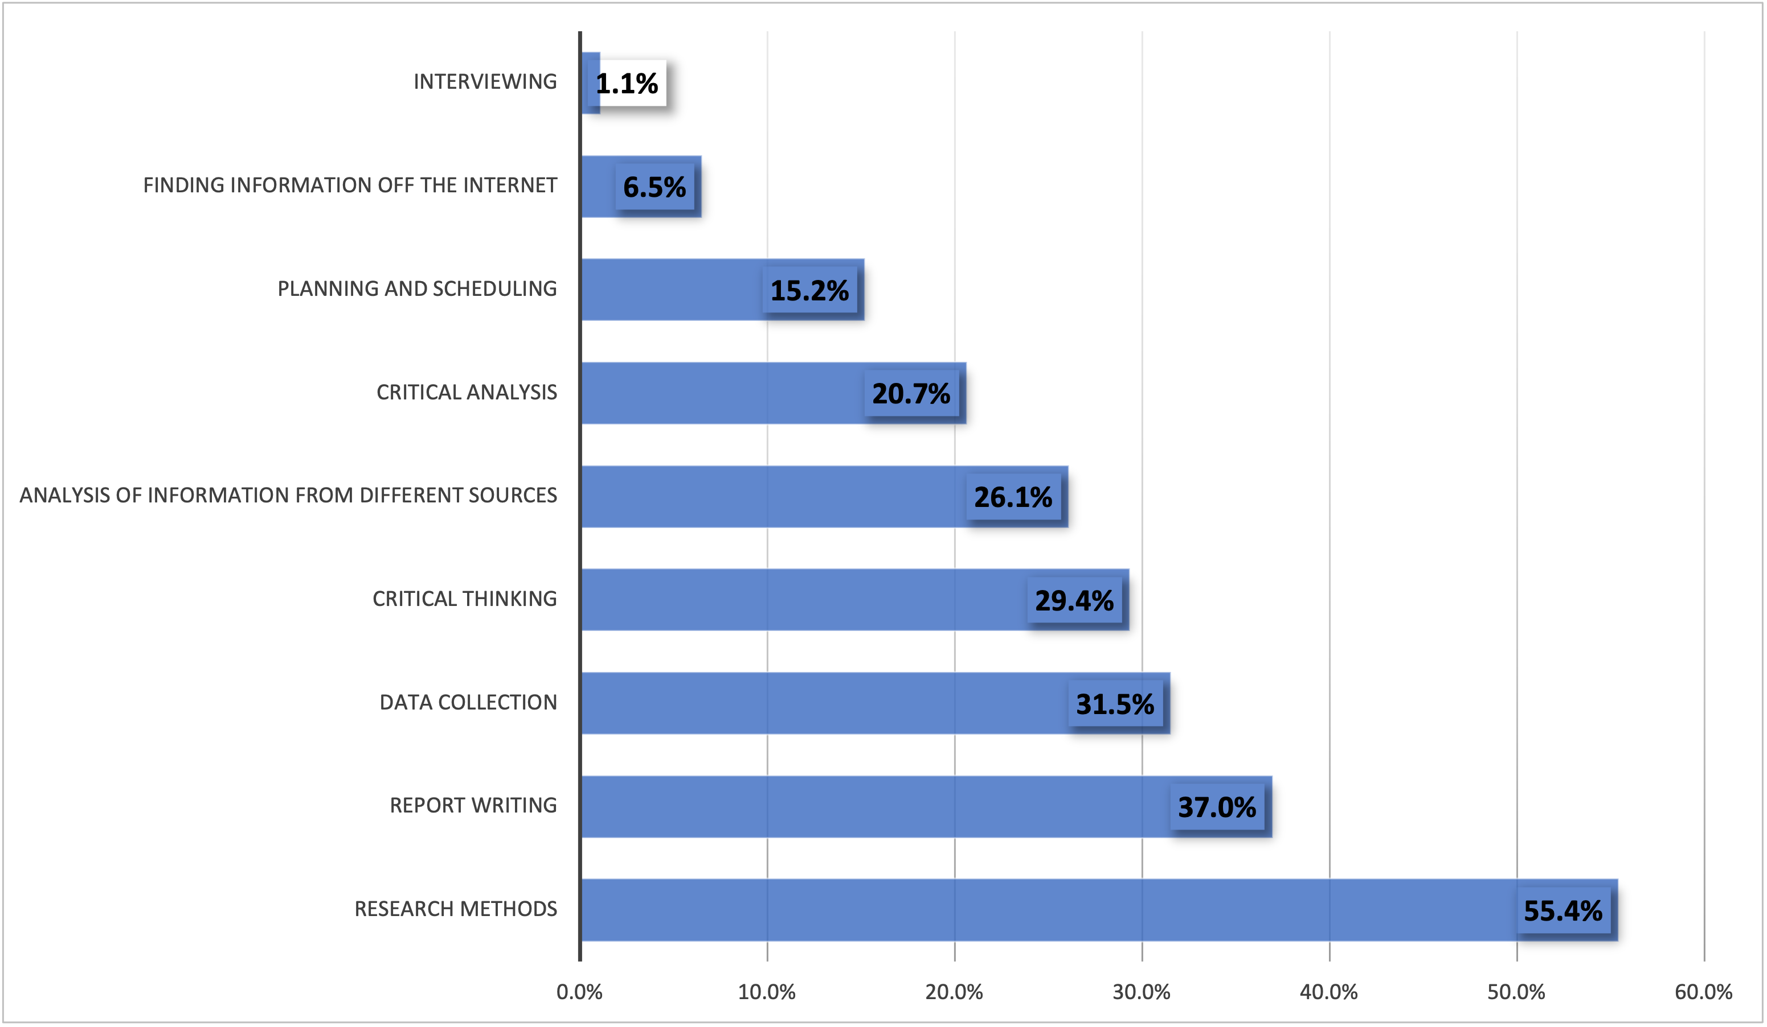

Slide 11
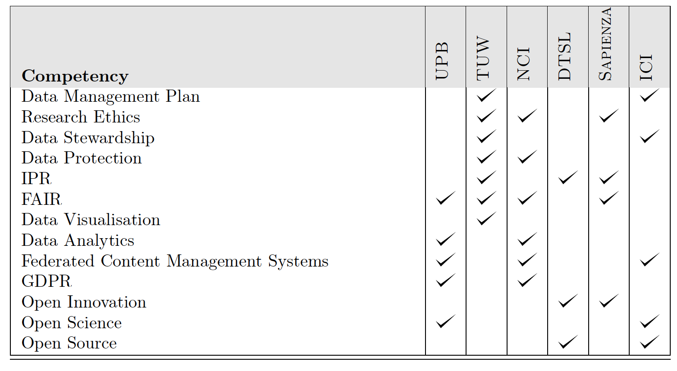
Competencies Matrix

Slide 12
Distributed eLearning Platform
rdmtraininghub.eu
This work is licensed under a Creative Commons Attribution 4.0 International License (CC BY 4.0)

Slide 13
Distributed Moodle/eduGAIN

Slide 14
MSc Programme
rdmtraininghub.eu
This work is licensed under a Creative Commons Attribution 4.0 International License (CC BY 4.0)

Slide 15
90-ECTS Structure
Michael Bradford
Programme Director
European Credit Transfer and Accumulation System (ECTS) is a tool of the European Higher Education Area for making studies and courses more transparent.

Slide 16
Further steps
rdmtraininghub.eu
This work is licensed under a Creative Commons Attribution 4.0 International License (CC BY 4.0)

Slide 17
Validation @ Ireland
Initial Programme Lifecycle Approval JAN-FEB 2022
Internal/Industry Panel
Winter 2022
QQI panel
Internal Panel: Jan 23
QQI Panel: Apr-May 23
Official Approval
Summer 2023
First Cohort
January 2024

Slide 18
THANK YOU!
Follow us
rdmtraininghub.eu
This work is licensed under a Creative Commons Attribution 4.0 International License (CC BY 4.0)

Slide 19
Open Science & Research Data Management: a FAIR European PG Programme
H González-Vélez, C Dobre, B Sánchez-Solis, G Antinucci, D Feenan, D Gheorghe
Dublin Trasnational Project Meting, January 2023
rdmtraininghub.eu
This work is licensed under a Creative Commons Attribution 4.0 International License (CC BY 4.0)

